Slide 1
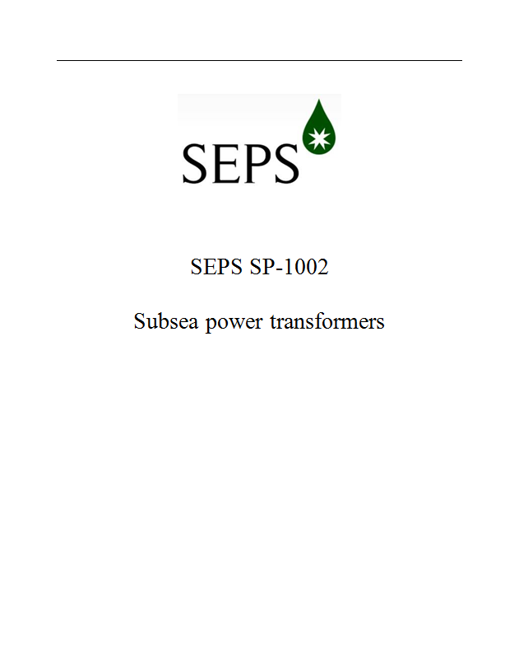
P61886-3: Subsea Transformers
SCOPE
Develop an International Standard applicable to liquid immersed subsea power transformers
APPROACH
Leverage SEPS work by utilizing SEPS SP-1002 “Subsea power transformers” as the initial draft standard
Collaborate with IEC Working Group to develop IEC/IEEE dual logo standard
SEPS SP-1002 DEVELOPMENT STATUS
Scope
Three-phase and single-phase liquid immersed subsea power transformers
Rated voltages in the range 3.6 ≤ Um ≤ 145 kV
Rated power in the range 50 kVA to 100 MVA
Designed & tests to more stringent of IEC and IEEE standards
Nameplate selectable by purchaser to either IEC or IEEE std. ratings
Draft progressing
Incorporating comments from 2nd round of manufacturers
Developing data sheet
Planned Issue by end of year or 1st quarter 2016
Rights to be forwarded shortly after issuance
DRAFT

Slide 2
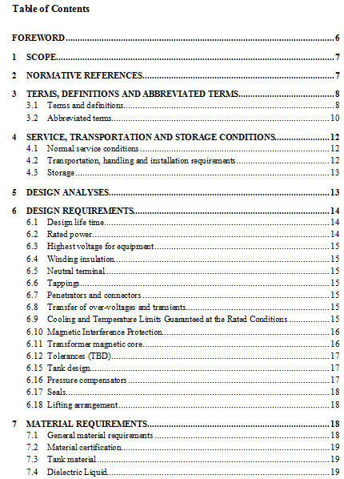
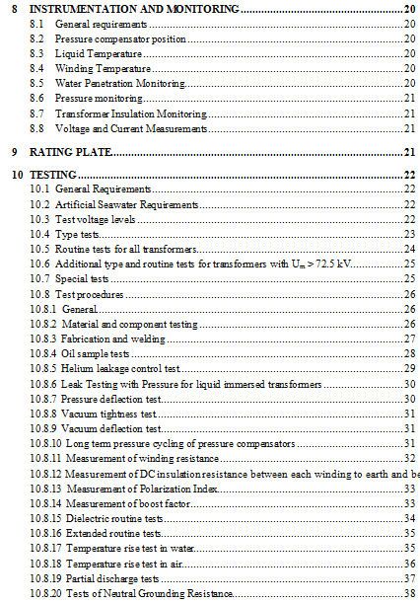
P61886-3: Subsea Transformers
SEPS SP-1002 TABLE OF CONTENTS
DRAFT
DRAFT

