Slide 1
ESP System Standards
October 3rd, 2015
Norman W. Ritchie

Slide 2
Agenda
Safety Moment
ESP System Overview
Current ESP Standards
ESP Qualification Requirements

Slide 3
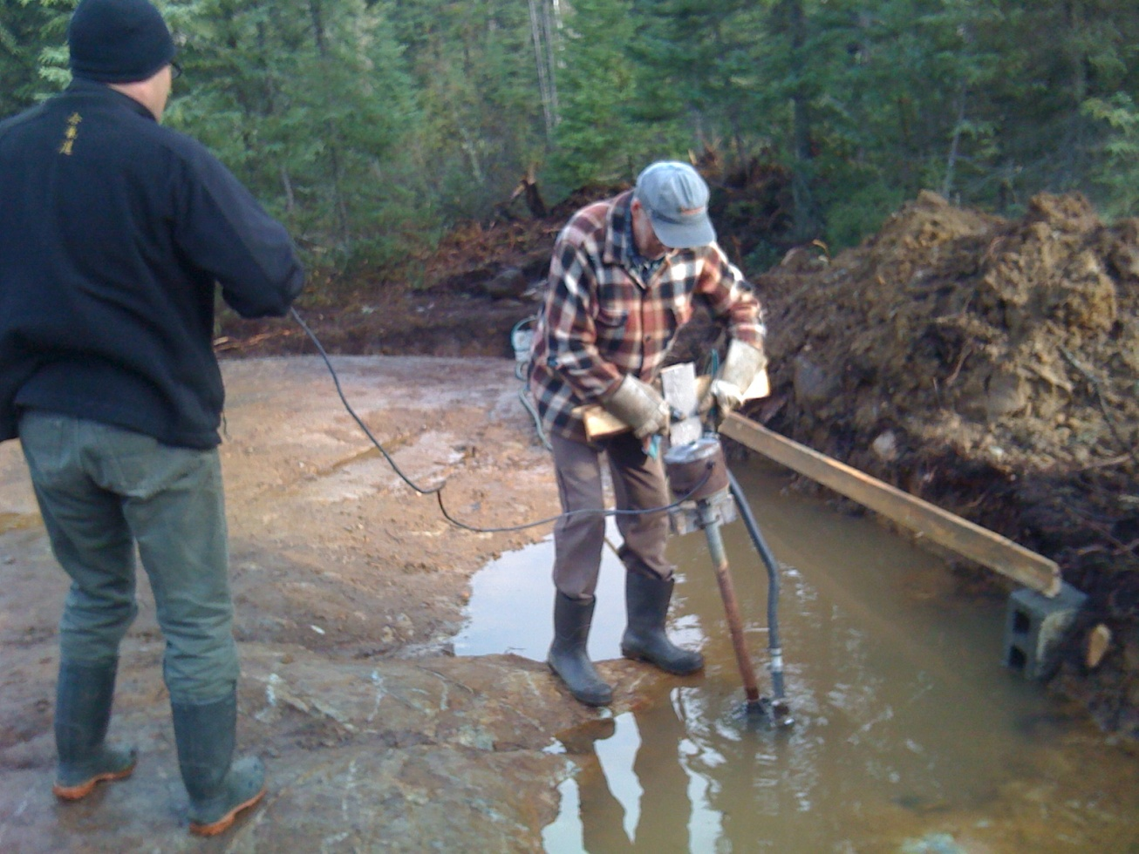
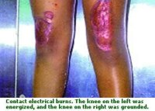
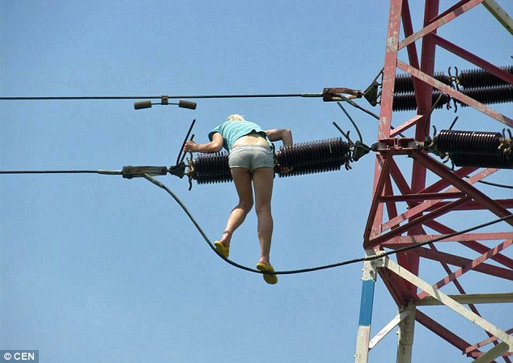
Safety Moment

Slide 4
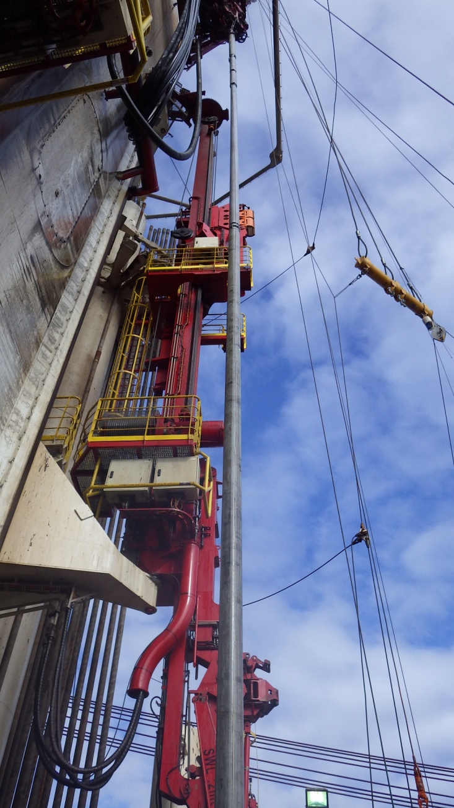
In Well ESP - Overview
Cable
Pump
Seal
DUAL Y-TOOL
ENCAPSULATED
STANDARD
Pothead
Motor

Slide 5
Existing ESP Standards
IEEE RP 1017 Cable testing
IEEE RP 1018 Cable Reqs. (EPR)
IEEE RP 1019 Cable Reqs. (PP)
API RP 11S:
S1 Teardown reporting
S2 Pump testing
S3 Surface equipment wiring
S4 Pump sizing
S5 Cable construction
S6 Cable testing
S7 Seal testing
S8 System vibration
S9 Motor testing
ISO 15551-1 (2015):
Functional specifications
Technical specifications
Mfg. requirements

Slide 6
ESP Qualification?
Rapid Gas Decompression:
Cable
Pothead
Electrical:
Motor
Cable
Pothead
Penetrations
RGD:
Pressure decline gradients
Temperature cycling
Fluid & gas compositions
Electrical (IEC 60502?):
Partial discharge
High voltage (AC)
IR (DC)
Voltage withstand
Temperature rise
Current endurance
Short circuit

Slide 7
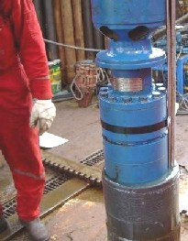
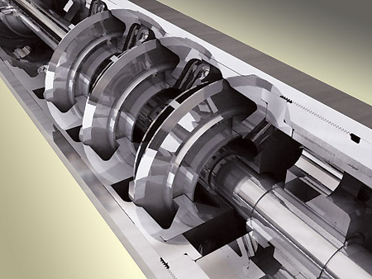
ESP Pump
Thrust surface
Impeller skirt
Shaft sleeve for space out
Radial Bearing

Slide 8
ESP Motor Design
Bearing Carriage
Anti Rotation Ring
Thrust Washer
Spacer
Shaft
Rotor
Stator
Sleeve
Bushing

Slide 9
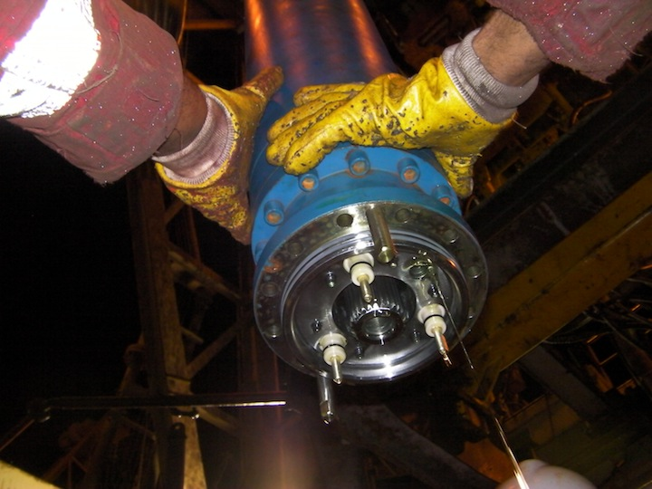
ESP Motor Base

Slide 10
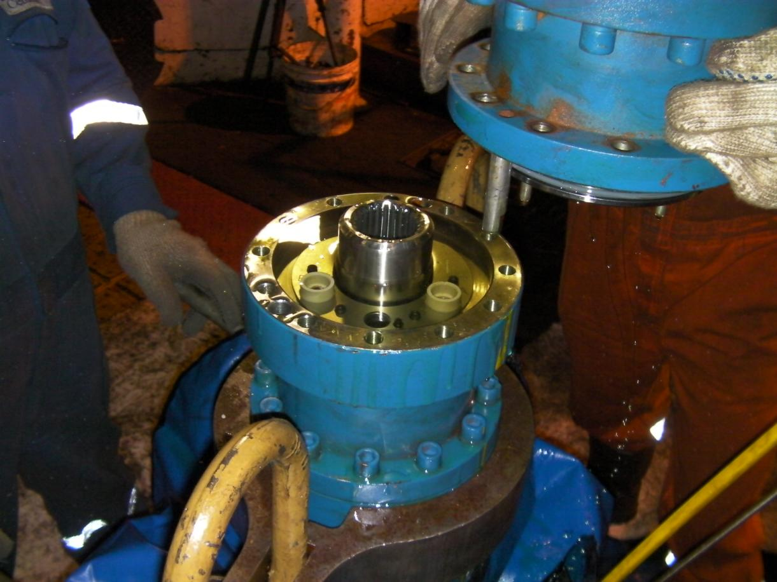
ESP Motor Mating

