Slide 1
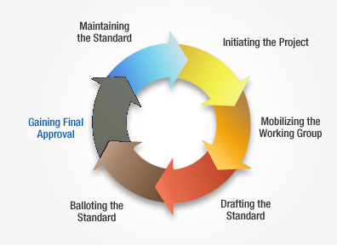
IEEE 61886
Mission
Advance the development of codes and standards for subsea electrical systems and equipment
Objective
Oversee the development of PARs for Standards for the Subsea Electrical Study Group according the Study Group Scope and procedures

Slide 2
IEEE 61886 – Road Map
IEEE – Standards Association
Industry Applications Society
Petroleum & Chemical Industry Committee
PCIC Standards Subcommittee
Subsea Electrical - Working Group Committee – 61886
Project Working Group – 61886.1
MV Penetrators and Connectors
Project Working Group – 61886.2
Electrical Submersible Pumps
Project Working Group – 61886.4
Subsea Electrical Power Transmission & Distribution Design
Project Working Group – 61886.3
Subsea Transformers
Project Working Group – 61886.?
LV Connectors & Penetrators
Subsea Motors
Subsea Switchgear
Subsea Adjustable Speed Drives
Subsea UPS
Project Working Group – 61886.5
Static & Dynamic Subsea Cables
(Umbilical, Jumper, ESP)

Slide 3
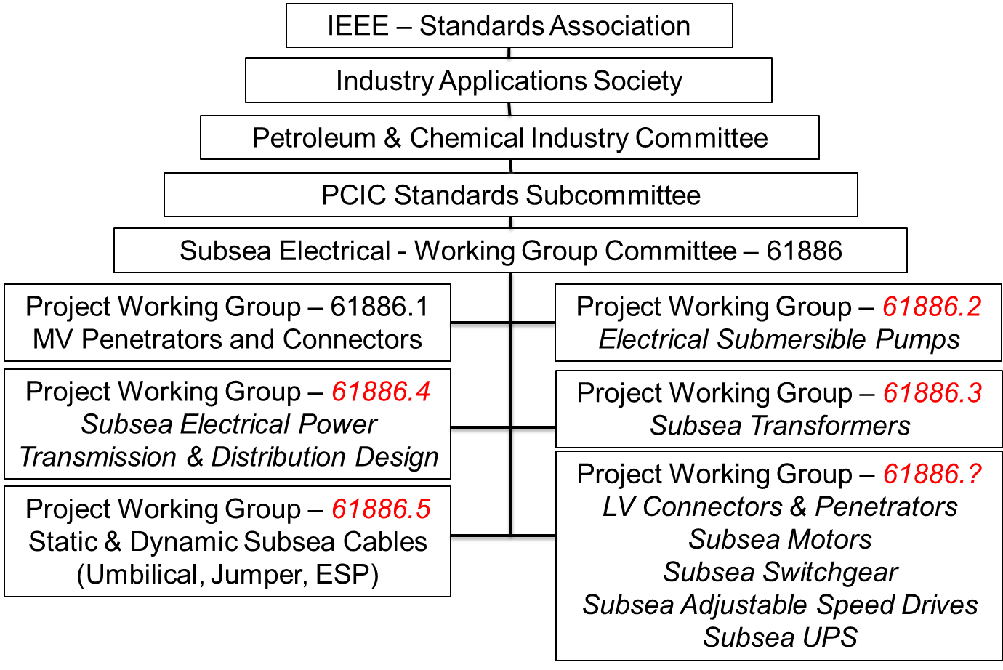
IEEE 61886 – Road Map
Subsea Electrical Power Standardization (SEPS) Joint Industry Project
IEC TC18

Slide 4
IEEE 61886 – Road Map
Subsea Electrical Power Standardization (SEPS) Joint Industry Project
Subsea Electrical - Working Group Committee – 61886
Target dates
IEEE/IEC – 61886.1
MV Penetrators and Connectors
2014
Project Working Group – 61886.2
Electrical Submersible Pumps
2017
IEC TC18
JWG 31
IEEE/IEC – 61886.3
Subsea Transformers
2016
Other Potential Technologies
Project Working Group – 61886.4
Subsea Electrical Power Transmission & Distribution Design
Project Working Group – 61886.?
Subsea Motors
LV Connectors & Penetrators
Subsea Switchgear
Subsea ASD
Subsea UPS
2016
Project Working Group – 61886.5
Static & Dynamic Subsea Cables
(Umbilical, Jumper, ESP)
2018

