Slide 1
API Recommended Practice 17X
Recommended Practice for Design, Installation, and Maintenance of Subsea Booster Pump Systems
Status Report
October 3, 2015
Mike Zerkus - michael.zerkus@genesisoilandgas.com – 832-217-0216

Slide 2
Agenda
Safety Moment
Mission of API-17X
Over all Status
Overview of Subsea Electrical Power Subsection

Slide 3
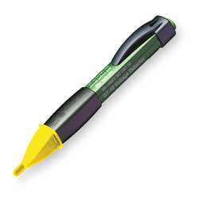
Job Site Electrical Safety
Recently I participated in a Habitat for Humanity home building activity
I make it a habit to “look around” for anything that could be a safety problem – especially electrical
I spotted a house power cable (unconnected) laying on the ground – I followed the wire up to the pole, it was connected to the transformer and the fuse/disconnect was CLOSED!
The Wire Was Live!!!
I used my electrostatic voltage detector to verify that the wire was live and alerted the foreman

Slide 4
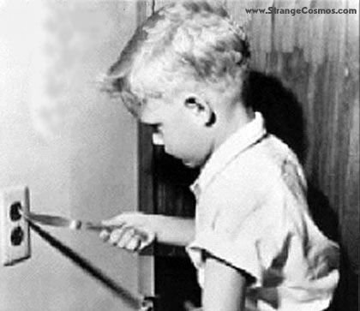
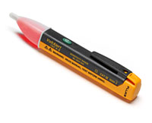
Electrical Safety
AC Voltage Detector
Every Home Owner SHOULD own one of these and know how to use it
It should be part of your standard PPE for plant visits
AC detector, detects the electrical field present around any wire which is connected to an AC source
It never touches the wire
AC detectors can be used even if no current is flowing through the wire in question
Detection of 90V to 1000V AC
Cost: About $10 to $40
Mike Zerkus – The Early Years

Slide 5
Mission of API-17X Recommended Practice on Subsea Pumping Systems
Need/Opportunity:
  Subsea pumping systems don’t have governing standards or practices that can be used for guidance by the end users or the manufacturers
Purpose:
  Assist engineers working on designing subsea pumps and to provide guidance on:
    minimum functional requirements
    system description
    common methods of the design steps
    engineering, reporting requirements and reliability considerations
  The Recommended Practice (RP) is intended to provide: guidance to the design, qualification testing, factory acceptance testing and deployment of the subsea pumping system.
  The RP will assist operators, suppliers and manufacturers to reach a common goal for the design of subsea pumps and thereby enable standardization of the design process.

Slide 6
API-17X Status
Raw basic text for first draft is complete
A table of contents for 1st draft is complete
The process of integrating the chapter texts into the 1st draft has begun
Working toward a complete 1st draft by the end of the year

Slide 7
API-17X Subsea Electrical Power Subsection
The purpose of the API RP 17X Subsea Electrical Power Subsection is to provide an overview for defining and developing a control system, subsea electric power system, and a safety system for a subsea booster pump system.
The intention of this document is to provide general guidelines to be followed in the design of a subsea booster pump system throughout the various development stages of a project: pre-FEED, FEED, and EXECUTE.
This guide is not intended to be a textbook
    It is intended to be a guide to the typical work flow, concerns, issues, and deliverables of the power, control and safety area of a typical a subsea booster pump project.
API-17X Subsea Electrical Power Subsection has three major sub sections
  Subsea Power
  Safety
  Controls

Slide 8
API-17X Subsea Electrical Power Subsection
Scope:
  The scope of the API-17X Subsea Electrical Power Subsection is confined to systems where a single booster pump is powered by a single circuit from the platform.
    The field may have multiple booster pumps, but each pump will be powered, and controlled from the platform.
    In such systems, the umbilical will have one or more 3-phase, AC power circuits that each deliver power to a single subsea pump motor, and each motor may operate at a different frequency from the other motors.
    The operating frequency of each load may vary from moment to moment according to a control algorithm set up for that pump.

Slide 9
Scope

Slide 10
API-17X Subsea Electrical Power Subsection
What is not in scope
  This API-17X Subsea Electrical Power Subsection does not cover subsea power distribution.
    Subsea power systems, both AC and DC, requiring subsea power distribution use a single circuit to deliver power to a subsea point where power is then distributed to several loads, where a subsea VFD or other means control each subsea load.
  Subsea water injection is not covered in the scope of this document.
  Well control and manifold control are not covered in this document.
  This document covers only two types of subsea motors used to operate subsea pumps
    Induction Motors and Permanent magnet synchronous motors. All other types of motors are not covered.

Slide 11
API-17X Subsea Electrical Power Subsection Target Audience
This API-17X Subsea Electrical Power Subsection is intended for engineers responsible for the design of a subsea safety, control and electric power system used to support a subsea booster pump project, and/or personnel who require a general orientation to the basic design approach of subsea booster pump systems and the associated key design concerns.
It is assumed that the person reading this document is familiar with the general design principles and equipment associated with subsea oil and gas production, as well as equipment typically used in industrial AC power systems and with the control of large AC motors.

