Slide 1
IEEE 802.1 OmniRAN TG December 11th , 2018 Conference Call
2018-12-11 Max Riegel, Nokia Bell Labs
(TG Chair)

Slide 2
Conference Call
Tuesday, December 11th , 2018 at 09:30-11:00am ET
Join WebEx meeting
https://nokiameetings.webex.com/nokiameetings/j.php?MTID=m9793214bccb92ce65fdc66e79dd6b9f0
Meeting number: 950 404 767
Meeting password: OmniRAN
Join by phone
+1 972 445 9814 US Dallas
+44 2036087616 UK London
+86 1084056120, +86 1058965333 China Beijing
Access code: 950 404 767
Global call-in numbers
https://nokiameetings.webex.com/nokiameetings/globalcallin.php?serviceType=MC&ED=533523267&tollFree=0

Slide 3
Agenda proposal
Minutes
Reports
Result of 802.1CF 2nd sponsor recirculation
Comment resolution, if required
Conclusion on going forward with 802.1CF
Plans, schedules and agenda proposal for Jan ’19 interim meeting
Next meeting
AOB

Slide 4
Participants have a duty to inform the IEEE
Participants shall inform the IEEE (or cause the IEEE to be informed) of the identity of each holder of any potential Essential Patent Claims of which they are personally aware if the claims are owned or controlled by the participant or the entity the participant is from, employed by, or otherwise represents
Participants should inform the IEEE (or cause the IEEE to be informed) of the identity of any other holders of potential Essential Patent Claims
Early identification of holders of potential Essential Patent Claims is encouraged

Slide 5
Ways to inform IEEE
Cause an LOA to be submitted to the IEEE-SA (patcom@ieee.org); or
Provide the chair of this group with the identity of the holder(s) of any and all such claims as soon as possible; or
Speak up now and respond to this Call for Potentially Essential Patents
If anyone in this meeting is personally aware of the holder of any patent claims that are potentially essential to implementation of the proposed standard(s) under consideration by this group and that are not already the subject of an Accepted Letter of Assurance, please respond at this time by providing relevant information to the WG Chair.

Slide 6
Other guidelines for IEEE WG meetings
All IEEE-SA standards meetings shall be conducted in compliance with all applicable laws, including antitrust and competition laws.
Don’t discuss the interpretation, validity, or essentiality of patents/patent claims.
Don’t discuss specific license rates, terms, or conditions.
Relative costs of different technical approaches that include relative costs of patent licensing terms may be discussed in standards development meetings.
Technical considerations remain the primary focus
Don’t discuss or engage in the fixing of product prices, allocation of customers, or division of sales markets.
Don’t discuss the status or substance of ongoing or threatened litigation.
Don’t be silent if inappropriate topics are discussed … do formally object.
For more details, see IEEE-SA Standards Board Operations Manual, clause 5.3.10 and Antitrust and Competition Policy: What You Need to Know at http://standards.ieee.org/develop/policies/antitrust.pdf

Slide 7
Patent-related information
The patent policy and the procedures used to execute that policy are documented in the:
IEEE-SA Standards Board Bylaws http://standards.ieee.org/develop/policies/bylaws/sect6-7.html#6
IEEE-SA Standards Board Operations Manual http://standards.ieee.org/develop/policies/opman/sect6.html#6.3
Material about the patent policy is available at http://standards.ieee.org/about/sasb/patcom/materials.html
If you have questions, contact the IEEE-SA Standards Board Patent Committee Administrator at patcom@ieee.org

Slide 8
Participation in IEEE 802 Meetings
All participation in IEEE 802 Working Group meetings is on an individual basis
Participants in the IEEE standards development individual process shall act based on their qualifications and experience. (https://standards.ieee.org/develop/policies/bylaws/sb_bylaws.pdf section 5.2.1)
IEEE 802 Working Group membership is by individual; “Working Group members shall participate in the consensus process in a manner consistent with their professional expert opinion as individuals, and not as organizational representatives”. (http://ieee802.org/PNP/approved/IEEE_802_WG_PandP_v19.pdf section 4.2.1)
You have an obligation to act and vote as an individual and not under the direction of any other individual or group. Your obligation to act and vote as an individual applies in all cases, regardless of any external commitments, agreements, contracts, or orders.
You shall not direct the actions or votes of any other member of an IEEE 802 Working Group or retaliate against any other member for their actions or votes within IEEE 802 Working Group meetings, see
https://standards.ieee.org/about/policies/bylaws/index.html section 5.2.1.3 and
http://ieee802.org/PNP/approved/IEEE_802_WG_PandP_v19.pdf section 3.4.1, list item x
By participating in IEEE 802 meetings, you accept these requirements. If you do not agree to these policies then you shall not participate.

Slide 9
Business #1
Call Meeting to Order
Chair called meeting to order at .. AM ET
Minutes taker:
.. is taking notes.
Mandatory slides
Mandatory slides were presented, .. IPR announcements came up.
Roll Call
Name | Affiliation |  | Name | Affiliation
Max Riegel | Nokia
Hao Wang | Fujitsu
Walter Pienciak | Adv. Cog. Arch.
Antonio de la Oliva | UC3M
Roger Marks | EthAirNet Assoc.

Slide 10
Agenda
Minutes
Reports
Result of 802.1CF 2nd sponsor recirculation
Comment resolution, if required
Conclusion on going forward with 802.1CF
Plans, schedules and agenda proposal for Jan ’19 interim meeting
Next meeting
AOB

Slide 11
Business #2
Minutes
https://mentor.ieee.org/omniran/dcn/18/omniran-18-0091-01-00TG-nov-2018-f2f-meeting-minutes.docx
Review ..
Reports
..

Slide 12
Business #3
Result of 802.1CF 2nd sponsor recirculation
Details on following slides.
Recirculation resulted in one additional approve and one additional abstain vote.
No new technical comment, no new disapprove vote.
Sponsor ballot completed!
Comment resolution, if required
No comments to resolve.
Conclusion on going forward with 802.1CF
..

Slide 13
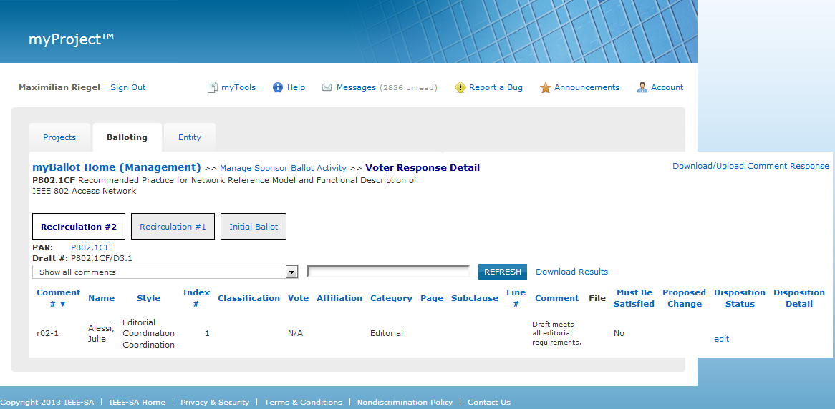
Recirculation #2 did not result in any technical comment

Slide 14
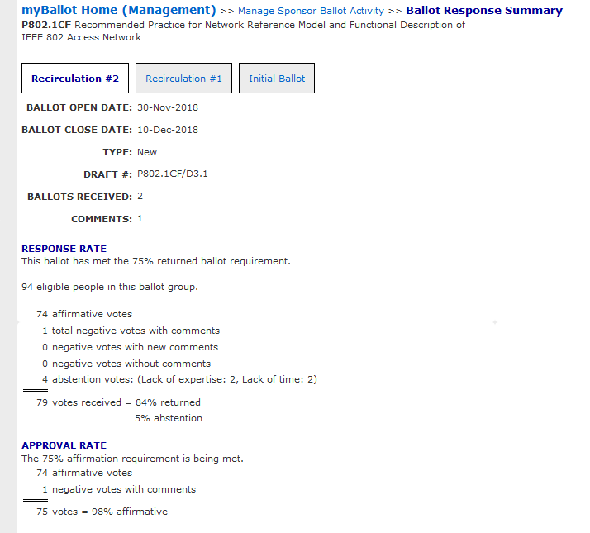
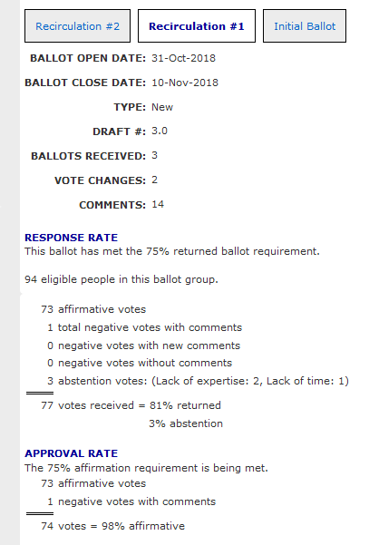
Recirculation #2 results in comparison to Recirculation #1
+1 APPROVE
+1 ABSTAIN

Slide 15
Business #4
Plans, schedules and agenda proposal for Jan ’19 interim meeting
See following two slides
Next meeting
F2F meeting at IEEE 802.1 interim meeting in Hiroshima, JP, on January 14th , 2019
AOB
..
Adjourned by chair at .. AM ET.

Slide 16
January 2019 Agenda Graphics
 | Mon 1/14 | Tue 1/15 | Wed 1/16 | Thu 1/17 | Fri 1/18
08:00 10:00 |  | Maintenance
10:30 12:30 |  | 802.1CQ w/ remote participation | Remote participation Nendica
13:30 15:30 | OmniRAN opening |  | OmniRAN closing
16:00 18:00
19:00 21:00 |  |  | Social

Slide 17
Agenda proposal for January 2019 F2F
Review of minutes
Reports
IEEE 802.1CF socialization activities
P802.1CQ contributions and discussions
Nendica related contributions preview
Potential new projects for OmniRAN TG
Conference calls until March 2019 F2F
Status report to IEEE 802 WGs
Next meeting
AOB

