Slide 1
Thoughts on
IEEE 802 network integration with respect to P802.1CF
Max Riegel (Nokia Bell Labs)
2018-11-14

Slide 2
802.24 “Network Integration” action item
Action assigned to 802.24 from 802 EC leadership conference in July.
  Discussion on role and positioning of IEEE 802 in standards, especially with respect to 3GPP and the publicity on “5G”
What is meant by Network Integration?
  Does the IEEE 802 architecture provide a unique value to vertical market?
  Is IEEE 802 more suited to deployment in the communication infrastructure of private enterprise, industry, and the individual user? (Compared to 3GPP, which is more oriented towards service providers?)
  The IEEE 802 architecture enables networks that are like Ethernet: Well understood, mature, predictable. A “cleaner” integration of disparate technologies under the common architecture and addressing.
Can we develop a clearer definition and description of this distinction and the value for the user / implementer?
Can this be developed into a white paper?

Slide 3
Introductory Thoughts
P802.1CF perspective on IEEE 802 Network integration

Slide 4
The issue
… as far as I would understand.
IEEE 802 would like to have a more striking picture of its market position.
  … to better emphasize its relevance in communication infrastructures.

Slide 5
Why?
… as far as I could see it.
‘5G’ of the mobile industry gained overwhelming public awareness.
  Pulling development resources away from other topics into ‘5G’-related projects
  Challenging the established markets of other technologies
Is IEEE 802 challenged by ‘5G’?
  Maybe, but it should keep in mind it made ‘5G’ happen
    Creating huge demand for broadband connectivity through Wi-Fi
    Providing the cost-effective backbone capacity through Ethernet
    Creating the path for MTC and URLLC through 802.15 and TSN
  The technologies and markets are quite distinct
    ‘5G’ is a E2E system designed for the cellular market
    IEEE 802 is a link layer technology, mainly deployed outside of the cellular domain

Slide 6
What is IEEE 802?
A very generic view
IEEE 802 is a set of link layer technologies, not an overarching communication system
Some of the IEEE 802 technologies are extremely successful
  E.g. Ethernet (IEEE 802.3), Wi-Fi (IEEE 802.11)
There is a variety of other solutions
  E.g. IEEE 802.15, IEEE 802.1, IEEE 802.22
Bridging ties the building blocks together
  IEEE 802.1
IEEE 802 does not standardize the system for the market but only building blocks used by others to design systems for the markets.

Slide 7
What to achieve?
Higher participation?
  More people coming to the meetings?
More projects?
  Bigger organization?
More design-ins?
  Better distribution of knowledge to the engineers?
More public funding and research activities?
  Better cooperation with universities?
… ?

Slide 8
What is meant by ‘network integration’ ?
A P802.1CF perspective
Integration of IEEE 802 components into networks (IEEE 802 networks)?
Integration of IEEE 802 components/ networks into non-IEEE 802 networks?
Both?
P802.1CF provides guidance for both!
  For the IEEE 802 access network only

Slide 9
P802.1CF Network Model
P802.1CF perspective on IEEE 802 Network integration

Slide 10
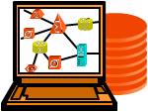
IEEE 802 access network
NMS
Subscription
Service
Information
Server
Terminal
Access Network
Access Router
IEEE 802 access network describes the layer 2 network between terminal and access router implemented through IEEE 802 technologies.
The part of the access infrastructure in scope of P802.1CF is shown through the shaded area of the protocol layer architecture of the data path.
Application
Application
Transport
Transport
Network
Network
Network
Network
Data Link
DL
DL
DL
DL
DL
DL
Data Link
Data Link
Data Link
Physical
Phy
Phy
Phy
Phy
Phy
Phy
Physical
Physical
Physical
Medium
Medium
Medium
Medium
Medium
Terminal
Interface
Node of
Attachment
Backhaul
Access Router
Interface
Scope of specification

Slide 11
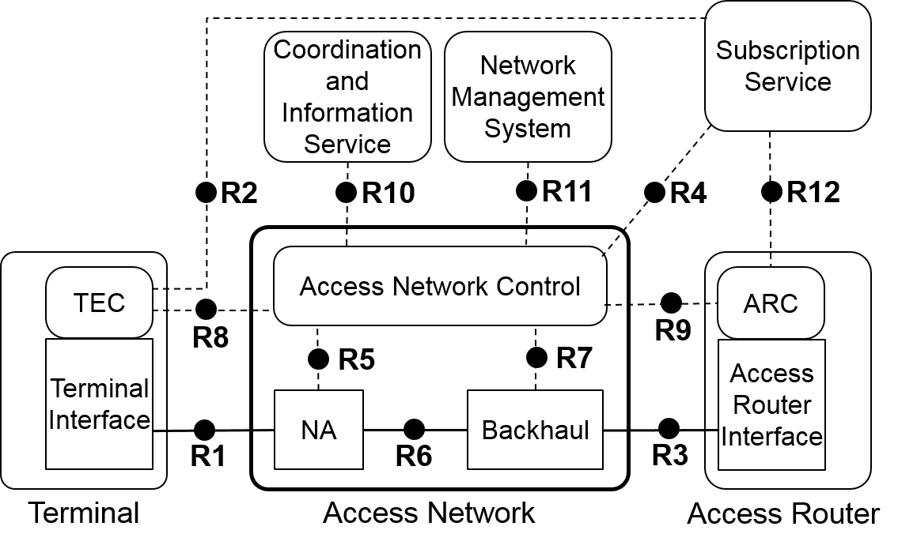
IEEE 802 Access Network Reference Model
Comprehensive NRM shows highest level of details
NRM represents an abstract view on an access network
  For the purpose to define interfaces
Control interfaces cover only attributes related to IEEE 802
  Protocol details on control interfaces are out of scope

Slide 12
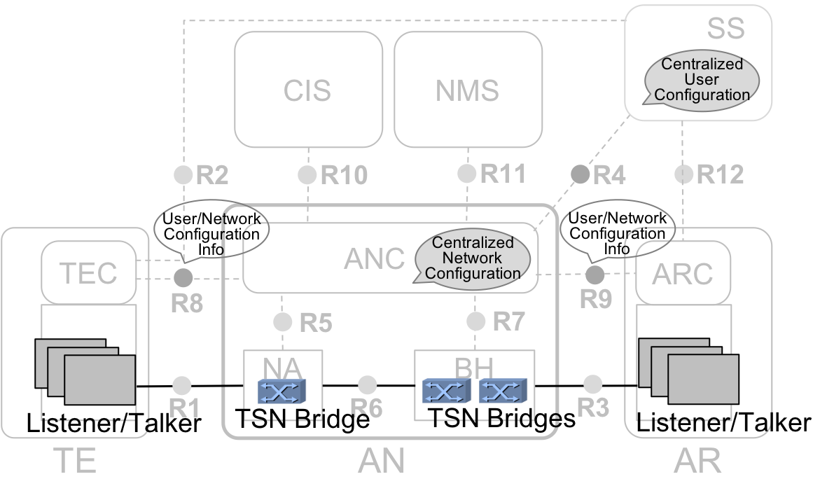
P802.1CF is able to cover the control of Time Sensitive Networks
P802.1CF access network represents the bridged connectivity between end stations
Access Network Control (ANC) provides centralized network configuration for TSN sessions
  CNC is contained in ANC
R8, R9, and ANC
provide means to
process User/Network
Configuration Info

Slide 13
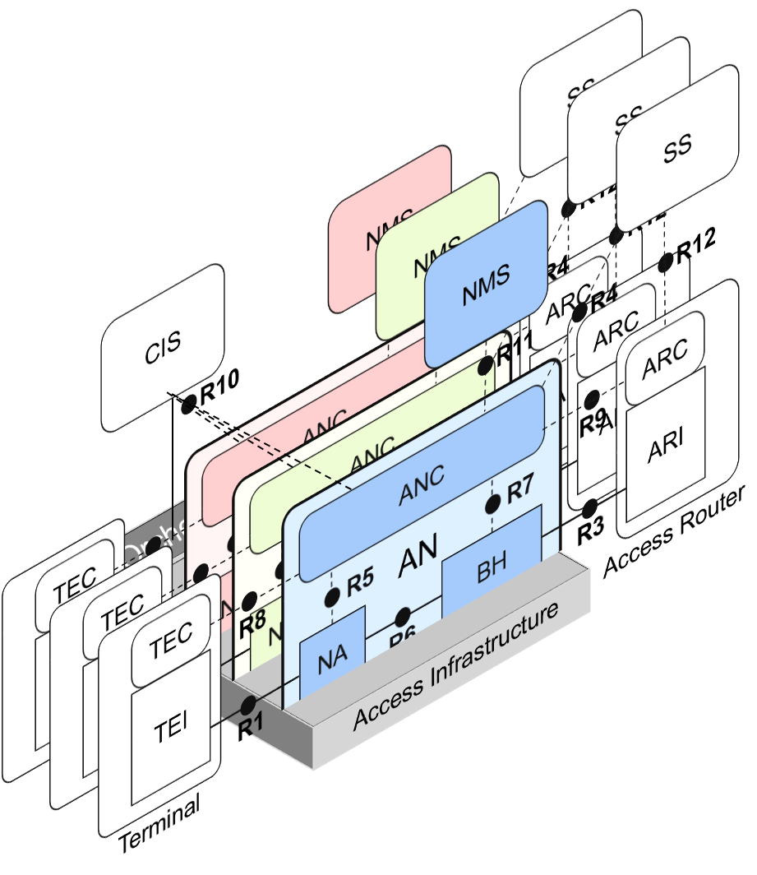
Network softwarization
Building networks through software
P802.1CF provides model for
network virtualization of
IEEE 802 access networks
Allows for realization of
several separate networks
on a common infrastructure
Virtualization establishes
separate control instances
for each of the networks
BTW: VLANs provide
separate datapaths
under a common
control

Slide 14
Network integration with external networks
IEEE 802 Access Network
External Network
Subscription
Service
Coordination and Information
Service
Network
Management
System
R2
R10
R11
R4
R12
Access Network Control
TEC
ARC
R8
R9
Terminal
Interface
R5
R7
Access Router
Interface
NA
Backhaul
R1
R6
R3
Terminal
Access Network
Access Router
P802.1CF provides a model for interfacing with external networks.

Slide 15
Deployment Examples
P802.1CF perspective on IEEE 802 Network integration

Slide 16
Wi-Fi Router
Wi-Fi Router may be the most common example of IEEE 802 access network
Generic schematic of Wi-Fi Router
FPROM
RAM
Micro Controller
IEEE 802.11
Interface
…
IEEE 802.11
Interface
eth1
eth0
Ethernet Bridge
ETH
PHY
ETH
PHY
ETH
PHY
ETH
PHY
ETH
PHY
LAN
LAN
LAN
LAN
WAN

Slide 17
Wi-Fi Router
Mapping of Wi-Fi router to NRM
Subscription
Service
Coordination and Information
Service
Network
Management
System
R2
R10
R11
R4
R12
Terminal
R2
TEC
Access Network Control
ARC
TEC
R8
R9
R8
Terminal
Interface
R5
R7
Access Router
Interface
Terminal
Interface
NA
‘WAN’
NA
(802.11)
Backhaul
R1
R6
R3
R1
‘LAN’
NA
LAN-WAN Gateway
NA
NA
NA
(802.3)
R1
R6
Access Network
WLAN Router

Slide 18
Enterprise Network
Network
Management
Directory
other
sites
WLAN-Ctrl
Internet
WAN Router
Firewall+VPN Gateway
Schematic example of Enterprise Network with multiple segments (VLANs)

Slide 19
Enterprise Network
Network
Management
SS
CIS
NMS
Directory
other
sites
R2
R10
R11
R4
R12
TEC
ANC
ARC
WLAN-Ctrl
R8
R9
Internet
TEI
R5
R7
NA
R6
BH
R1
R3
WAN Router
Firewall+VPN Gateway
TE
AN
AR
R1
Access portion of Enterprise Networks with multiple segments (VLANs) can be represented through NRM

Slide 20
Industrial Network
Network
Management
Directory
WLAN-Ctrl
Schematic example of Industrial Network

Slide 21
Industrial Network
Network
Management
SS
CIS
NMS
Directory
R2
R10
R4
R12
TEC
ANC
ARC
WLAN-Ctrl
R8
R7
TEI
R1
NA
BH
R6
R3
R1
TE
AN
AR
R1
R1
The access portion of an Industrial Network can be represented through the NRM

Slide 22
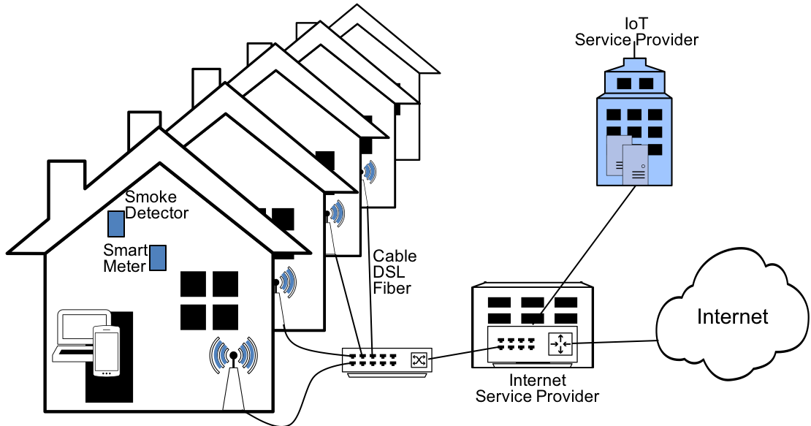
Virtualized residential Wi-Fi access for IoT
Multiple Wi-Fi accesses through ‘multi SSID’ configuration at CPE and traffic separation on the broadband access
Network virtualization allows for multiple separate access infrastructures on a common infrastructure.
CPE

Slide 23
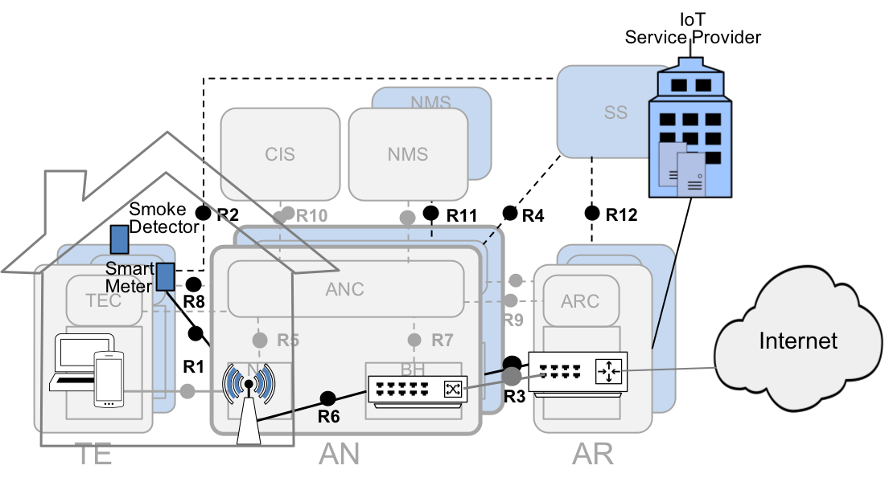
Virtualized residential Wi-Fi access for IoT
While not all of the residential broadband access infrastructure is defined by IEEE 802, its functional model is well applicable.
P802.1CF provides architecture and functional model of virtualized IEEE 802 access network, which can be applied to Wi-Fi.

Slide 24
Fog Computing
Fog computing deploys Cloud-technologies at the edge of the access network.
Fog computing provides considerable operational and economic benefits for IoT and communication services.
Network
Management
Fog
control and
orchestration
Fog
Cloud
WLAN-Ctrl

Slide 25
Fog Computing
Fog computing extends data-center networking concepts into the wide-area access network.
The access portion of the Fog computing networks can be represented through NRM.
Network
Management
SS
CIS
NMS
Fog
control and
orchestration
Fog
R2
R10
R11
R4
R12
Cloud
TEC
ANC
ARC
R8
WLAN-Ctrl
TEI
R5
R7
R1
NA
BH
R6
R3
TE
R1
AN
AR
R1
R1

Slide 26
Conclusion
P802.1CF perspective on IEEE 802 Network integration

Slide 27
Conclusion
The intention and the scope of the IEEE 802 network integration action item requires further clarifications and discussions
  Better understanding of intended outcome needed
P802.1CF has rich material to support the action item.
BTW: It is planned to forward P802.1CF to REVCOM before next IEEE 802 meeting.

