Slide 1
IEEE 802.1 OmniRAN TG conference call on 5G SC Action A (Industry Connections activity)
2017-01-31
Max Riegel, Nokia Bell Labs
(TG Chair)

Slide 2
Guidelines for IEEE-SA Meetings
All IEEE-SA standards meetings shall be conducted in compliance with all applicable laws, including antitrust and competition laws.
Don’t discuss the interpretation, validity, or essentiality of patents/patent claims.
Don’t discuss specific license rates, terms, or conditions.
Relative costs, including licensing costs of essential patent claims, of different technical approaches may be discussed in standards development meetings.
Technical considerations remain primary focus
Don’t discuss or engage in the fixing of product prices, allocation of customers, or division of sales markets.
Don’t discuss the status or substance of ongoing or threatened litigation.
Don’t be silent if inappropriate topics are discussed… do formally object.
---------------------------------------------------------------
If you have questions, contact the IEEE-SA Standards Board Patent Committee Administrator at patcom@ieee.org or visit http://standards.ieee.org/about/sasb/patcom/index.html
See IEEE-SA Standards Board Operations Manual, clause 5.3.10 and “Promoting Competition and Innovation: What You Need to Know about the IEEE Standards Association's Antitrust and Competition Policy” for more details.
This slide set is available at https://development.standards.ieee.org/myproject/Public/mytools/mob/preparslides.ppt

Slide 3
Agenda proposal
Introduction, reports, minutes
Industry Connections Activity Initiation Document (ICAID)
Going forward
AoB

Slide 4
Introduction, REPORTS, Minutes

Slide 5
Introduction
802.1 OmniRAN TG is tasked to hold sessions in preparation of an Industry Connections activity resulting out of 5G SC Action A.
Goals for this meeting:
Work and conclude on the wording of the ICAID
Plan for submission and approval of ICAID

Slide 6
Refined scope of 5G SC Action A
“IEEE next generation communication infrastructure specifications that support enhanced broadband, massive machine type communication and ultra-reliable and low latency communications not belonging to mobile networks”
Well sounding brand name missing.
For further study
IEEE ‘next gen network’ ??

Slide 7
Our goals?
Make new deployments of IEEE 802 happen by better serving deployment needs
Unifying technical approaches among various deployment domains by better communications
Development of further amendments to fulfill particular requirements.
Faster adoption of emerging trends to IEEE 802 standards by better understanding of market evolution.
More direct involvement of “customers” in the evolution of IEEE 802 technologies

Slide 8
Industry Connections activity discussions
OmniRAN TG held a number of meetings to progress the ICAID creation
December 6th conference call
https://mentor.ieee.org/omniran/dcn/16/omniran-16-0093-00-5gaa-dec-6th-5gaa-conference-call-minutes.docx
January 18th F2F meeting
https://mentor.ieee.org/omniran/dcn/17/omniran-17-0012-00-5gaa-jan-18th-5gaa-f2f-meeting-minutes.docx

Slide 9
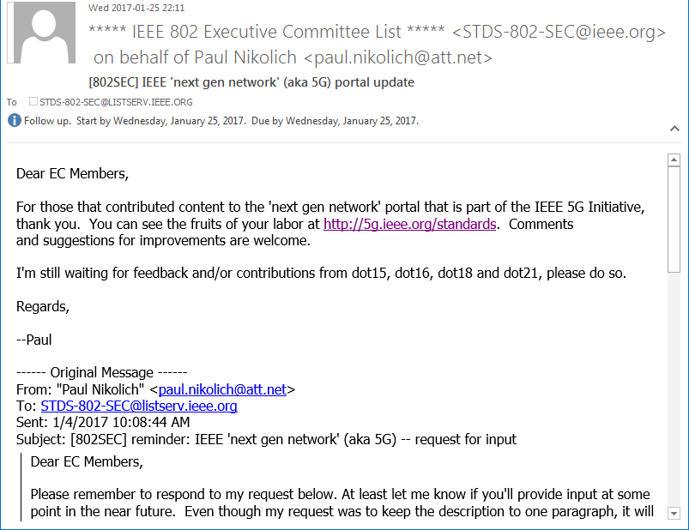
IEEE ‘next gen network’ – standards page

Slide 10
DRAFt ICAID

Slide 11
Draft ICAID
Draft text created in January 18th F2F meeting:
https://mentor.ieee.org/omniran/dcn/16/omniran-16-0084-02-5gaa-draft-icaid-for-5g-sc-action-a.docx
Proposed changes from 802.11 AANI SC:
https://mentor.ieee.org/omniran/dcn/17/omniran-17-0013-00-5gaa-11-aani-sc-proposed-changes-to-draft-icaid.docx

Slide 12
Way forward

Slide 13
Next steps
Pre-submission of ICAID to IEEE 802 EC for consideration in March plenary
Submission deadline: February 10th
Additionally pre-submission to ICcom
BTW: next OmniRAN TG conference call:
For final conclusions, if needed
Tues, February 7th, 2017, 09:30-11:00AM ET

Slide 14
AoB
??

