Slide 1
802.1CF perspective on planned Industry Connections activity
Date: 2017-01-15
Authors:
Name | Affiliation | Phone | Email
Max Riegel | Nokia | +491732938240 | maximilian.riegel@nokia.com
Notice: This document does not represent the agreed view of the IEEE 802.1 OmniRAN TG. It represents only the views of the participants listed in the ‘Authors:’ field above. It is offered as a basis for discussion. It is not binding on the contributor, who reserve the right to add, amend or withdraw material contained herein.
Copyright policy: The contributor is familiar with the IEEE-SA Copyright Policy <http://standards.ieee.org/IPR/copyrightpolicy.html>.
Patent policy: The contributor is familiar with the IEEE-SA Patent Policy and Procedures: <http://standards.ieee.org/guides/bylaws/sect6-7.html#6> and <http://standards.ieee.org/guides/opman/sect6.html#6.3>.
Abstract
OmniRAN TG currently prepares the authorization of an Industry Connections activity to determine potentials to initiate standardization of advanced communication services for markets outside the established mobile network operations.
The presentation raises questions, how OmniRAN may prepare for introduction of 802.1CF to a bigger industry.

Slide 2
802.1CF perspective on planned
Industry Connections activity
Max Riegel
(Nokia BellLabs)

Slide 3
3
Action A: IEEE “5G” specification
Candidate Approach
• specify an 802 access network
  could be based on P802.1CF
    “network reference model defines a generic foundation for the description of IEEE 802 access networks, which may include multiple network interfaces, multiple network access technologies, and multiple network subscriptions, aimed at unifying the support of different interface technologies, enabling shared network control and use of software-defined networking (SDN) principles”
  provides an external view into general 802 access network
  could support many 802 MACs and PHYs
  could plug into incumbent mobile operator networks
    for example, expand the notion of LWA so that the cellular network supports 802 rather than 802.11
    gives 802 a strong supporting role in cellular 5G networks
  could support integration into other operator networks
    e.g. cable TV or fixed telecom
    gives 802 a central role in non-cellular 5G networks
  feasible for 802 access network to support both
  need not promote it as an “IEEE 5G” network

Slide 4
Refined scope of 5G SC Action A
“IEEE next generation communication infrastructure specifications that support enhanced broadband, massive machine type communication and ultra-reliable and low latency communications not belonging to mobile networks”
Well sounding brand name missing.
  For further study
  Could we somehow reuse ‘OmniRAN’?

Slide 5
5
“P802.1CF Interface option to 5G”
Source: IEEE 802-EC-16-0083-00-5GSG
Does this picture work well to address all the other deployments aside of mobile networks?

Slide 6
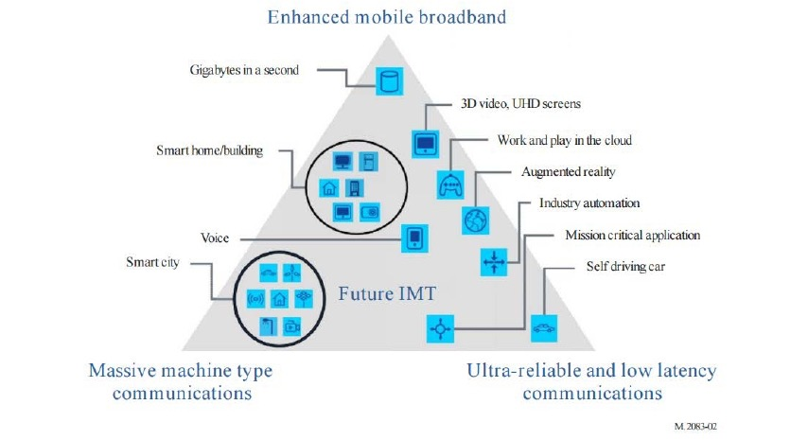
IMT-2020 (per ITU-R M.2083)
6

Slide 7
What are the deployments aside of mobile networks?
Other operators of public communication networks than mobile network operators
  MSO
  FNO
  Hotspot operators
‘Verticals’ represented in IEEE standards like
  Smart Grid
    http://standards.ieee.org/develop/msp/smartgrid.pdf
  Cloud Computing
    http://standards.ieee.org/develop/msp/cloudcomputing.pdf
  Internet of Things (including Green Community Networks)
    http://standards.ieee.org/develop/msp/iot.pdf
  Intelligent Transportation Systems
    http://standards.ieee.org/develop/msp/its.pdf
  eHealth
    http://standards.ieee.org/develop/msp/ehealth.pdf
  Smart Cities
    http://standards.ieee.org/develop/msp/smartcities.pdf

Slide 11
Getting in touch with the verticals?
Can IEEE SA headquarter help to establish communications to the verticals?
  Who are the staff liaisons for the verticals?
Can we do a kind of structured assessment to determine where P802.1CF matters most?
  Are P802.1CF-like networks already deployed?
  Could P802.1CF networks make a difference?
How would we initiate discussions?
  Presentations at standardization meetings?
  Workshops on IEEE conferences?

Slide 12
Our goals?
Make new deployments of IEEE 802 happen by better serving deployment needs
  Unifying technical approaches among various deployment domains by better communications
  Development of further amendments to fulfill particular requirements.
Faster adoption of emerging trends to IEEE 802 standards by better understanding of market evolution.
  More direct involvement of “customers” in the evolution of IEEE 802 technologies

Slide 13
OmniRAN P802.1CF topic
How could we prepare for the Industry Connections activity?
  What kind of ‘marketing material’ should OmniRAN TG prepare?
  Any particular enhancement to P802.1CF specification text required to make specification more ‘acceptable’?
  How could we introduce P802.1CF to a bigger industry?
  Do we have sufficient answers to ‘security, reliability, privacy’ in the text?

Slide 14
Going forward
Should we actively push forward P802.1CF into the Industry Connections activity?
Are we willing to spend the extra effort?
Who are the volunteers?

