Slide 1
Comparison Between 802.22 and 802.11af
Date: [2016-12-13]
Authors:
Name | Affiliation | Phone | Email
Hao Wang | Fujitsu R&D Center | +86-10-59691000 | wangh@cn.fujitsu.com
Lefei Wang | Fujitsu R&D Center | +86-10-59691000 | wanglefei@cn.fujitsu.com
Su Yi | Fujitsu R&D Center | +86-10-59691000 | yisu@cn.fujitsu.com
Xiaojing Fan | Fujitsu R&D Center | +86-10-59691000 | fanxiaojing@cn.fujitsu.com
Ryuichi Matsukura | Fujitsu/Fujitsu Laboratory | +81-44-754-2667 | r.matsukura@jp.fujitsu.com
Notice: This document does not represent the agreed view of the OmniRAN EC SG. It represents only the views of the participants listed in the ‘Authors:’ field above. It is offered as a basis for discussion. It is not binding on the contributor, who reserve the right to add, amend or withdraw material contained herein.
Copyright policy: The contributor is familiar with the IEEE-SA Copyright Policy <http://standards.ieee.org/IPR/copyrightpolicy.html>.
Patent policy: The contributor is familiar with the IEEE-SA Patent Policy and Procedures: <http://standards.ieee.org/guides/bylaws/sect6-7.html#6> and <http://standards.ieee.org/guides/opman/sect6.html#6.3>.
Abstract
This presentation briefly compares the concept between 802.22 and 802.11af, both specifies the network access procedure on TVWS, providing references for revision the AN setup procedures on shared spectrum.

Slide 2
Comparison Between 802.22 and 802.11af
2016-12-13
Hao Wang
Fujitsu R&D Center

Slide 3
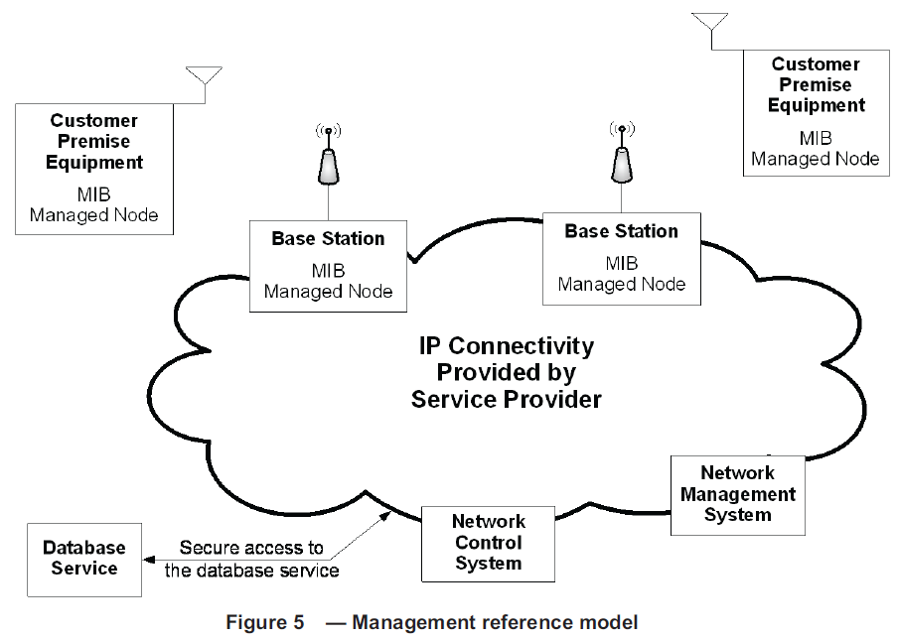
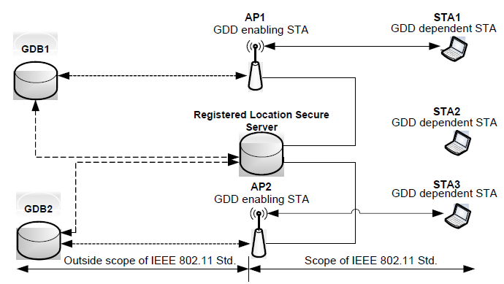
Reference Model
Both assume a dedicated database server providing information about permissible frequencies and operating parameters by geographic location
  Registered Location Secure Server (RLSS) deployed locally with BSSs
Database access primitives specified in 802.22, yet partly specified in 802.11af (between AP and RLSS)
802.22
802.11af

Slide 4
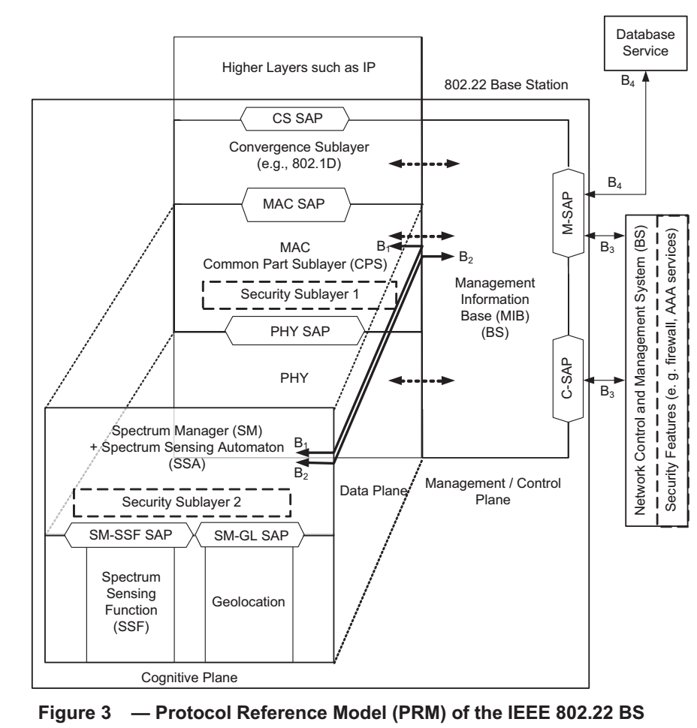
Protocol Model
A new cognitive plane to support cognitive radio capabilities defined by 802.22
  Spectrum manager has a key role located in the center of a BS
802.11af uses the generic 802.11 model with additional cognitive functions defined in MLME
  Controlled and managed by GDB/RLSS

Slide 5
Cognitive Characteristics
802.11af devices support the legacy CSMA/CA mechanism
802.22 devices (MS) don’t need to listen before transmitting (scheduled by BS)
  The differences in MAC strategy can limit the effectiveness of non-cooperative listen-before-talk mechanism in achieving fairness in TVWS coexistence.
 | 802.11af (WLAN) | 802.22 (WRAN)
Interface with spectrum sensors | No | Yes
Interface with geolocation device | Yes | Yes
Quiet periods for spectrum sensing | No | Yes
Interface with TVWS database | Yes | Yes

Slide 6
Spectrum Sensing
Coarse sensing method provided by energy detection for 802.11af
Informative sensing techniques described in 802.22 (Annex C)
  Blind sensing and signal specific sensing
accuracy
Multi-resolution sensing (MRSS)
Eigenvalue sensing
Energy detector
Blind sensing methods comparison for 802.22
complexity

Slide 7
802.11af Operation
GDD enabling STA (AP): be able to access a GDB and to obtain the information about the permitted frequencies and other information for use in its location
GDD dependent STA: under control of GDD enabling STA
  Unsolicited GDD Enablement Response frame is issued to cease transmission of GDD dependent STA

Slide 8
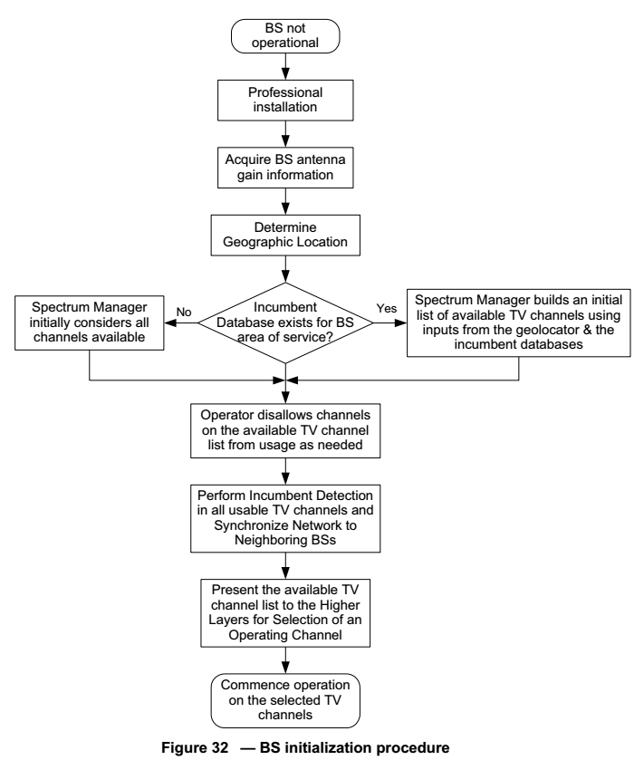
802.22 BS Initialization
BS is professionally installed.
BS acquires the antenna gain information
Determine the BS geographic location
If a database service exists, the SM at the BS receives an initial list of available channels from the database service.
If not exists, the SM initially considers all channels available.
Operator disallows channels on the available channel list as needed.
Perform incumbent detection in all usable channels and synchronize network to neighboring BSs.
Presentation of the available channel list to the higher layers for selection of an operating channel.
Commence operation on the selected operating channel(s).

Slide 9
Conclusion
802.11af is an amendment to 802.11 with extended capabilities for operating on TVWS
802.22 creates a dedicated technique for TVWS, which is fundamentally different from 802.11
  Concept of setup procedure has been introduced in 16-0078-00
The proposed new structure of 7.1 in 16-0079-00 can be a way forward to re-organize current texts and revisions.
  Harmonize the concept of AN setup for 802.11af and 802.22 under the new structure will not be an issue
  The setup procedure of 802.11af is not much different from the generic 802.11’s on unlicensed band except for the control from the geolocation database, which is conceptually the same as in 802.22.
Coexistence (e.g 802.19.1) is a more complicated issue than just the setup procedure, which may require further considerations for future drafts.

Slide 10
Questions, Comments

