Slide 1
Brief Introduction to
IEEE P802.1CF
2016-11-10

Slide 2
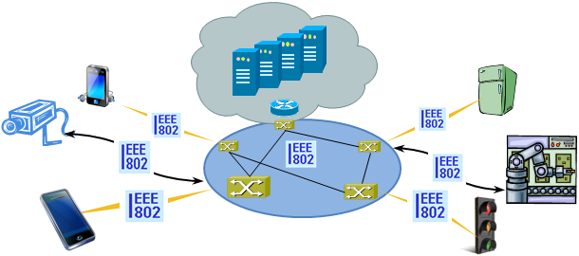
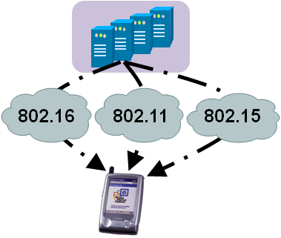
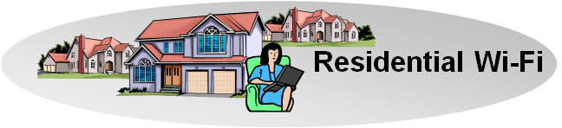

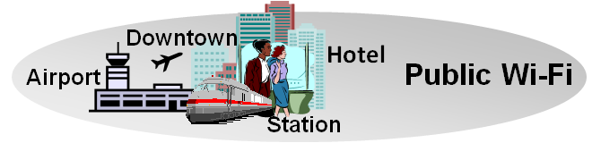
There is Evidence to consider Commonalities of IEEE 802 Access Networks
More (huge) networks are coming
up by everything gets connected
  e.g. SmartGrid, ITS, IoT, …
New markets for
IEEE 802 access technologies
  e.g. factory automation, in-car communication, home automation, …
IEEE 802 access is becoming more heterogeneous
  multiple network interfaces
    e.g. IEEE 802.3, IEEE 802.11, IEEE 802.15…
  multiple access network topologies
    e.g. IEEE802.11 in residential, corporate and public
  multiple network subscriptions
    e.g. multiple subscriptions for same interface
New emerging techniques, like SDN and virtualization

Slide 3
IEEE 802 demands a kind of ‘Stage 2’
Network Specification in 3 Stages
For the specification of the Integrated Services Digital Network the ITU-T defined in its Rec. I.130 a sequential 3 stage process,.
This process is nowadays commonly used in most telecommunication network standardization activities.
A Stage 2 specification provides a mapping of protocols to a functional network model, which facilitates easier evaluation.
‘External’ requirements from the
service/deployment perspective
Develop a logical/functional model
for evaluation of those requirements;
Available IEEE 802 specifications
of protocols and attributes.
?
?
More Information: ETSI: Making Better Standards
  http://docbox.etsi.org/MTS/MTS/10-PromotionalMaterial/MBS-20111118/protocolStandards/stagedApproach.htm

Slide 4
IEEE 802 demands a kind of ‘Stage 2’
Network Specification in 3 Stages
For the specification of the Integrated Services Digital Network the ITU-T defined in its Rec. I.130 a sequential 3 stage process,.
This process is nowadays commonly used in most telecommunication network standardization activities.
A ‘Stage 2’ specification would provide a mapping of the existing IEEE 802 protocols to a functional network model, which facilitates easier evaluation and better understanding of end-to-end behavior.
‘External’ requirements from the
service/deployment perspective
Develop a logical/functional model
for evaluation of those requirements;
Available IEEE 802 specifications
of protocols and attributes.
?

Slide 5
P802.1CF PAR
Project Title:
Network Reference Model and Functional Description of IEEE 802 Access Network
Scope:
This Recommended Practice specifies an access network, which connects terminals to their access routers, utilizing technologies based on the family of IEEE 802 Standards by providing an access network reference model, including entities and reference points along with behavioral and functional descriptions of communications among those entities.
Purpose:
Heterogeneous networks may include multiple network interfaces, multiple network access technologies, and multiple network subscriptions. In some cases such heterogeneous functionality must be supported in a single user terminal.
This Recommended Practice supports the design and deployment of access networks based on IEEE 802 technologies, guides the developers of extensions to the existing standards in support of a heterogeneous access network, and enables the use of IEEE 802 standards in new network deployments by specifying the functions of the IEEE 802 technologies when deployed in access networks.

Slide 6
P802.1CF D0.3 ToC
Overview
Normative references
Definitions
Acronyms, abbreviations, and conventions
Conformance
Network Reference Model
  Basic architectural concepts and terms
  Overview of IEEE 802 Network Reference Model
  Basic Network Reference Model
  NRM with Coordination and Information Service
  Comprehensive Network Reference Model
  Operational roles
  Network Virtualization
  Identifiers of functional entities
  Deployment scenarios
Functional Decomposition and Design
  Access network setup
  Access network discovery and selection
  Association and disassociation
  Authentication and trust establishment
  Data path establishment, relocation and teardown
  Authorization, QoS and policy control
  Accounting and monitoring
  Fault diagnostics and maintenance
Network virtualization functions
  SDN functional decomposition
  Network Function Virtualization
  Virtual Network Instantiation

Slide 7
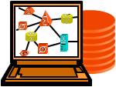


Network Reference Model design
Core functional entities were identified from a common topology figure of an access infrastructure
The portion of the access infrastructure in scope of IEEE 802 was defined according to the protocol layer architecture of the data path
IEEE 802 access network describes the layer 2 infrastructure between terminal and access router implemented through IEEE 802 technologies.
NMS
Subscription
Service
Information
Server
Terminal
Access Network
Backhaul
Access Router
Application
Application
Transport
Transport
Network
Network
Network
Network
Data Link
DL
DL
DL
DL
DL
DL
Data Link
Data Link
Data Link
Physical
Phy
Phy
Phy
Phy
Phy
Phy
Physical
Physical
Physical
Medium
Medium
Medium
Medium
Medium
Terminal
Interface
Node of
Attachment
Backhaul
Access Router
Interface
Scope of specification

Slide 8
Network Reference Model basics
The NRM denotes the functional entities and their relation to each others
Functional entities represented by rounded rectangles
Relations are shown by reference points indicating interfaces
  Reference points are denoted through R…
    Total of 12 reference points in the model
  Two different kind of reference points
    Forwarding path of Ethernet frames
      Represented by solid lines
    Control interfaces
      Represented by dotted lines
Subscription
Service
NMS
Terminal
R2
R11
R4
R12
Access Network
Access Router
R1
R3

Slide 9
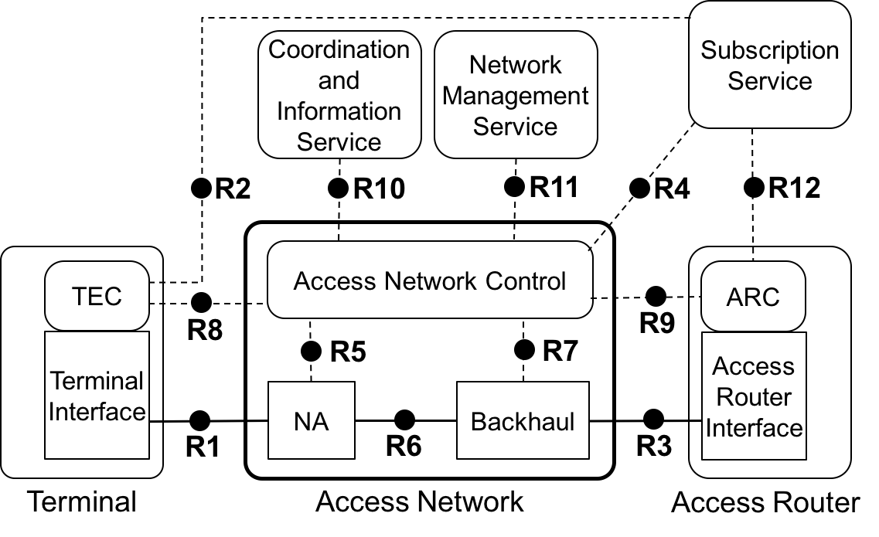
Comprehensive Network Reference Model
Comprehensive NRM shows highest level of details
NRM represents a logical view on an access network
  For the purpose to define interfaces
Control interfaces cover only attributes related to IEEE 802
  Protocol details on control interfaces are out of scope
  IEEE 802 protocols exist on R1, R3, and R6

Slide 10
Functional Decomposition and Design
Describes initialization of the network and the life cycle of user sessions
  Initialization
    Access network setup
  Life cycle of a user session
    Access network discovery and selection
    Association and disassociation
    Authentication and trust establishment
    Data path establishment, relocation and teardown
    Authorization, QoS and policy control
    Accounting and monitoring
    Fault diagnostics and maintenance
Provides the insights into the required IEEE 802 functions and control information for network operation.

Slide 11
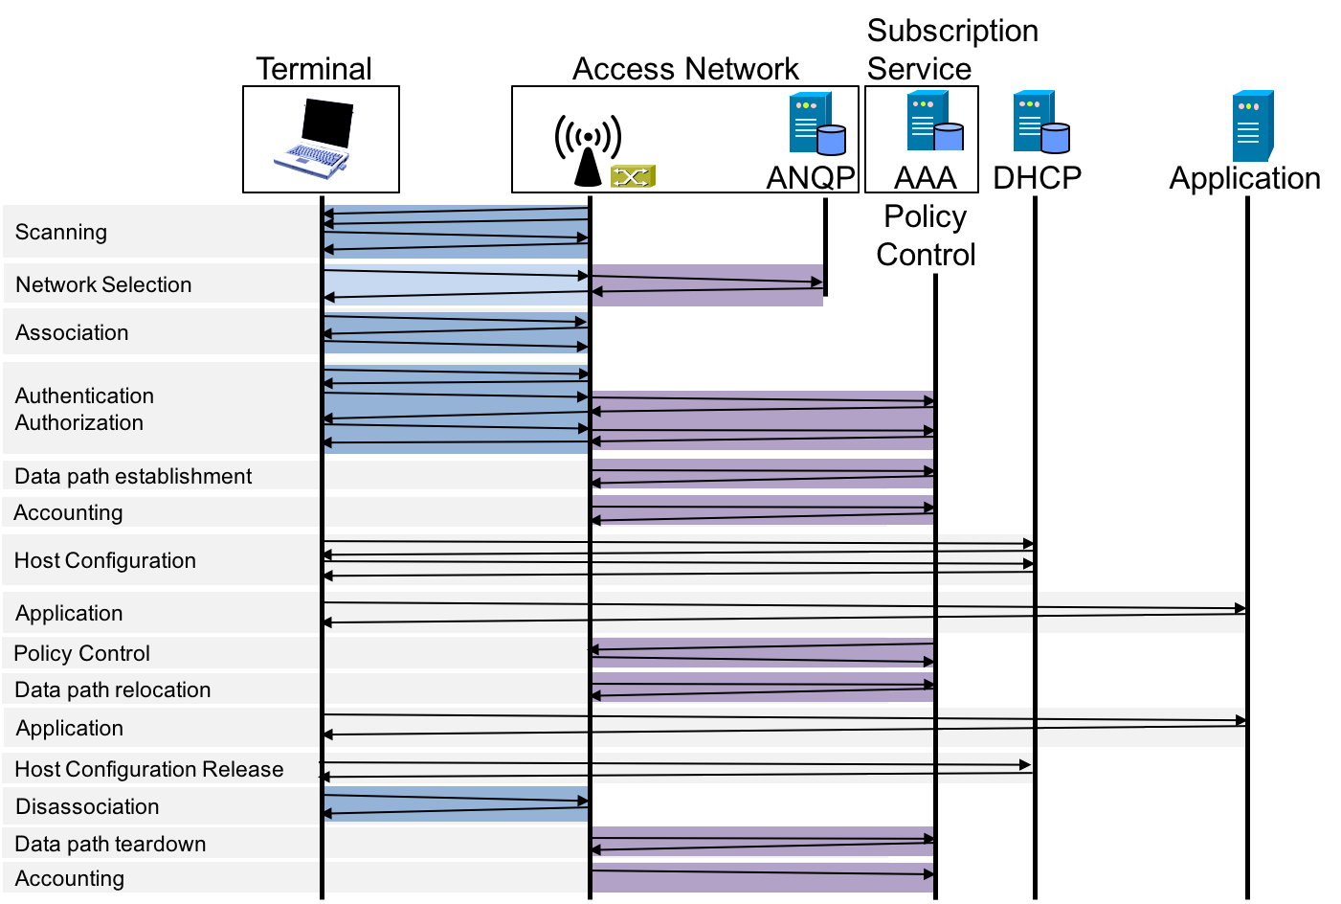
Session life cycle of IEEE 802 access
IEEE 802 messaging over R1
IEEE 802 control messaging

Slide 12
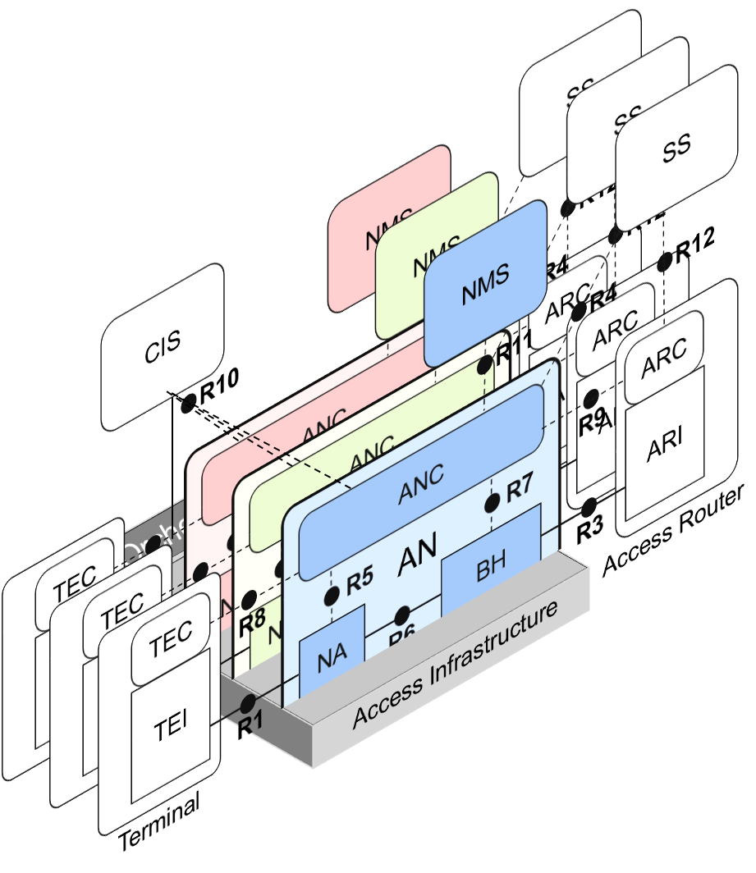
Advanced topic:
Network virtualization
Specification provides model
for network virtualization
Covers architectural aspects of SDN and NFV for IEEE 802 access network

Slide 13
Status of the work
Current draft P802.1CF-D0.3 provides initial text for all sections
Not all details are sufficiently described yet
Specification of network virtualization concepts is still evolving.
Review and input from networking experts wanted to detect flaws and to enhance the document.

Slide 14
How to get access to the specification
IEEE 802 draft specifications are not publicly available.
RFC 7241 describes various ways for IETF to get access to the draft specification.
Please contact
IEEE 802.1 chair
Glenn Parsons <glenn.parsons@ericsson.com>

