Slide 1
Response to Comments on Revision of Chapter 7.6.7
Date: [2016-09-27]
Authors:
Name | Affiliation | Phone | Email
Hao Wang | Fujitsu R&D Center | +86-10-59691000 | wangh@cn.fujitsu.com
Xiaojing Fan | Fujitsu R&D Center | +86-10-59691000 | fanxiaojing@cn.fujitsu.com
Su Yi | Fujitsu R&D Center | +86-10-59691000 | yisu@cn.fujitsu.com
Ryuichi Matsukura | Fujitsu/Fujitsu Laboratory | +81-44-754-2667 | r.matsukura@jp.fujitsu.com
Notice: This document does not represent the agreed view of the OmniRAN EC SG. It represents only the views of the participants listed in the ‘Authors:’ field above. It is offered as a basis for discussion. It is not binding on the contributor, who reserve the right to add, amend or withdraw material contained herein.
Copyright policy: The contributor is familiar with the IEEE-SA Copyright Policy <http://standards.ieee.org/IPR/copyrightpolicy.html>.
Patent policy: The contributor is familiar with the IEEE-SA Patent Policy and Procedures: <http://standards.ieee.org/guides/bylaws/sect6-7.html#6> and <http://standards.ieee.org/guides/opman/sect6.html#6.3>.
Abstract
This presentation provides response to the comments on omniRAN-16/0060 for revision of chapter 7.6.7.

Slide 2
Response to Comments on Revision of Chapter 7.6.7
2016-09-27
Hao Wang
Fujitsu R&D Center

Slide 3
Comment Response 1
Comment: Concerns about the purpose of ‘service flow addition received message’ and ‘service flow change received message’, immediate ACK may not be necessary
Response: according to IEEE 802.16 and WiMAX specification, the x.rvd message is necessary, mainly for two purposes
Immediate ACK
Verify the previous message is integrity
Notes:
最好补充DSX——RVD的细节，说明对完整性检查的支持

Slide 4
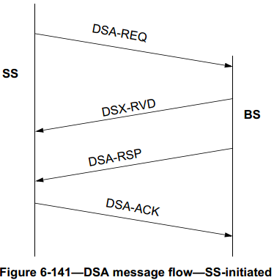
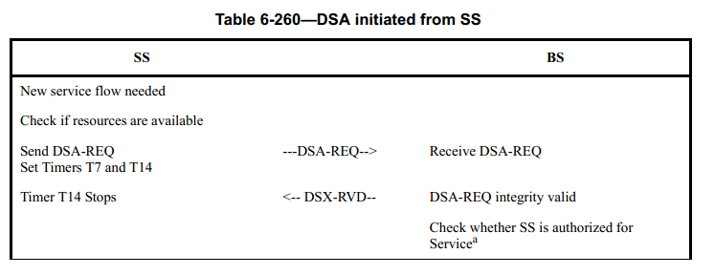
IEEE 802.16-2012 Specification
DSx_RVD message is defined to confirm the integrity of the previous DSx-REQ message, in case the DSx-RSP can not be transmitted immediately
In section 6.3.14.9.3.1
In section 6.3.14.7.1.1
Notes:
需要修改 text，说明目的包括integrity valid
补充章节号等细节信息

Slide 5
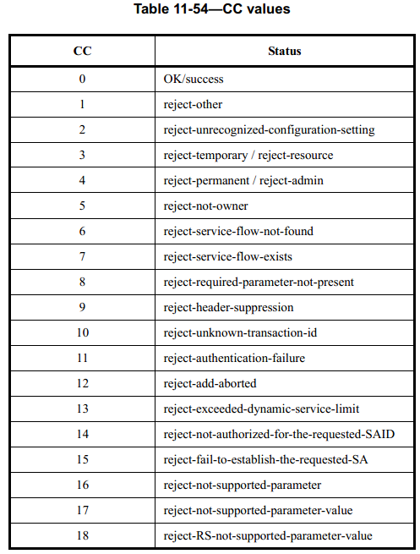
IEEE 802.16-2012 Specification
DSx_RVD message carries “Confirmation Code” field
Success, when the previous request message is integrity valid
Indicate the reason, when the previous request message is invalid
In section 11.13
Notes:
需要修改 text，说明目的包括integrity valid
补充章节号等细节信息

Slide 6
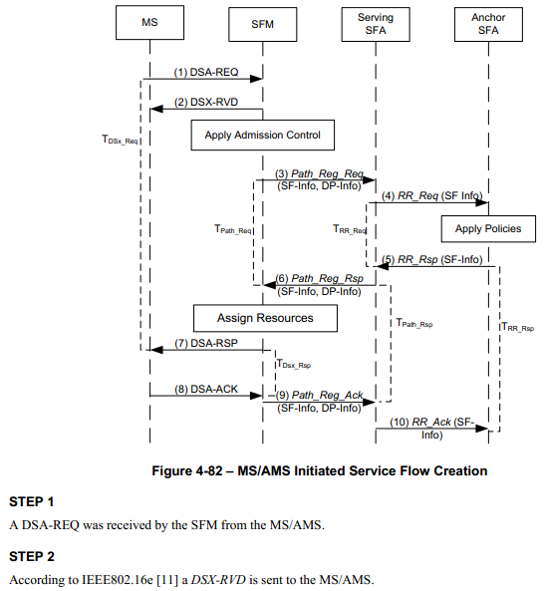
WiMAX Detail Protocols and Procedures (WMF-T33-001-R020v01)
DSx_RVD message is also specified in WiMAX, in case the DSx-RSP can not be transmitted immediately
In section 4.6.4.6.3

Slide 7
Comment Response 2
Comment: Concerns about the purpose of ‘SF delete response’ message, it may not be necessary to show ‘SF found’ information in a dedicated message
Response: according to IEEE 802.16 and WiMAX specification, “SF delete response” message has been defined for two purposes
ACK
Verify the corresponding resource was found

Slide 8
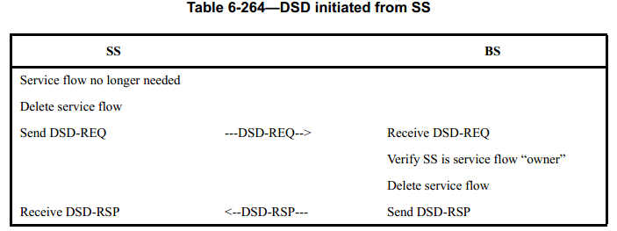
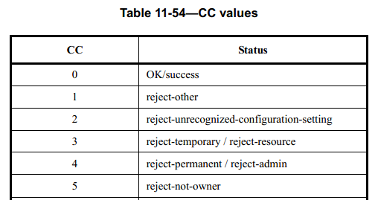
IEEE 802.16-2012 Specification
DSD_RSP message is defined to confirm the deletion of service flow
In section 6.3.14.9.5.1
DSD_RSP carries “confirmation code” field, which includes the status of “reject-not-owner”, in case the requester does not own of the service flow
Notes:
修改text，说明目的之一包括SS的owner check

Slide 9
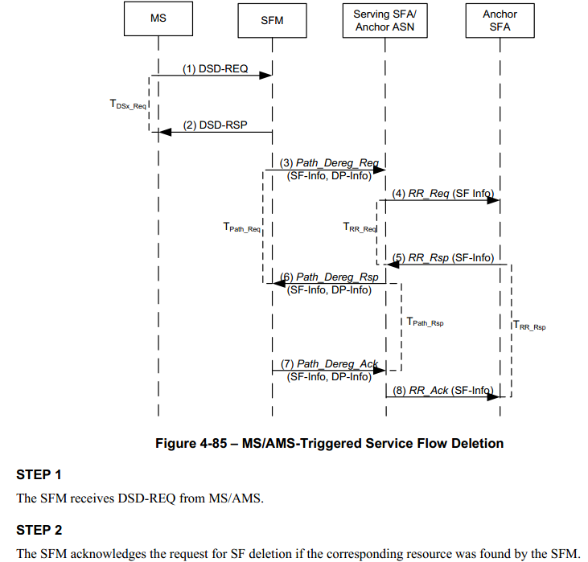
WiMAX Detail Protocols and Procedures (WMF-T33-001-R020v01)
DSD_RSP message has also been specified in WiMAX to confirm that the corresponding resource has been found
In section 4.6.4.6.6
Notes:
Text中增加对SS SF ower

Slide 10
Questions, Comments

