Slide 1
Some Detailed Information for Network Reference Model
Date: [2015-11-09]
Authors:
Name | Affiliation | Phone | Email
Su Yi | Fujitsu R&D Center | +86-10-59691000 | yisu@cn.fujitsu.com
Xiaojing Fan | Fujitsu R&D Center | +86-10-59691000 | fanxiaojing@cn.fujitsu.com
Hao Wang | Fujitsu R&D Center | +86-10-59691000 | wangh@cn.fujitsu.com
Ryuichi Matsukura | Fujitsu/Fujitsu Laboratory | +81-44-754-2667 | r.matsukura@jp.fujitsu.com
Notice: This document does not represent the agreed view of the IEEE 802.1 OmniRAN TG. It represents only the views of the participants listed in the ‘Authors:’ field above. It is offered as a basis for discussion. It is not binding on the contributor, who reserve the right to add, amend or withdraw material contained herein.
Copyright policy: The contributor is familiar with the IEEE-SA Copyright Policy <http://standards.ieee.org/IPR/copyrightpolicy.html>.
Patent policy: The contributor is familiar with the IEEE-SA Patent Policy and Procedures: <http://standards.ieee.org/guides/bylaws/sect6-7.html#6> and <http://standards.ieee.org/guides/opman/sect6.html#6.3>.
Abstract
This presentation discusses about the need for specifying detailed information flows across the reference points in the OmniRAN NRM.

Slide 2
Some Detailed Information for Network Reference Model
2015-11-09
Hao Wang
Fujitsu R&D Center

Slide 3
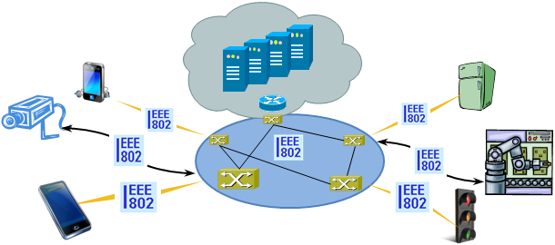
Introduction
OmniRAN provides a common platform to connect terminals to their access routers utilizing IEEE 802 access network technologies
Management applications, as well as user/business applications require functional descriptions for the deployment of the access network in this practice
New emerging techniques, like SDN and NFV, give opportunities to re-design some management functionalities

Slide 4
Management Functions/Applications
There will be a long list of management functions/applications from basic to enhanced
  Access network setup
  Access network discovery and selection
  Configuration management
  Accounting
  QoS
  Performance management
  Fault management
  Security
  …

Slide 5
STATE of the art
How does BroadBand Forum CWMP Support Management Functions?

Slide 6
Functional Components in BBF TR-069
Auto-configuration and dynamic service provisioning
Software/firmware image management
Software module management
Status and performance monitoring
Diagnostics

Slide 7
BBF TR-181 WiFi Data Model *
Device.WiFi
Device.WiFi.Radio.{i}
Device.WiFi.Radio.{i}.Stats
Device.WiFi.NeighboringWiFiDiagnostic
Device.WiFi.NeighboringWiFiDiagnostic.Results.{i}
WiFi.SSID.{i}
WiFi.SSID.{i}.Stats
WiFi.EndPoint.{i}.
WiFi.EndPoint.{i}.Stats
WiFi.EndPoint.{i}.Securtiy
WiFi.EndPoint.{i}.Profile.{i}
WiFi.EndPoint.{i}.Profile.{i}.Security
WiFi.EndPoint.{i}.WPS
WiFi.EndPoint.{i}.AC.{i}
WiFi.EndPoint.{i}.AC.{i}.Stats
WiFi.AccessPoint.{i}
WiFi.AccessPoint.{i}. Security
WiFi.AccessPoint.{i}. Accounting
WiFi.AccessPoint.{i}.WPS
WiFi.AccessPoint.{i}. AssociatedDevices.{i}
WiFi.AccessPoint.{i}. AssociatedDevives.{i}.Stats
WiFi.AccessPoint.{i}.AC.{i}
WiFi.AccessPoint.{i}.AC.{i}.Stats
  * https://www.broadband-forum.org/cwmp/tr-181-2-9-0.html and from omniran-15-0044-01-CF00-radio-interface-component.pptx

Slide 8
An Example of Stats Sub-object
A set of statistics parameters is contained within a Stats sub-object, e.g. Device.WiFi.SSID.{i}.Stats:
  BytesSent
  BytesReceived
  PacketsSent
  PacketsReceived
  ErrorsSent
  RetransCount
  FailedRetransCount
  RetryCount
  MultipleRetryCount
  ACKFailureCount
  AggregatedPacketCount
  ErrorsReceived
  UnicastPacketsReceived
  DiscardPacketsSent
  DiscardPacketsRecceived
  MulticastPacketsSent
  MulticastPacketsReceived
  BroadcastPacketsSent
  BroadcastPacketsReceived
  UnknownProtoPacketsReceived

Slide 9
OMniran
Can we do a better job?

Slide 10
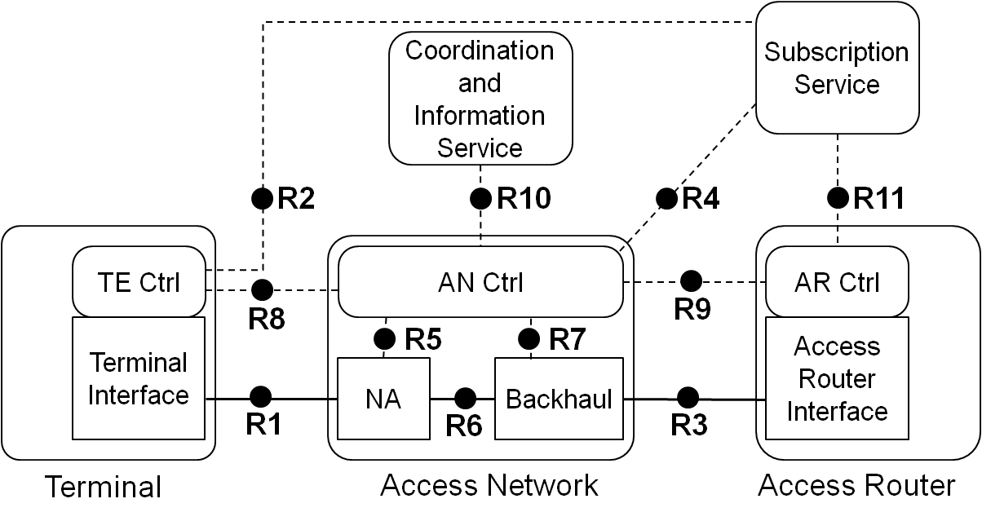
OmniRAN NRM
What information will be carried on each control reference point*?
  R2: Credentials carried in EAP-methods
  R4: Public user identity, authentication, authorization, accounting information, policy control
  R5: NA and interface configuration parameters
  R8: User identity, ANQP information
  R9: Flow identification for QoS, VLAN tagging
  R10: Network resource management, (e.g. interface into TVWS-DB)
  R11: Session specific interface configuration for access router (e.g. VLAN-ID)
  * omniran-15-0036-00-CF00-nrm-introduction.pptx
  omniran-15-0004-00-CF00-discussion-on-nrm-control-reference-points-information-and-parameters.pptx

Slide 11
More Details on NRM R5 Information
Four different categories of configuration parameters*:
Category |  | Examples | Source
Information flow from NA to AN Ctrl | Semi-static management parameters | Port configuration, link speed, queue parameters | MAC base information PHY base information
 | Dynamic parameters | Tx power, MCS, QoS characteristics, flow identification, measurements (RSSI, LinkQuality/SignalQuality, response time, …), number of associated devices, number of active devices, error message | MAC dynamic information MAC service information PHY dynamic information PHY service information
 | Statistical parameters | channel utilization, channel scan results, packet error count, retransmission count | Statistic information
Information flow from AN Ctrl to NA | Control of complex MAC/PHY dependent actions | Enable multicast support, move a user to other AP, QoS configuration exchange, power change, channel change, measurement request | AN controller
  * Revised based on omniran-15-0004-00-CF00-discussion-on-nrm-control-reference-points-information-and-parameters.pptx

Slide 12
Management Information

Slide 13
Take 802.11 for example
Management Information Source | Mapping to 802.11
Statistic information | Upper layer counting information, Dynamic MAC parameter, MAC primitive
MAC base information | MAC MIB
MAC dynamic information | Dynamic MAC parameter
MAC Service information | MLME primitive and MAC primitive
PHY Service information | PLME primitive and PLCP primitive
PHY base information | PHY MIB
PHY dynamic information | Dynamic PHY parameter

Slide 14
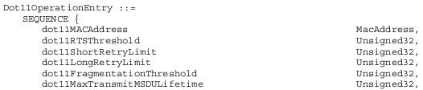


Semi-static management parameter in 802.11
MAC MIB
PHY MIB
Part of Dot11OperationEntry in MAC MIB
Part of Dot11PhyDSSSEntry in PHY MIB
dot11SupportedDataRatesTxTable in PHY MIB

Slide 15
Dynamic parameter in 802.11
Dynamic MAC parameters
  Number of associated devices
  Number of active devices
  …
Dynamic PHY parameters
  RSSI
  RSNI (received signal to noise indicator)
  …

Slide 16
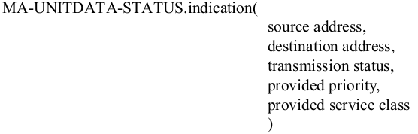
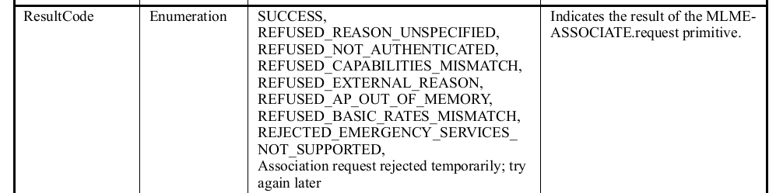
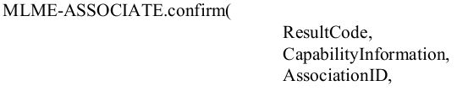

Dynamic parameter in 802.11 (continue)
MAC data Primitive
MLME-SAP Primitive
PLCP Primitive
e
 | Error Code
Transmission status | Successful. Undeliverable (excessive data length). Undeliverable (non-null source routing) Undeliverable: unsupported priority Undeliverable: unsupported service class Unavailable priority Undeliverable: unavailable service class Undeliverable (no BSS available) Undeliverable (cannot en crypt with a null key) …
 | Error Code
RXERROR | NoError FormatViolation CarrierLost UnsupportedRate

Slide 17
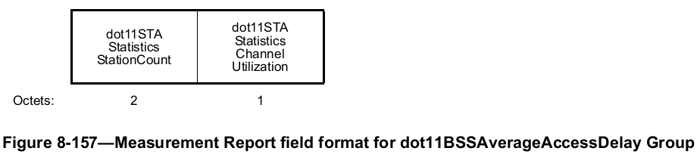
Statistical parameters in 802.11
Upper layer counting information
  Packet error count
    Higher layer counts it based on the error reported from MAC
MAC dynamic parameter
  QoS short retry counter / QoS long retry counter (QSRC/QLRC)
MLME primitive
  Channel utilization ratio carried in primitive related with measurement report

Slide 18
Proposal to OmniRAN
It’s important to specify detailed information flow across reference points in OmniRAN
To support different management applications, the information or parameters across each reference point need to be very detailed and extensive
It will benefit the interworking with other network standards, such as BBF TR-181

