Slide 1
Fault Diagnosis and Maintenance
Date: [2015-11-11]
Authors:
Name | Affiliation | Phone | Email
Hao Wang | Fujitsu R&D Center | +86-10-59691000 | wangh@cn.fujitsu.com
Su Yi | Fujitsu R&D Center | +86-10-59691000 | yisu@cn.fujitsu.com
Ryuichi Matsukura | Fujitsu/Fujitsu Laboratory | +81-44-754-2667 | r.matsukura@jp.fujitsu.com
Nami Hatazoe | Fujitsu Laboratory | +81-44-754-2667 | nami@jp.fujitsu.com
Notice: This document does not represent the agreed view of the OmniRAN EC SG. It represents only the views of the participants listed in the ‘Authors:’ field above. It is offered as a basis for discussion. It is not binding on the contributor, who reserve the right to add, amend or withdraw material contained herein.
Copyright policy: The contributor is familiar with the IEEE-SA Copyright Policy <http://standards.ieee.org/IPR/copyrightpolicy.html>.
Patent policy: The contributor is familiar with the IEEE-SA Patent Policy and Procedures: <http://standards.ieee.org/guides/bylaws/sect6-7.html#6> and <http://standards.ieee.org/guides/opman/sect6.html#6.3>.
Abstract
This contribution introduces the idea of fault diagnosis and maintenance to OmniRAN function design.

Slide 2
Fault Diagnosis and Maintenance
2015-11-11
Hao Wang
Fujitsu R&D Center

Slide 3
Some Points about Maintenance
Maintenance functionalities are the tasks if not done will affect service or network operation and performance
Not necessarily as a result of a fault, but reactions to the deterioration caused by configuration, policy change
Go through all functional decompositions
Go through data and control plane

Slide 4

Maintenance Life Cycle
Remote fault indication
Condition survey
Fault notification
Remote fault identification
Link/network performance
deteriorating
Recovery
Detection, identification
Diagnosis
Trouble shooting
Monitoring
Statistical measurement of Tx/Rx
Delay measurement
Link quality measurement
Link speed, capacity, throughput
Verify the capability of service
Provision
Configuration change for recovery

Slide 5
Maintenance is Essential to Business
Maintenance functions have been declared as attempting and advanced features by industry leading companies
  streamlines provisioning, management, and troubleshooting for multiple distributed access networks from a single platform
  helps reduce costs by doing away with the need to maintain an onsite management platform
Key features may include
  Monitoring • enable views of the status of network, APs, connected devices
  Remote troubleshoot • perform troubleshooting commands from the cloud
  Simplified deployment • apply consistent configurations and firmware upgrades
  Reporting • create scheduled or on-demand network and security reports
  Easy provisioning • require no local IT support; anyone onsite can plug in and power up

Slide 6
Maintenance is Essential to User Experience
Users complaint about their home network (mostly about wireless)
  TR-1057 (by Telecommunication Technology Committee, Japan) summarizes 3 fault scenarios
    Sometimes can’t connect, when connected network speed is low
    Sometimes certain device is disconnected frequently
    Sometimes all devices are disconnected
  and 16 fault descriptions of user complaints, for example
    AP can’t find an opportunity to communicate with device, because neighboring AP occupies the same or adjacent channel
    When serving AP is in standby but neighboring AP occupies the same or adjacent channel, devices try to connect to serving AP again and again
    Certain device constantly occupies the channel, therefore AP can’t transmit to this device (a/b/g/n/ac… mixed scenario)
    etc, ….
Table 2-1 Fault descriptions, TR-1057, original written in Japanese

Slide 7
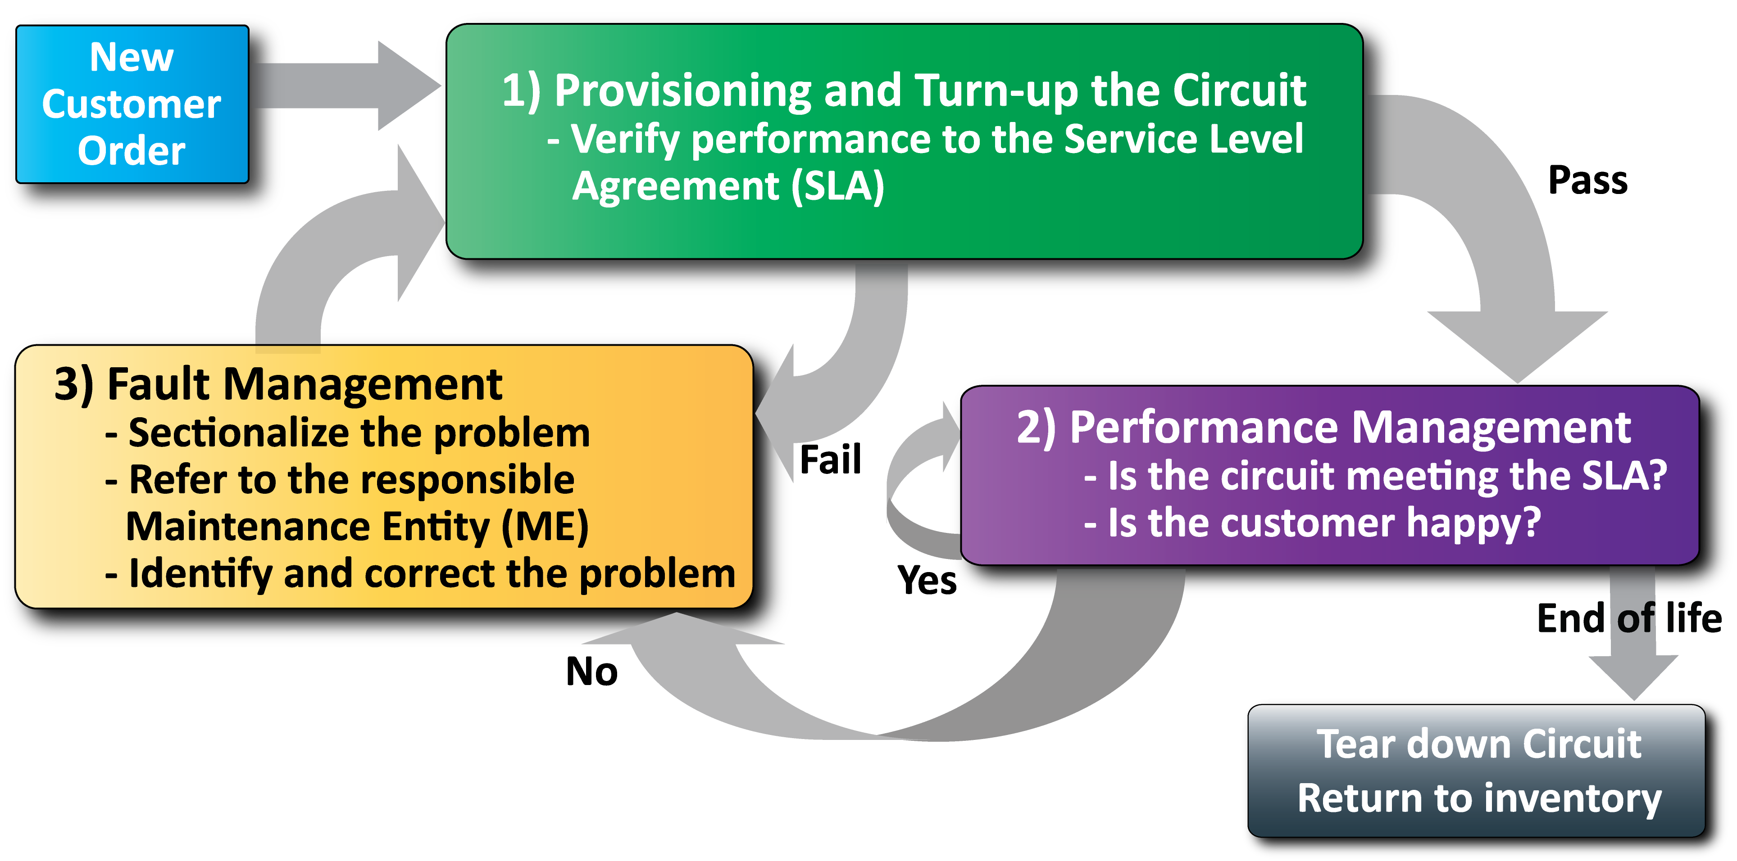
Put in a Operation Framework
An Example from MEF

Slide 8
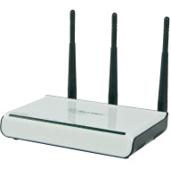


Trend for Providing Service Platform
Quote from M2M area: Revenues are moving towards the service enablement layer and the support of data access, storage, management and security
Application
Selected functional requirement:
Overall System
  Maintain M2M session, …
  QoS
  Management
    Device mgmt. and config.
    Network discovery
    Monitoring and diagnostics
Security
Charging
Operational
  Provide info related to usage and traffic characteristics of the underlying network
Communication Request Processing
  Maintain context associated with M2M sessions
API
Common service layer platform, middle ware including fault diagnosis and maintenance.
Management of devices and networks status in local network
API
Local network
Diagnostics, monitoring enabler (e.g. 802.11v, 802.11k)

Slide 9
Last Piece to the Life Cycle of a Session
fail
Fault
Diagnostics
&
Trouble
shooting
Scanning
fail
pass
Network Selection
fail
pass
Association
pass
fail
Authentication
Authorization
pass
Monitoring
Accounting Start
Host Configuration
Application
QoS Control
Application
fail
Host Cfg Release
Disassociation
pass
Accounting

Slide 10
Propose Changes to P802.1CF Draft
Introduction and Scope
Abbreviations, Acronyms, Definitions, and Conventions
References
Identifiers
Network Reference Model
  Overview
  Reference Points
  Access Network Control Architecture
    Multiple deployment scenarios including backhaul
Functional Design and Decomposition
  Access network setup
  Access network discovery and selection
  Association and Disassociaiton
  Authentication and Trust Establishment
  Datapath establishment, relocation and teardown
  Authorization, QoS and policy control
  Accounting and monitoring
  Fault diagnostics and maintenance
SDN Abstraction
Annex:
  Privacy Engineering
  Tenets (Informative)

Slide 11
Contents that Maybe Included
Functional Requirements
  Logging
    Monitoring Survey
    Fault Survey
  Reporting procedure
  Support for remote fault indication
  Support for remote fault identification
  Support for remote trouble shooting (t.b.d)

Slide 12
Questions, Comments
Fault Diagnosis and Maintenance

