Slide 1
Radio Interface Component from an OmniRAN perspective
Date: 2015-09-14
Authors:
Name | Affiliation | Phone | Email
Max Riegel | Nokia Networks | +491732938240 | maximilian.riegel@nokia.com
Notice: This document does not represent the agreed view of the OmniRAN EC SG. It represents only the views of the participants listed in the ‘Authors:’ field above. It is offered as a basis for discussion. It is not binding on the contributor, who reserve the right to add, amend or withdraw material contained herein.
Copyright policy: The contributor is familiar with the IEEE-SA Copyright Policy <http://standards.ieee.org/IPR/copyrightpolicy.html>.
Patent policy: The contributor is familiar with the IEEE-SA Patent Policy and Procedures: <http://standards.ieee.org/guides/bylaws/sect6-7.html#6> and <http://standards.ieee.org/guides/opman/sect6.html#6.3>.
Abstract
This contribution introduces the idea of ‘802.11 as a component’ to OmniRAN and brings up a couple of questions and approaches for further discussion in OmniRAN.

Slide 2
Radio Interface Component from an OmniRAN perspective
Max Riegel
Nokia Networks

Slide 3
Problem Statement
Radio Interface Component

Slide 4
What is a component?
From 11-15-0757-01-0000-802-11-as-a-component-tutorial.pptx
For the purpose of this submission, a component has a defined function and defined external interfaces.
The component doesn’t care how it is used, provided that the use of the component matches the constraints of its defined external interfaces.
It should be possible to swap implementations of the component from different sources provided those implementations are compliant to the defined functions and external interfaces.

Slide 5
Is 802.11 a component now?
From 11-15-0757-01-0000-802-11-as-a-component-tutorial.pptx
Answer: No
We have these main impediments:
  No concrete definition of our management interface, defined by various SAP primitives
  A “theoretical” MIB of which there is no compliant implementation.
  Lack of clarity as to whether the SME is part of the STA or not. There are “shall statements” for it, but no adequate interface to control it.

Slide 6
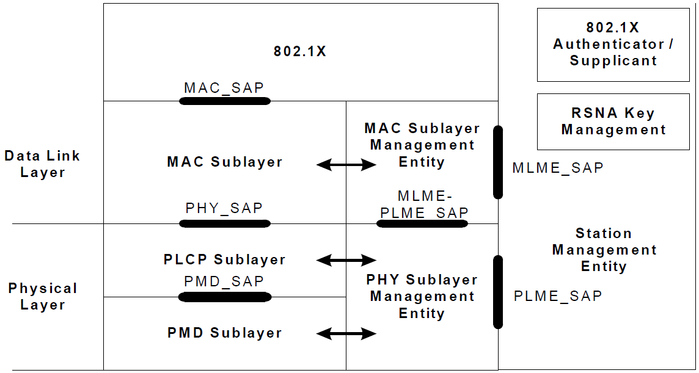
IEEE 802.11 Protocol Model
802.1X
  Port Access Entity
  Authenticator/Supplicant
RSNA Key Management
  Generation of Pair-wise and Group Keys
Station Management Entity (SME)
  interacts with both MAC
  and PHY Management
MAC Layer Management
Entity (MLME)
  synchronization
  power management
  scanning
  authentication
  association
  MAC configuration
  and monitoring
MAC Layer
  basic access mechanism
  fragmentation
  encryption
PHY Layer Management Entity (PLME)
  channel tuning
  PHY configuration and monitoring
Physical Layer Convergence Protocol (PLCP)
  PHY-specific, supports common PHY SAP
  provides Clear Channel Assessment signal (carrier sense)
Physical Medium Dependent Sublayer (PMD)
  modulation and encoding
Notes:
8

Slide 7
Value of an abstract management API
From 11-15-0757-01-0000-802-11-as-a-component-tutorial.pptx
An abstract API allows an architectural partition to be specified, in terms of entities, interfaces between entities, and the behaviour of those entities
This partition is not necessarily at the same level of granularity that would be chosen for a practical management API
Because this choice of granularity is left to the implementer, a higher layer network management entity cannot depend on any uniform behaviour to manage.

Slide 8
State of the Art
Radio Interface Component

Slide 9
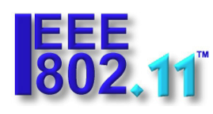



OAM in the IEEE 802.11 Standards Environment
IEEE 802.11 defines a radio interface
Wi-Fi Alliance ensures compliance of the radio interface by certification
OAM of the 802.11 radio interface is described by a comprehensive 802.11 MIB
A couple of organizations developed special variants of OAM interfaces for 802.11 to enable interoperability.
RADIUS is used for AAA messaging.
802.11
OAM
AAA
?
IEEE 802.11
Network
RADIUS

Slide 10
BroadBand Forum CWMP
CWMP: CPE WAN Management Protocol aka TR-069
  https://www.broadband-forum.org/cwmp.php
        Broadband Forum, MR230, TR-069 deployment scenarios
  TR-069 is an soap/HTTP based protocol for transmission of XMLbased descriptions of management models between CPE and ACS
  TR-069 Data Models are xml documents that are “schema-like”, that describe the management objects and parameters used for particular use cases.
The CWMP Data Model Schema is specified in TR-106.
TR-181 defines version 2 of the TR-069 Device data model (Device:2) and is applicable to all types of TR-069-enabled devices. It obsoletes both Device:1 and InternetGatewayDevice:1 specifications

Slide 11
TR-181 Wi-Fi Model
Device.WiFi
Device.WiFi.Radio.{i}
Device.WiFi.Radio.{i}.Stats
Device.WiFi.NeighboringWiFiDiagnostic
Device.WiFi.NeighboringWiFiDiagnostic.Results.{i}
WiFi.SSID.{i}
WiFi.SSID.{i}.Stats
WiFi.EndPoint.{i}.
WiFi.EndPoint.{i}.Stats
WiFi.EndPoint.{i}.Securtiy
WiFi.EndPoint.{i}.Profile.{i}
WiFi.EndPoint.{i}.Profile.{i}.Security
WiFi.EndPoint.{i}.WPS
WiFi.EndPoint.{i}.AC.{i}
WiFi.EndPoint.{i}.AC.{i}.Stats
WiFi.AccessPoint.{i}
WiFi.AccessPoint.{i}. Security
WiFi.AccessPoint.{i}. Accounting
WiFi.AccessPoint.{i}.WPS
WiFi.AccessPoint.{i}. AssociatedDevises.{i}
WiFi.AccessPoint.{i}. AssociatedDevises.{i}.Stats
WiFi.AccessPoint.{i}.AC.{i}
WiFi.AccessPoint.{i}.AC.{i}.Stats

Slide 12
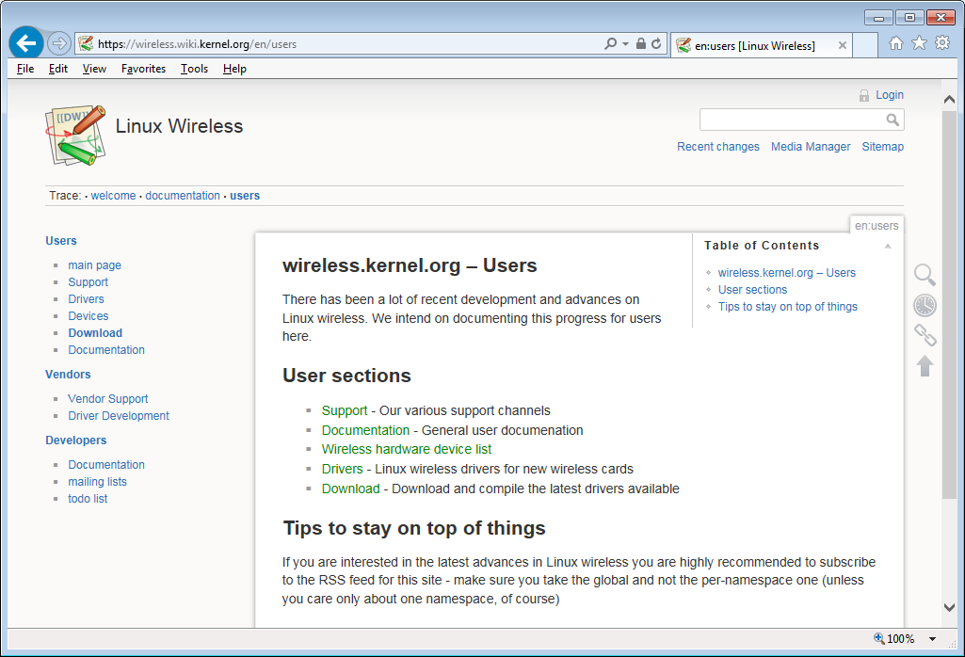
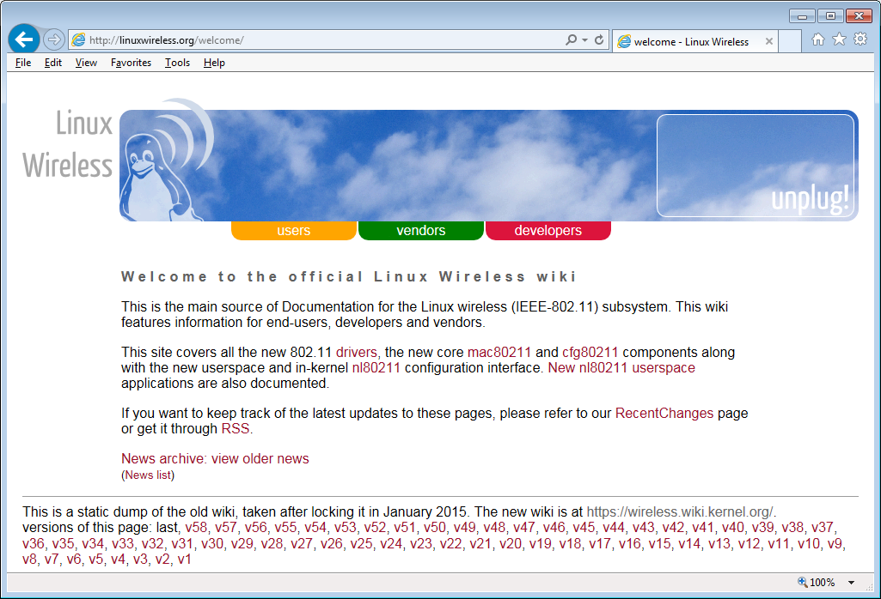
LINUX Wireless

Slide 13
LINUX Wi-Fi driver architecture
iw
hostapd
wpa_suplicant
nl80211 has become defacto standard for Wi-Fi configuration in LINUX
  Defines a comprehensive list of controls, commands and attributes for Wi-Fi
  Communicates by netlink (RFC3549) with kernel
cfg80211 provides unified interface into kernel drivers
…
userspace
nl80211
cfg80211
kernel
mac80211 and future fullmac drivers
Wi-Fi ‘hardware’

Slide 14
Wi-Fi OAM specification ‘nl80211.h’ http://git.kernel.org/cgit/linux/kernel/git/linville/wireless.git/tree/include/uapi/linux/nl80211.h?id=HEAD
#ifndef __LINUX_NL80211_H
#define __LINUX_NL80211_H
/*
* 802.11 netlink interface public header
*
* Copyright 2006-2010 Johannes Berg <johannes@sipsolutions.net>
* Copyright 2008 Michael Wu <flamingice@sourmilk.net>
* Copyright 2008 Luis Carlos Cobo <luisca@cozybit.com>
* Copyright 2008 Michael Buesch <m@bues.ch>
* Copyright 2008, 2009 Luis R. Rodriguez <lrodriguez@atheros.com>
* Copyright 2008 Jouni Malinen <jouni.malinen@atheros.com>
* Copyright 2008 Colin McCabe <colin@cozybit.com>
*
* Permission to use, copy, modify, and/or distribute this software for any
* purpose with or without fee is hereby granted, provided that the above
* copyright notice and this permission notice appear in all copies.
*
* THE SOFTWARE IS PROVIDED "AS IS" AND THE AUTHOR DISCLAIMS ALL WARRANTIES
* WITH REGARD TO THIS SOFTWARE INCLUDING ALL IMPLIED WARRANTIES OF
* MERCHANTABILITY AND FITNESS. IN NO EVENT SHALL THE AUTHOR BE LIABLE FOR
* ANY SPECIAL, DIRECT, INDIRECT, OR CONSEQUENTIAL DAMAGES OR ANY DAMAGES
* WHATSOEVER RESULTING FROM LOSS OF USE, DATA OR PROFITS, WHETHER IN AN
* ACTION OF CONTRACT, NEGLIGENCE OR OTHER TORTIOUS ACTION, ARISING OUT OF
* OR IN CONNECTION WITH THE USE OR PERFORMANCE OF THIS SOFTWARE.
*
*/
#include <linux/types.h>
#define NL80211_GENL_NAME "nl80211"
/**
* DOC: Station handling
*
* Stations are added per interface, but a special case exists with VLAN
* interfaces. When a station is bound to an AP interface, it may be moved
* into a VLAN identified by a VLAN interface index (%NL80211_ATTR_STA_VLAN).
* The station is still assumed to belong to the AP interface it was added
* to.
*
* Station handling varies per interface type and depending on the driver's
* capabilities.
*
nl80211.h defines
  120 commands
  about 600 attributes and controls
Potentially nl80211.h is the most comprehensive open OAM interface for 802.11
  next to the 802.11 MIB

Slide 15
OmnirAN Perspective
Radio Interface Component

Slide 16



Access network architecture
The physical view of an access network
Subscription
Service
Information
Server
Terminal
Access Network
Backhaul
Access Router
Protocol layer architecture of an access network
Application
Application
Transport
Transport
Network
Network
Network
Network
Data Link
DL
DL
DL
DL
DL
DL
Data Link
Data Link
Data Link
Physical
Phy
Phy
Phy
Phy
Phy
Phy
Physical
Physical
Physical
Medium
Medium
Medium
Medium
Medium
Terminal
Interface
Node of
Attachment
Backhaul
Access Router
Interface
Scope of P802.1CF
STA
AP

Slide 17
P802.1CF Network Reference Model
Subscription
Service
Coordination and Information
Service
R2
R10
R4
R11
TE Ctrl
AN Ctrl
AR Ctrl
R8
R9
Terminal
Interface
R5
R7
Access Router
Interface
NA
Backhaul
R1
R6
R3
Terminal
Access Network
Access Router
STA
AP
Radio interface components
NA = Node of Attachment {AP, BS}

Slide 18
Attributes of the OmniRAN network model
Application view
  Guides deployment of IEEE 802 technologies
Components
  Defines abstract functional entities of IEEE 802 technologies
    E.g. Node of Attachment, Backhaul, TE/AR Interface
Generic
  Emphasizes commonalities among IEEE 802 technologies
    E.g. MAC Service, EAPoL, LMI
Software oriented
  Creates data models for IEEE 802 access network and components.
    In OO terms: Definition of classes for ‘access network’, ‘na’, ‘backhaul’
Extensible
  Provides basic/generic data structures for extension by technology specifics

Slide 19
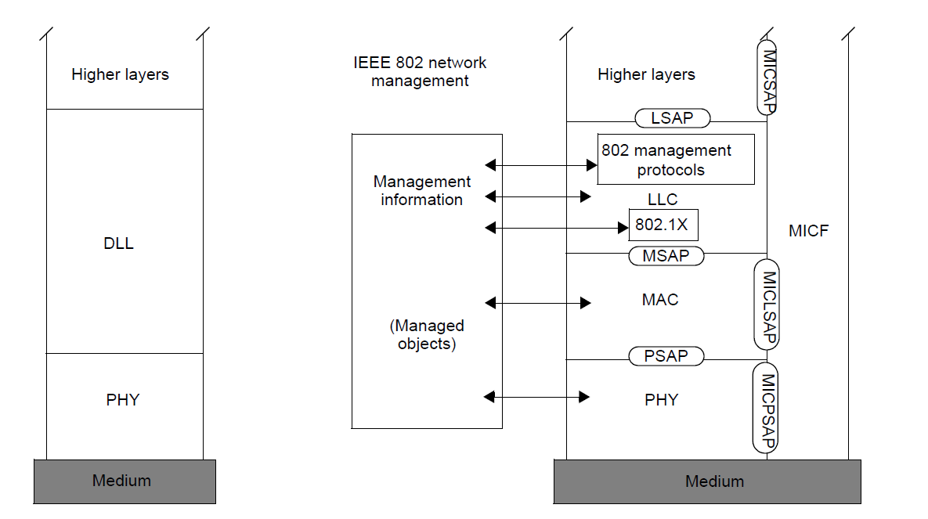
Reference point variations
IEEE 802 knows about 2 kind of interfaces:
User data as well as peer-to-peer control is conveyed via ports
Control and management is represented by Layer Management Information as currently specified by the MIB
Control
Port

Slide 20
Lifecycle of a WLAN session
STA
AP
ANQP
AAA
Policy
Configuration
DHCP
Application
Scanning
Network Selection
Association
Authentication
Authorization
Accounting Start
Host Configuration
Application
QoS Control
Application
Host Cfg Release
Disassociation
Accounting

Slide 21
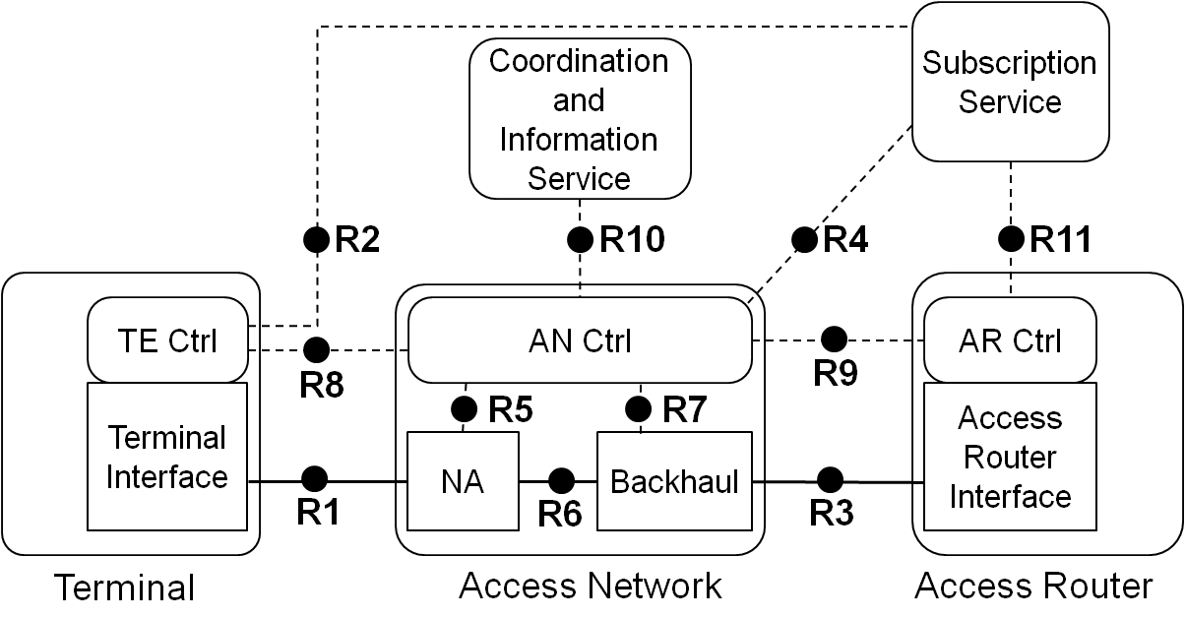
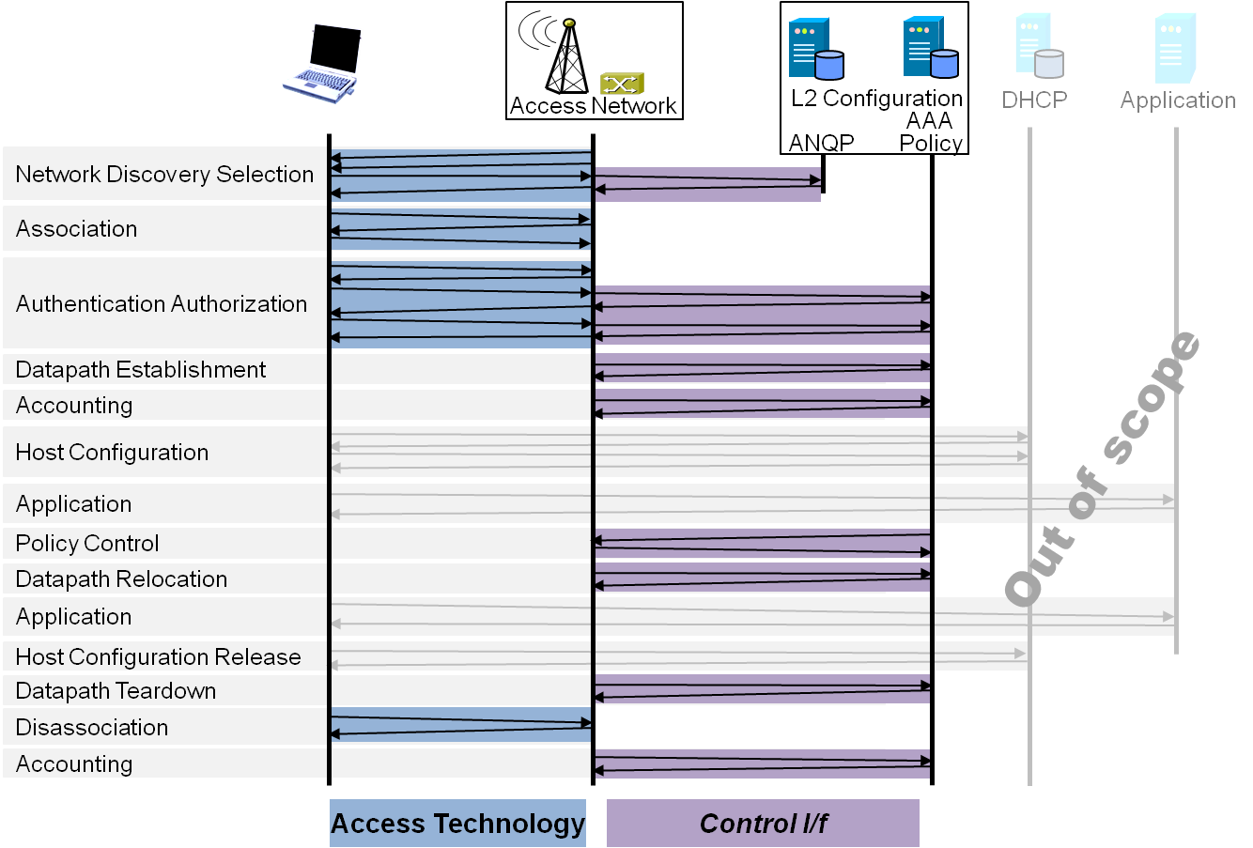
P802.1CF Draft ToC
Introduction and Scope
Abbreviations, Acronyms, Definitions, and Conventions
References
Identifiers
Network Reference Model
  Overview
  Reference Points
  Access Network Control Architecture
    Multiple deployment scenarios including backhaul
Functional Design and Decomposition
  Access Network Setup
  Network Discovery and Selection
  Association and Disassociation
  Authentication and Trust Establishment
  Datapath establishment,
  relocation and teardown
  Authorization, QoS and policy control
  Accounting and monitoring
SDN Abstraction
Annex:
  Privacy Engineering
  Tenets (Informative)

Slide 22
Specification of a component
Describing a network element as a ‘component’ would require:
  Deployment models
  A control architecture, i.e. definition of entities exchanging control information with the ‘component’
  An outline for the specification of the functional behavior from an application perspective
  Structuring the control attributes from an application perspective

Slide 23
What 802.1CF could do for
IEEE 802.11 as a ‘component’
802.1CF would provide a solution for
  Defining the deployment models (STA, AP)
  A control architecture, i.e. definition of entities exchanging control information with the ‘component’
  A generic structure for the management object model aligned to the functional behavior
Out of scope of 802.1CF
  Restructuring the IEEE 802.11 control attributes
    It would be left to 802.11 to develop an appropriate format of its LMI (Layer Management Information (MIB))

Slide 24
Questions, Comments
Radio Interface Component

