Slide 1
IEEE 802.1 OmniRAN TG Status Report to IETF – IEEE 802 Coordination
2015-06-18
Max Riegel
(TG Chair, Nokia Networks)

Slide 2
IEEE 802.1 OmniRAN TG Resources
OmniRAN TG maintains a Wiki page on mentor to reflect its status and achievements
https://mentor.ieee.org/omniran/bp/StartPage
Also showing meeting announcements and conference call dial-in information
OmniRAN filespace on mentor is used for contributions and meeting documents
https://mentor.ieee.org/omniran/documents
FYI: OmniRAN P802.1 PAR
https://development.standards.ieee.org/get-file/P802.1CF.pdf?t=81644900003

Slide 3
OmniRAN TG P802.1CF Status
First draft (editor’s draft) under preparation
Editor assigned and active to create first draft document
Still quite some content missing
Text available on Network Reference Model, Network Discovery and Selection, and SDN Abstraction
Text proposed for Dynamic Spectrum Management
Outline and thoughts for Data Path chapter
Contributions wanted for Association, Authentication, Authorization, and Accounting
Approach defined to cover privacy aspects within specification
Next steps (July IEEE 802 Plenary):
Continuation of work on P802.1CF draft
Further discussions on applicability of P802.1CF
Primarily IEEE 802 networks providing MAC service (IEEE 802.1AC)
Reaching out to networks not based on IEEE 802 PHYs, e.g. MSO, DSL
Also covering modern SDN approaches for Network Virtualization
Contribution to tutorial in July F2F on ‘IEEE 802.11 as component’
Presentation of generic modeling approach in P802.1CF for network components deploying IEEE 802 technologies

Slide 4
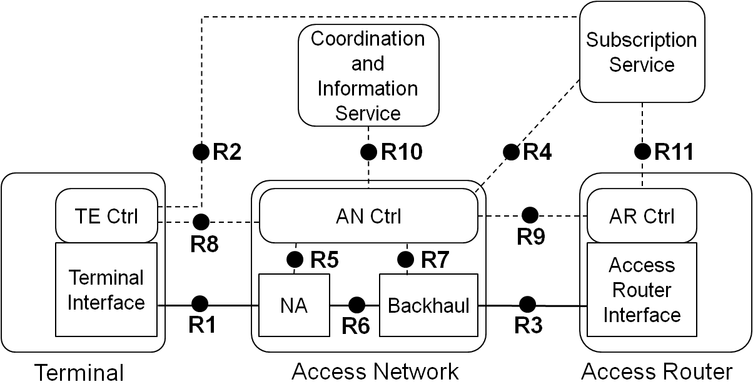
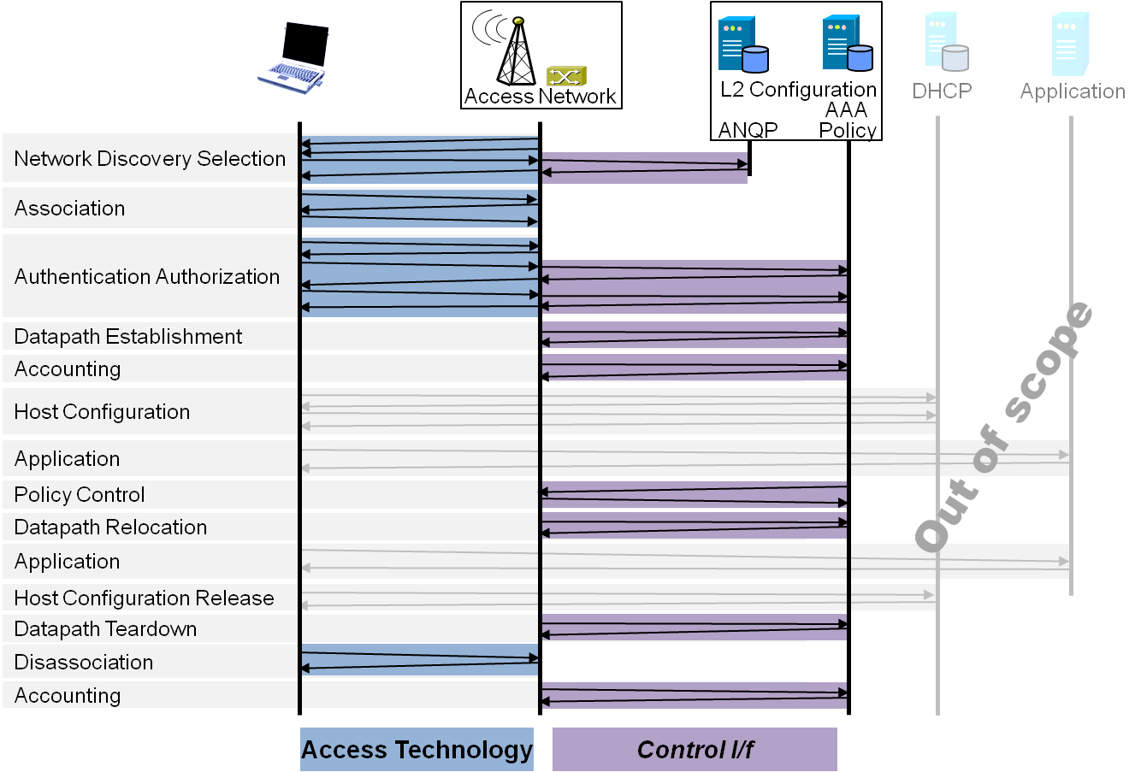
P802.1CF Draft ToC
Introduction and Scope
Abbreviations, Acronyms, Definitions, and Conventions
References
Identifiers
Network Reference Model
Overview
Reference Points
Access Network Control Architecture
Multiple deployment scenarios including backhaul
Functional Design and Decomposition
Dynamic Spectrum Access
Network Discovery and Selection
Association and Disassociaiton
Authentication and Trust Establishment
Datapath establishment, relocation and teardown
Authorization, QoS and policy control
Accounting and monitoring
SDN Abstraction
Annex:
Privacy Engineering
Tenets (Informative)

