Slide 1
P802.1CF NRM Discussions
Date: 2015-04-16
Authors:
Name | Affiliation | Phone | Email
Max Riegel | Nokia Networks | +49 173 293 8240 | maximilian.riegel@nokia.com
Notice: This document does not represent the agreed view of the IEEE 802.1 OmniRAN TG. It represents only the views of the participants listed in the ‘Authors:’ field above. It is offered as a basis for discussion. It is not binding on the contributor, who reserve the right to add, amend or withdraw material contained herein.
Copyright policy: The contributor is familiar with the IEEE-SA Copyright Policy <http://standards.ieee.org/IPR/copyrightpolicy.html>.
Patent policy: The contributor is familiar with the IEEE-SA Patent Policy and Procedures: <http://standards.ieee.org/guides/bylaws/sect6-7.html#6> and <http://standards.ieee.org/guides/opman/sect6.html#6.3>.
Abstract
This document provides additional input on conclusions on the definitions of the NRM interfaces R1, R3, R8.

Slide 2
P802.1CF NRM discussions
2015-04-16
Max Riegel
(Nokia Networks)

Slide 3
NRM discussions at March 2015 F2F as captured by the minutes
P802.1CF Network reference model
https://mentor.ieee.org/omniran/dcn/15/omniran-15-0008-02-CF00-nrm-refinements.pptx
  No final conclusion about the content of the R8c/R1c reference point in relation to the R1d reference point
    What functionality belongs to the “data path” reference point?
  Agreement reached that R1 and R3 should become symmetric, as both may be either wired or wireless
    No conclusion about which label should be used for R3c; group did not like the idea to introduce 2-digit reference point indices, i.e. R10c
https://mentor.ieee.org/omniran/dcn/15/omniran-15-0014-00-CF00-revision-proposal-of-omniran-14-0083.docx
  Edits presented to the group, but no final conclusion was reached, as no conclusion was reached either for treating the reference points between TEC – ANC – CNC, nor on replacement of term “Core Network”
  Introductory section appreciated, as well as presentation of fewer variations. More details required on treating control interfaces as well as definition of functional content of data path interfaces.
https://mentor.ieee.org/omniran/dcn/15/omniran-15-0013-00-CF00-r9c-reference-point-discussion.pptx
  Usage of “Core network” for the endpoint of the data path leads to ambiguities regards location of CIS
    Chair proposed to look for other term replacing “Core Network,” e.g. by “Network Service”
  It remains unclear to which 802.19.1 interface the R9c reference point refers. Further clarifications necessary.

Slide 4
Discussion status of the NRM
Subscription
Service
Coordination and Information
Service
R2c
R9c
R4c
R5c
TE Ctrl
AN Ctrl
CN Ctrl
R8c/1c
R3c
Terminal
Interface
R6c
R7c
Core
Network
Interface
NA
Backhaul
R1d
R6d
R3d
Terminal
Access Network
Core Network/
Network Service

Slide 5
Resolving the R8c vs. R1c issue
R8c
R1c
Denotes ctrl-to-ctrl interface
May comprise information elements not defined within R1 specification
..?
For symmetry reasons, R1 should follow R3
Label should be aligned to data path interface
No major distinction necessary as R1 may comprise multiple specifications
..?
Maybe, we have to more clearly specify the scope of a data path interface.
IMHO, an data path interface comprises all functions required for sending and receiving Ethernet frames once the connection is established.

Slide 6


NRM mapping
End-to-end network topology
Subscription
Service
Information
Service
Terminal
Access Network
Backhaul
Core Network
Scope of P802.1CF in the protocol layer architecture
Application
Application
Transport
Transport
Network
Network
Network
Network
Data Link
DL
DL
DL
DL
DL
DL
Data Link
Data Link
Data Link
Physical
Phy
Phy
Phy
Phy
Phy
Phy
Physical
Physical
Physical
Medium
Medium
Medium
Medium
Medium
Terminal
Interface
Node of
Attachment
Backhaul
Core Network
Interface
Scope of P802.1CF
Schematic NRM for the IEEE 802 access network
Subscription
Service
Terminal
R2
R4
Access Network
Core Network
R1
R3

Slide 7
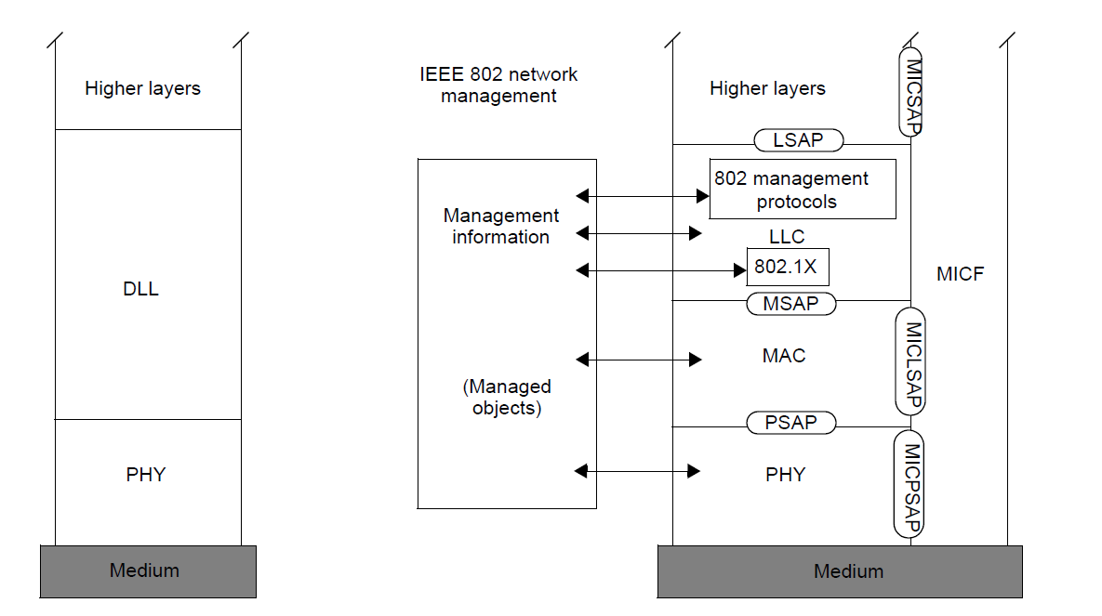
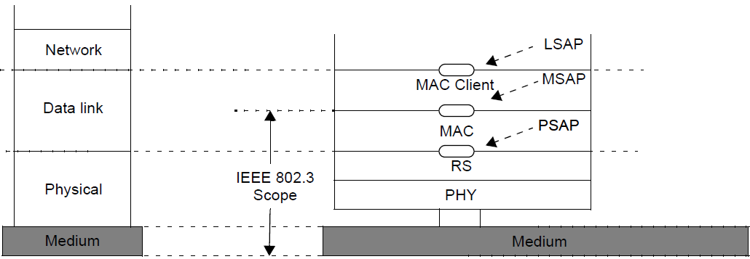
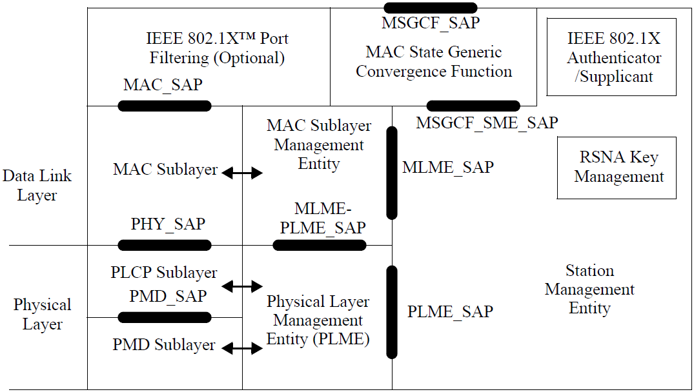
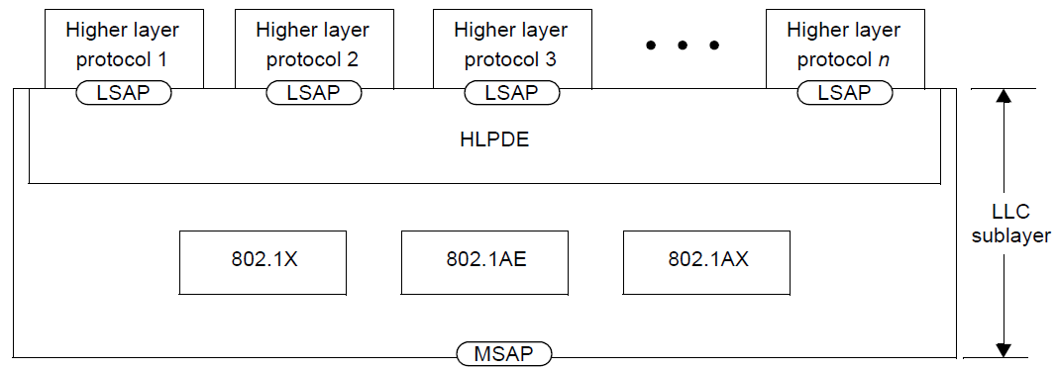
Reference Models of major R1/R3 interfaces
(taken from IEEE 802-2014)
Generic IEEE 802 RM
IEEE 802.3
IEEE 802.11
LLC Sublayer

Slide 8
Some thoughts on differentiation between R1/R8c and R3d/R3c, respectively
R1 should comprise the whole PHY+MAC+LLC interface as specified by IEEE 802 specification
R8c covers information exchanges related to managed objects
R3d should become R3, respectively.
R3c should be identified by a different suffix.

Slide 9
For discussion:
Re-labeling the NRM
Subscription
Service
Coordination and Information
Service
R2
R10
R4
R11
TE Ctrl
AN Ctrl
NS Ctrl
R8
R9
Terminal
Interface
R5
R7
Network Service
Interface
NA
Backhaul
R1
R6
R3
Terminal
Access Network
Network Service

