Slide 1
[ONF Wireless & Mobile WG Status Update]
Date: [2015-03-10]
Authors:
Name | Affiliation | Phone | Email
Paul Congdon | Tallac Networks | +1 916 765 4056 | paul.congdon@tallac.com
Charlie Perkins | Futurewei | +1 408 330 4586 | Charlie.perkins@huawei.com
Notice: This document does not represent the agreed view of the OmniRAN EC SG. It represents only the views of the participants listed in the ‘Authors:’ field above. It is offered as a basis for discussion. It is not binding on the contributor, who reserve the right to add, amend or withdraw material contained herein.
Copyright policy: The contributor is familiar with the IEEE-SA Copyright Policy <http://standards.ieee.org/IPR/copyrightpolicy.html>.
Patent policy: The contributor is familiar with the IEEE-SA Patent Policy and Procedures: <http://standards.ieee.org/guides/bylaws/sect6-7.html#6> and <http://standards.ieee.org/guides/opman/sect6.html#6.3>.
Abstract
This presentation provides an update on the status and activities of the Open Networking Foundation’s Wireless and Mobile Working Group as of March 2015.

Slide 2
ONF Wireless & Mobile Working Group Status Update
Charlie Perkins
March 10, 2014

Slide 3
Motivation
At the Tutorial for IEEE 802 Plenary in Dallas, Serge Manning, Chair of ONF WMWG, introduced the new ONF effort
This presentation reviews status and more detail into the activities of the ONF WMWG.
Discussion about ONF reorganization and new mission

Slide 4
Wireless & Mobile WG (WMWG)
Goals and Deliverables
Mission and Goals
  Examine the unique requirements of SDN in wireless and mobile networks
  Simplify the interaction between wireless physical networks and packet networks with centralized control and management.
  Develop reference architectural descriptions that encompass different elements of ONF based technologies in wireless and mobile network domains
  Identify enhancements to ONF technologies to improve operation of mobile and wireless networks.
    ONF technologies include OpenFlow Switch, OF-Config Protocols, Northbound interfaces and associated architectures.

Slide 5
WMWG Leadership
Xiaobo Long – Chair
Paul Congdon – Vice Chair
Charlie Perkins – Secretary
Project Teams
  Ariel Adam – Wireless Transport PT Lead
  Amy Ye – Wireless Transport PT Editor
  John Kaippallimalil – Mobile Packet Core PT Lead
  Xiaobo Long – Unified Access PT Lead

Slide 6
History and Timeline
Working Code
Protocol Extensions
Reference Architectures
Use Case Selection
Use Case Collection
Working Group and Project Teams
Formed
ONF Member
Workday
ONF Member
Workday
ONF Member
Workday
Study Group
Formed
3/13
6/13
9/13
12/13
3/14
6/14
9/14
12/14
3/10
6/15
You are here!

Slide 7
From use cases to project teams
Contributed Use Cases (Intention is to publish)
Flexible scalable packet core
Dynamic resource management for wireless backhaul
Mobile Traffic Management
Connection-Oriented SDN for Wireless SCB
Management of secured flows in LTE
Media-Independent Handover
SDN Enhanced Distributed P/S-GW
Network-Aware UE Multiple Radio Interface Management
S-GW virtualization
Service Chaining in Mobile Service Domain
Energy Efficiency in Mobile Backhaul Network
Security and Backhaul Optimization
Unified Equipment Management and Control
Network Based Mobility Management
SDN-Based Mobility Management in LTE
IEEE OmniRAN
Unified Access Network for Enterprise and Large Campus
Use Case Project Teams
Mobile Packet Core
Wireless Transport
Unified Access
NOTE: Other PTs may be added later

Slide 8
WMWG Projects
Work is divided into technical areas as Projects
Additional Projects may be created in the future
Mobile Packet Core
Unified Access
Wireless
Backhaul
    Apply OpenFlow to 3GPP Evolved Packet Core (EPC)
    Many uses such as user/data plane separation in GW, mobility management and mobile flow steering for offload.
    Develop a unified access network that uses a common controller to manage both wireless access points (AP) and wired switches
    Backhaul links are wireless
    Central SDN controller optimizes radio parameters in data plane using OpenFlow

Slide 9
ONF Reorganization
Working groups organized now into Areas
De-emphasize doing more OpenFlow extension, at least push it down in the stack
TAG becomes more advisory
More emphasis on Open Source, PoC
Paid programming for important projects

Slide 10
ONF Reorganization (2)
Specification area includes:
  Extensibility, Forwarding Abstractions, OF-Config, Optical Transport, Protocol Independent Forwarding, Testing & Interop, Wireless & Mobile
Operator area includes:
  Carrier Grade SDN, Data Center, Enterprise, Migration
Services area includes:
  Architecture & Framework, Information Modeling, L4-7 Services, Northbound Interfaces, Security
Market area includes:
  Liaisons, Proofs of Concept, Publications, SDN Solutions Showcase, Skills Certification, Workshops

Slide 11
Mobile Packet Core Project Team
    Address Three Use Cases
    SDN based Evolved Packet Core
    SDN based Mobility Management
    Service Chaining in Mobile Service Domain
  EPC control plane and SDN controller separated
  from data plane implemented by OpenFlow switches
  Place and move the routing of GTP and non-GTP tunnel flows through EPC data plane using OpenFlow while supporting the needs of the wireless network
  OpenFlow extensions may be required to support:
  GTP/non-GTP tunneling, Policy Control, Online/Offline charging, and Lawful Interception

Slide 12
Service Chaining in Mobile Service Domain
Use OpenFlow/SDN to selectively steer traffic to the desired service enablers in a specific order.
Consider the use of a common service chain label or ID between Traffic Classifier in the Mobile Connection Zone and Mobile Service Zone.

Slide 13
Wireless Backhaul Project
Application
Application plane
Client
SDN Controller
    Combining 4 Use Cases
    Backhaul resource management
    Energy Efficiency
    Unified Equipment Management
    Common Public Radio Interface (CPRI) and Ethernet support
Virtual Control
Virtual Control
Microwave Backhaul SDN Controller
Optical Backhaul SDN Controller
Control plane
Direct Control
Direct Control
Direct Control
Data plane
MW Backhaul Network
ETH Backhaul Network
Optical Backhaul Network
Backhaul where the transport links themselves are wireless
As demand for backhaul resources change, the SDN controller calculates the path and assigns the backhaul resources taking into account
  SLA parameters (e.g., guaranteed vs. non-guaranteed)
  Link availability, capacity, e.g., adjusting modulation.
  Collection of traffic statistics to estimate the actual throughput
  Can also accomplish other things such as Energy Efficiency
  Alignment with Optical Transport Working Group
  Define new OpenFlow port types for wireless backhaul links (e.g. microwave)

Slide 14



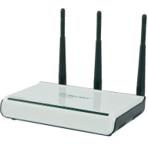

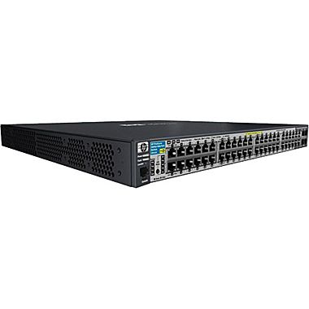
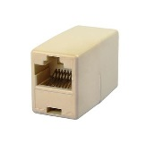


Unified Wired/Wireless Access Project
AAA Server
802.1X authenticator
Access Device Mgmt
CAPWAP
Device/users information collector
Policy rules
Fast Secure Handoff
802.11r
Rogue detection, etc…
Wireless User
SDN Applications
Unified Access NBI Convergence and Services
Wired User
SDN
Controller
VPN
Remote User
Requirements:
Ability to enforce consistent network access policy based on user/device authentication.
Ability to maintain network policy and meet application requirements in the present of user/device roaming.
Address needs for resilient network access in the presence of network infrastructure failure.
Provide fine grain monitoring for troubleshooting and rogue access device detection.

Slide 15
Application Priority Focus
Unified Access Control
  Enable IEEE 802.1X authenticator with OpenFlow policy enforcement
  Understand OpenFlow policy enforcement in IETF NEA and Trusted Computing TNC architectures
Large Scale Access Management
  OpenFlow enabled data path in CAPWAP environments
  OpenFlow agent and CAPWAP AP resident real-time function interaction
  CAPWAP device configuration and user session management operations
Other applications…

Slide 16
Example OpenFlow Implications
Unified IEEE 802.1X Authenticator
Scenario:
OpenFlow is used to capture/inject 802.1X/EAPOL messages
Application on controller performs 802.1X Authenticator/Radius Client functions
Resulting authorization causes controller to deploy user specific rules
Encryption key material must be installed in the access device (802.11i, MACSec)
Potential ONF Standardization Needs:
OpenFlow message extensions for key material distribution.
NOTE: ONF Security WG has similar need for IPSec key distribution.
Radius
Server
Unified Network Access Control
RADIUS
(UDP 1812/1813)
EAPOL
(802.1X)
Wireless User
OpenFlow Applications
OpenFlow
(TCP 6633/6634)
OpenFlow
Controller
=
OpenFlow Agent
EAPOL
(802.1X)
New Key Material Distribution
Wired User
=
802.1X Authenticator
Radius Client

Slide 17
Example OpenFlow Implications
Large Scale Access Management
Scenario:
Access device supports real-time functions locally
OpenFlow agent rules enable distributed device data path
Access device management provisions and monitors resources (RF channel assignment)
Potential ONF Standardization Needs:
OpenFlow action support for real-time functions (rate adaption, beam forming, learning)
Define WiFi port properties and unique 802.11 frame match fields for OpenFlow
OF-Config support for deploying WiFi configuration
Real-time
functions
Data path
management
Unified Access Device Mgmt
Unified Network Access Control
Wireless User
OF-Config
OpenFlow
Controller
Real-time
functions
Wired User
=
OpenFlow Agent
Real-time
functions
Wireless User

Slide 18
2015 Goals for WMWG
1Q 2015 Goals
  For each Project Team, complete Ref Architecture and OpenFlow Study. Update with progress at next Member Workday. complete Information Model.
  These documents will contain illustrative architectures, information models, determination of architectural or OpenFlow family protocol specific issues and suggestions for OpenFlow family extensions or enhancements.
  Start new project in Enterprise for UAPC
2Q-4Q 2015 Goals
  Focus on deployment issues. Proof of Concept demonstrations. Open Source
  Explore interactions with other groups.
  Move towards PoC
  Show implementation feasibility for OpenFlow family extensions or enhancements to ONF.

Slide 19
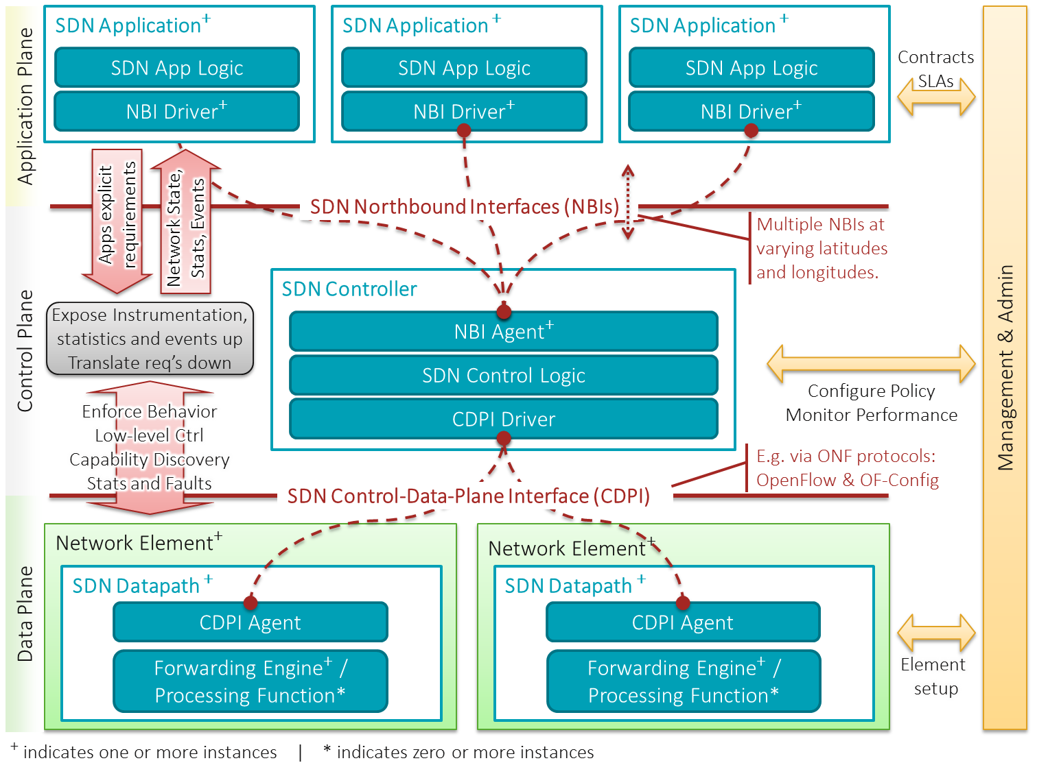
SDN Architecture Overview

Slide 20





Unified Policies for BYOD:
Authentication and Authorization
Who
PC users
Users with company's standard Pads
BYOD users
Policy
Access all resources in the Intranet
Access those services configured for use on pads via a mobile VPN
Access Intranet resources from mobile devices via a VPN
Unified Policy Platform
Where
In the company
Outside the company
In the company
Outside the company
In the company
Outside the company
How
LAN
WLAN
VPN
WLAN
VPN
WLAN
VPN
What
All company apps
VPN-PC allowed apps
Most company apps
VPN-PAD allowed apps
Restricted company apps
VPN-BYOD allowed apps

Slide 21












User Groups for Access Control
A user-group based policy decouples the users from IP subnets/ addresses/ VLANs so that unified policy enforcement can be performed dynamically.
Guest
Common BYOD user
Authentication domain
Demilitarized zone (DMZ)
Partner
User at non-office hours
General service
Common service
Limited service
Important service
Core service
Insecure user
Executive
Unauthorized user
User using an unregistered device
User at office hours
Anyone: Roles - managers, employees, partners, visitors, etc.
Any device: Terminals - PCs, mobile phones, dumb terminals, etc.
Anywhere: Network location - company Intranet, Extranet, etc.
Anytime: Time perception - time to start and finish work
Anything: Applications – common, limited, etc.

Slide 22
Unified Policies for BYOD:
Implementation
Definition
Synchronization
The Controller synchronizes user groups and policies to network devices manually, or automatically at regular intervals.
Defines user groups, as well as security, bandwidth, and traffic flow direction control policies on the Controller.
Execution
Identification
After a user is authenticated, the Controller identifies the user’s group based on the user identity, device, and location information.
The execution point identifies the source and destination user groups of service packets and executes corresponding service policies.

Slide 23
Key Take Aways
ONF WMWG is working quickly towards improvements to SDN for wireless environments
Current focus is on a reference architecture, information model, and proof of concept for each use case project
New project teams can be considered as long as there are warm bodies to work on them.

