Slide 1
Privacy Engineered Access Network
Date: 2015-03-09
Authors:
Name | Affiliation | Phone | Email
Max Riegel | Nokia Networks | +49 173 293 8240 | maximilian.riegel@nokia.com
Notice: This document does not represent the agreed view of the IEEE 802.1 OmniRAN TG. It represents only the views of the participants listed in the ‘Authors:’ field above. It is offered as a basis for discussion. It is not binding on the contributor, who reserve the right to add, amend or withdraw material contained herein.
Copyright policy: The contributor is familiar with the IEEE-SA Copyright Policy <http://standards.ieee.org/IPR/copyrightpolicy.html>.
Patent policy: The contributor is familiar with the IEEE-SA Patent Policy and Procedures: <http://standards.ieee.org/guides/bylaws/sect6-7.html#6> and <http://standards.ieee.org/guides/opman/sect6.html#6.3>.
Abstract
The slide set provides some very initial thoughts about how privacy aspects may be reflected in the P802.1CF specification.
- Slightly amended version for presentation to experts outside OmniRAN

Slide 2
Privacy Engineered Access Network
2015-03-09
Max Riegel
(Nokia Networks)

Slide 3
Prolog
Privacy is a huge topic with many aspects and dimensions.
This presentation intends to introduce a method and process to deal with privacy in P802.1CF on IEEE 802 access network
The proposal is derived from generic approaches and concepts proposed and published roughly during the past 5 years.
Please regard this presenation as a starting point for further discussions.
  It is definitely not conclusive yet!

Slide 4
References
The Privacy Engineer’s Manifesto - Getting from Policy to Code to QA to Value (Michelle Finneran Dennedy Jonathan Fox Thomas R. Finneran; ApressOpen)
  http://www.apress.com/9781430263555
Privacy Engineering Framework (MITRE Privacy Community of Practice (CoP) July 18, 2014)
  http://www.mitre.org/publications/technical-papers/privacy-engineering-framework
Engineering Privacy (Sarah Spiekermann, Lorrie Faith Cranor; IEEE Transactions on Software Engineering, Vol. 35, No. 1, Jan/Feb 2009)
  http://ssrn.com/abstract=1085333

Slide 5
Privacy
Some common definitions:
Merriam-Webster’s Dictionary:
  1a: the quality or state of being apart from company or observation: seclusion
  1b: freedom from unauthorized intrusion one’s right to privacy
  2. archaic: a place of seclusion
  3a: secrecy
  3b: a private matter: secret
According to Yael Onn et al., Privacy in the Digital Environment. Haifa Center of Law & Technology, 2005:
  “The right to privacy is our right to keep a domain around us, which includes all those things that are part of us, such as our body, home, thoughts, feelings, secrets, and identity. The right to privacy gives us the ability to choose which parts in this domain can be accessed by others, and to control the extent, manner, and timing of the use of those parts we choose to disclose.”

Slide 6
Privacy
IMHO, a more useful definition
Taken from: The Privacy Engineer’s Manifesto - Getting from Policy to Code to QA to Value (Michelle Finneran Dennedy Jonathan Fox Thomas R. Finneran; ApressOpen)

Slide 7
PII
Personally Identifiable Information
Privacy:
  “The fair and authorized “processing” of Personally Identifiable Information (PII)
Personally Identifiable Information
  Formally: Any data that identifies an individual or from which identity or contact information of an individual can be derived
  Practically: Includes otherwise non-personal information when associated or combined with personal information

Slide 8
Privacy by Design (PbD)
Based on the assumption that privacy cannot be assured only by compliance with regulatory frameworks
Privacy assurance must be included into the organization and mode of operation of a system
Adequate privacy requires thoughtful integration with every layer of an organization, including:
  Organization policies and governance;
  Business processes;
  Standard operating procedures;
  System and network architectures;
  IT system design and development practices;
  Management of data sources.

Slide 9
PbD Foundational Principles
Proactive not Reactive; Preventative not Remedial
  Anticipate issues; prevent problems before they arise
Privacy as the Default Setting
  Personal data protected from inception; individuals need not act to protect data
Privacy Embedded into Design
  Privacy protections are core, organic functions; not bolted on after the fact
Full functionality—Positive-sum, not Zero-sum
  Privacy enhances, not degrades, security and functionality
End-to-End Security—Full Lifecycle Protection
  Security applied to each data lifecycle stage, from creation to archiving or deletion
Visibility and Transparency—Keep it Open
  Individuals understand data use; privacy practices audited
Respect for User Privacy—Keep it User-Centric
  Organizational imperative = privacy is about personal control and free choice

Slide 10
Privacy Engineering
A systematic, risk-driven process that operationalizes the Privacy by Design philosophical framework within IT systems by
  Segmenting PbD into activities aligned with those of the systems engineering life cycle (SELC) and supported by particular methods that account for privacy’s distinctive characteristics
  Defining and implementing requirements for addressing privacy risks within the SELC using architectural, technical point, and policy controls
Privacy requirements must be defined in terms of implementable system functionality and properties
Privacy risks are identified and adequately addressed
  Supporting deployed systems by aligning system usage and enhancement with a broader privacy program
  The goal is to integrate privacy into the existing system testing process; it is not meant to be a separate new process

Slide 11
Privacy Enabling Technologies
Encryption
Digital rights management
Privacy rules within application programs
Identity management
Data anonymization
…?

Slide 12
Now, where is the meat for OmniRAN?
Three dimensions:
  Fair information principles
  Information processing
  Personal Identificable Information
OmniRAN deals with an informational model of the IEEE 802 access network
  The sample chapter structure for Functional Design and Decomposition exposes sections on PII

Slide 13
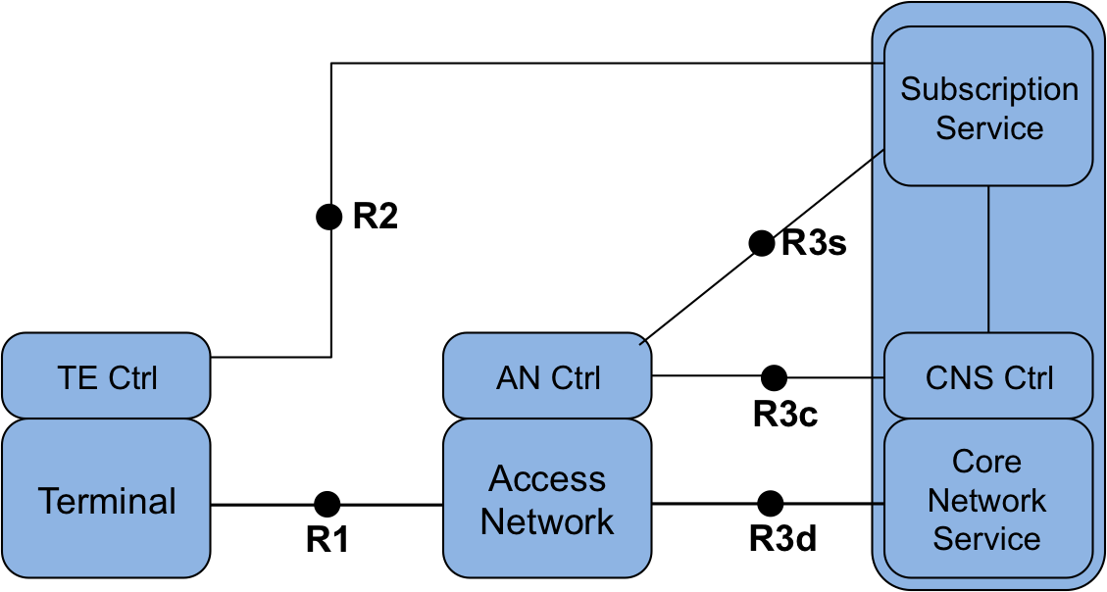
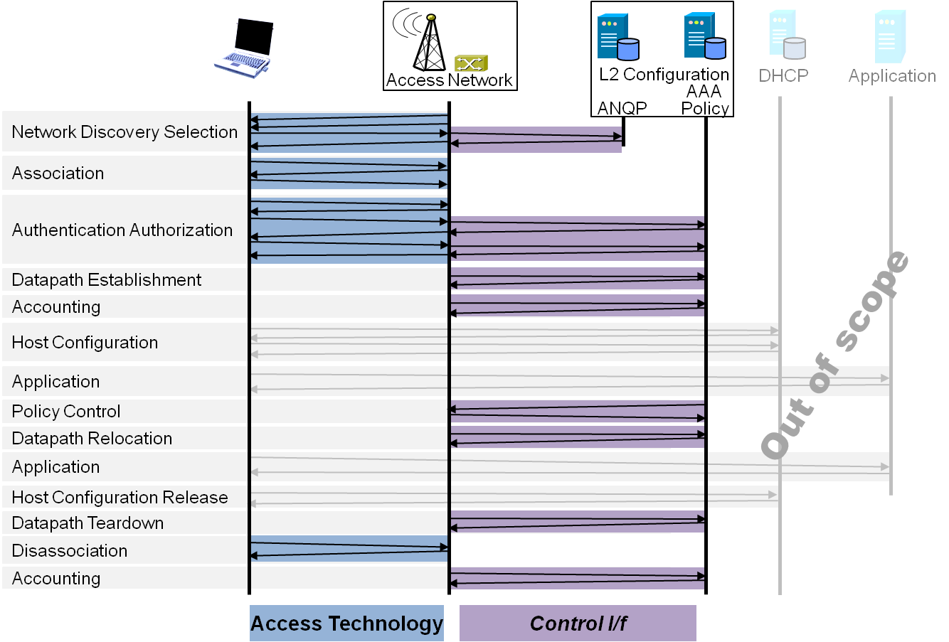
P802.1CF Draft ToC
Introduction and Scope
Abbreviations, Acronyms, Definitions, and Conventions
References
Identifiers
Network Reference Model
  Overview
  Reference Points
  Access Network Control Architecture
    Multiple deployment scenarios including backhaul
Functional Design and Decomposition
  Dynamic Spectrum Access
  Network Discovery and Selection
  Association and Disassociaiton
  Authentication and Trust Establishment
  Datapath establishment,
  relocation and teardown
  Authorization, QoS and policy control
  Accounting and monitoring
SDN Abstraction
  Terminal
  Access Network
Annex:
  Tenets (Informative)

Slide 14
Chapter ToC Template for
Functional Design and Decomposition
Introduction
Terminology
Roles and identifiers
Use cases
Functional requirements
Function specific attributes
Function details and message flows
Mapping to IEEE 802 technologies

Slide 15


Privacy issues can happen anywhere
End-to-end network topology
Subscription
Service
Information
Service
Terminal
Access Network
Backhaul
Core Network
Scope of P802.1CF in the protocol layer architecture
Application
Application
Transport
Transport
Network
Network
Network
Network
Data Link
DL
DL
DL
DL
DL
DL
Data Link
Data Link
Data Link
Physical
Phy
Phy
Phy
Phy
Phy
Phy
Physical
Physical
Physical
Medium
Medium
Medium
Medium
Medium
Terminal
Interface
Node of
Attachment
Backhaul
Core Network
Interface
Scope of P802.1CF
Schematic NRM for the IEEE 802 access network
Subscription
Service
Terminal
R2
R4
Access Network
Core Network
R1
R3

Slide 16
Roles and Identifiers from omniran-14-0065-02-CF00-key-concepts-of-nds
User
  One or more Subscriptions
    Subscription Identifier {NAI} + Subscription Name {String}
Terminal
  Station
    STA {EUI-48}
Access Network
  One or more Points of Attachment
    PoA {EUI-48}
  Access Network Identifier
    ANID {EUI-48} + AN Name {String}
  Supportive Information
Subscription Service Provider
  ‘Termination point of AAA’
    SSP Identifier {FQDN} + SSP Name {String}
  Supportive Information
Core Network Service
  ‘Network side IEEE 802 Link Layer SAP’
    CNS Identifier {???} + CNS Name {String}
  Supportive Information

Slide 17
Supportive information from omniran-14-0065-02-CF00-key-concepts-of-nds
Access Network
  Supported Subscription Service Providers
  Supported Core Network Services
  AN certificate
  Access Network Capabilities
    Link Layer capabilities
      E.g. MTU, encryption, shared/ptp-link
    Link Layer performance
      E.g. supported service classes (Throughput up/down, delay, jitter)
Subscription Service Provider
  List of supported Core Network Services
  SP certificate
Core Network Service
  Network Layer Capabilities
    E.g. IP version, configuration, multi-protocol support, service discovery support
  Network Interface performance
    E.g. supported service classes (throughput up/down, delay, jitter)
  Offered application services
    E.g. Internet, Voice, Printer, File service,

Slide 18
Roles and Identifiers from omniran-15-0002-01-CF00-key-concepts-of-data-path
Terminal
  Terminal Interface
    TE {EUI-48}
    R1-Interface ID
Access Network
    Access Network Identifier: ANID {EUI-48} + AN Name {String}
  Node of Attachment
    NA {EUI-48}
    R1-Interface ID
    R6d-Interface ID
    Supportive Information
  Backhaul
    BH-ID
    R6d-Interface ID
    R3d-Interface ID
    Supportive Information
Core Network Service
    CNS ID: CNS Identifier {???} + CNS Name {String}
    R3d-Interface ID
    Supportive Information
Subscription Service
  ‘AAA and policy control’
    SS Identifier {FQDN} + SSP Name {String}
    Supportive Information

Slide 19
So, what to do in OmniRAN?
OmniRAN describes information elements, which may belong to PII.
At least, OmniRAN may provide some indication for the information elements, which
  Definitely represents PII,
  May be sensitive regards PII.
Such classification may be added in an informative annex.

Slide 20
Discussion?
Thank you.

