Slide 1
SDN & NFV
omniran-14-0079-00-CF00
Author: Hesham ElBakoury; Yuanlong Jiang, Ruobin Zheng
Version: 1.0

Slide 2
AGENDA
SDN Architecture
  SDNv2 (SDN Fabric).
Network Function Virtualization (NFV)
  Architecture
  MANO
  Service Chaining
  Value Proposition
SDN & NFV combined together
  Value Proposition
  SDO
ETSI MANO & SDN Integration

Slide 3
Software Defined Network

Slide 4
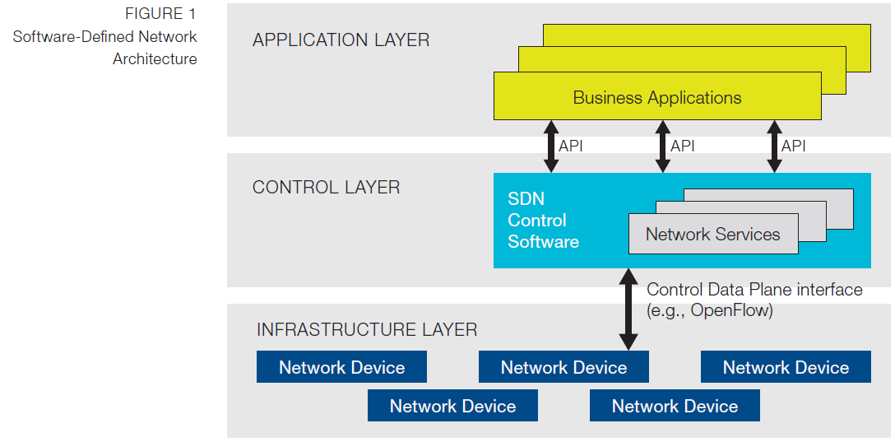
Software Defined Network Architecture
SDN is an architectural concept that encompasses the programmability of multiple network layers -- including management, network services, control, forwarding and transport planes -- to optimize the use of network resources, promote interoperability across suppliers and network layers, increase network agility, unleash service innovation, accelerate service time-to-market, extract business intelligence and ultimately enable dynamic, service-driven virtual networks [Heavy Reading]
The goal of Software Defined network is to allow Applications to tailor network behavior to suit their needs.
Network device uses openflow agent to communicate with openflow controller
*ONF White Paper: Software-Defined Networking: The New Norm for Networks

Slide 5


Centralized vs Distributed Control
Centralized Control
Distributed Control
Controller
Controller
OpenFlow
Switch
OpenFlow
Switch
Controller
OpenFlow
Switch
OpenFlow
Switch
Controller
OpenFlow
Switch
OpenFlow
Switch

Slide 6
Orchestration of Distributed Control in SDN
Network
Applications
OpenStack*
Orchestrator
Controller
Controller
Node
Node
Node
Node
Node
Node
Top of Rack Switch
Network
Appliances
Media
Gateways
BNG
EPC
C-RAN

Slide 7
High Level Architecture with SDN Fabric
NBI
Network fabric is a collection of forwarding elements whose primary purpose is packet transport
Address Translation
  Translate edge addresses to fabric internal addresses (e.g. MPLS labels) and vice versa.
Encapsulation
  Encapsulate packets with another header that carries the fabric addresses.
This approach would require edge version of openflow and a core version of openflow.
  The Fabric and Edge are controlled by (logically) separate controllers.
  Edge provides more rich services such as security and mobility.
Business Applications
Management Applications
Network Virtualization & VNF
Fabric Controller
Edge Controller
Fabric
Src
Host
Ingress
(Ingress Switch)
Egress
(Edge Switch)
Dst
Host
SDN Fabric is Proposed by Martin Casado et al.

Slide 8
Network Functions Virtualization

Slide 9
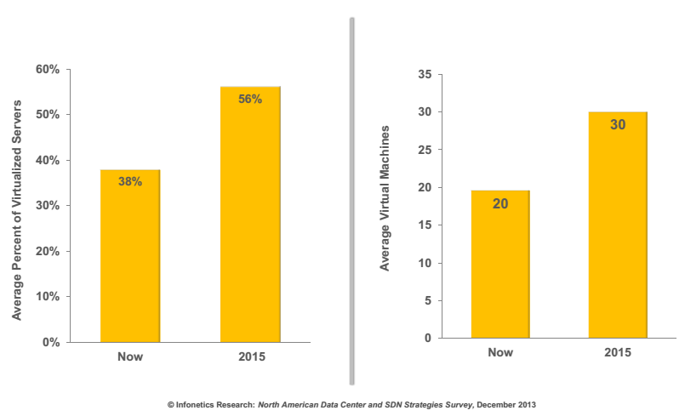
Server Virtualization Is Unstoppable

Slide 10
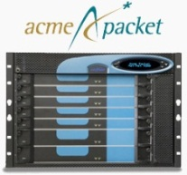







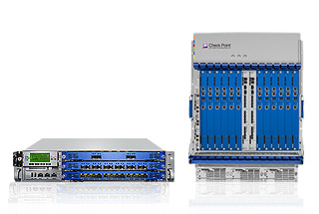
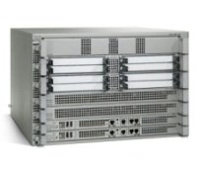
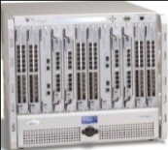



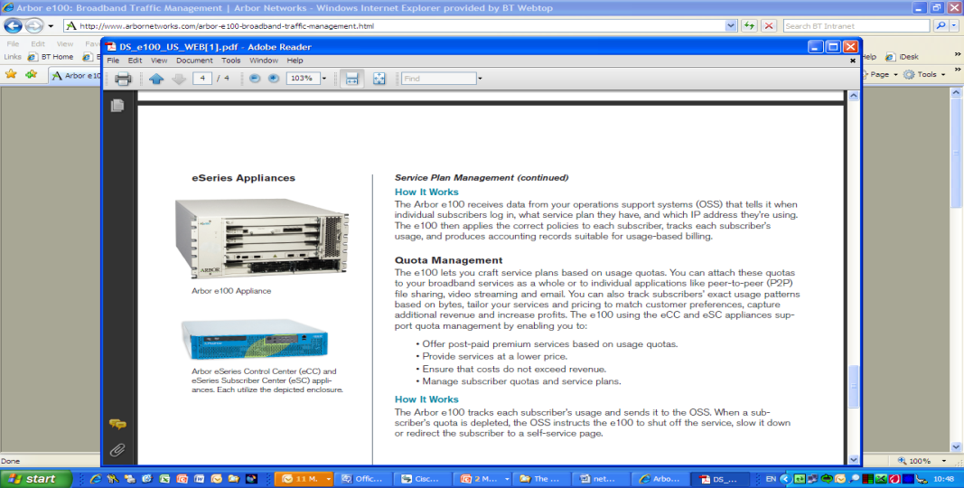

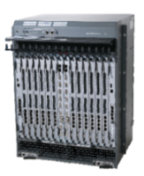
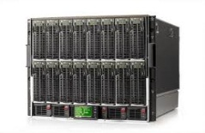
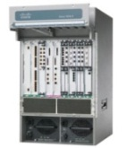
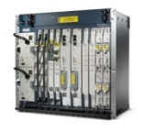
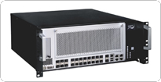

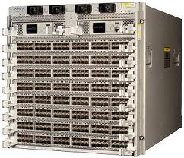
Network Functions Virtualization: Vision
Classical Network Appliance Approach
Network Functions Virtualization Approach
Independent
Software Vendors
Message
Router
CDN
Session Border
Controller
WAN
Acceleration
Competitive &
Innovative
Open Ecosystem
DPI
Firewall
Carrier
Grade NAT
Tester/QoE
monitor
Orchestrated,
automatic & remote install.
High volume standard servers
SGSN/GGSN
PE Router
BRAS
Radio/Fixed Access
Network Nodes
High volume standard storage
Fragmented, purpose-built hardware.
Physical install per appliance per site.
Hardware development large barrier to entry for new vendors, constraining innovation & competition.
High volume Ethernet switches

Slide 11
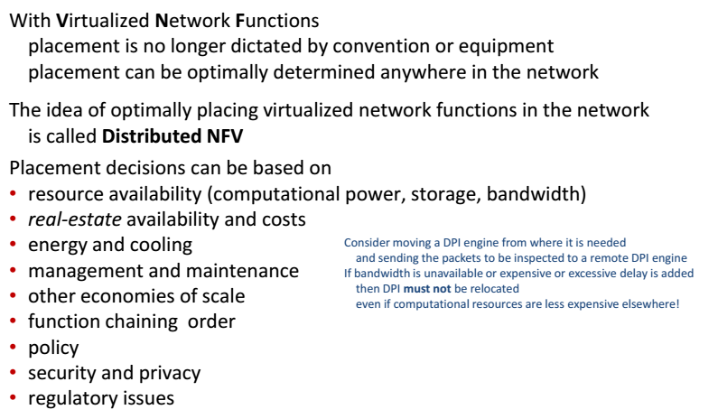
Distributed NFV (*)
(*) D-NFV is an idea that has been promoted by RAD.

Slide 12
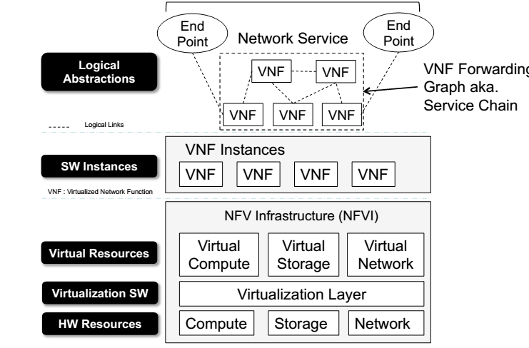
Network Function Virtualization Components

Slide 13




CPE Virtualization
BW on Demand
Service Level Agreements
Parental controls
Subscriber VM
firewall
Mobile
API
routing
Mobile
Tablet
provisioning
Open
Stack
Tablet
Cable Modem
Neutron
PC
SDN
STB – Linear & DVR
PC
Open
Daylight
Subscriber Home
Cloud

Slide 14
vCPE Value Proposition
Better service delivery (faster, cheaper, and easier)
  Less equipment to deploy on end-user’s premises, save on build out, power, cooling, wiring, and installation
  Faster service response
    Faster add, move, changes, deletes, and troubleshooting response.
  Simplifies Provisioning and service upgrades (e.g. faster Introduction of new Media services)
  Flexible Multiscreen support ; Unified UI on every screen
Policies tied to the user, not the device
  Same access, at home or on the road
Reduction of OPEX and CAPEX
  Eliminate the expensive STB costs.
  Less Call Center costs, Less Truck rolls
  Lower the costs to support multiple heterogeneous boxes
Significant OPEX/CAPEX reduction potential and flexible service innovation

Slide 15
CCAP Virtualization
Access Interfaces
Packet Processing
Routing
DOCSIS Encapsulation
PON
IP Provisioning
Channel Prov.
QAM D/S
CM
Subscriber Mgmt
Virtualization Candidates
Service Flow Mgmt
Encryption
Rate Limiting
DOCSIS U/S
Reporting/OSS
L2VPN
Scheduler
MPLS
EQAM
CCAP Architecture

Slide 16
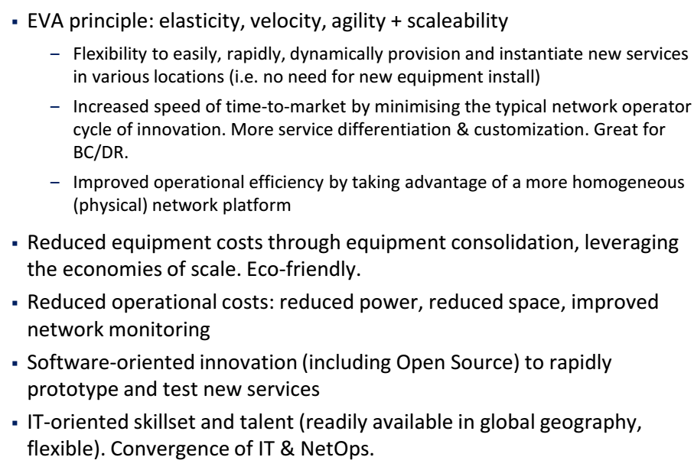
NFV Value Proposition

Slide 17
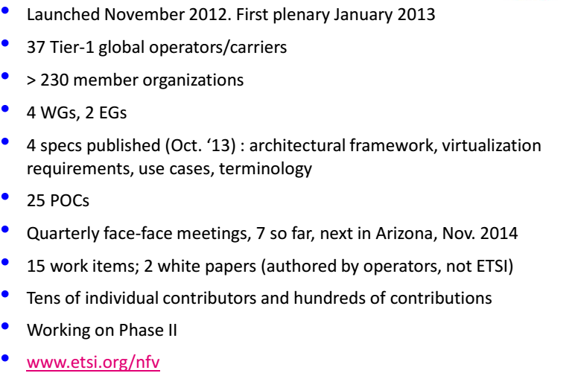
ETSI NFV ISG

Slide 18
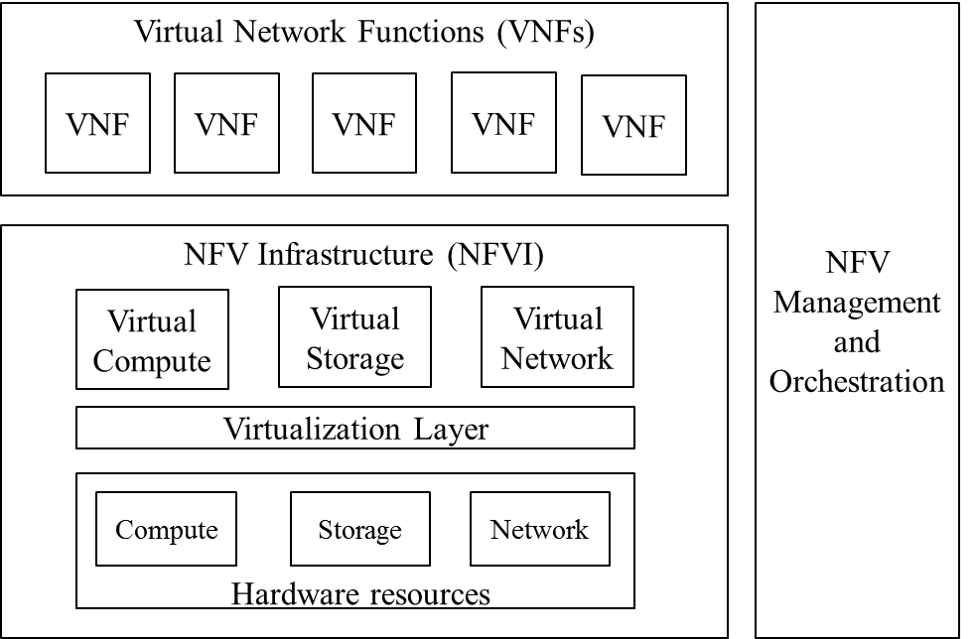
ETSI High-level NFV Framework
MANO

Slide 19
MANO Functional Blocks
The NFV Orchestrator is the single point of access for all requests from the OSS/APP to simplify the interfacing.
The NFV Orchestrator handles lifecycles of Network Service and VNF Forwarding Graph.
The VNF Manager handles VNF lifecycle from an application point of view.
The NFV Orchestrator has the end-to-end view of the resources being allocated across Network Services and VNFs by VNF Managers: all requests for resource allocation transit through, or are verified and granted by the NFV Orchestrator
The Virtualised Infrastructure Manager (VIM) is responsible for controlling and managing the NFVI compute, storage and network resources, usually within one operator’s Infrastructure Domain.

Slide 20
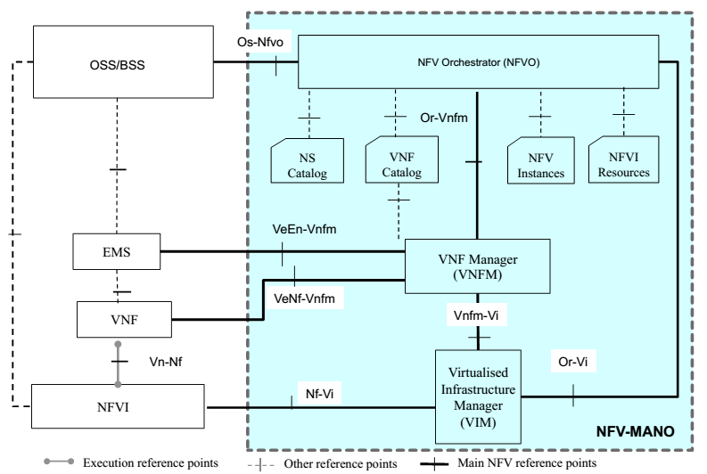
The NFV-MANO Architectural Framework with Reference Points
GS NFV-MAN 001 V0.7.0 (2014-10)

Slide 21
Service Chaining Requirements
Any order of Service Functions in a Service Chain must be possible;
Service function paths must be decoupled from their physical network connectivity
  That is, insertion/deletion of a service function or a change of Service Function Path does not necessitate a restructuring of the underlay network connectivity
A Service Function may be crossed by a Service Chain for multiple times
Processing of multiple subscriber service flows or Service Chains must be supported on a single Service Function.
Service Chaining should be flexible (more details in the next slide).
Service chaining should be bandwidth efficient

Slide 22
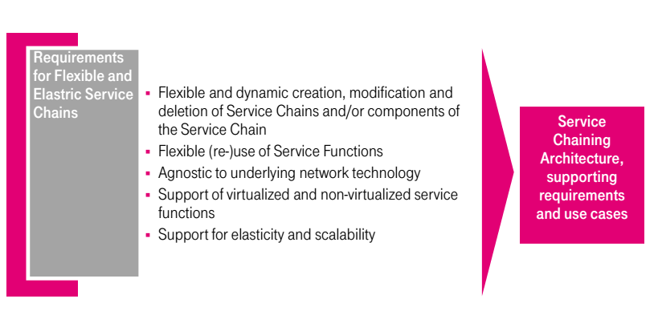
Flexible Service Chaining

Slide 23
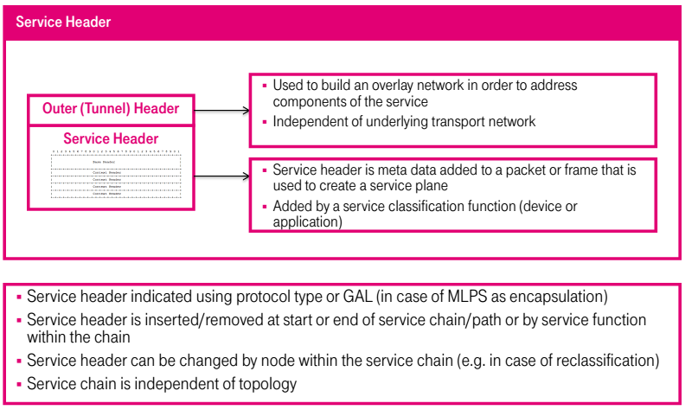
Service Chaining Using Service Header

Slide 24
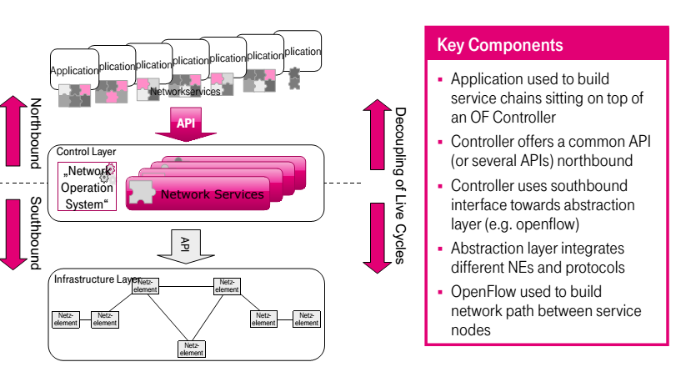
Openflow-Based Service Chaining

Slide 25
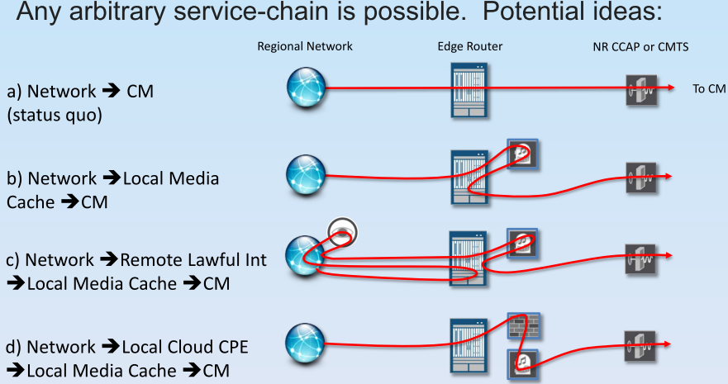
Service Chaining Use Cases for Cable

Slide 26
Service Chaining Examples
Service composition & insertion
vFW
vLB
vDPI
vCDN
vADC
vSwitch
SDN
Controller
physical
switch
vDPI
vCDN
Programmable service chains
Policies determine the chain order: customized chains!
Notes:
FB: on their Wedge switch: their requirements are on a 3-month cycle, hard to keep up with existing h/w. FB/Google/AMZN can afford to design their own h/w, but not everyone else can
Customized chains: can be app/user/network tailored

Slide 27
SDN & NFV

Slide 28
SDN
Abstraction of the control plane from the data plane
NFV
Abstraction of network functions from (dedicated) hardware

Slide 29
SDN & NFV Progress
2012: NTT w NEC deploy 1st live SDN network
2013: Year of PoCs (Proof of Concept testing)
  Operators, vendors learn in the lab
2014: Vendors productize NFV/SDN software in operator Lab Trials and a few Field Trials
2015: Field trials move to commercial deployments
  Many operators deploy 1 or 2 use cases (contained domains)
2016: Wider spread commercial deployments
  Many operators deploy several use cases
2017: SDN and NFV are mainstream, but much left to do
© Infonetics Research 2013: “SDN and NFV Strategies: Global Service Provider Survey,” July, 2013
29

Slide 30
SDN & NFV SDO
Open Networking Foundation
  Standardize openflow.
  Several working groups such as architecture and framework, extensibility, forwarding abstractions, wireless & mobility, Northbound Interfaces
ETSI NFV Industry Specification Group.
  Main SDO for NFV standardization
IETF has different WG that are working on SDN &NFV related standards activities
  PCE, FORces, SPRIN, PCE, I2RS, SFC.
IETF SDNRG provides a forum for researchers to investigate key and interesting problems in the Software-Defined Networking field.
Q.14 of Study Group 13 is developing generic SDN framework for telecom carriers
  SDN-related discussion in NGN groups of SG11 and SG 15/Q12
Huawei has significant contributions and plays leadership roles in these SDO

Slide 31
SDO Applying SDN & NFV
OIF
  Transport SDN
BBF
  SDN Use Case for broadband access network
  Virtua Gateway
MEF (Metro Ethernet Forum)
  Define use cases (e.g. bandwidth on demand) that are applicable to Carrier Ethernet Services

Slide 32
Status of Cablelabs Virtualization Projects
V-CCAP
  The 1st release of the V-CCAP TR will be issued end of October.
  Huawei is very active and ahead of the game compared with other vendors.
vBCPE
  Identify CPE functions that can be virtiualized to support EPL service
  Huawei is involved in developing the solution architecture which uses opendaylight SDN controller.
vHomeNet
  This new project is driven by Jeff (Cox).
  The scope of the project is still under discussion with MSO
  Vendors will get involved by January next year
  Don Clarke is leading the project.
  The project draws on the results of vBCPE project.

Slide 33
SDN an NFV are Complementary Technologies
Neither is dependent on (or requires) the other; but functionality is complementary
NFV contributes virtualized infrastructure upon which SDN control plane software, L2 – L3 data plane software, or network services runs in.
Both use programmatic application interfaces (APIs) for (southbound) data plane control and (northbound) service provisioning.
Together enable orchestration, virtualization, and automation of network services

Slide 34
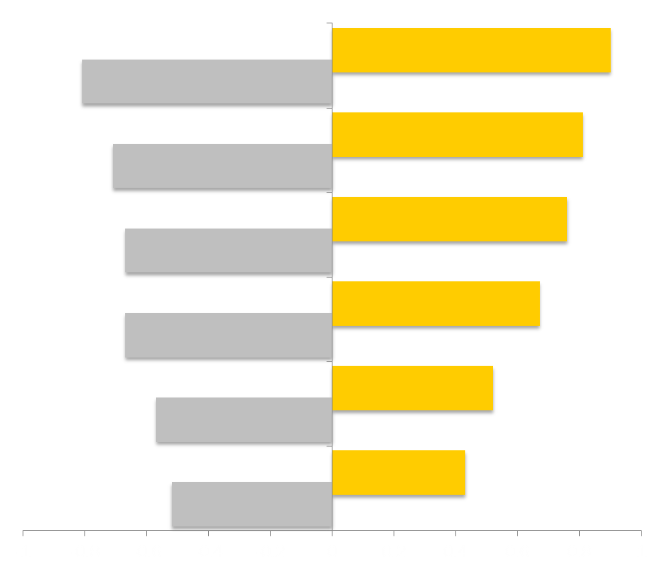
Drivers SDN and NFV: $$ Service Agility, Flexibility, Automation
© Infonetics Research: SDN and NFV Strategies: Global Service Provider Survey, July, 2013. (53% of world telecom capex)
NFV
SDN
Create new network services
quickly
Scale services up or down quickly
Optimize network configurations
in real-time
Reduce capex
through standard servers
Simplify multi-vendor network provisioning
and management (reduce OPEX)
Introduce new services quickly
Create new virtual networks quickly
Optimize network in real time
Create virtual networks across
multi-vendor gear
Multi-tenants on the same hardware
Use lower-cost routers
and switches
Reduce energy consumption
through standard servers
100%
0%
100%

Slide 35
NFV and SDN together can create greatest value
SDN can play a key role in the orchestration of the infrastructure (physical, virtual)
  Provisioning and configuration of VNFs
  Allocate and manage resources (e.g., bandwidth)
  VM mobility
  Automation & programmability
  Security & policy control
  Centralized network control. Unified control & management plane?
Service composition (NFV Forwarding Graphs)
  Directing traffic flows to VNFs
  Traffic flow characterization very important (especially for mobile, E2E scenarios)
Ad-hoc, on-demand, secure virtual tenant networks

Slide 36
SDN & NFV Value Proposition
Lack of service agility and length of time to implement new services and / or changes to the network have negative impact on costs and revenue.
  Ability to quickly introduce new revenue generating services to customers
  Ability for customers to order and instantly receive new services
Lack of visibility and instrumentation impact ability to grow network and manage OPEX costs
Reduce OPEX via automation of network management functions and dynamic control of network resources. and instantly receive new service
Notes:
We create innovations (with our members and vendors)
We do NOT create products, we occasionally provide services
The cable industries success comes from a leveraged R&D model
CableLabs, members and vendors agree on standards, specifications
Vendors build products based on the standards and specifications
Members deploy those products that enable products and services
CableLabs’ charter has been to:
Provide timely & evaluated information
Fund R&D projects
Facilitate transfer of relevant technology and best practices
Promote interoperability
To better address the Innovation Gap and Innovation Delay, CableLabs charter has been expanded to include:
Cultivate an innovation pipeline focused on future 5+ year planning horizon
Take educated risks

Slide 37



SDN+ NFV Value Proposition
Service Orchestration – Customized Delivery
  Automation / Accelerate Time to Revenue
Business Agility
Velocity
Scale
Operational Simplicity
SDN – Open and Programmable at All Layers
  Simplify / Reduce Complexity
NFV – Elastic Resource Capacity
  Reduce Total Costs Across All Services
Monetization

Slide 38
Strategic Networking Paradigms
Creates competitive supply of innovative applications by third parties
Software
Defined
Networking
Creates abstractions to enable faster innovation
Open
Innovation
Network
Functions
Virtualisation
Leads to agility, Reduces CAPEX, OPEX,
NFV and SDN are highly complementary, they are mutually beneficial but not dependent on each other.
Software is common denominator

Slide 39
MANO Network Controllers
The Network Controllers is an abstraction layer below the VIM for a given administrative domain.
When present, the controller provides intuitive programmatic interfaces for the VIM that enable the establishment of connectivity within the domain
An SDN controller could be a VNF or part of service orchestration (NFV’s MANO)
SDN Controller can be a Network Controller which provides control plane abstraction.

Slide 40
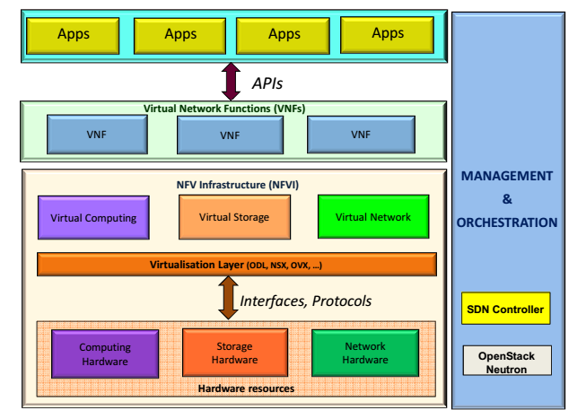
SDN-Based NFV
MANO
Openflow is used to build
The network path between
Service functions

Slide 41
ETSI Phase 2 New Work Item on SDN & NFV Integration
Software-Defined Networking (SDN) is mentioned in different ETSI NFV GSs (e.g. SWA001 Annex A). A number of POCs also combine NFV with SDN. This Work Item (WI) describes the usage of SDN within the context of the NFV architecture framework, including SDN Controller as a VNF, SDN Controller as a realization of the Infrastructure network controller, etc. , and specifies corresponding requirements to be fulfilled, e.g. by an SDN controller playing the role of network controller in the NFV architecture

Slide 42
Thank you
www.huawei.com

Slide 43
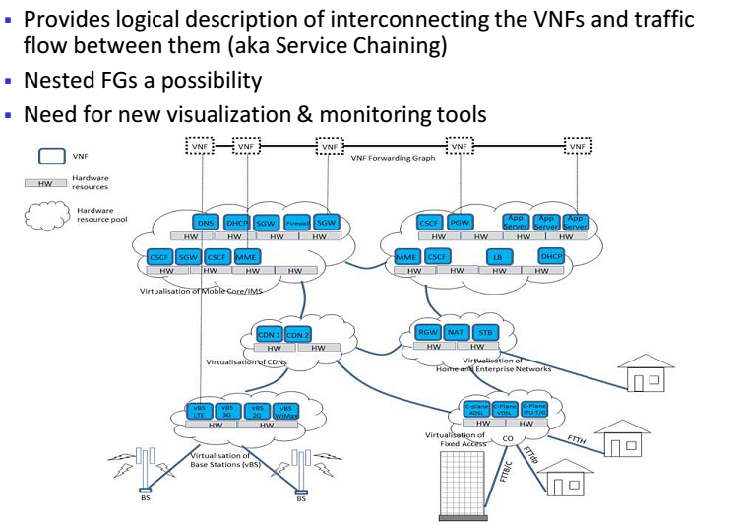
Virtual Network Functions Forwarding Graph

