Slide 1
IEEE 802.1 OmniRAN TG
Athens NRM Conclusions
2014-09-18
Max Riegel, Nokia Networks
(OmniRAN TG Chair)

Slide 2
P802.1CF Project Authorization Request
Project Title:
Network Reference Model and Functional Description of IEEE 802 Access Network
Scope:
This Recommended Practice specifies an access network, which connects terminals to their access routers, utilizing technologies based on the family of IEEE 802 Standards by providing an access network reference model, including entities and reference points along with behavioral and functional descriptions of communications among those entities.
Purpose:
Heterogeneous networks may include multiple network interfaces, multiple network access technologies, and multiple network subscriptions. In some cases such heterogeneous functionality must be supported in a single user terminal.
This Recommended Practice supports the design and deployment of access networks based on IEEE 802 technologies, guides the developers of extensions to the existing standards in support of a heterogeneous access network, and enables the use of IEEE 802 standards in new network deployments by specifying the functions of the IEEE 802 technologies when deployed in access networks.

Slide 3
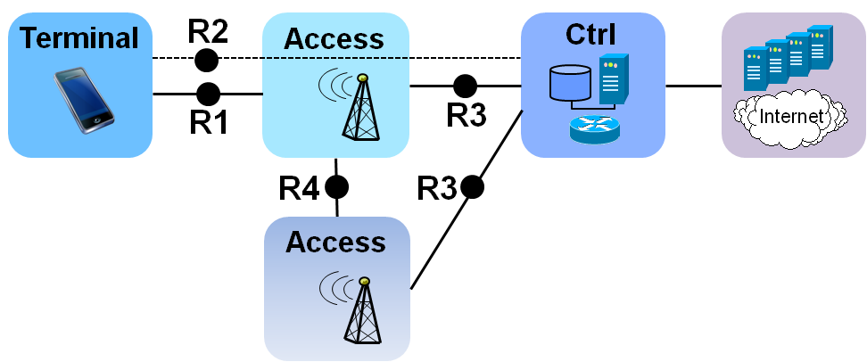
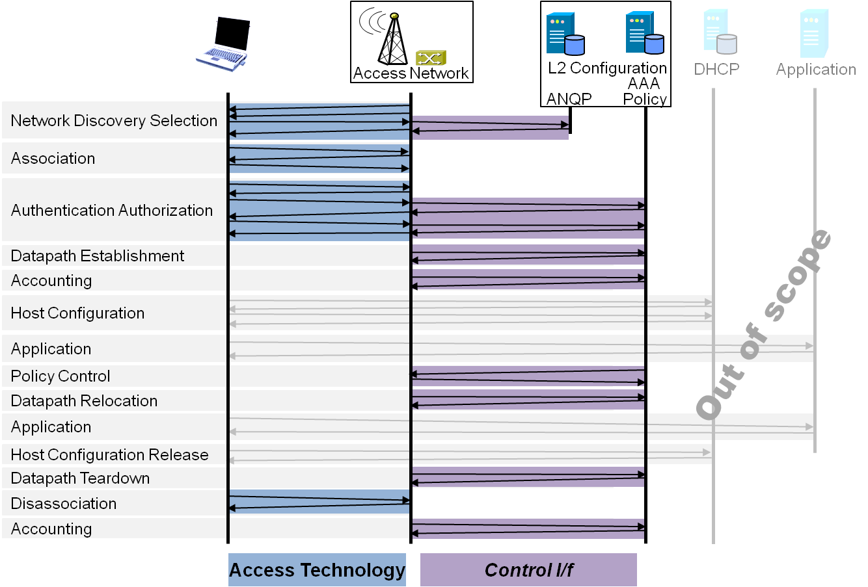
P802.1CF Draft ToC
Introduction and Scope
Abbreviations, Acronyms, Definitions, and Conventions
References
Identifiers
Network Reference Model
  Overview
  Reference Points
  Access Network Control Architecture
    Multiple deployment scenarios including backhaul
Functional Design and Decomposition
  Dynamic Spectrum Access
  Network Discovery and Selection
  Association and Disassociaiton
  Authentication and Trust Establishment
  Datapath establishment,
  relocation and teardown
  Authorization, QoS and policy control
  Accounting and monitoring
SDN Abstraction
  Terminal
  Access Network
Annex:
  Tenets (Informative)

Slide 4
Reference Point Definition
Entity
A
Entity
B
Entity
A
R#
Entity
B
R#
Function Aa
Protocol a
Function Ba
Function Ab
Protocol b
Function Bb
Function Ac
Protocol c
Function Bc
Function Ad
Protocol d
Function Bd
A Reference Point represents a set (one or more) of protocols terminating at peer functions at two entities.

Slide 5
Terminology
AN Access Network
SS Subscription Service
CNS Core Network Service
CIS Coordination and Information
Service
TE Terminal

Slide 6

OmniRAN P802.1CF entities mapped to the IEEE 802 Reference Model
Terminal
Coordination
Information
Service
Higher Layers
Subscription
Service
Higher Layers Control I/f
Higher Layers Control I/f
Core
Network
Service
Scope of IEEE 802
Data Link
Access Network
Data Link
Data Link
Data Link
Data Link
R3d
Data Link
Physical
R1
Physical
Physical
Physical
Physical
Physical
Medium
Medium
Medium
P802.1CF will define an abstraction of an access network based on IEEE 802 technologies
  The access network provides the link between a station (IP host) and the first hop router
The abstraction leads to very few generic interfaces for all kind of implementations
  R1 represents the PHY and MAC layer functions between terminal and base station, which are completely covered by the IEEE 802 specifications
  R2 represents a control interface between terminal and the subscription service, e.g. for authentication
  R3c represents a control interface between the access network and the subscription service
  R3d represents the IEEE 802 data path interface between access network and the first hop router of the Core Network Service
  Further functional entities can be exposed for particular deployment scenarios, e.g. a Coordination and Information Service for an access network deploying dynamically assigned spectrum resources.

Slide 7
Core Network Reference Model
Subscription
Service
R2
R3s
TE Ctrl
AN Ctrl
CNS Ctrl
R3c
Terminal
Access
Network
Core
Network
Service
R1
R3d

Slide 8
Network Reference Model with R8c
Subscription
Service
R2
R3s
TE Ctrl
AN Ctrl
CNS Ctrl
R8c
R3c
Terminal
Access
Network
Core
Network
Service
R1
R3d

Slide 9
NRM with R8c and CIS over R9c
Subscription
Service
Coordination and Information
Service
R2
R3s
R9c
TE Ctrl
AN Ctrl
CNS Ctrl
R8c
R3c
Terminal
Access
Network
Core
Network
Service
R1
R3d

