Slide 1
Key Concepts of Network Selection and Detection
Date: 2014-09-16
Authors:
Name | Affiliation | Phone | Email
Max Riegel | Nokia Networks | +49 173 293 8240 | maximilian.riegel@nsn.com
Notice: This document does not represent the agreed view of the IEEE 802.1 OmniRAN TG. It represents only the views of the participants listed in the ‘Authors:’ field above. It is offered as a basis for discussion. It is not binding on the contributor, who reserve the right to add, amend or withdraw material contained herein.
Copyright policy: The contributor is familiar with the IEEE-SA Copyright Policy <http://standards.ieee.org/IPR/copyrightpolicy.html>.
Patent policy: The contributor is familiar with the IEEE-SA Patent Policy and Procedures: <http://standards.ieee.org/guides/bylaws/sect6-7.html#6> and <http://standards.ieee.org/guides/opman/sect6.html#6.3>.
Abstract
The presentation provides a summary of the key concepts and identifiers for the specification of Network Detection and Selection. It is brought up to build concensus within OmniRAN TG on the topic to establish a foundation for creation of a text contribution to P802.1CF on NDS.

Slide 2
Key Concepts of
Network Discovery and Selection
Max Riegel
(Nokia Networks)

Slide 3
P802.1CF in the big picture of the Internet
Internet
Peer
(Client)
Peer
(Server)
Internet/Web Applications
WWW
WWW
HTTP
HTTP
TCP
TCP
IP
IP
IP
IP
IP
IP
IP
IP
LINK
LINK
LINK
LINK
LINK
LINK
LINK
LINK
LINK
LINK
LINK
LINK
PHY
PHY
PHY
PHY
PHY
PHY
PHY
PHY
PHY
PHY
PHY
PHY
P802.1CF Domain
Access
Router
UE

Slide 4
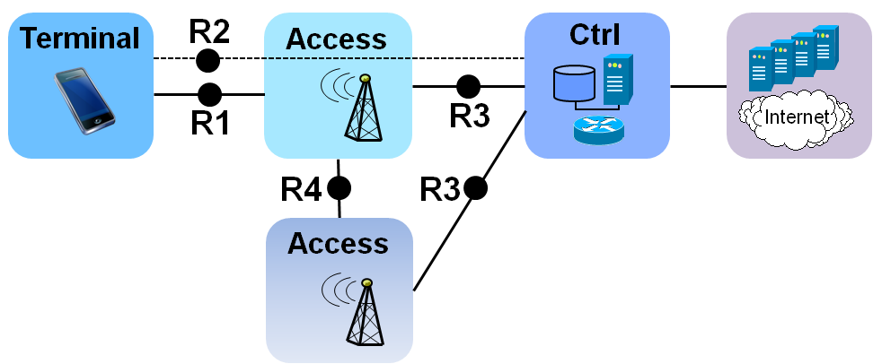
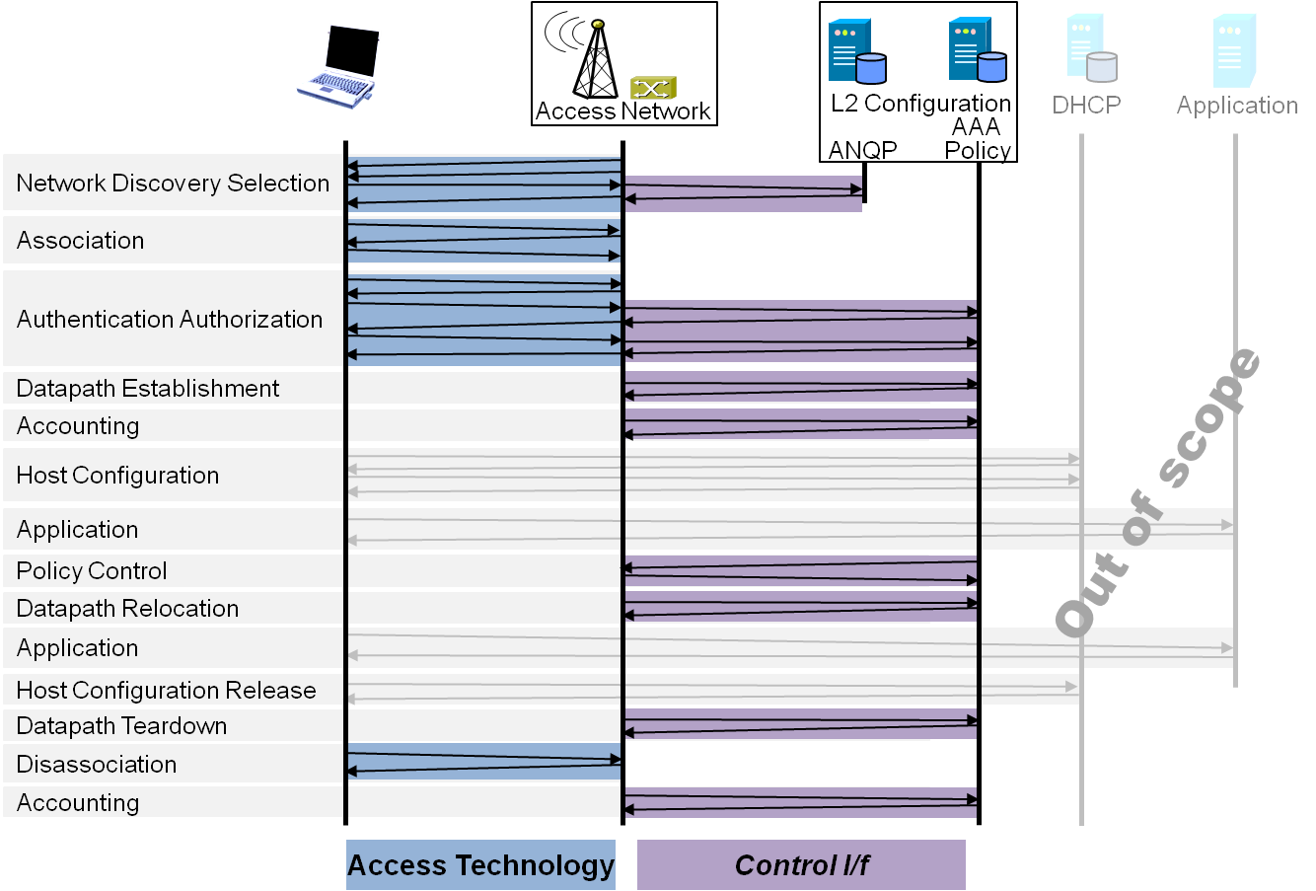
P802.1CF Draft ToC
Introduction and Scope
Abbreviations, Acronyms, Definitions, and Conventions
References
Identifiers
Network Reference Model
  Overview
  Reference Points
  Access Network Control Architecture
    Multiple deployment scenarios including backhaul
Functional Design and Decomposition
  Dynamic Spectrum Access
  Network Discovery and Selection
  Association and Disassociaiton
  Authentication and Trust Establishment
  Datapath establishment,
  relocation and teardown
  Authorization, QoS and policy control
  Accounting and monitoring
SDN Abstraction
  Terminal
  Access Network
Annex:
  Tenets (Informative)

Slide 5
NDS Chapter Structure
Functional Design and Decomposition
  Dynamic Spectrum Access
  Network Discovery and Selection
    Generic functional requirements and information flows
    Ethernet functional design <- 802.3
    WPAN functional design <- 802.15
    WLAN functional design <- 802.11
    WMAN functional design <- 802.16
    WRAN functional design <- 802.22
  Association and Disassociaiton
  Authentication and Trust Establishment
  Datapath establishment,
  relocation and teardown
  Authorization, QoS and policy control
  Accounting and monitoring

Slide 6
NDS Chapter Structure
Problem description
Acronyms
Roles and identifiers
Supportive information
Functions
Deployment
Mapping to IEEE 802 technologies
Add-ons in IEEE 802 technologies

Slide 7




Problem statement
NDS Functional Requirements
  Multiple access technologies
  Multiple different access networks
  Multiple subscriptions
  Specific service requirements
  No a-priori knowledge about offered services
Access Network
>1<
CORE
A
CORE
C
Access Network
>2<
CORE
B
Access
Network
>3<

Slide 8
Acronyms
AN Access Network
ANID Access Network Identity
ANIF Access Network Interface
NAI Network Access Identifier
SSP Subscription Service Provider
DSP Data Service Provider
EUI-48 48-bit Extended Unique Identifier

Slide 9
Roles and Identifiers
User
  One or more Subscriptions
    Subscription Identifier {NAI} + Subscription Name {String}
Terminal
  Station
    STA {EUI-48}
Access Network
  One or more Access Network Interfaces
    ANIF {EUI-48}
  Access Network
    ANID {EUI-48} + AN Name {String}
  Supportive Information
Subscription Service Provider
  ‘Termination point of AAA’
    SSP Identifier {FQDN} + SSP Name {String}
  Supportive Information
Data Service Provider
  ‘Termination point of IEEE 802 user plane’
    DSP Identifier {???} + DSP Name {String}
  Supportive Information

Slide 10
Supportive information
Access Network
  Supported Subscription Service Providers
  Supported Data Service Providers
  Trust certificate
  Access Network Capabilities
    Link Layer capabilities
      E.g. MTU, encryption, shared/ptp-link
    Link Layer performance
      E.g. supported service classes (Throughput up/down, delay, jitter)
Subscription Service Provider
  List of supported Data Service Providers
  Trust certificate
Data Service Provider
  Network Layer Capabilities
    E.g. IP version, configuration, multi-protocol support, service discovery support
  Network Interface performance
    E.g. supported service classes (throughput up/down, delay, jitter)
  Offered application services
    E.g. Internet, Voice, Printer, File service,

Slide 11
Functions
ANIF Discovery
  Active scanning
  Passive scanning
AN Detection
  Advertisement information retrieval
  Local data base query
  Remote data base query
SSP Detection
  Advertisement information retrieval
  Local data base query
  Remote data base query
DSP Detection
  Advertisement information retrieval
  Local data base query
  Remote data base query
Service Provider Selection
  Applying pre-configured priorities
  Applying dynamically provided policies (e.g. ANDSF)

Slide 12
Deployment
Initial AN access
  Session establishment
  AN access without any prior experience
    No cached information at all
AN re-entry
  Session establishment
  AN access with prior experience
    Some cached information about AN capabilities
ANIF transition
  Session continuation
  Association with another ANIF of the same AN
AN transition
  Session continuation
  Association with another AN

Slide 13
Mapping to IEEE 802 technologies
 |  | 802.3 | 802.11 | 802.15 | 802.16 | 802.22
Identifiers | STA | EUI-48 | EUI-48 | EUI-64 | EUI-48 | EUI-48
 | ANI | EUI-48 | EUI-48 | EUI-64 | EUI-48 | EUI-48
 | AN-id | ??? | EUI-48 | ??? | EUI-48 | EUI-48
 | AN-name | 256 Char | 30 Char | ???
Subscription Type |  | NAI | NAI/PSK | ???/PSK | NAI | NAI
Multiple SPs |  | Info | ANQP | - | ? | -
Discovery process |  | manual | passive, active | passive, active | passive | passive
NDS is initiated by IEEE 802 terminals
Is there any 802.15 i/f applicable to P802.1CF?

Slide 14
Add-ons in IEEE 802 technologies
Online subscription establishment
  E.g. Hotspot 2.0 ‘Online Sign Up’
Emergency services
Access Network Query Protocol
Pre-Association Discovery Protocol
Network triggered NDS
  E.g. Directed ANIF transition

Slide 15
Conclusion
The slides are presenting the logical structure and the essential content of the intented NDS section
Is there any other recommendation or hint for the section?

