Slide 1
Key Concepts of Network Selection and Detection
Date: 2014-09-15
Authors:
Name | Affiliation | Phone | Email
Max Riegel | Nokia Networks | +49 173 293 8240 | maximilian.riegel@nsn.com
Notice: This document does not represent the agreed view of the IEEE 802.1 OmniRAN TG. It represents only the views of the participants listed in the ‘Authors:’ field above. It is offered as a basis for discussion. It is not binding on the contributor, who reserve the right to add, amend or withdraw material contained herein.
Copyright policy: The contributor is familiar with the IEEE-SA Copyright Policy <http://standards.ieee.org/IPR/copyrightpolicy.html>.
Patent policy: The contributor is familiar with the IEEE-SA Patent Policy and Procedures: <http://standards.ieee.org/guides/bylaws/sect6-7.html#6> and <http://standards.ieee.org/guides/opman/sect6.html#6.3>.
Abstract
The presentation provides a summary of the key concepts and identifiers for the specification of Network Detection and Selection. It is brought up to build concensus within OmniRAN TG on the topic to establish a foundation for creation of a text contribution to P802.1CF on the topic.

Slide 2
Key Concepts of
Network Discovery and Selection
Max Riegel
(Nokia Networks)

Slide 3
P802.1CF in the big picture of the Internet
Internet
Peer
(Client)
Peer
(Server)
Internet/Web Applications
WWW
WWW
HTTP
HTTP
TCP
TCP
IP
IP
IP
IP
IP
IP
IP
IP
LINK
LINK
LINK
LINK
LINK
LINK
LINK
LINK
LINK
LINK
LINK
LINK
PHY
PHY
PHY
PHY
PHY
PHY
PHY
PHY
PHY
PHY
PHY
PHY
P802.1CF Domain
Access
Router
UE

Slide 4
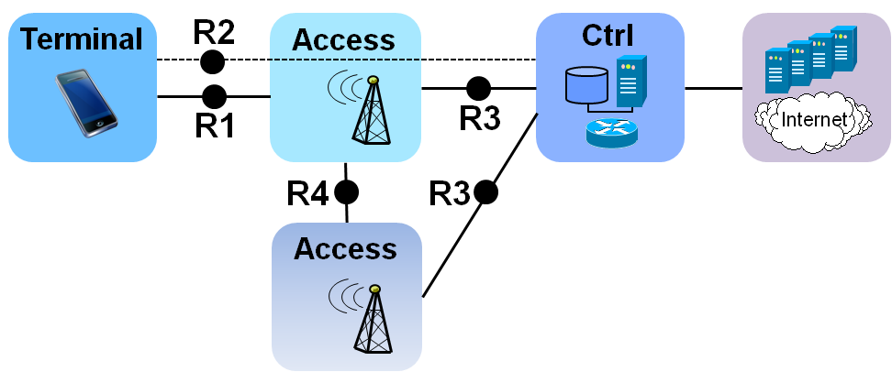
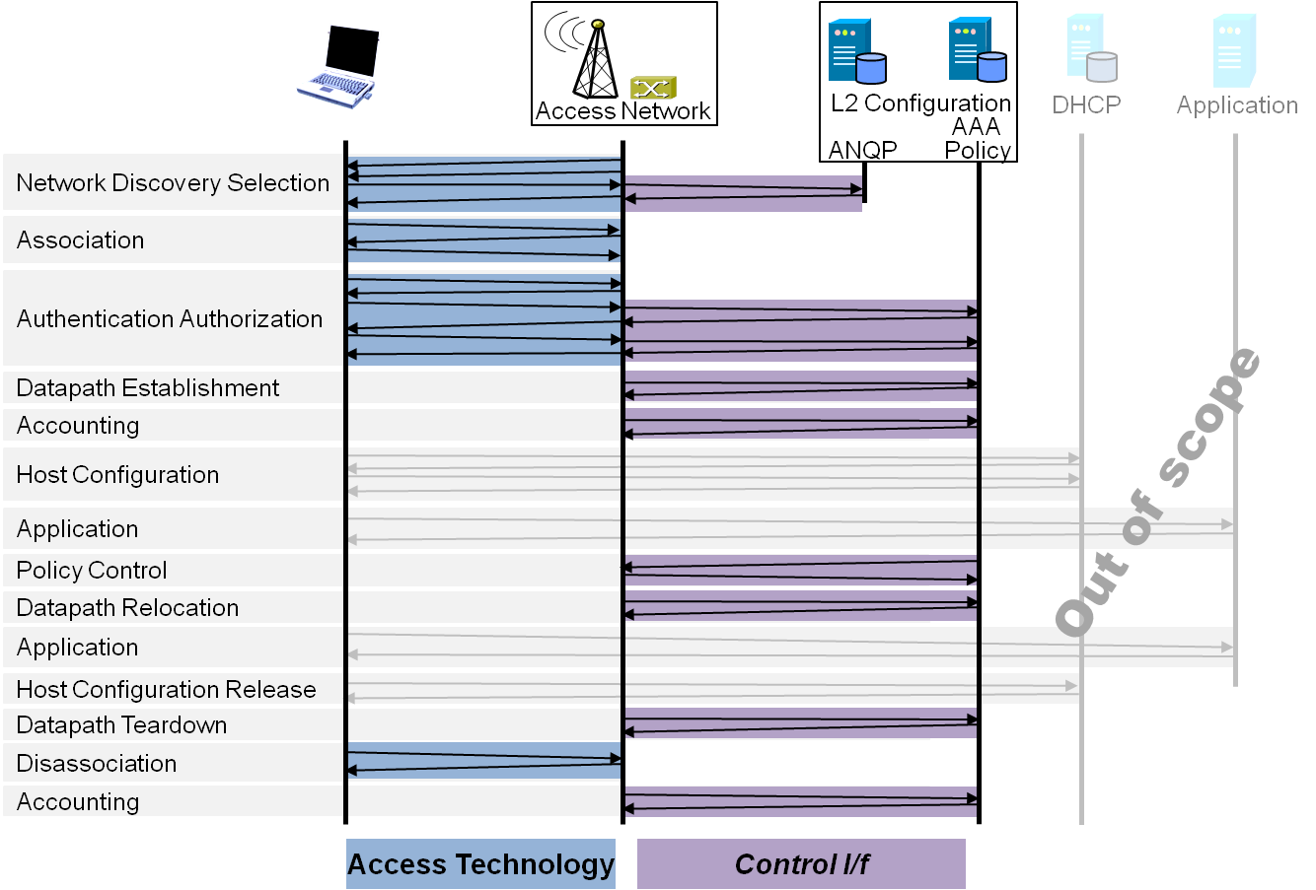
P802.1CF Draft ToC
Introduction and Scope
Abbreviations, Acronyms, Definitions, and Conventions
References
Identifiers
Network Reference Model
  Overview
  Reference Points
  Access Network Control Architecture
    Multiple deployment scenarios including backhaul
Functional Design and Decomposition
  Dynamic Spectrum Access
  Network Discovery and Selection
  Association and Disassociaiton
  Authentication and Trust Establishment
  Datapath establishment,
  relocation and teardown
  Authorization, QoS and policy control
  Accounting and monitoring
SDN Abstraction
  Terminal
  Access Network
Annex:
  Tenets (Informative)

Slide 5
NDS Chapter Structure
Functional Design and Decomposition
  Dynamic Spectrum Access
  Network Discovery and Selection
    Generic functional requirements and information flows
    Ethernet functional design <- 802.3
    WPAN functional design <- 802.15
    WLAN functional design <- 802.11
    WMAN functional design <- 802.16
    WRAN functional design <- 802.22
  Association and Disassociaiton
  Authentication and Trust Establishment
  Datapath establishment,
  relocation and teardown
  Authorization, QoS and policy control
  Accounting and monitoring

Slide 6




NDS Functional Requirements
IEEE 802 network discovery and selection should support more complex scenarios:
  Multiple access technologies
  Multiple different access networks
  Multiple subscriptions
  Specific service requirements
  No a-priori knowledge about offered services
Access Network
>1<
CORE
A
CORE
C
Access Network
>2<
CORE
B
Access
Network
>3<

Slide 7
Network Discovery and Selection
Functions
A process which allows a station to retrieve the list of all access network interfaces in reach by
  Passive scanning
  Active scanning
  Data base query
Retrieving supplementory information for each of the access network interfaces to learn about
  Identity of the access network
  Supported Subscriptions
  Supported Services
Some algorithm in the station, which processes all the retrieved information, for determination of the ‘best’ access network interface to connect to.

Slide 8
NDS Roles and Identifiers
User
  One or more Subscriptions
    Subscription Identifier {NAI} + Subscription Name {String}
Terminal
  Station
    STA {EUI-48}
Access Network
  One or more Access Network Interfaces
    ANI {EUI-48}
  Access Network
    AN Identifier {EUI-48} + AN Name {String}
  Supported Subscription Services
  Supported User Services
  Access Network Capabilities
    Record of capabilities {t.b.d. (ANQP???}
CORE
  Subscription Service – ‘Termination point of AAA’
    SSP Identifier {FQDN} + SSP Name {String}
  User Service – ‘Termination point of IEEE 802 user plane’
    USP Identifier {???} + USP Name {String}

Slide 9
NDS Technology Specific Design
 |  | 802.3 | 802.11 | 802.15 | 802.16 | 802.22
Identifiers | STA | EUI-48 | EUI-48 | EUI-64 | EUI-48 | EUI-48
 | ANI | EUI-48 | EUI-48 | EUI-64 | EUI-48 | EUI-48
 | AN-id | ??? | EUI-48 | ??? | EUI-48 | EUI-48
 | AN-name | 256 Char | 30 Char | ???
Subscriptions |  | NAI | NAI/PSK | ???/PSK | NAI | NAI
Multiple COREs |  | Info | ANQP | - | ? | -
Discovery process |  | manual | passive, active | passive, active | passive | passive
NDS is applicable to IEEE 802 terminals
  Only technologies used within terminal are relevant
Is there any 802.15 i/f applicable to P802.1CF?

Slide 10
Conclusion
… coming

