Slide 1
IEEE 802.1 OmniRAN TG
September 2014 F2F Meeting
2014-09-16
Max Riegel, Nokia Networks
(OmniRAN TG Chair)

Slide 2
September 2014 F2F Meeting
Venue
  Hilton Athens, 46 Vassilissis Sofias Avenue, Athens, 11528, Greece
Meeting-room:
  Kos, Mezzanine
Sessions:
  Mon, Sept 15th, 13:30 - 18:00
  Tue, Sept 16th, 13:30 - 18:00
  Wed, Sept 17th, 13:30 - 17:00
  Thu, Sept 18th, 13:30 - 18:00

Slide 3

Meals
Breakfast is included in your room rate if you booked via the IEEE link with the Hilton
Morning and Afternoon tea will be served in the foyer areas
Lunch (12:00 – 13:30) will be served from the foyer outside the Terpischore Ballroom

Slide 4
Social & Dinners
Social – Wednesday
  Athens orientation tour and Acropolis visit followed by dinner was an optional function
  Please see the registration desk if you would like to purchase a ticket, please be aware there is limited availability of tickets. Cost is US$95
  Reminder to wear comfortable shoes and that dinner is included, however drinks is not so please bring cash to purchase drinks, credit cards are not accepted
  Buses depart at 17:30, so please meet in the hotel foyer at 17:20
  Any questions please see Sara or Daniel on the registration desk.
Suggestions for Restaurants
  For suggestions for restaurants in the area, please visit the registration desk for a list of restaurant ideas
  Please note, most local restaurants only accept cash, particularly the smaller ones

Slide 5
Participants, Patents, and Duty to Inform
All participants in this meeting have certain obligations under the IEEE-SA Patent Policy.
Participants [Note: Quoted text excerpted from IEEE-SA Standards Board Bylaws subclause 6.2]:
  “Shall inform the IEEE (or cause the IEEE to be informed)” of the identity of each “holder of any potential Essential Patent Claims of which they are personally aware” if the claims are owned or controlled by the participant or the entity the participant is from, employed by, or otherwise represents
    “Personal awareness” means that the participant “is personally aware that the holder may have a potential Essential Patent Claim,” even if the participant is not personally aware of the specific patents or patent claims
  “Should inform the IEEE (or cause the IEEE to be informed)” of the identity of “any other holders of such potential Essential Patent Claims” (that is, third parties that are not affiliated with the participant, with the participant’s employer, or with anyone else that the participant is from or otherwise represents)
The above does not apply if the patent claim is already the subject of an Accepted Letter of Assurance that applies to the proposed standard(s) under consideration by this group
Early identification of holders of potential Essential Patent Claims is strongly encouraged
No duty to perform a patent search

Slide 6
Patent Related Links
All participants should be familiar with their obligations under the IEEE-SA Policies & Procedures for standards development.
Patent Policy is stated in these sources:
  IEEE-SA Standards Boards Bylaws
  http://standards.ieee.org/develop/policies/bylaws/sect6-7.html#6
  IEEE-SA Standards Board Operations Manual
  http://standards.ieee.org/develop/policies/opman/sect6.html#6.3
Material about the patent policy is available at
  http://standards.ieee.org/about/sasb/patcom/materials.html
If you have questions, contact the IEEE-SA Standards Board Patent Committee Administrator at patcom@ieee.org or visit http://standards.ieee.org/about/sasb/patcom/index.html
This slide set is available at
https://development.standards.ieee.org/myproject/Public/mytools/mob/slideset.ppt

Slide 7
Call for Potentially Essential Patents
If anyone in this meeting is personally aware of the holder of any patent claims that are potentially essential to implementation of the proposed standard(s) under consideration by this group and that are not already the subject of an Accepted Letter of Assurance:
  Either speak up now or
  Provide the chair of this group with the identity of the holder(s) of any and all such claims as soon as possible or
  Cause an LOA to be submitted

Slide 8
Other Guidelines for IEEE WG Meetings
All IEEE-SA standards meetings shall be conducted in compliance with all applicable laws, including antitrust and competition laws.
Don’t discuss the interpretation, validity, or essentiality of patents/patent claims.
Don’t discuss specific license rates, terms, or conditions.
  Relative costs, including licensing costs of essential patent claims, of different technical approaches may be discussed in standards development meetings.
    Technical considerations remain primary focus
Don’t discuss or engage in the fixing of product prices, allocation of customers, or division of sales markets.
Don’t discuss the status or substance of ongoing or threatened litigation.
Don’t be silent if inappropriate topics are discussed … do formally object.
---------------------------------------------------------------
  See IEEE-SA Standards Board Operations Manual, clause 5.3.10 and “Promoting Competition and Innovation: What You Need to Know about the IEEE Standards Association's Antitrust and Competition Policy” for more details.

Slide 9
Resources – URLs
Link to IEEE Disclosure of Affiliation
  http://standards.ieee.org/faqs/affiliationFAQ.html
Links to IEEE Antitrust Guidelines
  http://standards.ieee.org/resources/antitrust-guidelines.pdf
Link to IEEE Code of Ethics
  http://www.ieee.org/web/membership/ethics/code_ethics.html
Link to IEEE Patent Policy
  http://standards.ieee.org/board/pat/pat-slideset.ppt

Slide 10
Sept 2014 Agenda Graphics
 | Mon 9/15 | Tue 9/16 | Wed 9/17 | Thu 9/18 | Fri 9/19
08:00 10:00 | Opening Sessions |  | 802.11 ARC |  | 802.11 Closing
10:30 12:30 |  |  | 802.11/802.15 Mid-week Plenaries
13:30 15:30 | OmniRAN Opening
16:00 18:00 |  |  |  | OmniRAN Closing
 |  |  | Social tour to Acropolis
 | 802.11 ARC |  |  | 802.15 Closing

Slide 11
Agenda proposal
Review of minutes
Reports
P802.1CF contributions
  ToC
  Network reference model
  Functional design and decomposition
  SDN Abstraction
Related discussions in 802 WGs
Demand for liaisons
Status report to IEEE 802 WGs
AOB

Slide 12
Business#1
Call Meeting to Order
  Meeting called to order by chair
Minutes taker:
  Juan Carlos is taking notes
Roll Call
Name | Affiliation |  | Name | Affiliation
Max Riegel | Nokia Networks |  | George Flammer | SSN
Juan Carlos Zuniga | Interdigital |  | Yonggang Fang | ZTE
Walter Pienciak | IEEE SA
Antonio de la Oliva | UC3M
Dick Roy | SRA
Behcet Sarikaya | Huawei
HuamPung Lu | NICT

Slide 13
Business#2
Approal of agenda
  Review of minutes
  Reports
  P802.1CF contributions
    ToC
    Network reference model
    Functional design and decomposition
    SDN Abstraction
  Related discussions in 802 WGs
  Demand for liaisons
    Related activities in IETF
    Need for alignment and cooperation with ITU-T
  Status report to IEEE 802 WGs
  AOB
Attendence recording
  Please sign in daily in the paper sheet if you like to get 802.1 attendance credits
  There are reciprocal attendence credits with 802.11 and 802.15

Slide 14
Business#3
Review of minutes
  https://mentor.ieee.org/omniran/dcn/14/omniran-14-0062-00-00TG-sept-4th-meeting-minutes.docx
    No comments raised
Reports
  Report and discussion of recent liaison activities between IEEE 802.1 and ITU
    http://www.ieee802.org/1/files/public/docs2014/liaison-ieee802response-ITUTSG15-LS114-v1.docx
    http://www.ieee802.org/1/files/public/docs2014/liaison-ieee802-ITU-T-JCA-SDN-v1.docx
    No feedback received yet on liaison letters
  Juan Carlos reported about the newly established Privacy ECSG
    https://mentor.ieee.org/privecsg/dcn/14/privecsg-14-0007-01-ecsg-update-to-802-wgs-at-sep-interim-meetings.pptx
    Discussion about scope of potential measures in IEEE 802
    E.g.: http://www.ieee802.org/1/files/public/docs2014/new-addresses-thaler-local-address-acquisition-0714-v2.pdf
  Update on ONF: on Thursday, as ONF currently meets F2F
    Done by Charlie Perkins on Thur PM1 based on https://mentor.ieee.org/omniran/dcn/14/omniran-14-0009-01-0000-onf-wireless-and-mobile-wg-status-update.pptx
P802.1CF contributions
  Schedule for discussions
    ToC
      ffs
    Network reference model
      https://mentor.ieee.org/omniran/dcn/14/omniran-14-0066-00-CF00-vlans-within-the-scope-of-nrm.pptx - Mon
      T.b.d. JC – to be presented on Wed
    Functional design and decomposition
      https://mentor.ieee.org/omniran/dcn/14/omniran-14-0065-00-CF00-key-concepts-of-nds.pptx - Tue
    SDN Abstraction
      ffs

Slide 15
OmniRAN P802.1CF provides a kind of ‘Stage 2’ Specification for IEEE 802
The ITU-T defined in its Rec. I.130 a sequential 3 stage process, which is nowadays commonly used in most telecommunication network standardization activities.
A ‘Stage 2’ specification provides a mapping of the existing IEEE 802 protocols to a functional network model, which facilitates easier evaluation and better understanding of end-to-end behavior.
‘External’ requirements from the
service/deployment perspective
Develop a logical/functional model
for evaluation of those requirements
Available IEEE 802 specifications
of protocols and attributes.
?

Slide 16
P802.1CF in the big picture of the Internet
Internet
Peer
(Client)
Peer
(Server)
Internet/Web Applications
WWW
WWW
HTTP
HTTP
TCP
TCP
IP
IP
IP
IP
IP
IP
IP
IP
LINK
LINK
LINK
LINK
LINK
LINK
LINK
LINK
LINK
LINK
LINK
LINK
PHY
PHY
PHY
PHY
PHY
PHY
PHY
PHY
PHY
PHY
PHY
PHY
P802.1CF Domain
Access
Router
UE

Slide 17
Aims for P802.1CF
Reverse engineering of a ‘Stage 2’ document based on the existing IEEE 802 protocols
  Show, how the IEEE 802 protocols fit together
  Show, that required functionality is available
  Gaps in existing IEEE 802 protocols may appear, but its up to the responsible 802 WGs to fill them
Recommended Practice
  It provides common understanding however does not exclude other solutions
  It may lead to better alignment of capabilities of IEEE 802 access technologies (wired as well as wireless)
Aim is to sharpen the understanding of IEEE 802 for the deployment in access networks
  Provide a kind of cookbook to network engineers
  Provide a reference specification to other organizations and operators

Slide 18
P802.1CF Project Authorization Request
Project Title:
Network Reference Model and Functional Description of IEEE 802 Access Network
Scope:
This Recommended Practice specifies an access network, which connects terminals to their access routers, utilizing technologies based on the family of IEEE 802 Standards by providing an access network reference model, including entities and reference points along with behavioral and functional descriptions of communications among those entities.
Purpose:
Heterogeneous networks may include multiple network interfaces, multiple network access technologies, and multiple network subscriptions. In some cases such heterogeneous functionality must be supported in a single user terminal.
This Recommended Practice supports the design and deployment of access networks based on IEEE 802 technologies, guides the developers of extensions to the existing standards in support of a heterogeneous access network, and enables the use of IEEE 802 standards in new network deployments by specifying the functions of the IEEE 802 technologies when deployed in access networks.

Slide 19

Scope of OmniRAN P802.1CF mapped to the IEEE 802 Reference Model
Terminal
Higher Layers
Subscription
Service
Provider
Higher Layers Control I/f
Higher Layers Control I/f
Core
Network
Service
Scope of IEEE 802
Data Link
Access Network
Data Link
Data Link
Data Link
Data Link
Data Link
Physical
R1
Physical
Physical
Physical
Physical
Physical
Medium
Medium
Medium
P802.1CF will define an abstraction of an access network based on IEEE 802 technologies
  The access network provides the link between a station (IP host) and the first hop router
The abstraction leads to very few generic interfaces for all kind of implementations
  R1 represents the PHY and MAC layer functions between terminal and base station, which are completely covered by the IEEE 802 specifications
  R2 represents a control interface between terminal and central control entity, e.g. for authentication
  R3 represents a control interface between the access network and a central control entity and the data path interface towards the first hop router, which is defined by the IEEE 802 Data Link SAP.

Slide 20
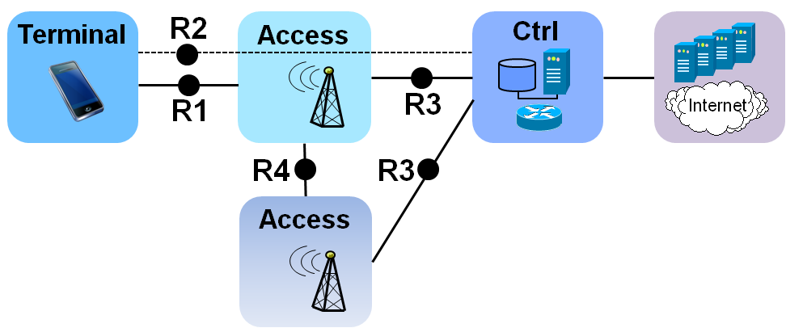
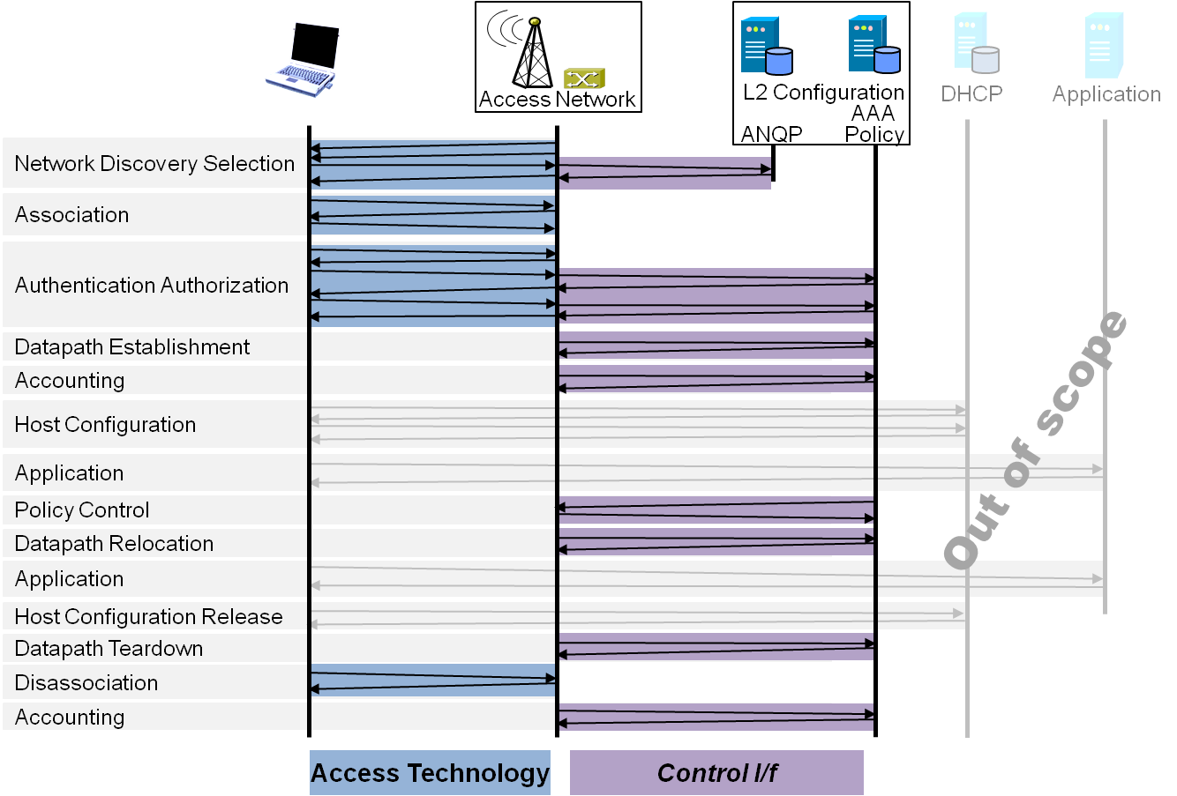
P802.1CF Draft ToC
Introduction and Scope
Abbreviations, Acronyms, Definitions, and Conventions
References
Identifiers
Network Reference Model
  Overview
  Reference Points
  Access Network Control Architecture
    Multiple deployment scenarios including backhaul
Functional Design and Decomposition
  Dynamic Spectrum Access
  Network Discovery and Selection
  Association and Disassociaiton
  Authentication and Trust Establishment
  Datapath establishment,
  relocation and teardown
  Authorization, QoS and policy control
  Accounting and monitoring
SDN Abstraction
  Terminal
  Access Network
Annex:
  Tenets (Informative)

Slide 21
Business#4
P802.1CF contributions
  ToC
    No new contributions available
  Network reference model
    https://mentor.ieee.org/omniran/dcn/14/omniran-14-0066-00-CF00-vlans-within-the-scope-of-nrm.pptx
    Contribution raised several questions regards handling of backhaul in the NRM.
    https://mentor.ieee.org/omniran/dcn/14/omniran-14-0068-00-CF00-generic-ieee-802-network-reference-model.docx
    Unanimous conclusion was reached on basic terminology and concepts of OmniRAN NRM as described in https://mentor.ieee.org/omniran/dcn/14/omniran-14-0069-01-CF00-athens-nrm-conclusions.pptx
  Functional design and decomposition
    https://mentor.ieee.org/omniran/dcn/14/omniran-14-0065-01-CF00-key-concepts-of-nds.pptx
    Discussion led to refinements in terminology and structure
      https://mentor.ieee.org/omniran/dcn/14/omniran-14-0065-02-CF00-key-concepts-of-nds.pptx
  SDN Abstraction
    No new contribution available

Slide 22
Business#5
Related discussions in 802 WGs
  Dick Roy provided introduction of ITS use cases as presented to IEEE 802.21
    https://mentor.ieee.org/omniran/dcn/14/omniran-14-0067-00-CF00-its-use-cases.pptx
Need for liaisons
  No urgent need for liaisons
  Initial OmniRAN specification might be introduced to ONF by making a contribution via Paul/Charlie
    Asking for individual feedback of participants
    No need for official response by ONF
  Other organizations under consideration for sharing initial specification
    Small Cell Forum
    Wireless Broadband Alliance
    Metro Ethernet Forum
    ITU-T SG15
    BBF E2E Architecture
    ETSI NFV
Status report to IEEE 802 WGs
  https://mentor.ieee.org/omniran/dcn/14/omniran-14-0070-00-00TG-sep-2014-status-report-to-802-wgs.pptx
AOB
  Nothing raised
  Meeting adjourned at 17:45

