Slide 1
CF ToC Refinements
Date: 2014-05-14
Authors:
Name | Affiliation | Phone | Email
Max Riegel | NSN | +49 173 293 8240 | maximilian.riegel@nsn.com
Notice: This document does not represent the agreed view of the OmniRAN EC SG. It represents only the views of the participants listed in the ‘Authors:’ field above. It is offered as a basis for discussion. It is not binding on the contributor, who reserve the right to add, amend or withdraw material contained herein.
Copyright policy: The contributor is familiar with the IEEE-SA Copyright Policy <http://standards.ieee.org/IPR/copyrightpolicy.html>.
Patent policy: The contributor is familiar with the IEEE-SA Patent Policy and Procedures: <http://standards.ieee.org/guides/bylaws/sect6-7.html#6> and <http://standards.ieee.org/guides/opman/sect6.html#6.3>.
Abstract
The presentation provides further thoughts on the ToC of 802.1CF.

Slide 2
OmniRAN P802.1CF ToC Refinements
Max Riegel
(NSN)

Slide 3
Example ToC of the P802.1CF specification (Nov 2013)
Introduction and Scope
Abbreviations, Acronyms, Definitions, and Conventions
References
Network Reference Model
Overview
Reference Points
Access Network Control Architecture
Multiple deployment scenarios
Functional Design and Decomposition
Network Discovery and Selection
Association
Authentication and Authorization
Datapath establishment
QoS and policy control
Datapath relocation
Datapath teardown
Disassociation
Accounting
Annex:
Tenets (Informative)
Network Reference Model
Functional Description

Slide 4
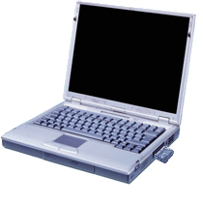
IEEE 802 Access Network Functional Diagram
Access Network
L2 Configuration
AAA Policy
DHCP
Application
Discovery
ANQP
Network Selection
Association
Authentication
Authorization
Link Establishment
Accounting
Host Configuration
Application
Policy Control
Link Relocation
Application
Host Config Release
Disassociation
Link Teardown
Accounting
Access Technology
Control I/f

Slide 5
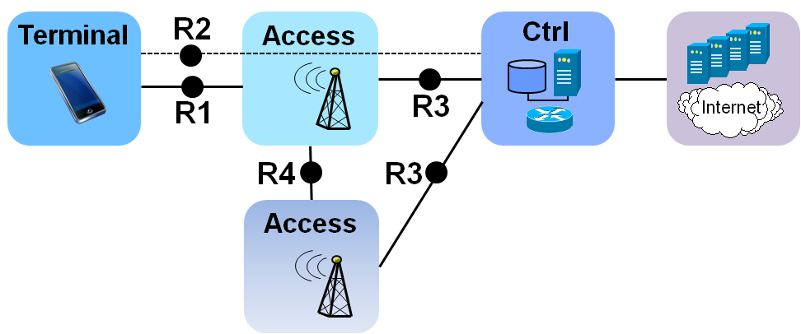
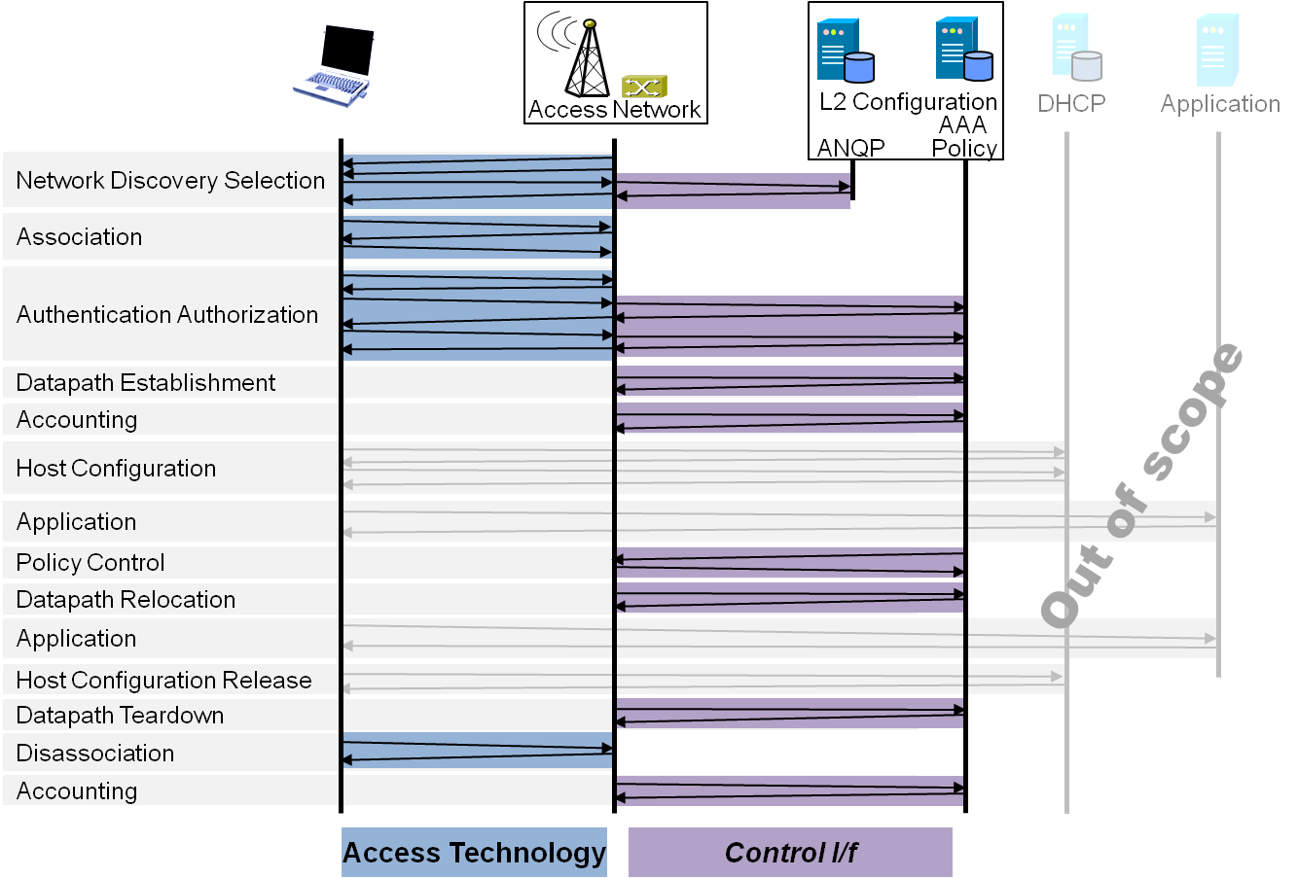
P802.1CF Draft ToC (Jan 2014)
Introduction and Scope
Abbreviations, Acronyms, Definitions, and Conventions
References
Identifiers
Network Reference Model
Overview
Reference Points
Access Network Control Architecture
Multiple deployment scenarios
Functional Design and Decomposition
Network Discovery and Selection
Association
Authentication and Authorization
Datapath establishment
QoS and policy control
Datapath relocation
Datapath teardown
Disassociation
Accounting
SDN Abstraction Layer
Terminal
Access
Backhaul
Annex:
Tenets (Informative)

Slide 6
P802.1CF Draft ToC Proposal (May 2014)
Introduction and Scope
Abbreviations, Acronyms, Definitions, and Conventions
References
Identifiers
Network Reference Model
Overview
Reference Points
Access Network Control Architecture
Multiple deployment scenarios
Functional Design and Decomposition
Access Network Preconfiguration
Network Discovery and Selection
Association
Authentication and Authorization
Datapath establishment
QoS and policy control
Datapath relocation
Datapath teardown
Disassociation
Accounting
SDN Abstraction
Terminal
Access and Backhaul
Annex:
Tenets (Informative)

Slide 7
Further thoughts
See also https://mentor.ieee.org/omniran/dcn/14/omniran-14-0013-01-0000-omniran-toc-update.pptx
Grouping of individual sections may make sense, e.g.
Datapath establishment, relocation and teardown
QoS and policy control with Authorization
Association and Disassociation
What else?
How to structure SDN Abstraction section
Is Terminal/Access and Backhaul sufficient?
Should we introduce SDN in the NRM section?

Slide 8
Conclusion
The 802.1CF ToC requires further refinements.
ToC refinements should be accompanied by contributions to the particular sections to show evidence and dependencies
At least a sequence of headings for the particular sections
ToC should be kept under discussion during the development of the specification
Detailed content may provide better understanding of the relationship of the material.

