Slide 1
OmniRAN Update on SDN Use Case
IEEE 802 Wireless SDN BoF
2014-01-23

Slide 2


SDN-based OmniRAN Use Case
Reference Point Mappings
Access 1
Access Abstraction
Core
Operator A
Backhaul
R3
R4
R5
Terminal
Access 2
Backhaul Abstraction
R1
Core
Operator B
Internet
Access Abstraction
Access Abstraction
R2
AAA
Multiple Cores sharing Access Network
Access Abstraction
Data and Control plane separation
Central control
SDN
Controller
R5
Core
Operator C
Access 3
Access Abstraction
Access Network
Core Network(s)
Data path
Control path

Slide 3
SDN related Gaps in IEEE 802
Control of data forwarding plane, common to 802 technologies
  Southbound interface enabling the communication between the 802 technologies and the central controller (e.g. access abstraction)
  Clearly defined interfaces, SAPs and behaviors
  Ability to modify data path based on arbitrary but bounded selection parameters
    Packet classification mechanisms based on templates (á la OpenFlow)
    End-to-end packet flow and QoS
Radio configuration mechanism for access and backhaul links
  With defined metrics and reporting
Data plane management of the multiple-interface Terminal
  Notion of 802 logical interface facing L3
Generic 802 access authorization and attachment

Slide 4
OmniRAN Considerations for SDN
Control plane
  Control of interface/radio parameters
  Control of MAC-specific features
  Data path establishment
  User authentication and authorization
Data plane
  Arbitrary matching of (wireless) frame parameters
  Frame forwarding

Slide 5
Current Assumption:
Specific section on SDN Abstraction Layers
One separate section in draft ToC
Define SDN Abstraction Layers
  Terminal
  Access
  Backhaul
Common abstraction layers applicable to different 802 technologies
  E.g. 802.3, 802.11, 802.15, 802.16, 802.22,
  Technology dependent profiles to support specific behavior and features

Slide 6
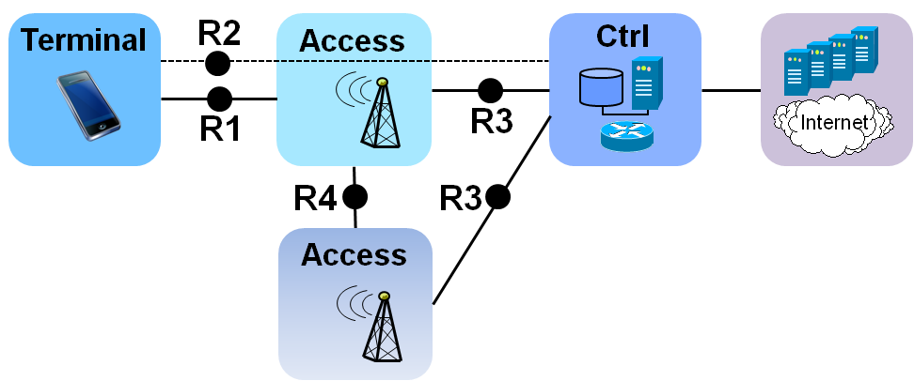
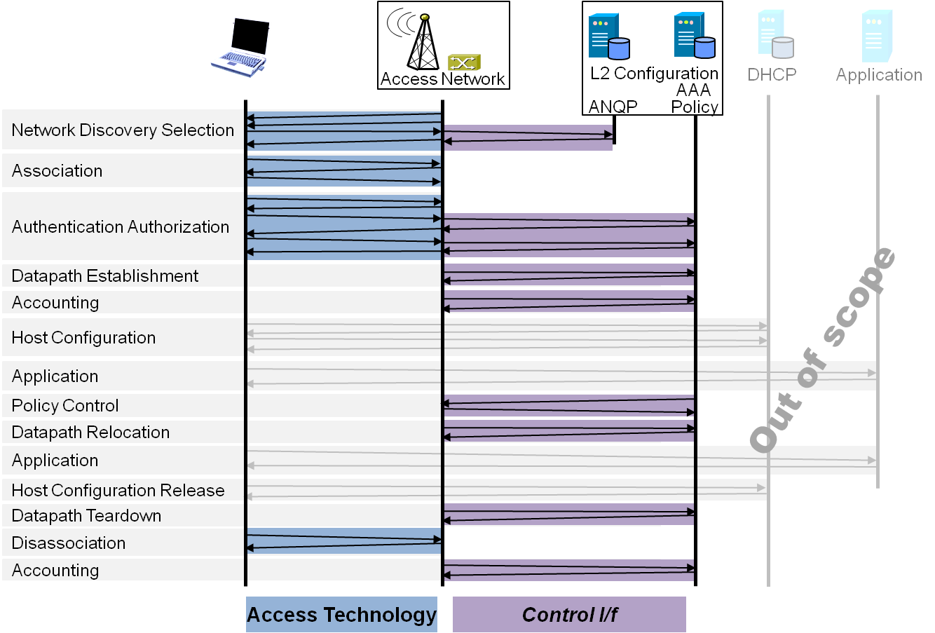
P802.1CF Draft ToC
Introduction and Scope
Abbreviations, Acronyms, Definitions, and Conventions
References
Identifiers
Network Reference Model
  Overview
  Reference Points
  Access Network Control Architecture
    Multiple deployment scenarios
Functional Design and Decomposition
  Network Discovery and Selection
  Association
  Authentication and Authorization
  Datapath establishment
  QoS and policy control
  Datapath relocation
  Datapath teardown
  Disassociation
  Accounting
SDN Abstraction Layer
  Terminal
  Access
  Backhaul
Annex:
  Tenets (Informative)

