Slide 1
OmniRAN SDN Use Case ToC
Date: 2014-01-22
Authors:
Name | Affiliation | Phone | Email
Juan Carlos Zúñiga | InterDigital | +1514 904 6300 | j.c.zuniga@ieee.org
Antonio de la Oliva | UC3M | +34 91 624 8803 | aoliva@it.uc3m.es
Notice: This document does not represent the agreed view of the OmniRAN EC SG. It represents only the views of the participants listed in the ‘Authors:’ field above. It is offered as a basis for discussion. It is not binding on the contributor, who reserve the right to add, amend or withdraw material contained herein.
Copyright policy: The contributor is familiar with the IEEE-SA Copyright Policy <http://standards.ieee.org/IPR/copyrightpolicy.html>.
Patent policy: The contributor is familiar with the IEEE-SA Patent Policy and Procedures: <http://standards.ieee.org/guides/bylaws/sect6-7.html#6> and <http://standards.ieee.org/guides/opman/sect6.html#6.3>.
Abstract
This document presents some considerations for addressing the SDN use case in the proposed Reference Model Table of Contents (ToC).

Slide 2
What do we want to achieve?
Control plane
  Control of interface/radio parameters
  Control of MAC-specific features
  Data path establishment
  User authentication and authorization
Data plane
  Arbitrary matching of (wireless) frame parameters
  Frame forwarding

Slide 3
SDN section in the ToC
One separate section in draft ToC
Define SDN Abstraction Layers
  Access
  Backhaul
  Terminal
Abstraction layers applicable to different 802 technologies
  802.3, 802.11, 802.15, 802.16, 802.22, etc
  There could be specific differences within each technology (e.g. 11ac, 802.11af, 802.16r, etc.)

Slide 4
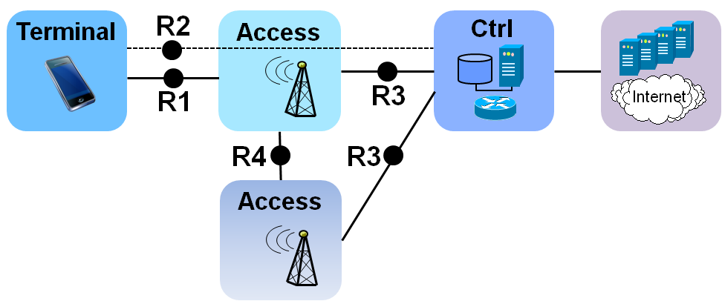
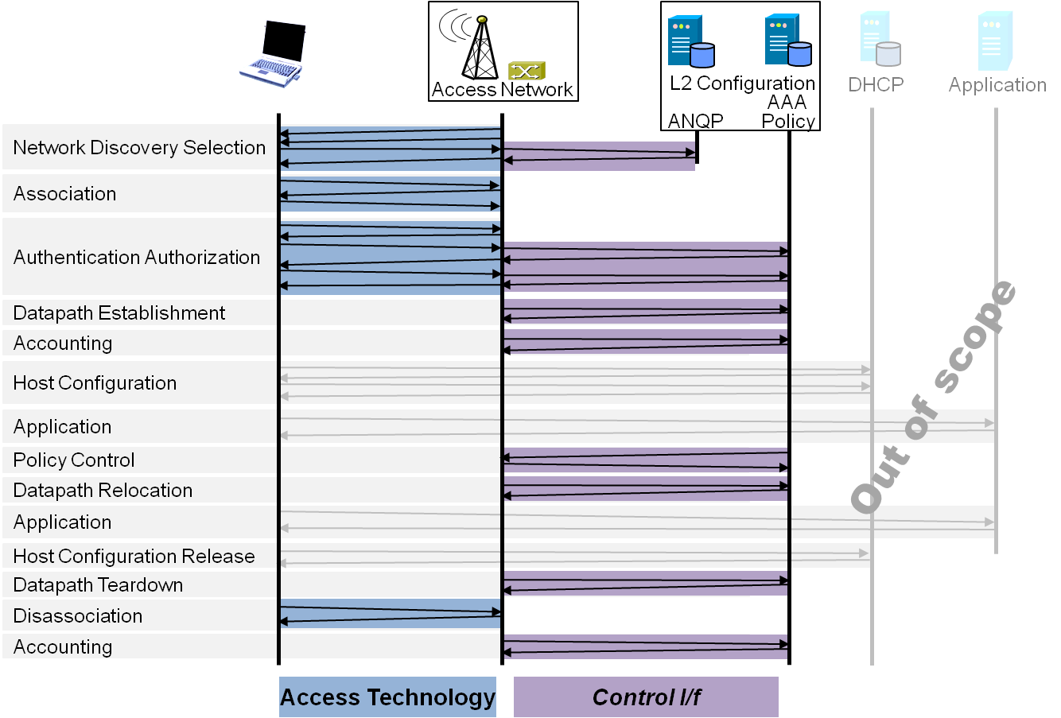
Draft ToC of the proposed specification
Introduction and Scope
Abbreviations, Acronyms, Definitions, and Conventions
References
Identifiers
Network Reference Model
  Overview
  Reference Points
  Access Network Control Architecture
    Multiple deployment scenarios
Functional Design and Decomposition
  Network Discovery and
  Selection
  Association
  Authentication and Authorization
  Datapath establishment
  QoS and policy control
  Datapath relocation
  Datapath teardown
  Disassociation
  Accounting
SDN Abstraction Layer
  Access
  Backhaul
  Terminal
Annex: Tenets for IEEE 802 Access Network Systems

