Slide 1
Thoughts about the tenets in IEEE 802.1CF
Date: 2014-01-20
Authors:
Name | Affiliation | Phone | Email
Max Riegel | NSN | +49 173 293 8240 | maximilian.riegel@nsn.com
Notice: This document does not represent the agreed view of the OmniRAN EC SG. It represents only the views of the participants listed in the ‘Authors:’ field above. It is offered as a basis for discussion. It is not binding on the contributor, who reserve the right to add, amend or withdraw material contained herein.
Copyright policy: The contributor is familiar with the IEEE-SA Copyright Policy <http://standards.ieee.org/IPR/copyrightpolicy.html>.
Patent policy: The contributor is familiar with the IEEE-SA Patent Policy and Procedures: <http://standards.ieee.org/guides/bylaws/sect6-7.html#6> and <http://standards.ieee.org/guides/opman/sect6.html#6.3>.
Abstract
This document addresses the meaning and the potential content of the tenets section in IEEE 802.1CF. It is accompanied by a Word document providing examples of tenets.

Slide 2
Thoughts about the ‘tenets’ in IEEE 802.1CF
Max Riegel
(NSN)

Slide 3
Definition of ‘tenets’
  tenet (plural tenets)
  An opinion, belief, or principle held to be true by someone or especially an organization.
In the context of IEEE 802.1CF, the tenets are providing a kind of generic functional requirements specification
As 802.1CF should be applicable to many different deployment scenarios of IEEE 802 technologies, there is not the single requirements document (‘Stage 1’) for it.

Slide 4
802.1CF provides a kind of ‘Stage 2’
Network Specification in 3 Stages
For the specification of the Integrated Services Digital Network the ITU-T defined in its Rec. I.130 a sequential 3 stage process,.
This process is nowadays commonly used in most telecommunication network standardization activities.
A Stage 2 specification provides a mapping of protocols to a functional network model, which facilitates easier evaluation.
‘External’ requirements from the
service/deployment perspective
Develop a logical/functional model
for evaluation of those requirements;
Available IEEE 802 specifications
of protocols and attributes.
?
?
More Information: ETSI: Making Better Standards
  http://docbox.etsi.org/MTS/MTS/10-PromotionalMaterial/MBS-20111118/protocolStandards/stagedApproach.htm

Slide 5
802.1CF provides a kind of ‘Stage 2’
Network Specification in 3 Stages
For the specification of the Integrated Services Digital Network the ITU-T defined in its Rec. I.130 a sequential 3 stage process,.
This process is nowadays commonly used in most telecommunication network standardization activities.
A ‘Stage 2’ specification would provide a mapping of the existing IEEE 802 protocols to a functional network model, which facilitates easier evaluation and better understanding of end-to-end behavior.
‘External’ requirements from the
service/deployment perspective
Develop a logical/functional model
for evaluation of those requirements;
Available IEEE 802 specifications
of protocols and attributes.
?

Slide 6
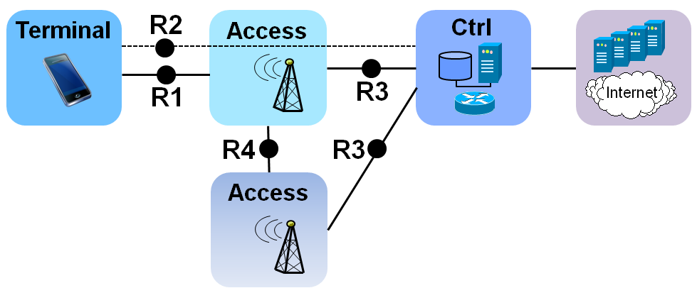
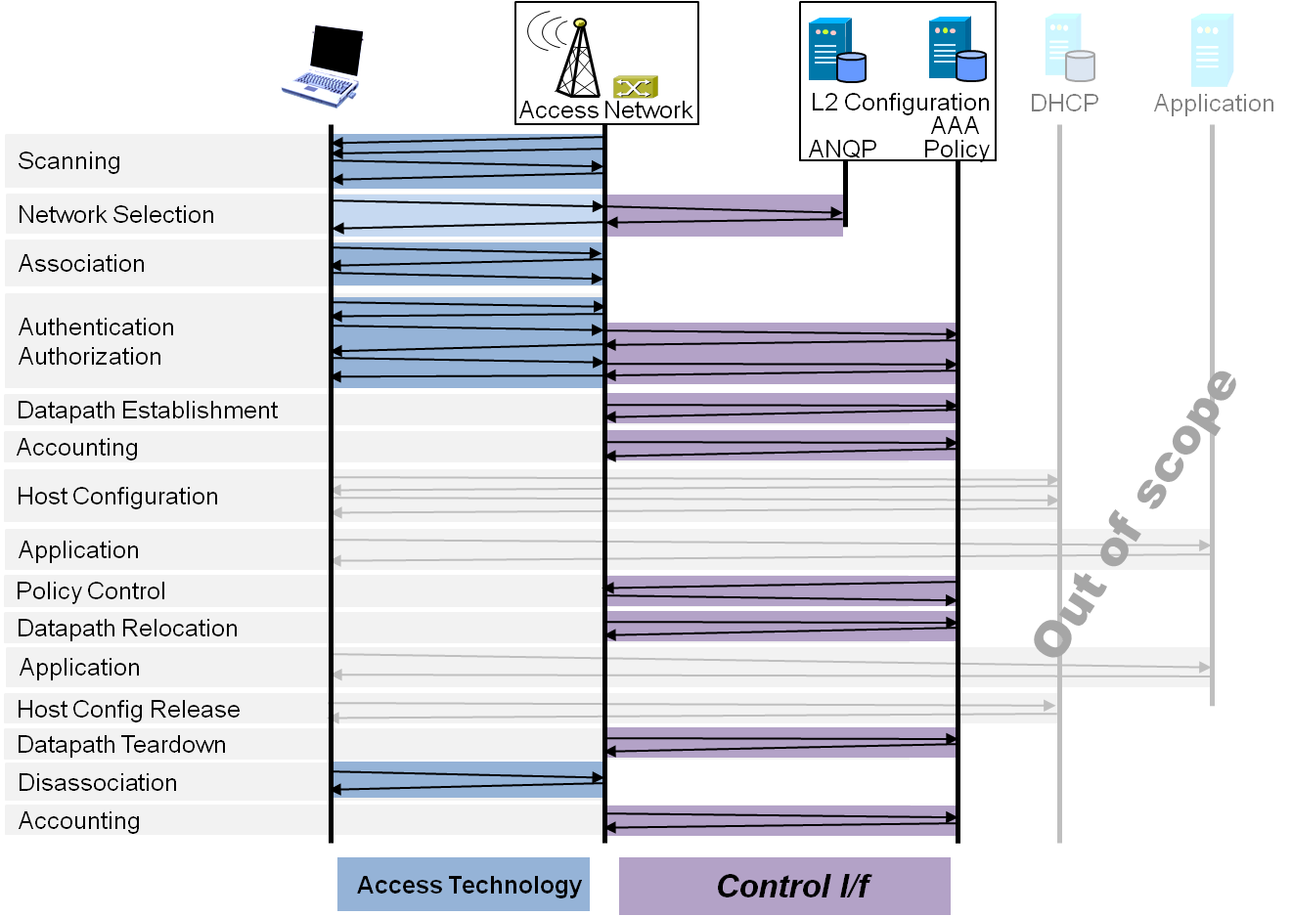
Potential ToC of the proposed specification
Introduction and Scope
Acronyms, Definitions, and Conventions
References
Identifiers
Tenets
Network Reference Model
  Overview
  Reference Points
  Access Network Control Architecture
    Multiple deployment scenarios
Functional Design and Decomposition
  Network Discovery and
  Selection
  Association
  Authentication
  Datapath establishment
  QoS and policy control
  Datapath relocation
  Datapath teardown
  Disassociation
  Accounting

Slide 7
Content of ‘Tenets’
Statements in tenets should be available for each of the sections in the network reference model and functional description
  Reflecting the underlying ideas behind the chosen solutions
  Documenting the agreements in the group
  Reverse mapping the technical solutions to functional requirements
An example of how the tenets may look like is provided in the accompanying text document:
  https://mentor.ieee.org/omniran/dcn/14/omniran-14-0005-00-0000-examples-for-the-802-1cf-tenets.docx

