Slide 1
IEEE Standards Association IMAT Manager

Slide 2
Sign in to IMAT
http://imat.ieee.org
Enter your IEEE Account username/email and password

Slide 3
Terms
Event or Session – The overall meeting event that contains one or many sub-meetings (Breakouts).
Timeslot – Times that breakouts may occur. Timeslots regulate when meetings should be occurring during your event and prevent attendees from logging their attendance in multiple concurrent meetings.
Breakout or Meeting – This is the specific meeting that a user may log attendance for. He/she may only log attendance for one breakout occurring at a particular time.
You must first create an Event, then the Timeslots, then Breakouts.
NOTE: If you are holding a meeting with another group (Plenary Session) the person with group access must set up the Event and Timeslot. Contact your Staff Liaison or Solutions Staff for assistance.

Slide 4
Select or create a Session/Event
Click “Events” to create a new session/event or add meetings to an existing one

Slide 5
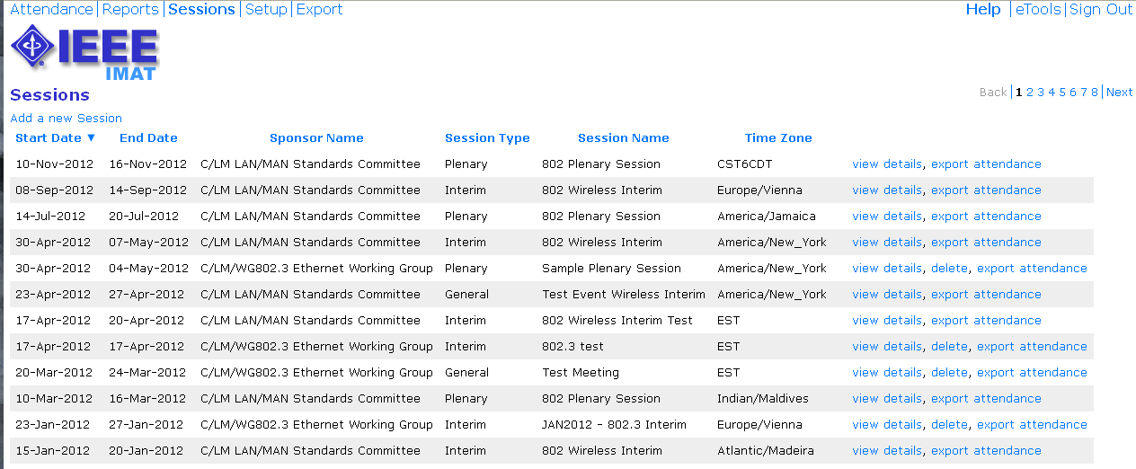
Select or create a Session/Event
Click “Add a new session” to create a new session
Click “view details” to add to an existing session

Slide 6
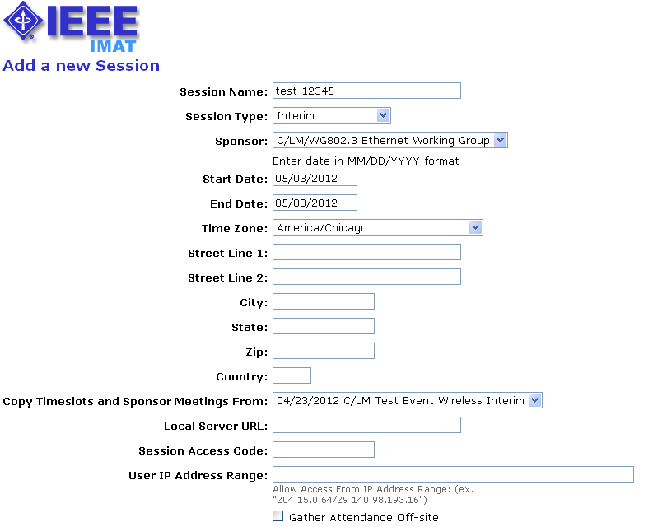
Add a new session/event
Add details, such as: Session type, start/end dates, time zone, location
Copy timeslots from an existing event
Restrict access by creating a session access code or requiring a specific IP range

Slide 7
Add a new session/event
Only check “Gather Attendance Off-site” if you are using a local server
Use this wiki to provide attendees with additional information about the venue

Slide 8
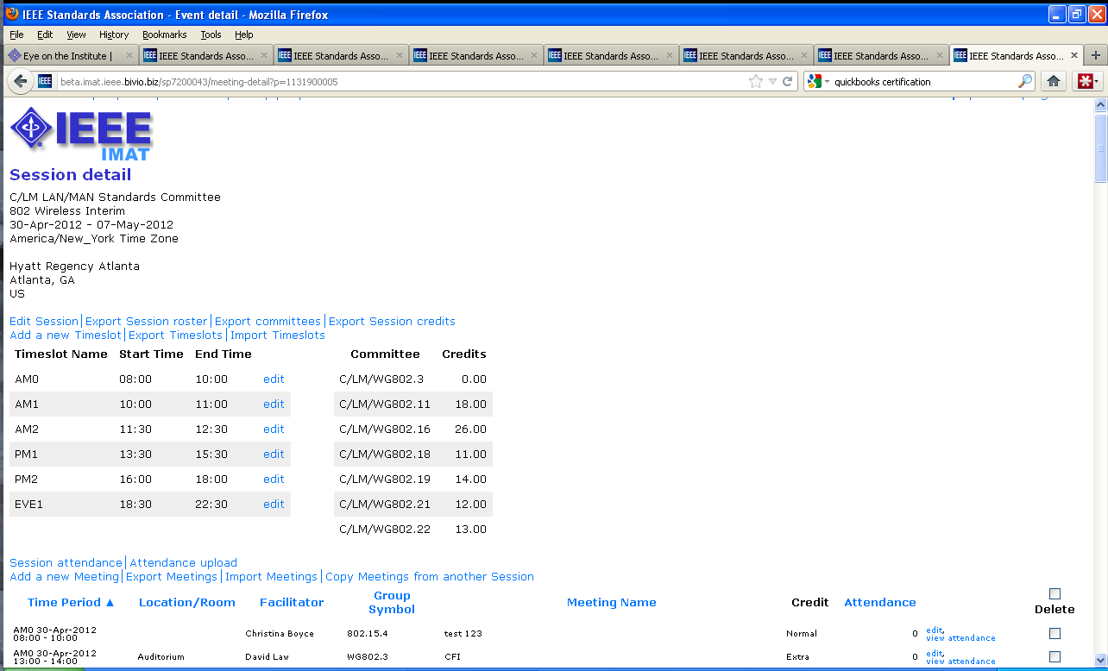
Session details
View and edit session/event details
Add a timeslot or edit an existing one
Add a meeting or edit an existing one

Slide 9
Add a timeslot
Timeslots will be the same for all days of the session/event. Use generic names, e.g., “AM 1”
Enter times in 24 hour format, e.g., “14:00”.

Slide 10
Add a Breakout/Meeting
Meetings can be associated with a working group or particular PAR/project
Select the timeslot for the start and end. You can span multiple timeslots.
Use the override fields to start/end at a different time than what is presented in the timeslot field
Enter the amount of attendance credit this breakout is to be given.
The facilitator should be the person chairing the meeting. This will default to the Working Group Chair.

Slide 11
Reports Menu
Click “attendance summary” to see a summary of all event attendance listed by individual
Click “session attendance” to view attendance for a particular session

Slide 12
Attendance Summary
Click on the attendance percentage to see meetings attended in that month by the individual for a particular event/session. You can also override the attendance percentage on this screen.

Slide 13
Event/Session Attendance
Click “daily attendance” to see the full daily attendance report for a particular event/session.

Slide 14
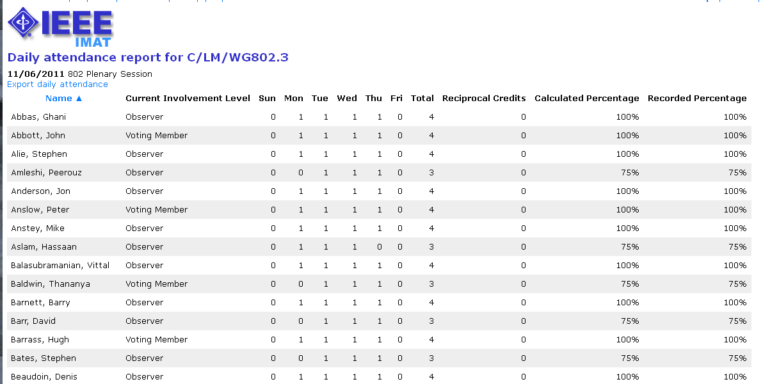
Event/Session Attendance
View the attendance report or export as CSV.

Slide 15
Add attendance (during an event/session)
Select the event/session from the “Attendance” screen and click “Add Attendee”

Slide 16
Add attendance (during an event/session)
Enter the user email or search by name or SA pin
Enter an affiliation
Select the breakout/meeting to add attendance

Slide 17
Add/Modify attendance percentage
From the “Attendance Summary” report: Click on “Add user attendance” to add a user. Click the attendance percentage and then click “Override” to modify a user’s attendance percentage.

Slide 18
Add attendance percentage
Enter a username or email for the individual you would like to add
Select an event/session from the dropdown list
Enter an attendance percentage

Slide 19
Questions? Contact: Gregory Marchini g.marchini@ieee.org

