Slide 1
Mentor ePolls
Polling for Groups

Slide 2
What is ePolls?
ePolls is the newest feature of Mentor, the IEEE tool for Working Group collaboration.
ePolls allows group officers to set up online ballots strictly for the use of their groups.
ePolls is structured similarly to the myBallot section of myProject™, but is flexible enough to be used for whatever the group wishes to use it for.
Unlike myBallot, ePolls will not: handle group balance, allow for recirculations or create automatic notifications and invitations.

Slide 3
How do I access ePolls?
Access ePolls from your group’s mentor area.
You must request access to ePolls for your mentor group.
Email myproject-admin@standards.ieee.org to request ePolls, or contact your staff liaison for more information. A complete list of staff liaisons can be found here: https://development.standards.ieee.org/pub/liaisons
Access mentor at:
https://development.standards.ieee.org/my-site

Slide 4
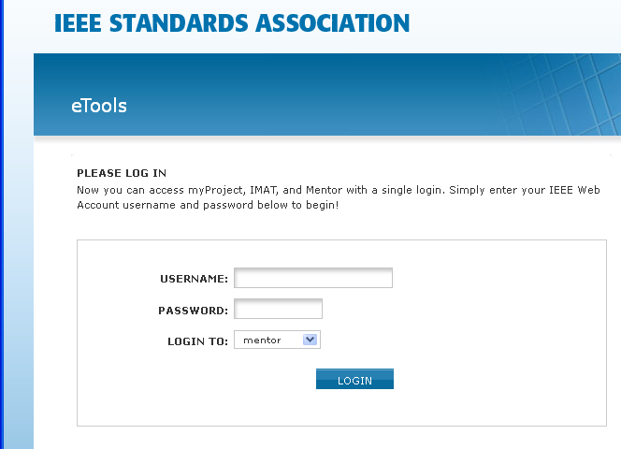
Accessing ePolls
Log into Mentor using your IEEE username and password. Select “mentor” from the “LOGIN TO” menu.

Slide 5
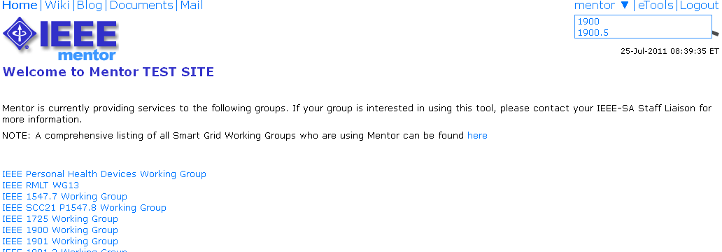
Accessing ePolls
Select your group from the dropdown menu

Slide 6
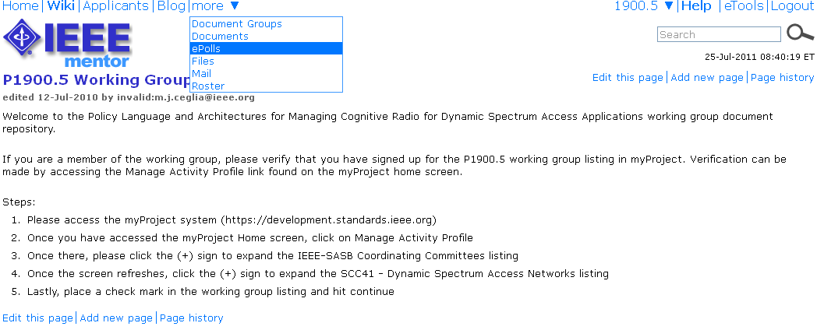
Accessing ePolls
Select “ePolls” from the “more” menu

Slide 7
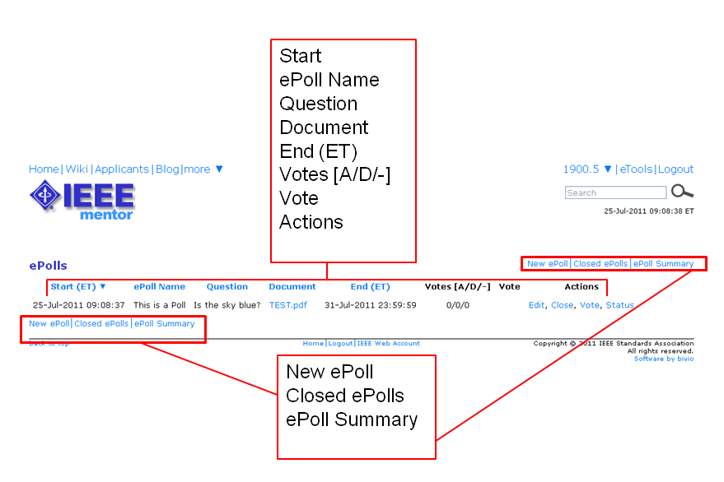
ePolls Features

Slide 8
ePolls Features
Start – This is the date and time the poll was opened. All times are US Eastern Time.
ePoll Name – This is the name of the poll.
Question – This is the question you are responding to with your vote
Document – This is a file related to the poll. This is useful for taking preliminary ballots on a draft document, but polls can also be created without a file.
End – This is the date and time the poll will close. All times are US Eastern Time.
Votes [A/D/-] – This is a tally of the votes cast [A Approve, D Disapprove, - Abstain].
Vote – This is your current vote on the poll.
Actions – These are all of the actions you have available to you for a particular poll. The available actions will change depending on the status of the poll and your particular access level.
  Edit – Edit the poll
  Close – Close the poll
  Vote – Vote or make comments on the poll
Status – View voting results and comments
New ePoll – Use this to create a new poll (will only be available to officers).
Closed ePolls – This shows all polls that have ended.
ePoll Summary - This allows you to view all of the votes cast for all polls in a specified date range.

Slide 9
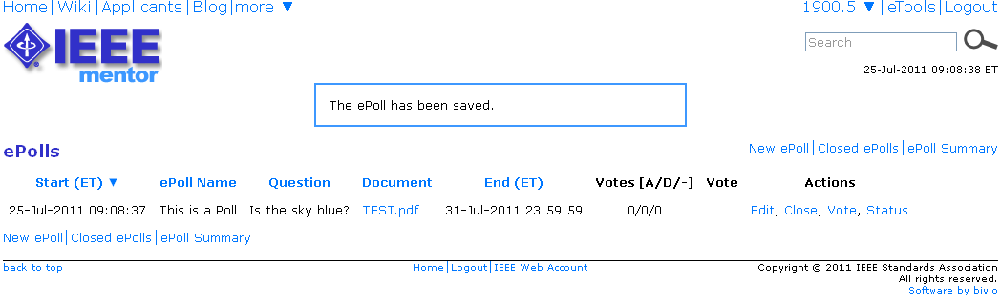
Creating a New Poll (Admins/Officers)
To create a new poll, click “New ePoll”

Slide 10
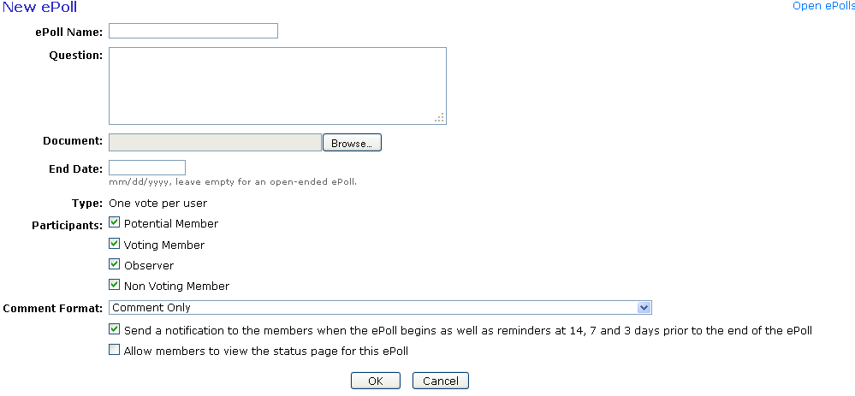
Creating a New Poll (Admins/Officers)
Fill out the fields and click “OK” to create your poll.

Slide 11
Creating a New Poll (Admins/Officers)
ePoll Name – Enter a unique name for your poll, this cannot be the same as another poll either open or closed.
Question – The question that will be answered by the approve/disapprove vote. Place all instructions for the specific poll in this box.
Document – Upload a file if the poll is related to a specific document. You can only upload one file. If multiple files are required, create a .zip file first.
End Date – Specify the date you would like the poll to close (use mm/dd/yyyy format e.g. 01/01/2012) or leave this box empty for an open-ended poll. All polls start when they are created, you cannot delay the start of a poll.
Participants (Working Groups only) – All IC group involvement levels will have voting access to ePolls. Place a check in the box next to the involvement level of participants you would like to have access to the poll (you must select at least one). For Working Groups, these involvement levels can be managed through myProject™. Users who have not been given an involvement level are classified as “interested” and will not have access to ePolls. For more information on managing your group involvement levels, see Sec 8 Appendix A: Managing Mentor Groups and User Roles.
Comment Format – Select the level of structure you would like to be available for comments depending on what your poll is being used for.
Send a notification… - Place a check in this box if you would like all individuals eligible to vote in this poll to receive a notification that the poll is available (will be sent out the day after the poll is created) as well as reminder emails at 14, 7 and 3 days before the closing date of the poll. Notifications will be sent through myProject™.
Allow members to view… - Place a check in this box if you would like all poll participants to be able to view votes and comments on the status

Slide 12
Editing a Poll (Admins/Officers)
To edit an open poll, click “Edit”

Slide 13
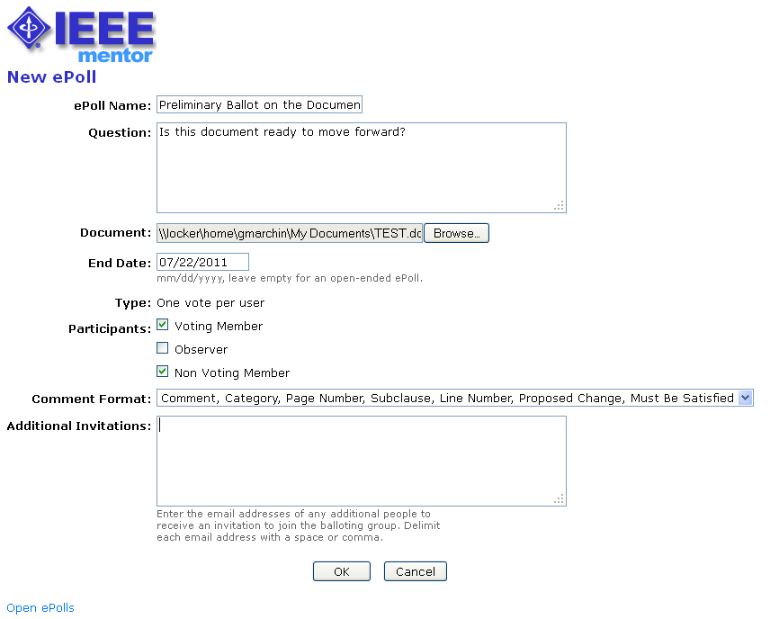
Editing a Poll (Admins/Officers)
Change any of the fields or upload a different file and click “OK” to save your changes.
Editing a poll does not notify the group of the change. Notifications should be handled separately through the Mentor email function.

Slide 14
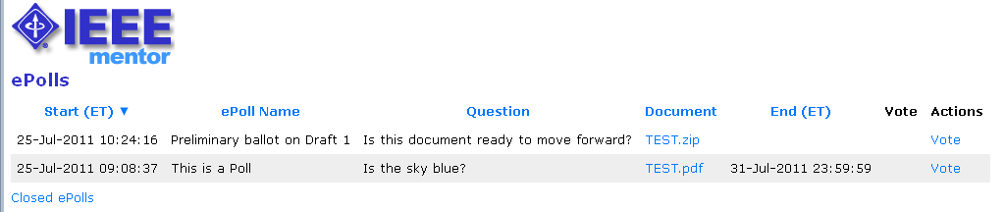
Voting on a Poll
Click “Vote” next to the poll you would like to vote on.
Votes can be changed by the individual voter at any time during the poll period.

Slide 15
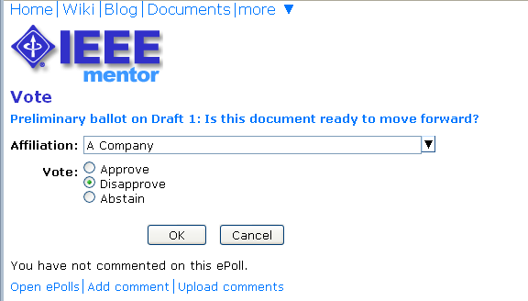
Voting on a Poll
Confirm your affiliation (this field will be pre-filled with your affiliation selection in myProject™).
Select your vote and click “OK”. You will receive a message telling you that you may now submit comments.

Slide 16
Submitting Comments
To submit a comment, click “Add comment”.
Comments are only visible by the commenter and group officers.
Comments are not required and the ability to comment is not dependant on the type of vote, but you must vote first in order to make comments.
You may make multiple comments on a single poll.

Slide 17
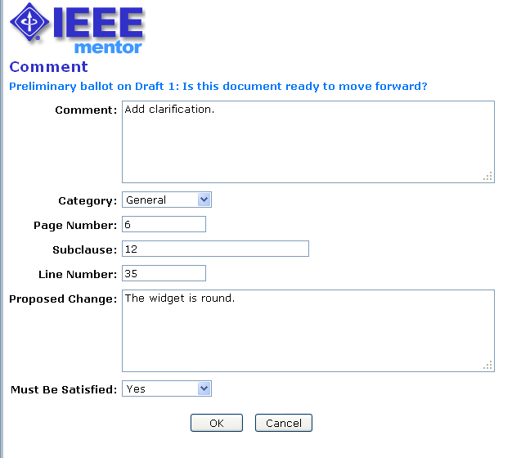
Submitting Comments
Fill out the fields and click “OK” to save your comment.
The fields available may change.
Admins/Officers have the ability to determine which fields they want displayed.

Slide 18
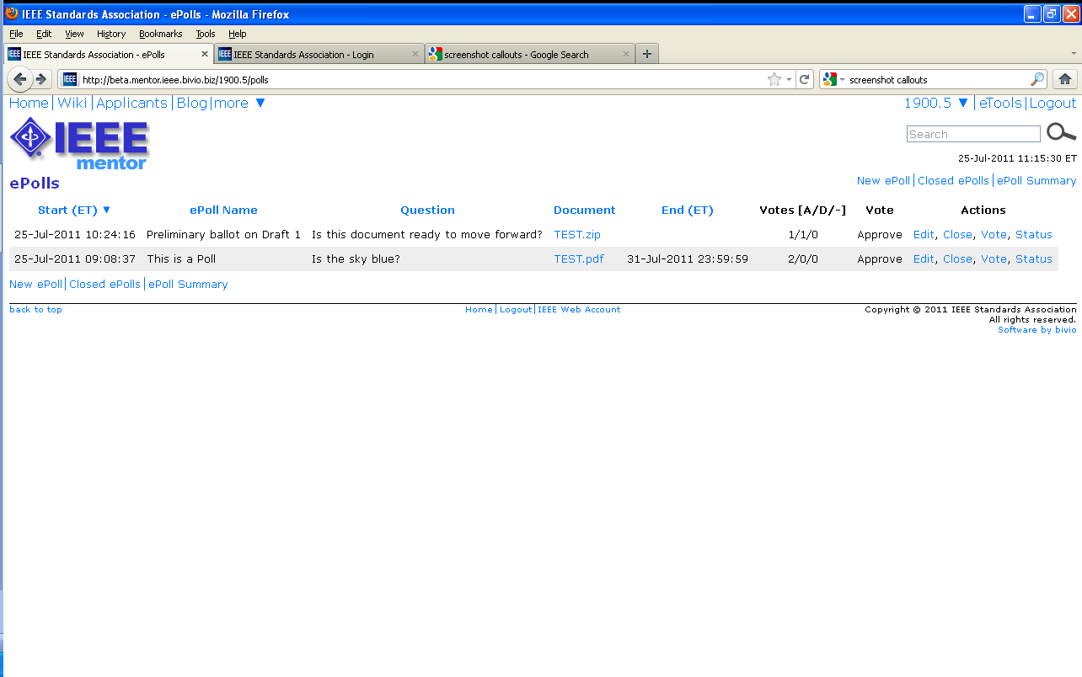
Viewing Votes and Comments (Admins/Officers)
To view votes and comments, click “Status”

Slide 19
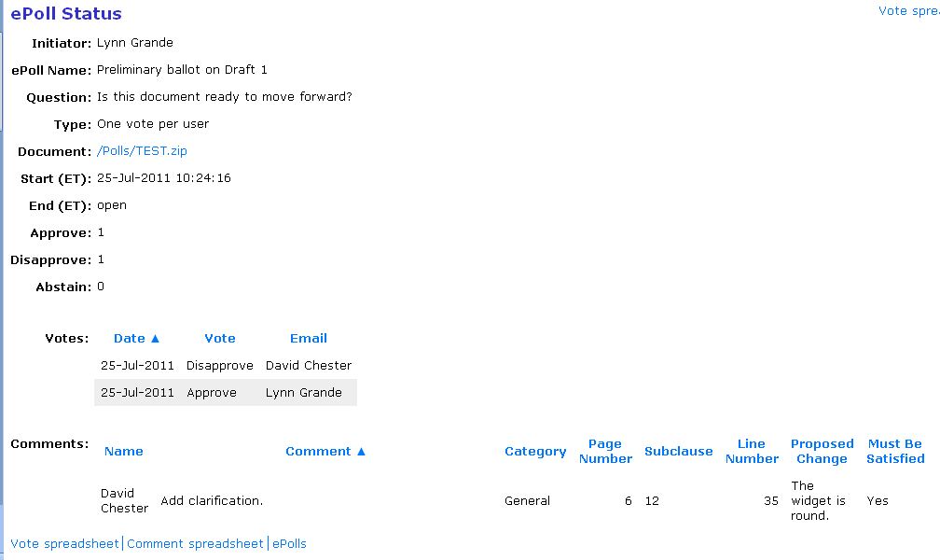
Viewing Votes and Comments (Admins/Officers)
Vote tally
Vote detail
Download
Comments

Slide 20
Closing a Poll (Admins/Officers)
To close a poll before it’s end date or close an open-ended poll, click “Close”
You cannot edit or vote on closed polls, but you can access results in “Closed ePolls”

Slide 21
For More Information
Mentor ePolls User Guide
https://mentor.ieee.org/etools_documentation/dcn/11/etools_documentation-11-0012-00-MENT-epolls-user-guide.pdf
Mentor help pages
https://mentor.ieee.org/mentor-help/bp/StartPage
Contact Your Staff Liaison
https://development.standards.ieee.org/pub/liaisons

