Slide 1
802.24 Vertical Applications TAG
Agenda and Meeting Presentation
November 2024 Plenary Meeting
Vancouver, BC, Canada

Slide 2
802.24 Overview
802.24 Vertical Applications TAG
802.24.1 Smart Grid TG
802.24.2 IoT TG
Officers
  TAG Chair: Tim Godfrey
  Secretary & TAG Vice Chair: Ben Rolfe
Task Groups
  802.24.1 Smart Grid TG Tim Godfrey
  802.24.2 IoT TG Chris DiMinico
25 Voting Members

Slide 3
802.24 November Plenary - Meeting Plan
Registration is required
Two slots:
  Tuesday PM2
  Wednesday PM2
Accredited Hybrid Meeting with Remote Participation
PM2: Tuesday November 12 4PM PST
Join WebEx meeting
Meeting password: kS5qy9Gqw33
Tap to join from a mobile device (attendees only)
+1-855-797-9485,,24205365781## US Toll free
+1-415-655-0002,,24205365781## US Toll
Join by phone
+1-855-797-9485 US Toll free
+1-415-655-0002 US Toll
PM2: Wednesday November 13 4PM PST
Join WebEx meeting
Meeting password: 3uzJq3AJgw5
Tap to join from a mobile device (attendees only)
+1-855-797-9485,,24205825955## US Toll free
+1-415-655-0002,,24205825955## US Toll
Join by phone
+1-855-797-9485 US Toll free
+1-415-655-0002 US Toll

Slide 4
Agenda
Call session to order / “Guidelines for IEEE SA meetings”
Review of Agenda / Approval of Agenda / Approve Minutes
Liaison Updates / Regulatory
Publication of “Low Latency White Paper”
IoT white paper Development and Contributions
Development of update to Smart Grid White paper.
AFV Infrastructure communications white paper: Review contributions and white paper draft

Slide 5
Guidelines for IEEE-SA Meetings
All IEEE-SA standards meetings shall be conducted in compliance with all applicable laws, including antitrust and competition laws.
Don’t discuss the interpretation, validity, or essentiality of patents/patent claims.
Don’t discuss specific license rates, terms, or conditions.
  Relative costs, including licensing costs of essential patent claims, of different technical approaches may be discussed in standards development meetings.
    Technical considerations remain primary focus
Don’t discuss or engage in the fixing of product prices, allocation of customers, or division of sales markets.
Don’t discuss the status or substance of ongoing or threatened litigation.
Don’t be silent if inappropriate topics are discussed… do formally object.
---------------------------------------------------------------
If you have questions, contact the IEEE-SA Standards Board Patent Committee Administrator at patcom@ieee.org or visit http://standards.ieee.org/about/sasb/patcom/index.html
See IEEE-SA Standards Board Operations Manual, clause 5.3.10 and “Promoting Competition and Innovation: What You Need to Know about the IEEE Standards Association's Antitrust and Competition Policy” for more details.
This slide set is available
at https://development.standards.ieee.org/myproject/Public/mytools/mob/preparslides.ppt
IEEE 802 Executive Committee

Slide 6
IEEE SA Copyright Policy
By participating in this activity, you agree to comply with the IEEE Code of Ethics, all applicable laws, and all IEEE policies and procedures including, but not limited to, the IEEE SA Copyright Policy.
  Previously Published material (copyright assertion indicated) shall not be presented/submitted to the Working Group nor incorporated into a Working Group draft unless permission is granted.
  Prior to presentation or submission, you shall notify the Working Group Chair of previously Published material and should assist the Chair in obtaining copyright permission acceptable to IEEE SA.
  For material that is not previously Published, IEEE is automatically granted a license to use any material that is presented or submitted.

Slide 7
IEEE SA Copyright Policy
    The IEEE SA Copyright Policy is described in the IEEE SA Standards Board Bylaws and IEEE SA Standards Board Operations Manual
      IEEE SA Copyright Policy, see
      Clause 7 of the IEEE SA Standards Board Bylaws
      https://standards.ieee.org/about/policies/bylaws/sect6-7.html#7
      Clause 6.1 of the IEEE SA Standards Board Operations Manual
      https://standards.ieee.org/about/policies/opman/sect6.html
    IEEE SA Copyright Permission
      https://standards.ieee.org/content/dam/ieee-standards/standards/web/documents/other/permissionltrs.zip
    IEEE SA Copyright FAQs
      http://standards.ieee.org/faqs/copyrights.html/
    IEEE SA Best Practices for IEEE Standards Development
      http://standards.ieee.org/develop/policies/best_practices_for_ieee_standards_development_051215.pdf
    Distribution of Draft Standards (see 6.1.3 of the SASB Operations Manual)
      https://standards.ieee.org/about/policies/opman/sect6.html

Slide 8
Participant behavior in IEEE-SA activities is guided by the IEEE Codes of Ethics & Conduct
All participants in IEEE-SA activities are expected to adhere to the core principles underlying the:
  IEEE Code of Ethics
  IEEE Code of Conduct
The core principles of the IEEE Codes of Ethics & Conduct are to:
  Uphold the highest standards of integrity, responsible behavior, and ethical and professional conduct
  Treat people fairly and with respect, to not engage in harassment, discrimination, or retaliation, and to protect people's privacy.
  Avoid injuring others, their property, reputation, or employment by false or malicious action
The most recent versions of these Codes are available at
  http://www.ieee.org/about/corporate/governance

Slide 9
Participants in the IEEE-SA “individual process” shall act independently of others, including employers
The IEEE-SA Standards Board Bylaws require that “participants in the IEEE standards development individual process shall act based on their qualifications and experience”
This means participants:
  Shall act & vote based on their personal & independent opinions derived from their expertise, knowledge, and qualifications
  Shall not act or vote based on any obligation to or any direction from any other person or organization, including an employer or client, regardless of any external commitments, agreements, contracts, or orders
  Shall not direct the actions or votes of other participants or retaliate against other participants for fulfilling their responsibility to act & vote based on their personal & independently developed opinions
By participating in standards activities using the “individual process”, you are deemed to accept these requirements; if you are unable to satisfy these requirements then you shall immediately cease any participation

Slide 10
IEEE-SA standards activities shall allow the fair & equitable consideration of all viewpoints
The IEEE-SA Standards Board Bylaws (clause 5.2.1.3) specifies that “the standards development process shall not be dominated by any single interest category, individual, or organization”
  This means no participant may exercise “authority, leadership, or influence by reason of superior leverage, strength, or representation to the exclusion of fair and equitable consideration of other viewpoints” or “to hinder the progress of the standards development activity”
This rule applies equally to those participating in a standards development project and to that project’s leadership group
Any person who reasonably suspects that dominance is occurring in a standards development project is encouraged to bring the issue to the attention of the Standards Committee or the project’s IEEE-SA Program Manager

Slide 11
Administration
Attendance take on IMAT – This meeting will be accredited to attendance
  Reciprocal rights for most WGs
Web page
  http://www.ieee802.org/24
Mailing list
  stds-802-24@listserv.ieee.org
  802-24-voters@listserv.ieee.org (voters list)
Document archive
  http://mentor.ieee.org/802.24/documents
IEEE 802 announcement reflector, stds-802-all@listserv.ieee.org
  Send email to listserv@listserv.ieee.org with no subject and with the
  following 2 lines appearing first in the body of the message
Subscribe stds-802-all
end

Slide 12
802.24 TAG Opening
Approve Sept 2024 TAG minutes
  24-24-24r0
  Approved Unanimous Consent
Action Items from Sept
Opening Notes

Slide 13
Liaison Updates
Wi-Fi Alliance (Informal) <vacant>
CSA / Matter (Informal) Clint Powell Active
FiRa (UWB ranging based on 15.4) Clint Powell
CCC (access control and automotive key based on NFC, next gen will be UWB) (new – liaison needed)
TIA-TR42 IoT Entity Chris DiMinico
  ISO IEC WG3
Wi-SUN Alliance (informal) Phil Beecher
802.18 Edward Au
ATIS TOPS <vacant>

Slide 14
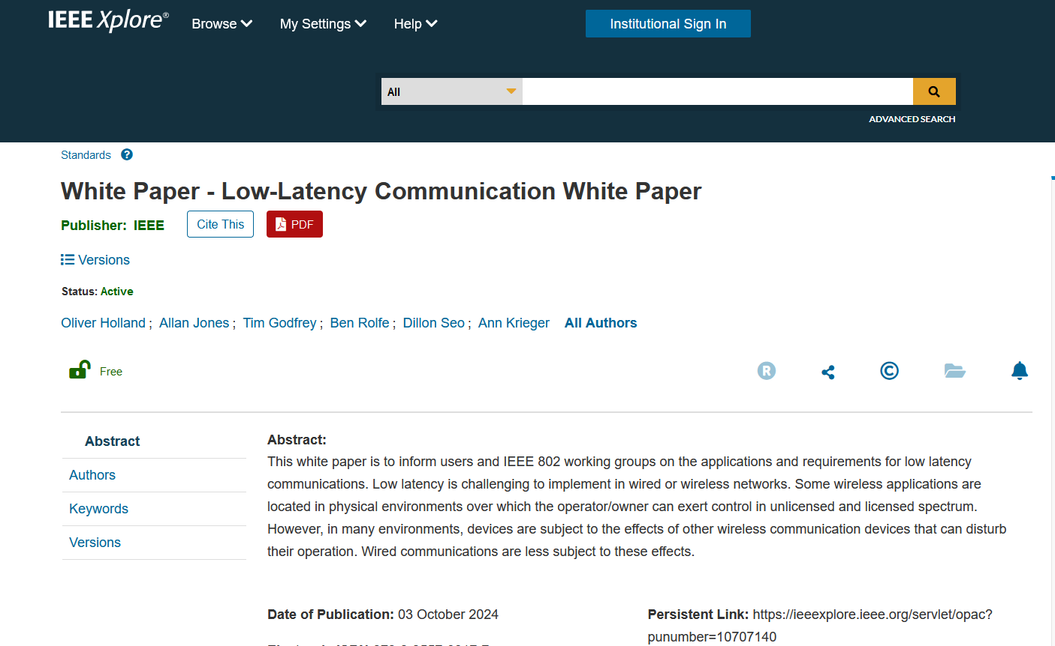
Low Latency White Paper
Published October 3rd.
https://ieeexplore.ieee.org/document/10707142

Slide 15
IoT White Paper Discussion
Latest Version Internet of Things White Paper 24-22-0011-06-IoTg-internet-of-things-white-paper
Discussions Notes
  Disambiguate the general poor state of available information on IoT, and highlight the IEEE 802 solutions that address them.
  Need to distinguish “Internet” public vs private. OT network for highly secure, isolated networks.
  Embedded comments need text contributions
  How to incorporate wired IoT – specifically Single Pair Ethernet.
    Add section 5 for Connectivity Technologies
    Revise closing section
  Nov 2024
    Smart Home section – Ben will seek Wi-Sun text for this.
    New section needs text: “7.Looking back at the Hype, and what has actually been delivered.” (Ben will find a volunteer)
    Fill in section on IoT with high reliability (Tim)
    Closing statement (Ann)

Slide 16
Smart Grid white paper revision
Update of first Smart Grid white paper to address latest amendments of 802.15.4 u, v, w, x, y, Rev-me, and new organization of documents to clarify UWB vs Narrowband
New baseline document for 2024 revision:
  Working Draft Current Version at start of November meeting
  24-24-0014-02-sgtg-802.24 smart grid white paper (2024 Update).docx

Slide 17
Smart Grid White Paper Revision Plan
New Standards
  Amendments of 802.15.4 (SUN) u, v, x, y, ac, ad/NG, (4me revision) Phil Beecher, Gary Stuebing, Don Sturek, Jeorg
  LECIM/LPWAN 802.15.4w Jeorg
  802.15.9 Tero
  802.1 TSN Reference to the TSN White Paper (Janos)
  802.11ah and 11ax (Dave Halasz)
  802.16s, 16t (Tim, Harry)
  802.19.3 sub-1 GHz coexistence (Ben)
New topics
  Integration of Gas/Water into electric metering
  Battery leaf nodes for low power
  Sensors
  Situational Awareness
  Physical Security
  Wildfire detection and prevention
  Any others identified by contributors.
Complementary role of IEEE 802 with cellular technologies

Slide 18
Areas discussed and Edited Nov 2024
Discussion Notes – Sept 2024
  Other Standards and Non-802 Networks
  Need for Peer to Peer communications for dynamic reconfiguration of microgrids and outage recovery.
  CBRS and spectrum sharing concepts and introduction
  IoT in introduction
Nov 2024
  Companion document update - 24-24-0029-00-sgtg-2025-update-package-of-802-smart-grid-standards.docx
  Final version 14r4

Slide 19
AFV Communications - White Paper
Types of AFV sites: residential, commercial vehicle depot, public transport site, long haul freight transportation. (Public parking facilities)
Communications requirements: data volume, resilience, reliability.
  Ancillary communication to vehicles (maps, firmware and software updates for vehicles, inventory tracking, logistics, media, etc)
Relate to the use of IEEE 802 technologies as the solution

Slide 20
Contributions related to AFV White Paper
12-Nov-2024 ET | 2024 | 28 | 0 | TAG documents | Fresh AFV WP outline | Craig Rodine (Sandia) | 12-Nov-2024 19:49:14 ET | Download, Revise, Correct, Delete
27-Oct-2024 ET | 2024 | 27 | 0 | TAG documents | Proposed an extended outline for adding use cases of 'Integrated Charging Infrastructure with Distributed Energy Resources, Building and Grid-Level Energy Management Systems' in Clause 3 of the AFV draft outline (Doc. 24-24-0025-00-0000) | Jin Seek Choi (Hanyang University), Hyeong Ho Lee (Seoul National University of Science & Technology/NetvisionTelecom Inc.) | 27-Oct-2024 20:16:45 ET | Download, Revise, Correct, Delete

Slide 21
AFV Next Steps
This new outline in doc 24-0025r0 will be expanded by importing text from prior WP 23-0007r6
Output document of combined outline:
  24-24-0027-01-0000-proposed-an-extended-outline-for-adding-use-cases-of-integrated-charging-infrastructure-with-distributed-energy-resources-building-and-grid-level-energy-management-systems-in-clause-3--1

Slide 22
Future TAG Activity Planning
A whitepaper/document for application-specific use cases of Sub 1GHz standards 802.15.4g and 802.11ah. How use mechanisms in 802.19.3 and new amendment 802.19.3a
  Can this also include applying 802.15.4s-2018 (Spectrum Resource Measurement Capability) in sub-1GHz spectrum?
  New activities in Sub-1GHz. Update to 11ah possible in 802.11-rev, also changes in 802.15.
  Aspect of unique communications requirements for DER integration- dispatch/provisioning vs protection.
  Review possible activity in mid-2025?
Possible topic follow up on AFV.
  Future state of integrated networks for Energy Management Systems across electric vehicle, home, building, and grid.
TSN – movement of 802.1 and 802.3 towards specific profiles (related to vertical applications) AVB, Industrial Automation, Automotive, Aerospace. Select features out of base standards. TSN is a toolbox, profiles provide interoperability. Integration of TSN into 802.11 and high availability, could affect TSN profiles.

Slide 23
802.24 TAG closing
Action Items
  Text contributions for SG white paper update, IoT White Paper. (AI’s inside document)
Any New Business?
Next Meeting
    January 2025 – Kobe, Japan (Ben Rolfe will Chair)
    March 2025 – Atlanta, GA, USA
Adjourn

