Slide 1
Vertical application opportunity in integrating Smart home and EV charging system for Cooperative Energy Management
Jin Seek Choi, Hanyang University,
Hyeong Ho Lee, Seoul National University of Science &
Technology/Netvision Telecom Inc.
and Young Kyu Ko, Korea Smart Grid Association
March 2023 IEEE 802 Plenary Session
Georgia, USA

Slide 2
Contents
BG: Opportunity for IEEE 802 vertical application
  Vertical Applications: 24-22-0012-032-0000-ieee-802-networks…
  Wi-Fi use case for large-scale EV (AC) charging: 24-22-0016-01-0000 (Sept 2022)
  Wi-Fi/TSN use case for “over-the-top” transaction services: 24-22-0020-01-0000 (Nov 2022)
A brief look at Smart Home with Renewable Energy Sources and EVs
Propose: Development of an IEEE 802 vertical application integrating smart home and EV charging system for cooperative energy management
  Discussion and next steps

Slide 3
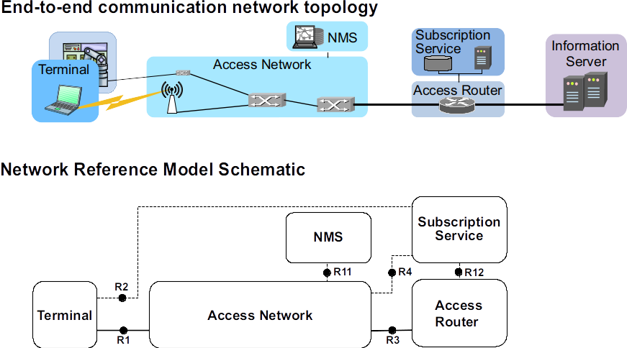
BG: Vertical application
Vertical Applications refer to networks that serve specific use cases in specific market segments.
Requirements: The network is used by the entities to enable its business processes, that usually integrate various systems including network connectivity in order to perform specific tasks or enable use cases for their industry.
IEEE 802 based networks are usually aimed to “enable creating/delivering a product” instead of “the network is the product” defined by a open standard:
  IEEE 802 networks for e.g. time-sensitive networking (TSN), Wireless LAN, Media Independent Handover (MIH), Bridging and Management could enhance site operations and systems integration for vertical applications.
  IEEE 802 Network is the Access Network that connects terminally either directly through bridging or forwards traffic to the access router when the communication peer is behind the same Layer 2 domain. Various control entities support the access network to provide secured and managed connectivity.
Figure 1: Network reference model design
Ref: 24-22-0012-03-0000-ieee-802-networks-for-vertical-applications.docx

Slide 4
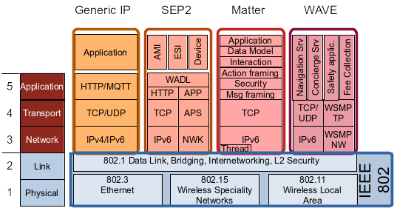
BG: Higher layer functions and service design in vertical application networks for Smart home
IEEE 802 provides a high number of wired and wireless solutions for the Physical and Link layer functions of communication links to serve a very wide range of requirements of applications.
  Often the Generic IP protocol stack is used for realizing vertical applications, like HTTP, CoAP, or MQTT in the Application layer.
  IEEE 802 technologies allow for more specific network solutions when particular requirements or conditions arise.
  Smart Energy Profile 2 (SEP 2) is a standard
  for information and control for energy management.
  Matter is a smart-home connectivity standard.
  EMAP is an IEC-ISO application layer protocol among
  energy management agents (EMAs) for cooperative
  energy management in smart home environment.
EMAP
Applications
CoAP
UDP
IPv4/IPv6
Figure 5: Examples of vertical applications based on IEEE 802 networking
Ref: 24-22-0012-03-0000-ieee-802-networks-for-vertical-applications.docx

Slide 5
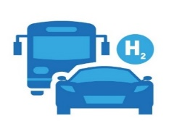
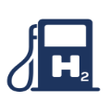

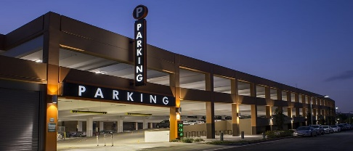


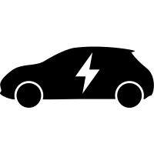
BG: Opportunity for IEEE 802 vertical application
Explore how 802 services for e.g. TSN, Wireless LAN, and MIH could enhance site operations and systems integration of renewable energy sources for smart home
Explore a ‘Secure L2 EV charging communications fabric’ for EV applications
  Develop LAN architecture/s supporting site-level (depot, public fueling) operations
  Towards a secure, cohesive, extensible ‘EV charging’
  Draw on existing and coming 802.1/.3/.11 standards
Example next-generation (esp. fleet) EV charging uses cases
  Use 802.1 TSN/Wi-Fi for transactions, high-power EV charging control
  Use VLANs to provide security and QOS for high-data-volume EV/AV applications,
  e.g. GIS data, route and schedule optimization, media services, trusted electric vehicles
Ref: 24-22-0016-01-0000 (Sept 2022) Wi-Fi use case for large-scale EV (AC) charging

Slide 6












Let’s take a brief look at Smart home with DERs and EVs!
Smart Home can implement a system that attempts to coordinate and control when the house needs services such as heating, air conditioning, distributed energy resources (DERs) and Electric vehicles (EVs) to increase efficiency.
Energy management is an early target for similar verticals such as healthcare, agriculture, manufacturing, automotive, public transportation, utilities and energy, environmental, smart cities, and more.
Home
Management
Security
Door lock
Energy
Management
Home
Entertainment
Healthcare
Etc.
Home
management
DERs
EMA
Thermostat
Dishwasher
Smart meter
Refrigerator
HES
gateway
Stationary
battery
Air conditioner
or Heat pump
EVSE
Smart home or small building
EVs
Ref: ISO/IEC 15067-3-3 Model of a system of interacting Energy Management Agents (EMAs) for demand response energy management (2019)

Slide 7
Energy management for Smart home?
An Energy management Agent (EMA) is a self contained autonomous software agent for energy management by allocating/scheduling limited energy resources (e.g., thermostat) within homes and buildings.
The ISO/IEC 15067-3-3 standard creates interacting EMAs for energy systems.
The ISO/IEC 15067-3-31 specifies a communication mechanism through which application layer messages may be passed across EMAs.
Energy
Management
EMA
EMA
DERs
Thermostat
Dishwasher
Smart meter
Refrigerator
GRID
EMA
EMA
HES
gateway
Stationary
battery
Air conditioner
or Heat pump
EVSE
EVs
Smart home or small building
Ref: ISO/IEC 15067-3-3 Model of a system of interacting Energy Management Agents (EMAs) for demand response energy management (2019)

Slide 8
Energy management for Smart home with renewable energy sources and EVs?
The smart home energy management framework must extend high-level communication that allow a bidirectional energy flow to support substation automation of renewable energy sources such as DERs and EVs.
In this context, real-time control of the energy systems will allow the management of energy flow generated from DERs and EVs for consumption or for storage in the collective EVs.
However, the control system must generate messages in a matter of milliseconds to request direct consumption at the moment of generation or for use of the reserved energy to switch the energy systems from charging mode to power supply mode.
The significant advancement has been accomplished for the communication infrastructure with the special technologies that include the IEEE 1588 v2 or Precision Time Protocol (PTP) and Time-Sensitive Networking (TSN) standards to this area. These technologies are a clear evolution of the real-time control and allow synchronization levels of over 1 ms to be achieved.

Slide 9
Why we need PTP or TSN network standards?
The smart home energy management framework will need to support precise control for the bidirectional energy flow to support substation automation, and it is vital to guarantee a high level of synchronization for the capture, transmission, and storage of all electrical parameters.
The incorporation of PTP or TSN guarantees the high-performance synchronism of the data captured at various points in the network. This methodology will make it possible to create a virtual synchronization and approach the synchronization problem of phase, frequency, and voltage measurements.
The PTP or TSN standard, allows the transmission of critical data in real time with a conventional Ethernet infrastructure in integrating smart home, DERs and EV charging system for Cooperative Energy Management.
This is to ensure that real-time control can be extended to vertical applications.
Thus, the smart home energy management framework works with PTP or TSN standard, so that message latency is guaranteed the high-performance synchronism in integrating smart home, DERs and EV charging system for cooperative energy management.
Smart
Home
DERs
EVs
Ref1: Energy Management Agent Frameworks: Scalable Flexible and Efficient Architectures for 5G Vertical Industries", IEEE Industrial Electronics Magazine vol. 15, no. 1, pp. 62-73, 2021.

Slide 10
Propose: Development of an IEEE 802 vertical application integrating smart home, DERs and EV charging system for cooperative energy management
The smart home energy management framework will allow the management of energy flow generated from DERs or EVs for consumption or for storage in the collective EVs or energy storage systems [Ref1].
IEEE 802 standards allow the transmission of critical data in real time with a conventional Ethernet infrastructure in integrating smart home, DERs and EV charging system for cooperative energy management [Ref2].
  To respond to voltage and frequency events in the home/microgrid/power grid in a timely fashion
  To Increase energy efficiency and DER resiliency via management of the EV charging infrastructure
  Through smart charging, the charging stations may monitor, manage (the timing to charge based on the price and needs, charging and discharging decision), and restrict the use of charging devices to optimize energy consumption.
Evolution of Electric Vehicle Smart home Integration: need Collaboration and Coordination [Ref2]
  To take advantage of the charging system and allow for a scalable approach while improving reliability and resilience in smart home with renewable energy sources.
  To take advantage of Collaboration and Coordination
  Collaborative Autonomy to compute charging schedules and to implement demand response and ancillary services
Ref1: https://www.energy.gov/eere/vehicles/electric-vehicles-scale-consortium-smart-charge-management-and-vehicle-grid
Ref2: A Hierarchical Distributed Energy Management Agent Framework for Smart Homes, Grids, and Cities," IEEE Communications Magazine, vol. 57, no. 7, 2019

Slide 11





Use case: Concrete, near-term example (new)
IEEE 802 could provide a superior (secure LAN) foundation!
  Electric Vehicle Smart home Integration for cooperative energy management
    Demand Response (Save Excessive Energy by using EVs)
    Demand Response (Vehicle-to-home)
  802.11/TSN for integrating Smart Home, DERs and EV (AFV) charging [Ref1]
    EV joins smart home Wi-Fi network, negotiates fueling service parameters
    On-site edge/cloud services platform directs EV(AFV) to fueling bay (EVSE)
    Coupling to fueling device could be robotic, controlled via Wi-Fi
    Charging control (conductive or inductive) could be Wi-Fi as well
  802.11/TSN for Energy, Assets and security management
    negotiates fueling service parameters with EV
  Secure LAN/HES gateway for protect privacy and security
Dishwasher
Refrigerator
DERs
EMA
Thermostat
EMA
GRID
Smart meter
EMA
Stationary
battery
Air conditioner
or Heat pump
EMA
HES
gateway
Home/Building
EVSE
EVs
Ref1: Energy Management Agent Frameworks: Scalable Flexible and Efficient Architectures for 5G Vertical Industries", IEEE Industrial Electronics Magazine vol. 15, no. 1, pp. 62-73, 2021.

Slide 12
Requirement: discussion with IEEE Std P802.11/TSN ?
How could 802.11/TSN standards support secure and reliable communications for energy management integrating EV charging system and DERs?
  Critical functions must be operational and resilient
  Data privacy for fueling, power/energy distribution, logistics, operations
  Coordinated security contexts
    Fueling: vehicle, dispenser, energy sources and sinks; safety-critical?
    Load balancing: Demand Response
    Data: public/private, site/region, cooperating entities; trust domains
Architecture
  Distributed energy, computing, control
  Orchestration of workloads between edge/cloud
  Vehicle-to-Home & Home-to-Vehicle
UML
Data Modeling
Energy
(DR)
Management
Control
CoAP/
HTTP
UDP/IPv6
802.11/TSN
(synchronization)

Slide 13
Discussion, next steps
Thank you very much!
jinseek@hanayng.ac.kr

