Slide 1
802.24 Vertical Applications TAG
Cross-cutting vertical opportunity for EV Charging
Craig Rodine Principal Member, Technical Staff: Cybersecurity R&D
Renewable and Distributed Energy Systems Integration
Sandia National Laboratories Albuquerque, NM, USA
Sept 2022 IEEE 802 Wireless Interim
Waikoloa, Hawaii, USA (and remote)

Slide 2
Agenda
Overview of present-day public EV charging
System architecture, open standards-based systems
Focus on charging comms (lack of) cybersecurity
Potential project in IEEE 802.24 TF
Describe secure L2 (wired+w/less) ‘EV edge’ comms fabric
Supporting mission critical & data/comms-centric applications
Supporting integration of DERs, building/site energy mgmt
Discussion and next steps

Slide 3
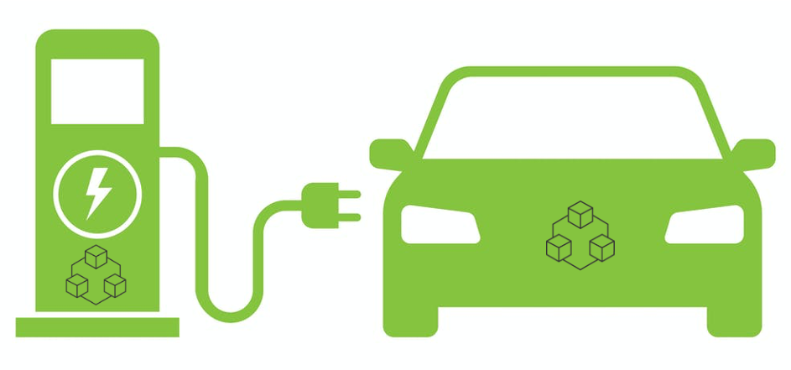
Overview of EV Charging (systems, services)
CNO₂ cloud
MSP₂ cloud
OEM₂ cloud
Reseller/Self
Partner/Self
Roaming
Reseller
CNO₁ cloud
Reseller
MSP₁ cloud
OEM₁ cloud
Reseller
Partner
Reseller/Self
Partner/Self
Foundation: safe energy exchange via coupler (connector+inlet), controlled by communication between state machines in EV and EVSE.

Slide 4
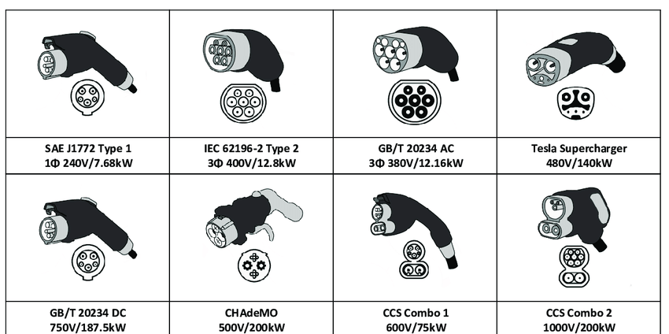
Overview of EV Charging (couplers, comms)
AC charging: analog control (so far*)
DC charging: digital signaling between EV-EVSE
EV-EVSE Communications
CHAdeMO, GB/T:
CAN bus / packets
CCS:
BPLC / IP / TCP / [TLS**] / XML (EXI)
Tesla:
SW-CAN / packets
* AC charging using messages over TCP/IP is defined in ISO 15118-2 but not yet implemented, since analog control plus CSP service logic works just fine.
** ISO 15118-2 and -20 define Certificate Profiles for TLS endpoints (EV and EVSE) but no PKI requirements. An industry group is developing those in SAE Intn’l.

Slide 5
Overview of EV Charging (cybersecurity)
Focus on EV-EVSE communication link
Critical function: must be operational and resilient
Almost no apparent protection = attractive attack surface
Everything “northward” is M2M (secure 4G) & cloud2cloud
Acknowledging other obvious, well-understood attack vectors (RFID/CC readers, attainable ETH & USB ports, etc.)
Summary of the two variants (details next slide)
CAN bus: presents less ‘interesting’ opportunities
BPLC: has been hacked and remains vulnerable

Slide 6
Overview of EV Charging (cybersecurity)
CAN bus stack (CHAdeMO, GB/T)
Differential signaling in cable (UTP) is hard to sniff, disturb
State machines are limited to energy transfer, no “higher level services” (such as AAA, payment transactions)
BPLC/IP/TCP stack
Cable radiates 2-28 MHz energy (HomePlug Green PHY)
Readily sniff-able from 10+m distance, Wireshark interception: 99% of packets
DoS attack has been disclosed (Brokenwire, Univ. Oxford cybersecurity research team)
Almost all DC charging in NA (CCS) must utilize the DIN 70121 protocol
A very small % of EV models can use TLS (v1.2, one-way per ISO 15118-2)
Only one CSP in NA currently supports the TLS handshake (per ISO 15118-2)
So almost all EV models and almost all stations use unprotected TCP/IP per DIN 70121
Mitigations being explored, but wide-scale deployment would be very challenging
I believe IEEE 802 could provide a superior (secure LAN) foundation

Slide 7
Opportunity for IEEE 802 vertical application
Explore a ‘Secure L2 EV charging comms fabric’
Develop LAN architecture/s supporting site-level (depot) operations
Towards a secure, cohesive, extensible ‘EV charging edge’
Draw on existing and coming 802.1/.3/.11 standards
Explore how 802 services for TSN, location, and privacy could enhance site operations and systems integration
Example next-generation (fleet) EV charging uses cases
Use Wi-Fi for transactional services, robotics, and AV control
Use SPE for end-to-end control and management of high-power EV charging systems, integrating building/site DERs and the electrical utility edge
Use VLANs to provide security and QOS for high-volume EV/AV data applications, e.g. GIS data refresh, route and schedule optimization, media services, trusted vehicle ECU FW/SW updates, etc.

Slide 8
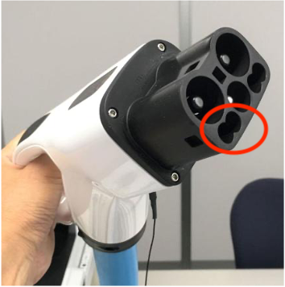
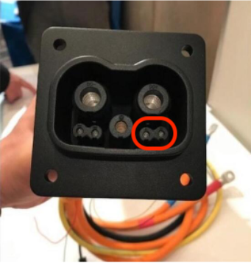
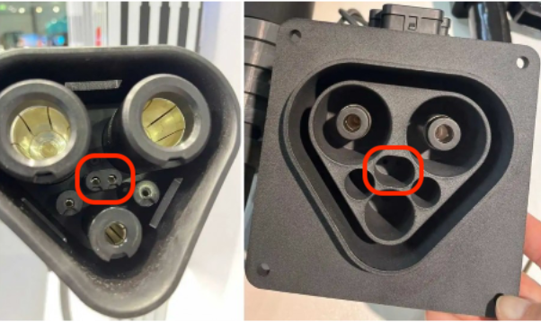
Concrete, near-term example #1
Use 802.3 (SPE?) for control and management of high-power EV charging systems
Both couplers have 2x pins with ~8mm spacing for comms
CHAdeMO/ChaoJi are now testing “Two-wire Ethernet” over these pins
MCS group is exploring alternatives to BPLC (CAN bus, 10Base-T1S)
CHAdeMO 3.0 aka ChaoJi
Megawatt Charging System (MCS)

Slide 9
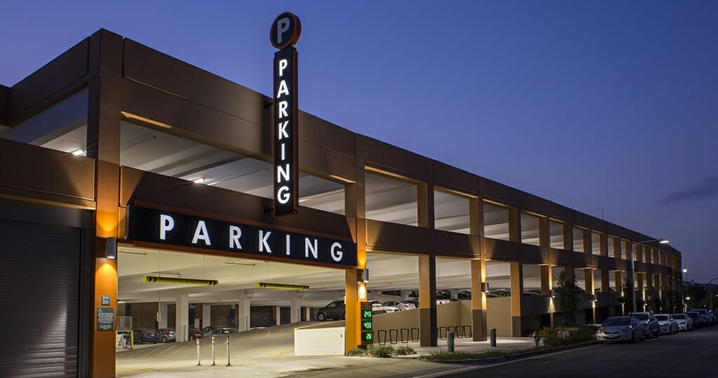
Concrete, near-term example #2
Use Wi-Fi for “over-the-top” transaction services, e.g.
EV joins site Wi-Fi network, negotiates service parameters
On-site/cloud services platform directs EV to EVSE
Conductive coupling can be robotic, controlled over Wi-Fi
Charging control (conductive or inductive) can be Wi-Fi messages as well

Slide 10
Discussion, next steps
Thank you very much!
c.rodine@ieee.org
crrodin@sandia.gov

