Slide 1
802.24.1 Smart Grid TAG
Consolidated White Paper Presentation
Date: March 7, 2016
Authors: The 802.24 TAG

Slide 2
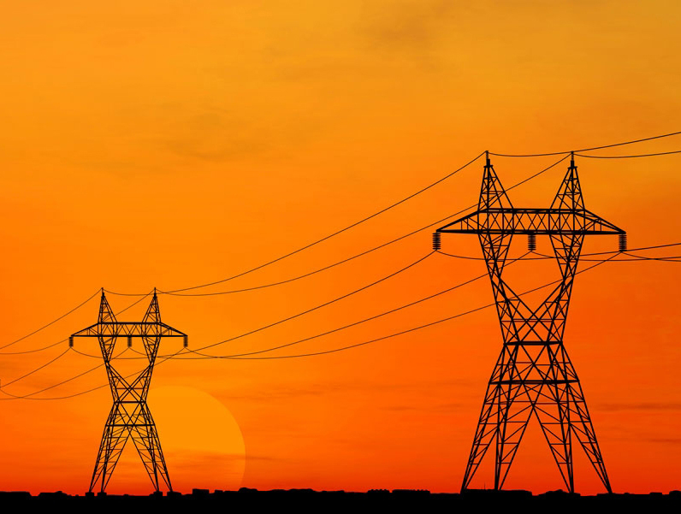

IEEE-SA Smart Grid

Slide 3
Smart Grid
Smart Grid is defined as:
  Providing bidirectional communication of power quality, supply, and demand across the power grid to utilize electricity more dynamically resulting in increased energy efficiency and power grid reliability. This change is necessary to manage the increased variability caused by renewable resources, the increased peak demand created by energy intensive consumers such as electric vehicles, and to minimize the environmental impact of ever increasing aggregate demand for electrical power.
Notes:
Split into two.

Slide 4
IEEE 802 and Smart Grid
IEEE 802 networking technologies bring the following advantages to Smart Grid communications:
  Enterprise grade security compatibility
  Huge ecosystem (billions of products, hundreds of manufacturers)
  Long-term (20 year), battery-powered operation
  Continued operation during line fault events when using wireless media
  Wide choice of products across the spectrum of power versus performance
  Ability to be implemented in resource-constrained devices
  Ongoing development of standards to address changing environment and technology
  Wireless standards that operate in a licensed and license-exempt spectrum
  Offers a rich set of data rate/range/latency tradeoffs
  Common upper layer interface to seamlessly integrate into existing IT systems

Slide 5
IEEE 802 Standards Applicable to Grid Communications
IEEE Std 802.1™ for bridging, time-sensitive networks, and link security
IEEE Std 802.3™ (Ethernet) for wired LANs
IEEE Std 802.11™ (Wi-Fi) for wireless LAN and HAN
IEEE Std 802.15™ (ZigBee and Wi-SUN) for HAN and AMI networks (NAN)
IEEE Std 802.16™ (WiMAX) for FAN and MAN
IEEE Std 802.21™ for media independent handover and multicast group management
IEEE Std 802.22™ for wireless regional area networks (WRAN) in TV white space (TVWS) bands

Slide 6
The Integrated Grid
Graphic Courtesy of EPRI
Notes:
Clarify the meaning of “intelligence” with a new bullet
Remove or clean-up figure. Larger text.
More inclusive phrase (considering water and gas applications as well)? Find a phrase that avoids “Smart Grid”

Slide 7









Summary of utility communications protocols
Application
Layer
Other Applications
Metering
IEC 61968 CIM, ANSI C12.22,
DLMS/COSEM,…
SCADA
IEC 61850, 60870
DNP3/IP, Modbus/TCP,…
DNS, NTP, IPfix/Netflow, SSH
RADIUS, AAA, LDAP, SNMP,…
(RFC 6272 IP in Smart Grid)
Session
Layer
Web Services, EXI, SOAP,
RestFul,HTTPS/CoAP
Transport
Layer
DTLS/TLS
UDP/TCP
Network
Layer
IPv6/IPv4
Addressing, Routing, Multicast, QoS, Security
IPv6 RPL
Data
Link
Layer
802.1X / EAP-TLS & IEEE 802.11i based Access Control
IPv6 over PPP
(RFC 5072)
LLC`
6LoWPAN (RFC 6282)
IPv6 over Ethernet (RFC 2464)
IP or Ethernet
Convergence SubL.
802.15.9 KMP
M
A
C
IEEE 802.15.4e MAC enhancements
IEEE 802.11
Wi-Fi
IEEE 802.3
Ethernet
IEEE 802.16
WiMAX
IEEE 802.22
WRAN
2G, 3G, LTE
Cellular
IEEE 802.15.4
including FHSS
IEEE 1901.2
802.15.4 frame
format
Physical
Layer
IEEE 802.15.4g
2.4GHz, 915, 868MHz
DSSS, FSK, OFDM
IEEE 1901.2
NB-PLC
OFDM
IEEE 802.11
Wi-Fi
2.4, 5 GHz, Sub-GHz
IEEE 802.3
Ethernet
UTP, FO
IEEE 802.16
WiMAX
1.x - 3.x GHz
IEEE 802.22
TV White
Space
2G, 3G, LTE
Cellular

Slide 8
Overview of AMI Applications
Meter Reading
Theft Detection
Prepay Metering
Integration of Renewables
Electric
Demand Response
Time Of Use
  Service Disconnect/Reconnect
  Outage and Restoration Management
  Voltage and VAr Optimization (power factor monitoring)
Gas / Water
  Leak Detection
  Seismic Event
  Cathodic Protection

Slide 9


SG Network Architecture
High level example of an Advanced Metering Infrastructure system
Internet
May be called FAN or NAN
Data Aggregation Point
Optional – within customer premises
Notes:
Explain that this is an example for a home, but the customer could be a business, industrial, etc.

Slide 10
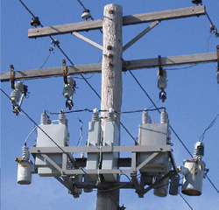
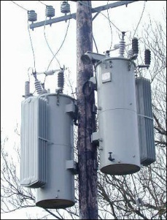
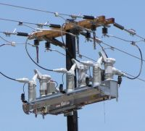
Overview of DA Applications
Distribution Automation (DA) involves monitoring and control of devices on the medium voltage (2 kV to 35 kV) grid, which provides the connection between a substation and customer transformer
DA Applications include:
  Voltage VAr (Capacitor Bank Control)
    Compensating for reactive power losses due to inductive load by switching in capacitor banks on the distribution circuit
  Voltage regulation
    Compensating for voltage loss and varying voltage due to load by changing taps on a specialized autotransformer
  Switching / Sectionalizers
    Remotely switching the connectivity of the distribution grid to balance load or route power around damaged areas.
Notes:
Add DER example here too.

Slide 11
Security Overview
Something on cyber security and IEEE 802
Scope limited to link-layer
Support higher layer security protocols (required in most cases)
Evolution to AES256 – future
List in SP800-57
References to FIPS, 2006 version, and later versions.
We would like to show how IEEE 802 fits into a comprehensive security architecture.
Generally 802 provides layer 2 authentication and encryption. Show key management interfaces and mechanisms. Cypher suites
NISTIR (Phil Beecher to provide this. Describe PKI, EAPOL, KMP, )
X – Y chart showing NISTIR requirements in rows, and 802 protocols in columns

Slide 12
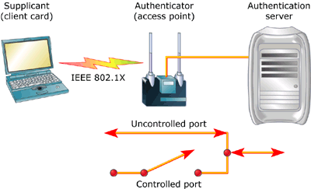
802.1X Security
802.1X is the industry standard for port-based authentication on “Ethernet like” networks, and 802.15.4 networks with 802.15.9 KMP
Supplicant can communicate only with Authentication server until authenticated.
Multiple types of Extensible Authentication Protocol (EAP) are supported
Once security between the supplicant and authenticator is established, Controlled Port is activated, granting full access.

Slide 13
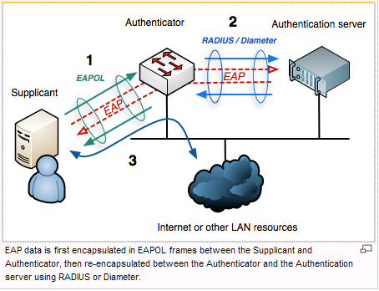
802.1X Authentication
EAP enables master keys to be provided by Authentication server in secure location.

Slide 14
802.11 Security
802.11 originally offered Wired Equivalent Privacy (WEP)
  Significant vulnerabilities were discovered ⁽¹⁾ – now deprecated
The 802.11i amendment updated the security architecture.
The Wi-Fi Alliance developed two phases of Wi-Fi Protected Access (WPA) based on 802.11i
  WPA was backward compatible to legacy 802.11b chipsets, using TKIP encryption. It has been deprecated.
  WPA2 has mandatory support for AES-CCMP encryption.
WPA and WPA2 can use different authentication methods:
  WPA-PSK Pre-shared key entered by the user
  WPA-Enterprise Uses 802.1X authentication in conjunction with a RADIUS server. Various forms of EAP are supported
  WPS Wi-Fi Protected Setup – uses a PIN to simplify PSK setup, but introduces vulnerabilities in some implementations
(1) https://en.wikipedia.org/wiki/Wired_Equivalent_Privacy

Slide 15
802.15 Security
802.15.4 security
  AES-CCM-128 provides confidentiality and message authentication on the link layer. Supports both per peer keys and group keys.
  How keys are used and created is left for the upper layers
802.15.9 KMP
  Provides support for running existing KMPs over the 802.15.4 frames.
  KMP frame fragmentation & multiplexing.
  Supports creating and deleting both per peer keys and group keys.
  Uses existing KMPs: IKEv2, HIP, 802.1X, PANA, Dragonfly, 802.11/4WH, 802.11/GKH, ETSI TS 102 887-2.
  Different KMPs have different authentication features: pre shared keys, raw public keys, certificates, other EAP methods.

Slide 16
802.16 Security
802.16 has been deployed based on two standards with different security implementations. A few smart grid deployments were based on IEEE 802.16-2004, but most are using 802.16-2009.
Standard | Identity | Authentication | Mutual Authentication | Replay Protection | Cryptographic algorithms
IEEE 802.16-2004 | X.509 digital certificates | PKMv1 | No | Yes – packet numbering | DES in cipher block chaining (CBC) mode (DES-CBC).
802.16-2009 802.16-2012 | X.509 digital certificates that include MAC address | PKMv2: RSA and EAP based authentication | Yes | Yes – packet numbering | DES-CBC and AES (with CBC, CTR, and CCM)

Slide 17
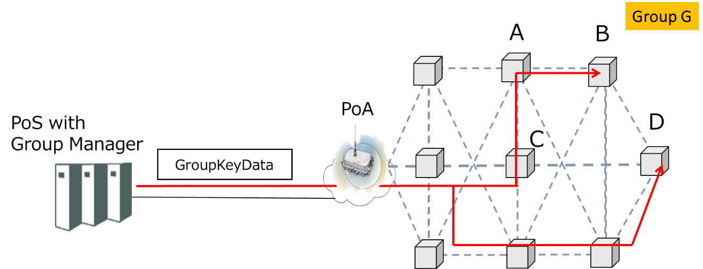
Security for 802.21d
Multicast Group Management
IEEE 802.21d standardizes a mechanism for distributing a symmetric key to group members, securely and efficiently.
Group Ciphersuites:
AES CCM-128 Encryption and message authentication
ECDSA-256 Digital Signature Algorithm
Group key distribution Ciphersuites
Wrapping: AES_KeyWrapping-128, AES_ECB-128
Message Authentication: AES-CMAC-128

Slide 18
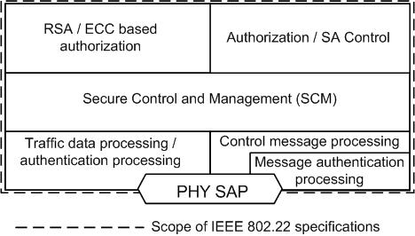
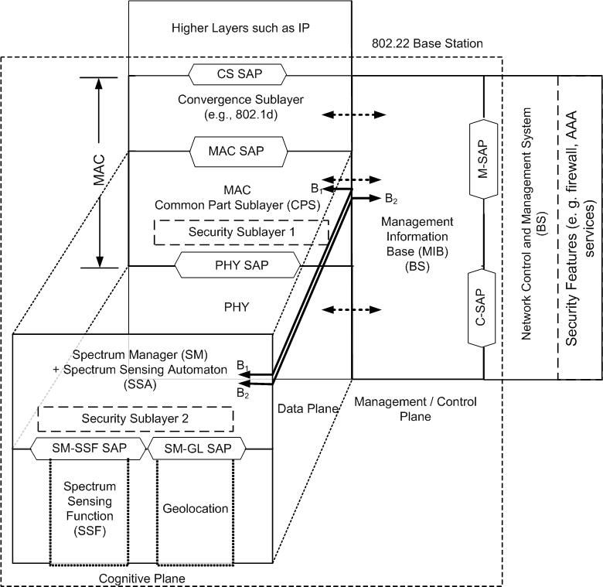
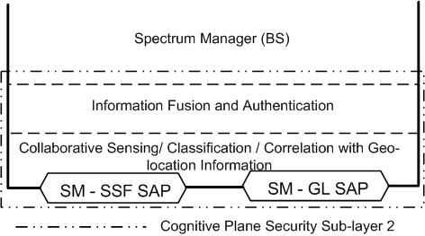
802.22 Security
Security Sub-layer 1
encryption
Security Sub-layer 2
IEEE 802.22 (Wi-FAR™) Standard on Cognitive Radio based Wireless Regional Area Networks (WRAN) defines Security Sublayers for traditional communications layers and also its Cognitive Functions. More information mat be found here. (Slides 13 and 14)

Slide 19
Non Mains and Low Power Applications
Example applications that take advantage of low power operation, (water, oil/gas, line sensors)
Example of “constrained” types of devices
Notes:
Chris Calvert will create this

Slide 20
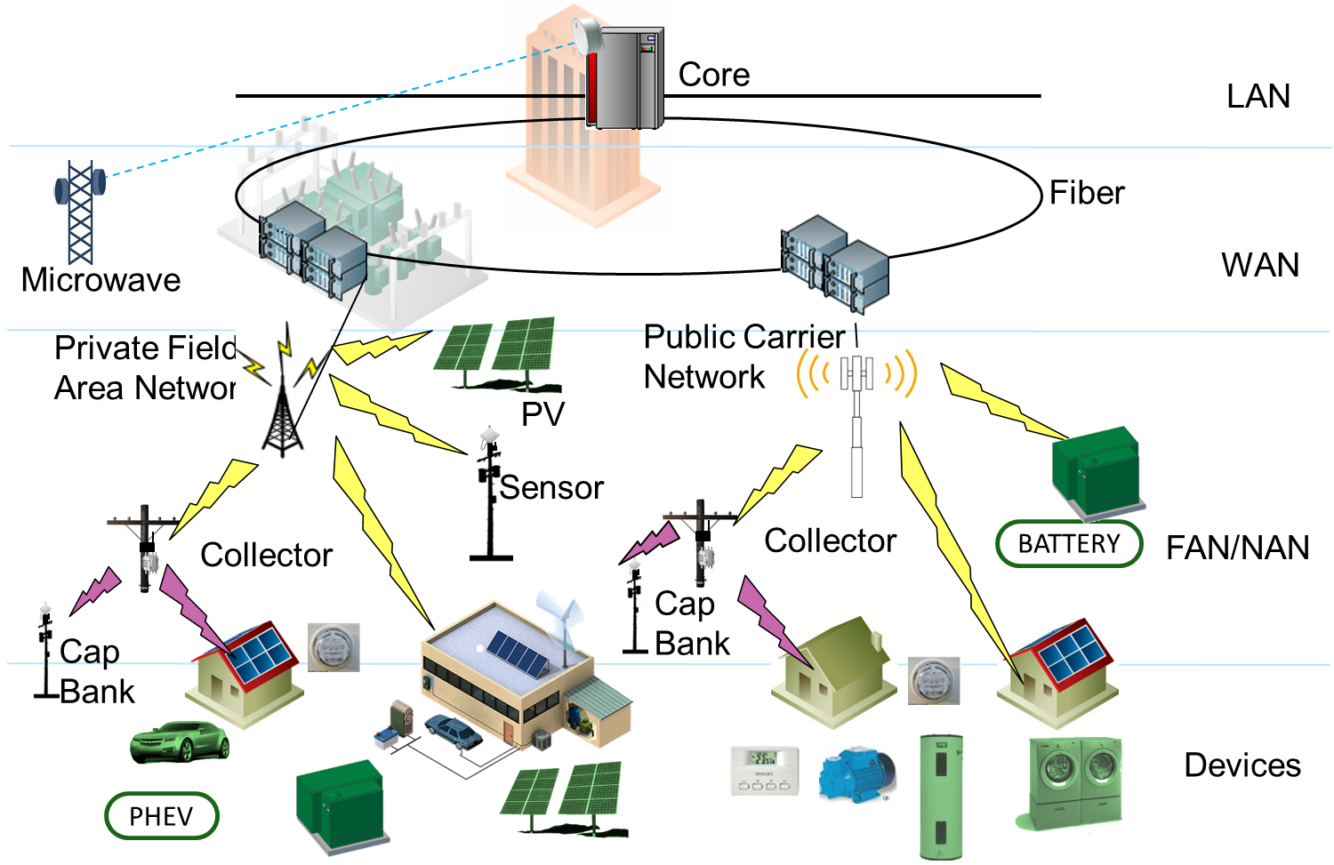
IEEE 802 Standards for Grid Communications Networks
IEEE 802.3
IEEE 802.11
IEEE 802.3 1000BASE-X
IEEE 802.22
IEEE 802.16
IEEE 802.11
(Mesh Topology)
IEEE 802.15.4:
(SUN, LECIM, TVWS)
IEEE 802.11ah, 802.11af
IEEE 802.11
IEEE 802.15.4

Slide 21
Complementary Communications Technologies
Narrowband Power Line Communications (PLC) is used in some geographic areas for metering and other purposes.
  Operation below 500 KHz
  PLC technologies are difficult to scale into applications that do not have a connection to the electric grid (water, gas, etc)
  IEEE P1901.2
Commercial wireless network operators are often employed, both for backhaul and direct connection to grid devices and meters.

Slide 22
Why is mesh networking used
The advantages of mesh networks are:
Extending connectivity to nodes that would otherwise be out of range
To increase reliability if a node fails or is unable to communicate due to interference
To provide redundant paths to backhaul networks
To reduce power consumption due to shorter transmission distance

Slide 23
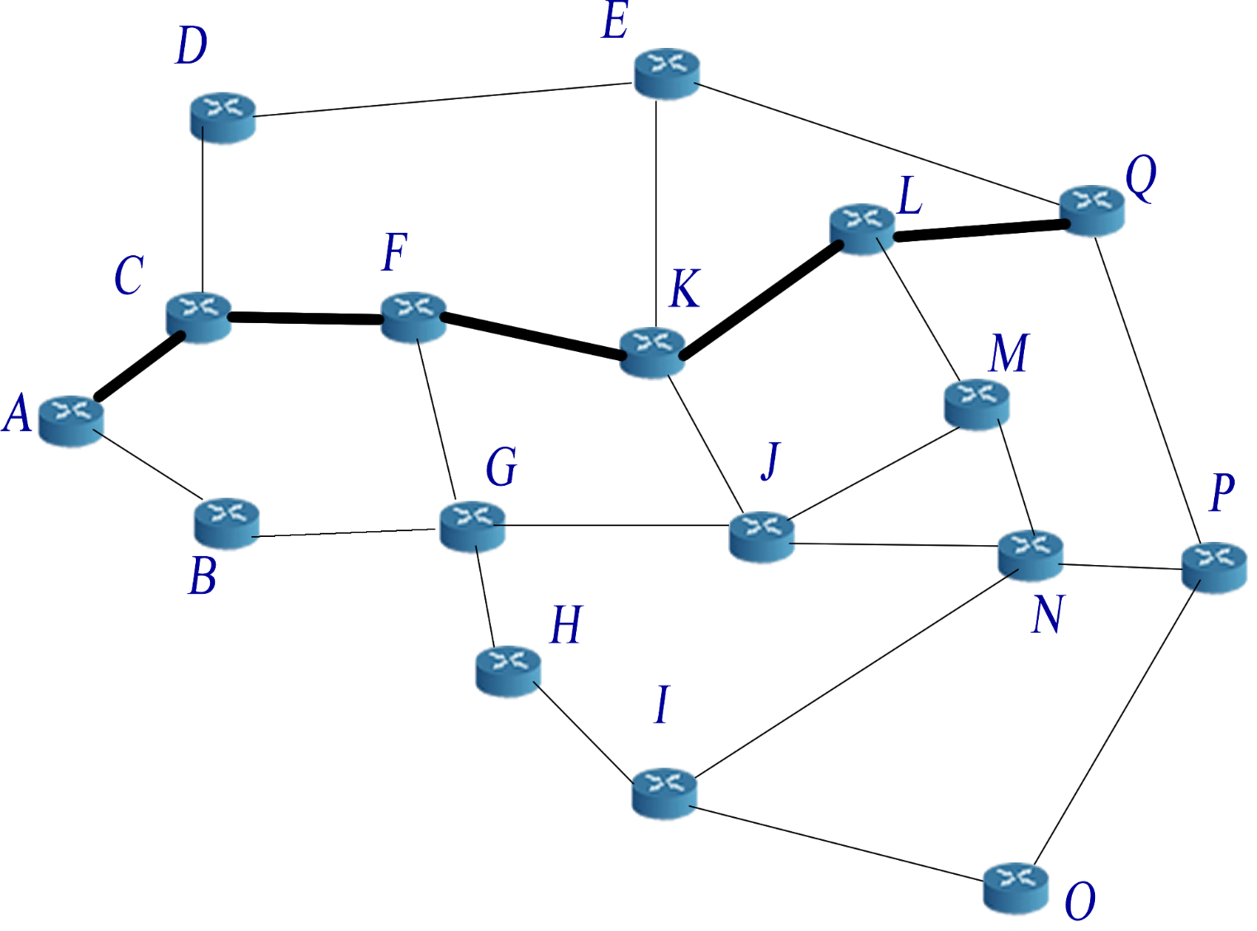
Example of Mesh Network
http://upload.wikimedia.org/wikipedia/commons/c/c5/17_node_mesh_network.png
Notes:
Look in L2R contributions.

Slide 24
Lifecycle Considerations
Many utility field networks and devices are expected to have a lifetime of 15 or more years.
IEEE 802 standards continue to evolve, but typically provide a backward compatibility path to older versions, enabling extended life cycles.

Slide 25
Backup Section

Slide 26
802.11 – Spectrum / Rate view
.11ad
500MHz
1GHz
2GHz
5GHz
10GHz
60GHz
802.11ac
500Mbps
802.11n
802.11n
100Mbps
.11af
.11ah
802.11g
.11y
.11j
802.11a
.11p
10Mbps
802.11
802.11b
1Mbps

Slide 27
802.15.4 PHY Overview (data rate vs frequency)
10Kbps
100Kbps
1Mbps
5GHz
O-QPSK
CSS
CSS
2GHz
4g 2FSK
4g 2FSK
4g 4FSK
4g O-QPSK
4g ODFM
4g 2FSK
4g 2FSK
4g 4FSK
1GHz
4g ODFM
BPSK DSSS
4g 2FSK
GFSK
4g 2FSK
O-QPSK, ASK
920
4g 4FSK
915
4g ODFM
BPSK DSSS
O-QPSK
868
4g O-QPSK
BPSK DSSS
O-QPSK, ASK
863
4g ODFM
780
O-QPSK, ASK
MPSK
500MHz
4g O-QPSK
4g 2FSK
4g 2FSK
4g 4FSK
4g 2FSK
4g ODFM

Slide 28
SG Network Architecture
Notes:
Backup section – only used by those who have the background.

