Slide 1

  802.16 GRIDMAN Task Group - Session #109
[IEEE 802.16 Mentor Presentation Template (Rev. 0)]
Document Number:
  IEEE 802. 16-17-0031-00-000s.
  Date Submitted:
  31-May-2017
Source:
  Tim Godfrey Voice:
  EPRI E-mail:
  *<http://standards.ieee.org/faqs/affiliationFAQ.html>
Re:
Base Contribution:
  N/A
Purpose:
  Session #109 Task Group Meeting Presentation (May 2017)
Notice:
  This document does not represent the agreed views of the IEEE 802.16 Working Group or any of its subgroups. It represents only the views of the participants listed in the “Source(s)” field above. It is offered as a basis for discussion. It is not binding on the contributor(s), who reserve(s) the right to add, amend or withdraw material contained herein.
Copyright Policy:
  The contributor is familiar with the IEEE-SA Copyright Policy <http://standards.ieee.org/IPR/copyrightpolicy.html>.
Patent Policy:
  The contributor is familiar with the IEEE-SA Patent Policy and Procedures:
      <http://standards.ieee.org/guides/bylaws/sect6-7.html#6> and <http://standards.ieee.org/guides/opman/sect6.html#6.3>.
  Further information is located at <http://standards.ieee.org/board/pat/pat-material.html> and <http://standards.ieee.org/board/pat >.

Slide 2
GRIDMAN Discussion Items
Link to Agenda
Review of Comments Sponsor Ballot on P802.16s/D2

Slide 3
Participants, Patents, and Duty to Inform
All participants in this meeting have certain obligations under the IEEE-SA Patent Policy.
  Participants [Note: Quoted text excerpted from IEEE-SA Standards Board Bylaws subclause 6.2]:
    “Shall inform the IEEE (or cause the IEEE to be informed)” of the identity of each “holder of any potential Essential Patent Claims of which they are personally aware” if the claims are owned or controlled by the participant or the entity the participant is from, employed by, or otherwise represents
    “Should inform the IEEE (or cause the IEEE to be informed)” of the identity of “any other holders of potential Essential Patent Claims” (that is, third parties that are not affiliated with the participant, with the participant’s employer, or with anyone else that the participant is from or otherwise represents)
  The above does not apply if the patent claim is already the subject of an Accepted Letter of Assurance that applies to the proposed standard(s) under consideration by this group
  Early identification of holders of potential Essential Patent Claims is strongly encouraged
  No duty to perform a patent search
Slide #1

Slide 4
Patent Related Links
  All participants should be familiar with their obligations under the IEEE-SA Policies & Procedures for standards development.
  Patent Policy is stated in these sources:
  IEEE-SA Standards Boards Bylaws
  http://standards.ieee.org/develop/policies/bylaws/sect6-7.html#6
  IEEE-SA Standards Board Operations Manual
  http://standards.ieee.org/develop/policies/opman/sect6.html#6.3
  Material about the patent policy is available at
  http://standards.ieee.org/about/sasb/patcom/materials.html
If you have questions, contact the IEEE-SA Standards Board Patent Committee Administrator at patcom@ieee.org or visit http://standards.ieee.org/about/sasb/patcom/index.html
This slide set is available at https://development.standards.ieee.org/myproject/Public/mytools/mob/slideset.ppt
Slide #2

Slide 5
Call for Potentially Essential Patents
If anyone in this meeting is personally aware of the holder of any patent claims that are potentially essential to implementation of the proposed standard(s) under consideration by this group and that are not already the subject of an Accepted Letter of Assurance:
  Either speak up now or
  Provide the chair of this group with the identity of the holder(s) of any and all such claims as soon as possible or
  Cause an LOA to be submitted
Slide #3

Slide 6
Other Guidelines for IEEE WG Meetings
All IEEE-SA standards meetings shall be conducted in compliance with all applicable laws, including antitrust and competition laws.
  Don’t discuss the interpretation, validity, or essentiality of patents/patent claims.
  Don’t discuss specific license rates, terms, or conditions.
    Relative costs, including licensing costs of essential patent claims, of different technical approaches may be discussed in standards development meetings.
      Technical considerations remain primary focus
  Don’t discuss or engage in the fixing of product prices, allocation of customers, or division of sales markets.
  Don’t discuss the status or substance of ongoing or threatened litigation.
  Don’t be silent if inappropriate topics are discussed … do formally object.
---------------------------------------------------------------
See IEEE-SA Standards Board Operations Manual, clause 5.3.10 and “Promoting Competition and Innovation: What You Need to Know about the IEEE Standards Association's Antitrust and Competition Policy” for more details.
Slide #4

Slide 7
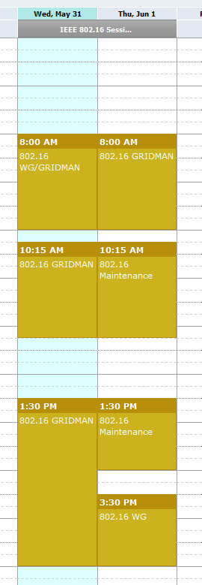
Meeting Plan
Wednesday 5/31
Thursday 6/1

Slide 8
Project Plan and Milestones
May 2017 SB Comment resolution, recirculation
July 2017 Sponsor Recirculation
Comment Resolution
802 EC: Forward to RevCom
Sept 2017 RevCom Approval

Slide 9
Results of Ballot on P802.16s/D2
P802.16s/D2 Sponsor Ballot has completed. The results are:
  49 Approve (100%)
  0 Disapprove
  2 Abstain (3%)
  8 not voting (84% return)

Slide 10
Comment Resolution
Proposed Resolutions in 802.16-17-002r0
  P802.16s/D2 Sponsor Ballot comments-with-Editor-Dispositions

Slide 11
TG Closing
Authorize a Sponsor Recirculation Letter Ballot
  "To conduct a 10 day Sponsor Recirculation Letter Ballot on Draft P802.16s/D3”
    Moved
    Second
    Vote
Planned Teleconferences
  None

