Slide 1

  802.16 GRIDMAN Task Group - Session #106
[IEEE 802.16 Mentor Presentation Template (Rev. 0)]
Document Number:
  IEEE 802. 16-17-0005-00-000s
  Date Submitted:
  17-Jan-2017
Source:
  Tim Godfrey Voice:
  EPRI E-mail:
  *<http://standards.ieee.org/faqs/affiliationFAQ.html>
Re:
Base Contribution:
  N/A
Purpose:
  Session #107 Task Group Meeting Presentation (January 2017)
Notice:
  This document does not represent the agreed views of the IEEE 802.16 Working Group or any of its subgroups. It represents only the views of the participants listed in the “Source(s)” field above. It is offered as a basis for discussion. It is not binding on the contributor(s), who reserve(s) the right to add, amend or withdraw material contained herein.
Copyright Policy:
  The contributor is familiar with the IEEE-SA Copyright Policy <http://standards.ieee.org/IPR/copyrightpolicy.html>.
Patent Policy:
  The contributor is familiar with the IEEE-SA Patent Policy and Procedures:
      <http://standards.ieee.org/guides/bylaws/sect6-7.html#6> and <http://standards.ieee.org/guides/opman/sect6.html#6.3>.
  Further information is located at <http://standards.ieee.org/board/pat/pat-material.html> and <http://standards.ieee.org/board/pat >.

Slide 2
GRIDMAN Discussion Items
Link to Agenda
Review Contributions
Review of System Requirements Document
Review and Development of System Description Document
Develop Table of Contents of Draft Standard

Slide 3
Participants, Patents, and Duty to Inform
All participants in this meeting have certain obligations under the IEEE-SA Patent Policy.
  Participants [Note: Quoted text excerpted from IEEE-SA Standards Board Bylaws subclause 6.2]:
    “Shall inform the IEEE (or cause the IEEE to be informed)” of the identity of each “holder of any potential Essential Patent Claims of which they are personally aware” if the claims are owned or controlled by the participant or the entity the participant is from, employed by, or otherwise represents
    “Should inform the IEEE (or cause the IEEE to be informed)” of the identity of “any other holders of potential Essential Patent Claims” (that is, third parties that are not affiliated with the participant, with the participant’s employer, or with anyone else that the participant is from or otherwise represents)
  The above does not apply if the patent claim is already the subject of an Accepted Letter of Assurance that applies to the proposed standard(s) under consideration by this group
  Early identification of holders of potential Essential Patent Claims is strongly encouraged
  No duty to perform a patent search
Slide #1

Slide 4
Patent Related Links
  All participants should be familiar with their obligations under the IEEE-SA Policies & Procedures for standards development.
  Patent Policy is stated in these sources:
  IEEE-SA Standards Boards Bylaws
  http://standards.ieee.org/develop/policies/bylaws/sect6-7.html#6
  IEEE-SA Standards Board Operations Manual
  http://standards.ieee.org/develop/policies/opman/sect6.html#6.3
  Material about the patent policy is available at
  http://standards.ieee.org/about/sasb/patcom/materials.html
If you have questions, contact the IEEE-SA Standards Board Patent Committee Administrator at patcom@ieee.org or visit http://standards.ieee.org/about/sasb/patcom/index.html
This slide set is available at https://development.standards.ieee.org/myproject/Public/mytools/mob/slideset.ppt
Slide #2

Slide 5
Call for Potentially Essential Patents
If anyone in this meeting is personally aware of the holder of any patent claims that are potentially essential to implementation of the proposed standard(s) under consideration by this group and that are not already the subject of an Accepted Letter of Assurance:
  Either speak up now or
  Provide the chair of this group with the identity of the holder(s) of any and all such claims as soon as possible or
  Cause an LOA to be submitted
Slide #3

Slide 6
Other Guidelines for IEEE WG Meetings
All IEEE-SA standards meetings shall be conducted in compliance with all applicable laws, including antitrust and competition laws.
  Don’t discuss the interpretation, validity, or essentiality of patents/patent claims.
  Don’t discuss specific license rates, terms, or conditions.
    Relative costs, including licensing costs of essential patent claims, of different technical approaches may be discussed in standards development meetings.
      Technical considerations remain primary focus
  Don’t discuss or engage in the fixing of product prices, allocation of customers, or division of sales markets.
  Don’t discuss the status or substance of ongoing or threatened litigation.
  Don’t be silent if inappropriate topics are discussed … do formally object.
---------------------------------------------------------------
See IEEE-SA Standards Board Operations Manual, clause 5.3.10 and “Promoting Competition and Innovation: What You Need to Know about the IEEE Standards Association's Antitrust and Competition Policy” for more details.
Slide #4

Slide 7
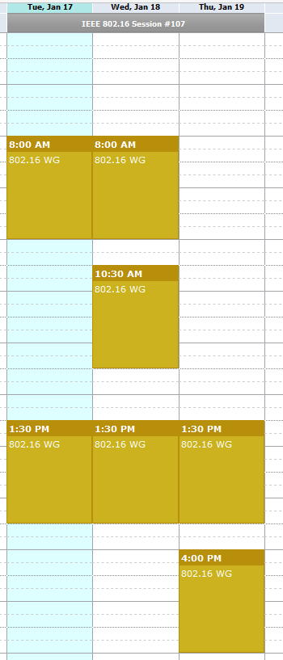
Meeting Plan for Week
802.16 WG
  Tuesday AM1
  Thursday PM2
GRIDMAN TG (802.16s)
  Tuesday PM1
  Wednesday AM1, AM2
  Wednesday PM1
  Thursday PM1

Slide 8
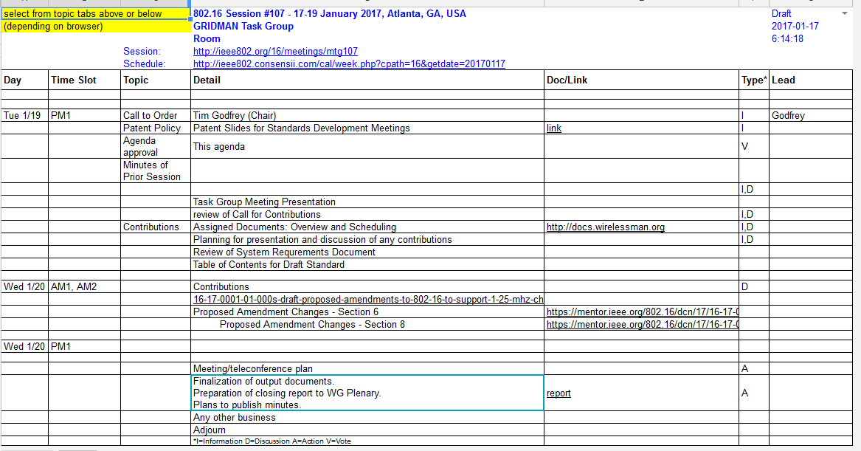
Agenda
From docs.google.com

Slide 9
Project Plan and Milestones
Jan 2017 Complete Draft Development, WG Letter Ballot
Mar 2017 Comment Resolution, recirc,
Conditional Sponsor Ballot
May 2017 Comment resolution, recirculation
July 2017 Forward to RevCom

Slide 10
Plan for presentation and discussion of contributions
16-17-0001r1 Draft: Proposed Amendments to 802.16 to Support <1.25 MHz Channels
  Doug Gray
16-17-0002r1 Proposed Amendment Changes - Section 6
  Menashe Shahar (Full Spectrum
16-17-0003r0 Proposed Amendment Changes - Section 8
  Menashe Shahar (Full Spectrum)

Slide 11
System Requirements Document
Approved SRD is posted as 802.16-16-0034r4

Slide 12
Presentation of Contributions

Slide 13
System Description Document SDD
Current version 802.16-16-44r7
https://mentor.ieee.org/802.16/dcn/16/16-16-0044-07-000s-802-16s-draft-system-description-document-sdd.docx

Slide 14
SDD Discussion - November
Update draft to 0044r5
  Change channel BW to “100 KHz to 1.25 MHz in steps of 50 KHz.”
  Develop tables to ultimately insert in clause 12.9 system profile
  Determine optimal set of sampling clock choices
To Be Developed
  Table for PHY Parameters (Clause 12 Profile Format)
  Updated MAC Overhead Calculation

Slide 15
Draft Structure (Nov)
MAC - clause 6.3
  6.3.2.3 - For DL MAP and UL MAP MAC messages, the generic MAC Header (6.3.2.1.1) is modified for narrow channel.
    In 6.2.3.2.3, define a replacement header for each type of MAP (DL and UL), to be used in place of the generic MAC header.
  Modify table 6-53 for MAC overhead reduction
  Need to re-define some IE formats (shortened form)
    8.4.5.3 DL-MAP IE format
    8.4.5.4 UL-MAP IE format

Slide 16
Open Issues
Do we design the profile table with a built-in guard-band?

Slide 17
Accomplishments at November meeting
Approved SRD : 802.16-16-0034r4
Reviewed contributions
Developed SDD
  Version at end of meeting 802.16-16-0044r7

Slide 18
TG Closing
Assignment of Technical Editor
Review draft for completeness
Authorize a WG Letter Ballot
Planned Teleconferences

Slide 19
Reference

