Slide 1
802.16 GRIDMAN Task Group - Session #106
[IEEE 802.16 Mentor Presentation Template (Rev. 0)]
Document Number:
IEEE 802. 16-16-0058-00-000s
Date Submitted:
8-Nov-2016
Source:
Tim Godfrey Voice:
EPRI E-mail:
*<http://standards.ieee.org/faqs/affiliationFAQ.html>
Re:
Base Contribution:
N/A
Purpose:
Session #106 Task Group Meeting Presentation (November 2016)
Notice:
This document does not represent the agreed views of the IEEE 802.16 Working Group or any of its subgroups. It represents only the views of the participants listed in the “Source(s)” field above. It is offered as a basis for discussion. It is not binding on the contributor(s), who reserve(s) the right to add, amend or withdraw material contained herein.
Copyright Policy:
The contributor is familiar with the IEEE-SA Copyright Policy <http://standards.ieee.org/IPR/copyrightpolicy.html>.
Patent Policy:
The contributor is familiar with the IEEE-SA Patent Policy and Procedures:
<http://standards.ieee.org/guides/bylaws/sect6-7.html#6> and <http://standards.ieee.org/guides/opman/sect6.html#6.3>.
Further information is located at <http://standards.ieee.org/board/pat/pat-material.html> and <http://standards.ieee.org/board/pat >.

Slide 2
GRIDMAN Discussion Items
Link to Agenda
Review Contributions
Review of System Requirements Document
Review and Development of System Description Document
Develop Table of Contents of Draft Standard

Slide 3
Participants, Patents, and Duty to Inform
All participants in this meeting have certain obligations under the IEEE-SA Patent Policy.
Participants [Note: Quoted text excerpted from IEEE-SA Standards Board Bylaws subclause 6.2]:
“Shall inform the IEEE (or cause the IEEE to be informed)” of the identity of each “holder of any potential Essential Patent Claims of which they are personally aware” if the claims are owned or controlled by the participant or the entity the participant is from, employed by, or otherwise represents
“Should inform the IEEE (or cause the IEEE to be informed)” of the identity of “any other holders of potential Essential Patent Claims” (that is, third parties that are not affiliated with the participant, with the participant’s employer, or with anyone else that the participant is from or otherwise represents)
The above does not apply if the patent claim is already the subject of an Accepted Letter of Assurance that applies to the proposed standard(s) under consideration by this group
Early identification of holders of potential Essential Patent Claims is strongly encouraged
No duty to perform a patent search
Slide #1

Slide 4
Patent Related Links
All participants should be familiar with their obligations under the IEEE-SA Policies & Procedures for standards development.
Patent Policy is stated in these sources:
IEEE-SA Standards Boards Bylaws
http://standards.ieee.org/develop/policies/bylaws/sect6-7.html#6
IEEE-SA Standards Board Operations Manual
http://standards.ieee.org/develop/policies/opman/sect6.html#6.3
Material about the patent policy is available at
http://standards.ieee.org/about/sasb/patcom/materials.html
If you have questions, contact the IEEE-SA Standards Board Patent Committee Administrator at patcom@ieee.org or visit http://standards.ieee.org/about/sasb/patcom/index.html
This slide set is available at https://development.standards.ieee.org/myproject/Public/mytools/mob/slideset.ppt
Slide #2

Slide 5
Call for Potentially Essential Patents
If anyone in this meeting is personally aware of the holder of any patent claims that are potentially essential to implementation of the proposed standard(s) under consideration by this group and that are not already the subject of an Accepted Letter of Assurance:
Either speak up now or
Provide the chair of this group with the identity of the holder(s) of any and all such claims as soon as possible or
Cause an LOA to be submitted
Slide #3

Slide 6
Other Guidelines for IEEE WG Meetings
All IEEE-SA standards meetings shall be conducted in compliance with all applicable laws, including antitrust and competition laws.
Don’t discuss the interpretation, validity, or essentiality of patents/patent claims.
Don’t discuss specific license rates, terms, or conditions.
Relative costs, including licensing costs of essential patent claims, of different technical approaches may be discussed in standards development meetings.
Technical considerations remain primary focus
Don’t discuss or engage in the fixing of product prices, allocation of customers, or division of sales markets.
Don’t discuss the status or substance of ongoing or threatened litigation.
Don’t be silent if inappropriate topics are discussed … do formally object.
---------------------------------------------------------------
See IEEE-SA Standards Board Operations Manual, clause 5.3.10 and “Promoting Competition and Innovation: What You Need to Know about the IEEE Standards Association's Antitrust and Competition Policy” for more details.
Slide #4

Slide 7
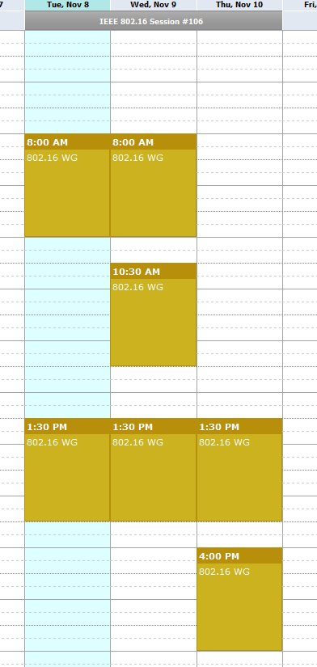
Meeting Plan for Week
802.16 WG
Tuesday AM1
Thursday PM2
GRIDMAN TG (802.16s)
Tuesday PM1
Wednesday AM1, AM2
Wednesday PM1
Thursday PM1

Slide 8
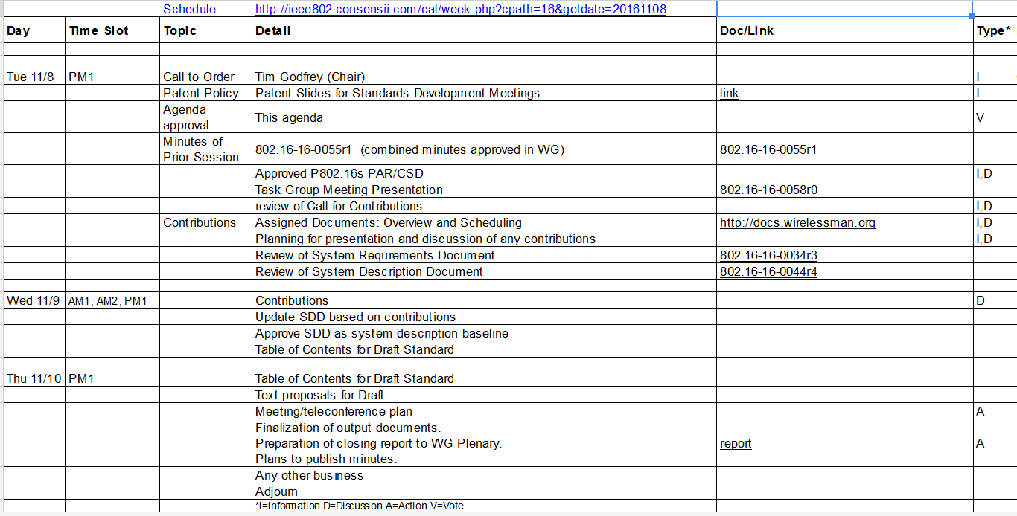
Agenda
From docs.google.com

Slide 9
Project Plan and Milestones
Nov 2016 Complete SDD, Initial Draft Development
Jan 2016 Draft Development, WG Letter Ballot
Mar 2017 Comment Resolution, recirc, Conditional Sponsor Ballot
May 2017 Comment resolution, recirculation
July 2017 Forward to RevCom

Slide 10
Plan for presentation and discussion of contributions
16-16-0059r0 Proposed MAC Layer Overhead Reduction Schemes
Menashe Shahar (Full Spectrum)
16-16-0060r0 Calculator for Proposed MAC Layer Overhead Reduction Schemes
Menashe Shahar (Full Spectrum)
16-16-0047r2 Benefits of Specific PHY Layer Parameters to Support 1MHz Channels
Doug Gray (EPRI)

Slide 11
Development and Editing of Draft SRD
Draft SRD is posted as 802.16-16-0034r2
https://mentor.ieee.org/802.16/dcn/16/16-16-0034-02-000s-draft-p802-16s-system-requirements-document-srd.docx
Updated to 802.16-16-34r3

Slide 12
Presentation of Contributions

Slide 13
Development of SDD
As of September, in outline form:
802.16-16-44r4
https://mentor.ieee.org/802.16/dcn/16/16-16-0044-04-000s-802-16s-draft-system-description-document-sdd.docx

Slide 14
Parameters for consideration
Primary
Subcarrier spacing
Number of Subcarriers
Sampling Clock
FFT Size
Permutations
Preamble
Frame Size
Resultant
Latency
PAPR
ICI
ISI, Delay Spread
Interference cancellation
Out of band interference sensitivity (related to pilot and subcarriers)

Slide 15
Preamble Notes on SDD (September)
Preamble approach as described in section 4.2 of document 0039r3.
To be considered: this approach also disassociates preamble ID from sector ID.

Slide 16
CDMA Notes on SDD (September)
We prefer to maintain the existing 128 bit FFT standard 96 bit CDMA codes and maintaining the number of codes because it reduces probability of collision on UL in case of large number of devices, and improves interference rejection between sectors. The downside is slightly increased overhead on the UL, but only during ranging and BW requests, so it is not as significant.

Slide 17
SDD Notes (Sept)
Relationship between channel width, frame size, and overhead
Develop chart into SDD
Implication of overhead – places limits on asymmetrical UL/DL ratios
Describe concept of using multiple non-contiguous 100 KHz channels in different sectors for frequency re-use option.
Are there any optimizations to improve mitigation of in-band interference?

Slide 18
Accomplishments at September meeting
Updated SRD to 802.16-16-0034r3
Reviewed contributions
Developed SDD
Version at end of meeting 802.16-16-0044r4
Updated Call for Contributions
Comments and contributions related to SDD
Document 802.16-16-0035-03-000s-call-for-contributions-project-802-16s
Planned Teleconference

Slide 19
TG Closing
Plan for January
Finalize and approve SDD (802.16-16-0044r4 or subsequent) defining technical approach
Assignment of Technical Editor
Develop Table of Contents / Draft Framework
Set Conference call for coordination

Slide 20
Reference

Slide 21
November: Development of Table of Contents for Draft Standard
Baseline document – IEEE Std 802.16-2012
As amended by 802.16p, 802.16n, and 802.16q
Relevant Contributions
802.16-0030-00-Gcon: 802.16s Amendment Outline Menashe Shahar (Full Spectrum), Guy Simpson (Full Spectrum)
Create a group document representing the agreed outline and clauses for amendment
IEEE 802.16™: BROADBAND WIRELESS METROPOLITAN AREA NETWORKS (MANs)
IEEE 802.16™-2012 IEEE Standard for Air Interface for Broadband Wireless Access Systems

Slide 22
November: Discussion on Table of Contents
First agree on the overall structure of the changes and the principles
Step 1: Capture the principles of the amendment into an independent document
Name: System Description Document (SDD)
Step 2: map SDD into the base standard, which then leads us to a ToC and outline for the draft amendment.

Slide 23
Development Process (1)
The draft development process will follow this approach.
Phase 1a: Agree on the overall structure of the PHY layer and its principles of operation. The proposals and operation should address the requirements in the SRD, and conform to the scope defined in the PAR. Capture the design principles of the amendment into this System Description Document (SDD).
Phase 1b: Consider MAC changes needed to support the PHY operation and further optimizations for efficiency to satisfy the SRD requirements.
• Text Proposals should provide a table of system description parameters and performance analysis addressing the requirements in the SRD.
• Text proposals should describe any necessary (consequential) MAC changes and how they affect the performance metrics
• Text Proposals can be adopted into the SDD with the approval of the Task Group.
When the SDD has adopted proposals meeting the requirements of the SRD,
Phase 2 will map the SDD into the base standard, which then leads us to a ToC and outline for the draft amendment.

Slide 24
Development Process (2)
General profile that addresses all but the “edge case”
Specialized profiles for optimizing specific use cases: can extend toward general profile.
Longest range vs shorter range
Lowest BW vs wide bandwidth
Shortest possible latency

Slide 25
Guidelines for proposal evaluation
Proposals are evaluated on how well they
Address the requirements in the SRD
Specifies the minimum set of essential changes to the OFDMA PHY defined in 802.16-2012 as necessary to meet the requirements
Address the performance metrics from the SDD
PHY Throughput
Goodput
Frame Size / Latency
Peak to Average Power Ratio
Inter-carrier Interference
Inter-symbol Interference, Delay Spread
Interference management, MIMO, beam forming
CINR performance
Out of band emissions
Mobility capability
Provides sufficient information and supporting data to allow the understanding of how the requirements and performance are met
Ability to maintain performance across the frequency range of interest

