Slide 1

  802.16 GRIDMAN Task Group - Session #104
[IEEE 802.16 Mentor Presentation Template (Rev. 0)]
Document Number:
  IEEE 802. 16-16-0041-00-000s
  Date Submitted:
  26 July 2016
Source:
  Tim Godfrey Voice:
  EPRI E-mail:
  *<http://standards.ieee.org/faqs/affiliationFAQ.html>
Re:
Base Contribution:
  N/A
Purpose:
  Session #104 Task Group Meeting Presentation (July 2016)
Notice:
  This document does not represent the agreed views of the IEEE 802.16 Working Group or any of its subgroups. It represents only the views of the participants listed in the “Source(s)” field above. It is offered as a basis for discussion. It is not binding on the contributor(s), who reserve(s) the right to add, amend or withdraw material contained herein.
Copyright Policy:
  The contributor is familiar with the IEEE-SA Copyright Policy <http://standards.ieee.org/IPR/copyrightpolicy.html>.
Patent Policy:
  The contributor is familiar with the IEEE-SA Patent Policy and Procedures:
      <http://standards.ieee.org/guides/bylaws/sect6-7.html#6> and <http://standards.ieee.org/guides/opman/sect6.html#6.3>.
  Further information is located at <http://standards.ieee.org/board/pat/pat-material.html> and <http://standards.ieee.org/board/pat >.

Slide 2
GRIDMAN Discussion Items
Link to Agenda
Project Planning and Milestones
Review of PAR Scope
Review of System Requirements Document
Develop Table of Contents of Draft Standard
Review Contributions

Slide 3
Participants, Patents, and Duty to Inform
All participants in this meeting have certain obligations under the IEEE-SA Patent Policy.
  Participants [Note: Quoted text excerpted from IEEE-SA Standards Board Bylaws subclause 6.2]:
    “Shall inform the IEEE (or cause the IEEE to be informed)” of the identity of each “holder of any potential Essential Patent Claims of which they are personally aware” if the claims are owned or controlled by the participant or the entity the participant is from, employed by, or otherwise represents
    “Should inform the IEEE (or cause the IEEE to be informed)” of the identity of “any other holders of potential Essential Patent Claims” (that is, third parties that are not affiliated with the participant, with the participant’s employer, or with anyone else that the participant is from or otherwise represents)
  The above does not apply if the patent claim is already the subject of an Accepted Letter of Assurance that applies to the proposed standard(s) under consideration by this group
  Early identification of holders of potential Essential Patent Claims is strongly encouraged
  No duty to perform a patent search
Slide #1

Slide 4
Patent Related Links
  All participants should be familiar with their obligations under the IEEE-SA Policies & Procedures for standards development.
  Patent Policy is stated in these sources:
  IEEE-SA Standards Boards Bylaws
  http://standards.ieee.org/develop/policies/bylaws/sect6-7.html#6
  IEEE-SA Standards Board Operations Manual
  http://standards.ieee.org/develop/policies/opman/sect6.html#6.3
  Material about the patent policy is available at
  http://standards.ieee.org/about/sasb/patcom/materials.html
If you have questions, contact the IEEE-SA Standards Board Patent Committee Administrator at patcom@ieee.org or visit http://standards.ieee.org/about/sasb/patcom/index.html
This slide set is available at https://development.standards.ieee.org/myproject/Public/mytools/mob/slideset.ppt
Slide #2

Slide 5
Call for Potentially Essential Patents
If anyone in this meeting is personally aware of the holder of any patent claims that are potentially essential to implementation of the proposed standard(s) under consideration by this group and that are not already the subject of an Accepted Letter of Assurance:
  Either speak up now or
  Provide the chair of this group with the identity of the holder(s) of any and all such claims as soon as possible or
  Cause an LOA to be submitted
Slide #3

Slide 6
Other Guidelines for IEEE WG Meetings
All IEEE-SA standards meetings shall be conducted in compliance with all applicable laws, including antitrust and competition laws.
  Don’t discuss the interpretation, validity, or essentiality of patents/patent claims.
  Don’t discuss specific license rates, terms, or conditions.
    Relative costs, including licensing costs of essential patent claims, of different technical approaches may be discussed in standards development meetings.
      Technical considerations remain primary focus
  Don’t discuss or engage in the fixing of product prices, allocation of customers, or division of sales markets.
  Don’t discuss the status or substance of ongoing or threatened litigation.
  Don’t be silent if inappropriate topics are discussed … do formally object.
---------------------------------------------------------------
See IEEE-SA Standards Board Operations Manual, clause 5.3.10 and “Promoting Competition and Innovation: What You Need to Know about the IEEE Standards Association's Antitrust and Competition Policy” for more details.
Slide #4

Slide 7
Status of 802.16s PAR/CSD
The 802.16s project was authorized by NesCom on 30 June 2016.
Editorial changes were made to the PAR since the last meeting. Final approved PAR is available in 802.16-16-0038r0.
Final CSD is available in 802.16-16-0013r2

Slide 8
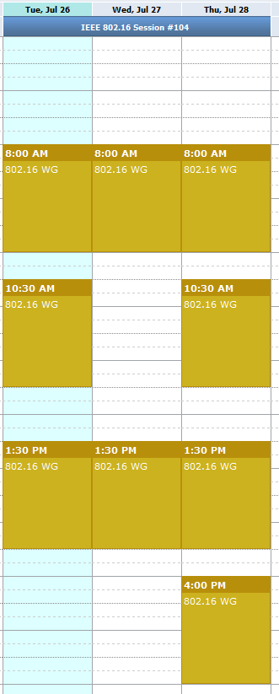
Meeting Plan for Week
802.16 WG
  Tuesday AM1
  Thursday PM2
GRIDMAN TG (802.16s)
  Tuesday AM2
  Tuesday PM1
  Wednesday AM1
  Wednesday PM1
  Thursday AM1
  Thursday AM2
  Thursday PM1

Slide 9
Possible Project Plan and Milestones
July 2016 Discussion of Contributions
Amendment TOC, outline
Sept 2016 Draft Development
Nov 2016 Draft Development, WG Letter Ballot
Mar 2017 Start Sponsor Ballot
July 2017 Forward to RevCom

Slide 10
PAR Scope
From 802.16-16-0038-00-000s
This project specifies WirelessMAN-OFDMA TDD operation in exclusively-licensed spectrum with channel bandwidth from 100 kHz up to 1.25 MHz, including 1 MHz explicitly. The amendment will target operation in the 700 MHz band but will also support operation in other VHF/UHF bands. The project amends Clause 12 of IEEE Std 802.16, adding a new system profile and amending other clauses as required to support the narrower channel widths. The range and data rate supported by the added profile are commensurate with those of the base standard, as scaled by the reduced channel bandwidth.

Slide 11
Review of Draft SRD
Draft SRD is posted as 802.16-16-0034r1
https://mentor.ieee.org/802.16/dcn/16/16-16-0034-01-000s-draft-p802-16s-system-requirements-document.docx

Slide 12
Development of Table of Contents for Draft Standard
Baseline document – IEEE Std 802.16-2012
    As amended by 802.16p, 802.16n, and 802.16q
Relevant Contributions
  802.16-0030-00-Gcon: 802.16s Amendment Outline Menashe Shahar (Full Spectrum), Guy Simpson (Full Spectrum)
Create a group document representing the agreed outline and clauses for amendment
IEEE 802.16™: BROADBAND WIRELESS METROPOLITAN AREA NETWORKS (MANs)
IEEE 802.16™-2012 IEEE Standard for Air Interface for Broadband Wireless Access Systems

Slide 13
Amendment boundaries based on PAR
“The project amends Clause 12 of IEEE Std 802.16, adding a new system profile and amending other clauses as required to support the narrower channel widths”

Slide 14
Discussion of Contributions
Contributions for this session
  802.16-16-0037r0- Evaluation of Alternatives for 1 MHz Channels Doug Gray (EPRI)
  802.16-16-0039r0 Proposed PHY Layer Parameters for IEEE 802.16s Menashe Shahar (Full Spectrum)

