Slide 1

  802.16 Working Group Treasurer’s Report - Session #102
[IEEE 802.16 Mentor Presentation Template (Rev. 0)]
Document Number:
  IEEE 802. 16-16-0023-00-Gcon
Date Submitted:
  17 March 2016
Source:
  Tim Godfrey Voice:
  EPRI E-mail:
  *<http://standards.ieee.org/faqs/affiliationFAQ.html>
Re:
Base Contribution:
  N/A
Purpose:
  Session #102 Working Group Treasurer Report (March 2016)
Notice:
  This document does not represent the agreed views of the IEEE 802.16 Working Group or any of its subgroups. It represents only the views of the participants listed in the “Source(s)” field above. It is offered as a basis for discussion. It is not binding on the contributor(s), who reserve(s) the right to add, amend or withdraw material contained herein.
Copyright Policy:
  The contributor is familiar with the IEEE-SA Copyright Policy <http://standards.ieee.org/IPR/copyrightpolicy.html>.
Patent Policy:
  The contributor is familiar with the IEEE-SA Patent Policy and Procedures:
      <http://standards.ieee.org/guides/bylaws/sect6-7.html#6> and <http://standards.ieee.org/guides/opman/sect6.html#6.3>.
  Further information is located at <http://standards.ieee.org/board/pat/pat-material.html> and <http://standards.ieee.org/board/pat >.

Slide 2
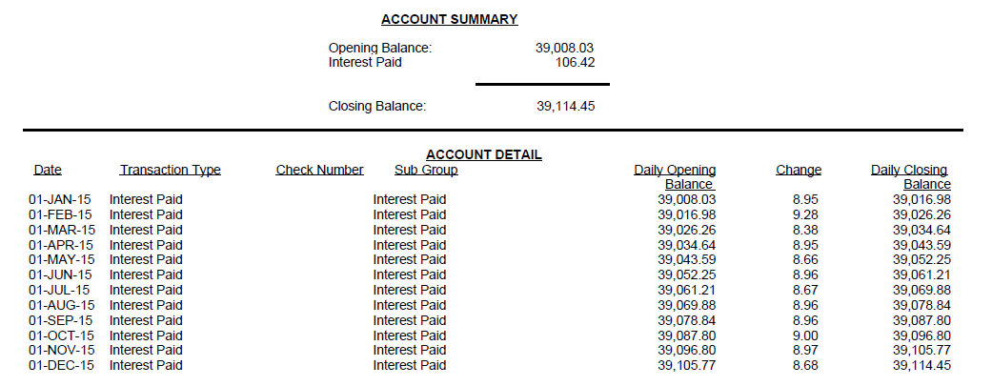
2015 Transactions Summary
Closing Balance at end of 2015 $39,114.45

Slide 3
2016 year to date

Slide 4
Summary
No account activity other than interest
Balance at March 2016 Plenary: $39,132.39

