Slide 1
802.16/802.24 Tutorial: Proposed 802.16s Narrowband Project
802.24 Vertical Applications TAG - applications of 802.16 in utility field area networks
Tim Godfrey (EPRI)

Slide 2
Agenda
What is a Field Area Network (FAN)?
Why would a utility use 802.16? Why not LTE?
What are spectrum options for FAN?
Why amend 802.16?

Slide 3
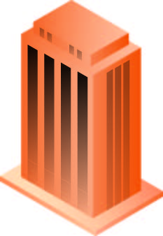


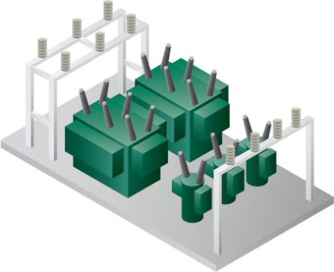


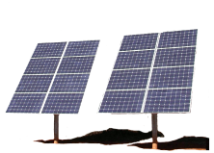

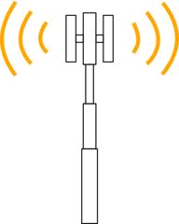

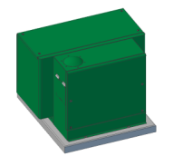

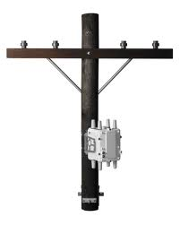




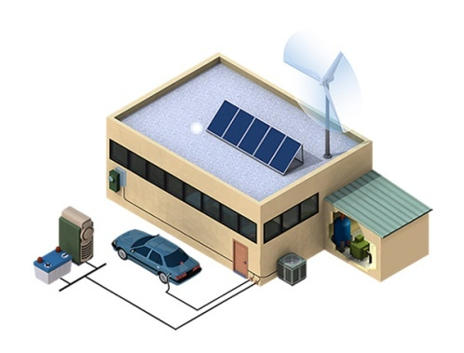



Core
LAN
Fiber
WAN
Microwave
Commercial
Cellular
Network
Private Field
Area Network
PV
FAN
Sensor
Collector
Collector
Cap
Bank
NAN
Cap
Bank
Premises

Slide 4
Utility Deployed FAN – private network
Licensed Spectrum Available?
Yes
No
Paired (FDD) Spectrum?
Large Coverage Area?
Yes
No
No
Yes
802.16
WiMAX
LTE
Unlicensed Mesh
Unlicensed P-P
Simplified chart – many other factors must be considered

Slide 5
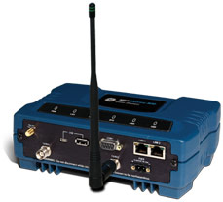
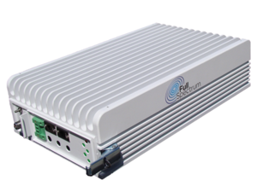
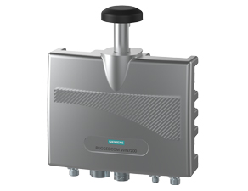

Popular 802.16 products for utilities
Full Spectrum FullMAX
GE MDS Mercury 3650
Cisco Connected Grid
Router (Station Only)
Siemens
RUGGEDCOM WIN7200
Airspan
AirSynergy
4G

Slide 6
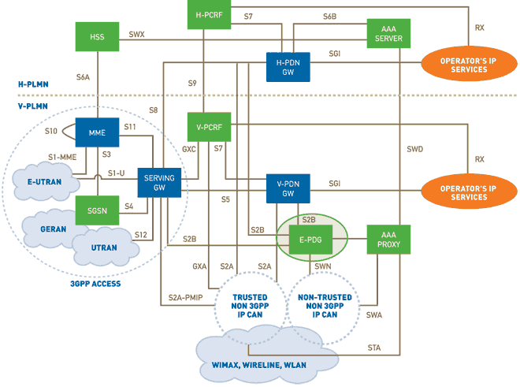
LTE Network Architecture
Fully integrated with legacy mobile system
Oriented towards mobile network operators needs
Notes:
MME Mobility Management Entity
PLMN: Public Land Mobile Network
SGSN: Serving GPRS Support Node
HSS Home Subscriber Server
PCRF: Policy and Charging Rules Function
PDG: Packet Data Gateway

Slide 7
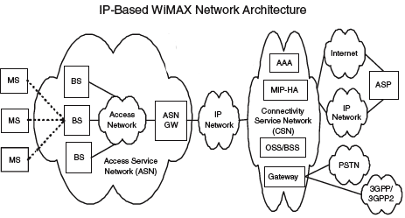
802.16 Network Architecture
Optional
Simpler architecture with L2 support
More aligned with utility IT services and architecture
Notes:
http://www.tutorialspoint.com/wimax/wimax_network_model.htm

Slide 8
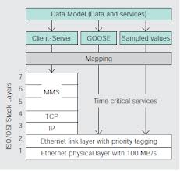


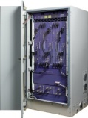

Other key differences in 4G technologies
Spectrum Type
  LTE typically uses FDD (paired) spectrum,
    TD-LTE standard does support unpaired
    Most equipment is for FDD
  WiMAX typically operates in unpaired spectrum
    Best match to “uplink biased” grid applications
IEEE 802 Ethernet Model
  Intrinsic support for Layer 2 connectivity
  IEEE 802.16 supports an Ethernet Interface and Layer-2 messages (e.g. IEC 61850 GOOSE)
  LTE is IP (layer 3) only – Layer 2 must be tunneled
Local forwarding
  802.16 supports direct SS to SS forwarding through base station
  LTE typically routes all packets through EPC
    Local gateways have been proposed
FDD
TDD
Frequency
DL Freq
UL
DL
UL
DL
UL Freq
Time
Time
ASN
GW
EPC

Slide 9


Why not Cellular IoT or other commercial wireless?
Public
Private
Low CapEx, ongoing OpEx
Security and reliability up to carrier
Carrier provides the spectrum
Network evolution up to carrier
Network maint & repair up to carrier
High CapEx, lower OpEx
Utility controls security and reliability
Utility provides the spectrum
Utility controls pace of evolution
Utility controls maint & repair
Utilities that choose the private option have specific financial and operational reasons, and are unlikely to change to a public provider.
They are not potential customer for operators

Slide 10
Spectrum for utility 802.16 FANs
5.8 GHz Unlicensed
  WiMAX certification and profiles
  Less attractive due to poor propagation at high frequency
4.9 GHz Public Safety
  WiMAX certification and profiles
  Limited availability of spectrum – negotiation with PS entities required.
3.65 GHz “Lightly Licensed”
  WiMAX certification and profiles
  Has been widely used by over 100 utilities.
  Recent rules changes have made the band less attractive for future expansion
  Reports of interference in utility pilots
1.8 GHz Canadian band
  WiMAX certification and profiles
  Widely used Canadian utilities.
700 MHz Upper A Block
  Superior propagation
  Too narrow to support 802.16 or LTE as currently specified

Slide 11
Why narrow channel is of interest
Spectrum is less attractive to mobile operators since LTE is not supported
  Cost is moderated
Narrow spectrum means lower data rate, but capacity is still sufficient for grid applications
Other spectrum with similar narrow channel characteristics is available or may become available:
  217 MHz, 406 MHz, 901 MHz, 1.4 GHz

Slide 12
Conclusion
802.16 is technically well suited for utility Field Area Networks
802.16 continues to be widely used for utility Field Area Networks
The industry desires to use 802.16 for 700 MHz and in other narrow allocations, but a standard is needed

