Slide 1
802.16.3 and LMAP liaison
Document Number: IEEE 802.16-15-0011-03-03R0
Date Submitted: 2015-03-20
Source:
Antonio Bovo Voice: +393771821211
E-mail: antonio1234.pd@gmail.com
*<http://standards.ieee.org/faqs/affiliationFAQ.html>
Re: 16-15-0011-03-03R0
Base Contribution:
Purpose: WG discussion
Notice:
This document does not represent the agreed views of the IEEE 802.16 Working Group or any of its subgroups. It represents only the views of the participants listed in the “Source(s)” field above. It is offered as a basis for discussion. It is not binding on the contributor(s), who reserve(s) the right to add, amend or withdraw material contained herein.
Copyright Policy:
The contributor is familiar with the IEEE-SA Copyright Policy <http://standards.ieee.org/IPR/copyrightpolicy.html>.
Patent Policy:
The contributor is familiar with the IEEE-SA Patent Policy and Procedures:
<http://standards.ieee.org/guides/bylaws/sect6-7.html#6> and <http://standards.ieee.org/guides/opman/sect6.html#6.3>.
Further information is located at <http://standards.ieee.org/board/pat/pat-material.html> and <http://standards.ieee.org/board/pat >.

Slide 2
Goal of the document
Update IETF LMAP WG regarding status of IEEE Project 802.16.3 by means of:
An overview of IEEE P802.16.3 scope
Commonalities and differences with respect of LMAP
Some hints about how IEEE P802.16.3 Architecture and Requirements might be used to enhance the current LMAP.
References:
[A&R] “IEEE 802.16-14-0078-00-03R0” Architecture and requirements document, available at:
https://mentor.ieee.org/802.16/dcn/14/16-14-0078-00-03R0-ieee-802-16-3-architecture-and-requirements-for-mobile-broadband-network-performance-measurements.docx

Slide 3
IEEE Project 802.16.3 Overview and Status
The main purpose of IEEE Project 802.16.3 is “…characterizing the performance of deployed mobile broadband networks from a user perspective…” ([A&R] section 1)
By means of “…metrics and test procedures as well as communication protocols and data formats…allowing a network-based server to coordinate and manage test operation and data collection…” ([A&R] section 1)
And as well “…collect information from a disparate set of devices in the network…”
Where the potential stakeholders of such measurements are not only network operators or regulators but also for example “…users of broadband mobile networks, including enterprises…policy makers…researchers…” ([A&R] section 1).
Some key similarities with LMAP:
The end-user perspective.
The inclusion of metrics in the scope.
The inclusion of protocol details in the scope.
The coordination of measurements done by an external entity not necessarily included in the network under test.
Some key differences with respect to LMAP:
The focus on MOBILE broadband networks.
The variety of measurements stakeholders.
The generality of measurement devices active in the network.

Slide 4
Use cases in IEEE P802.16.3 architecture
 | Stakeholder
Measurement application | Governmental policy maker | User (individual or enterprise) | Cell tower operator | Wireless carrier / Network operator | Researcher | Standards developer | User device vendor | Application developer | Mobile Application Service Provider
Overall data on Quality of Experience of set of networks available to consumers | x | x | x | x | x |  | x | x | x
Quality of Experience of a specific network |  | x | x | x | x |  | x | x | x
Identify limitations in deployment of a specific network |  | x | x | x |  |  |  | x
Monitor for changes in operation of a specific network |  | x |  | x
Diagnose problems in a specific network |  |  | x | x
Improve knowledge of system performance |  |  |  | x | x |  |  |  | x
Lead the market toward more effective networks | x |  |  |  |  |  |  |  | x
Encourage the redeployment of scarce spectrum using efficient technologies and implementations | x |  | x | x
Compare measured performance data to simulated results |  |  |  |  | x | x
Assess theoretical models |  |  |  |  | x | x
Assess technology elements proposed during standards development |  |  |  |  |  | x
The table above (from [A&R] section 4) lists the identified use cases for the measurements.
This includes a number of possible stakeholders that are not only ISPs and Regulators.

Slide 5
802.16.3 and LMAP commonalities
Both the WGs have the focus on measuring the performance of broadband services with the end user perspective.
The two frameworks have several commonalities as the MA (Measurement Agent) concept, that in 802.16.3 is embedded either in the Client or in the Server entities while in LMAP is a separate logical entity.
However, the role of the “Measurement peer” in LMAP is not apparent, as it is marked “out of scope”, while the P802.16.3 CLIENT entity includes the roles of both the MA and the “Measurement peer”.
CONTROLLER and COLLECTOR are logical entities that have similar roles in both the scenarios.
The link to the IETF IPPM workgroup is common in both the WGs to include such metrics, if makes sense.
The definition of a protocol to communicate among the different entities is present in both the WGs, even if the details are different.
Both the WGs consider security as one of the major topics.

Slide 6
Possible P802.16.3-based enhancements to LMAP
The MOBILE aspects. In fact the mobile domain is including some specifics that are potentially very important to capture.
As an example, see the list present in [A&R] section 5:
“…measurements will typically be related to a specific user device, rather than to a router on a LAN
a single user device can typically operate with multiple disparate network technologies
a single user device may connect with multiple operators
a user device experiences widely varying signal and network conditions
due to variability, far larger statistical samples may be required to draw generalized conclusions
significantly more metadata (including, for example, location information) is required to characterize the scenario of a specific sample
it may be necessary to trigger testing based on a set of environmental circumstances, such as location, rather than relying upon scenarios such as LAN quiescence as a trigger
active testing may be relatively more constrained due to practical issues, including data plan limits and battery consumption
underlying software on many mobile devices is relatively closed, and underlying network data is often relatively difficult to access…”
The inclusion of several use cases. They can imply specific needs in the metrics, in the way to manage the tests but also architecture specific needs.
One of the major example is the ENTERPRISE use case, where an organization can adopt a private “server” and a private “Data collector”, in order to manage its own tests and store the results.
Finally, the protocol definition and the data model that has been proposed into P802.16.3 can be examined by LMAP to find possible reuse.
An example is the encapsulation of basic procedures in some workflows that can be helpful for the measurement process.
Another example is the definition of some peers behaviors related to the protocols message exchange.
Finally, the modeling of some IPPM metrics into this protocol could be helpful even for LMAP.
See the example in the following slides about a possible measurement workflow.

Slide 7
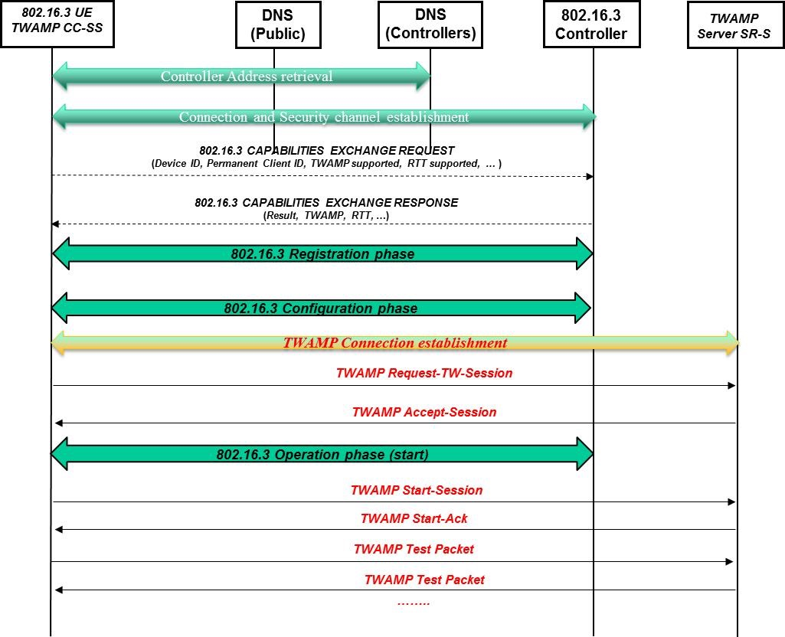
Example of TWAMP into 802.16.3 framework (1/2)
The following graph is an example of the 802.16.3 protocol workflow with TWAMP.
LMAP is also mentioning this TWAMP example, so this scenario can be a good example for possible hints.

Slide 8
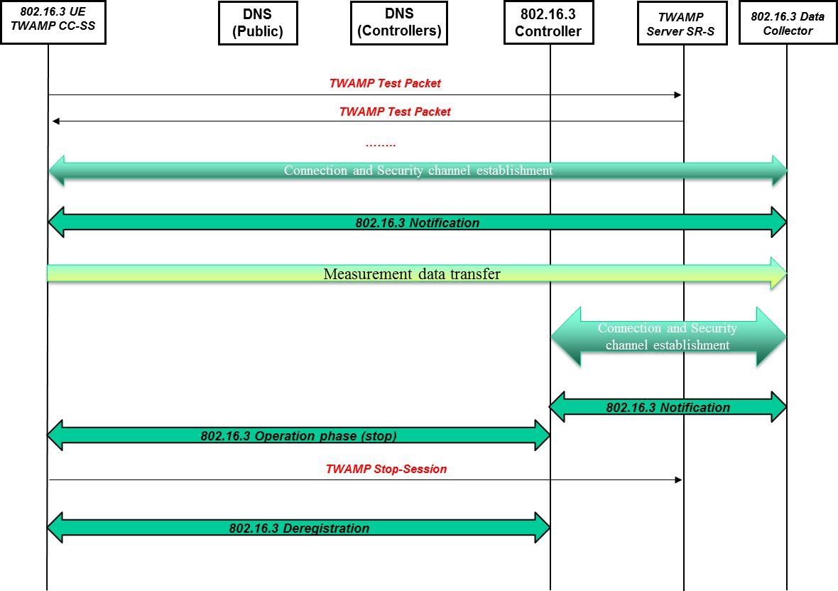
Example of TWAMP into 802.16.3 framework (2/2)
Continuation of the example.

