Slide 1
IEEE 802 Wireless Use Cases
Wireless & Mobility DG
DCN 16-14-0020-00-Gcon
Charlie Perkins / Futurewei
IEEE 802 Wireless Interim, Los Angeles
January 23, 2014 SDN BoF
Previously presented:
October 10, 2013 ONF Member Workday

Slide 2
Outline of presentation
Overview of IEEE 802 Wireless standardization effort
Brief overview of three groups contributing use cases
802.16r: Connection-Oriented SDN for Wireless SCB
802.21: Media-Independent Handover
OmniRAN: Sharing access and backhaul network resources

Slide 3
Overview of IEEE 802
CHAIR
Paul Nikolich
Working Group/TAG Chairs
802.1
BRIDGING/ARCH
Tony Jeffree
802.3
Ethernet
David Law
802.11
WLAN
Bruce Kraemer
Hibernating
WG Chairs
(non voting)
Appointed Officers
1st VICE CHAIR
Pat Thaler
2nd VICE CHAIR
James P.K. Gilb
802.15
WPAN
Bob Heile
802.16
BWA
Roger Marks
802.18 TAG
Radio Regulatory
Mike Lynch
802.17
Resilent Packet
Ring
John Lemon
EXECUTIVE SECY
Jon Rosdahl
RECORDING SECY
John D’Ambrosia
802.19
Coexistence
Steve Shellhammer
802.21
Media indep.
handover
Subir Das
802.22
WRAN
Apurva Mody
802.20
MBWA
Mark Klerer
802.24
Smart Grid
James P.K. Gilb
OmniRAN
Study Group
Max Riegel
TREASURER
Clint Chaplin
Appointed Officers
(non voting)
DISBANDED
802.2 LLC 802.4 Token Bus ECSG TV Whitespace
802.5 Token Ring 802.6 DQDB ECSG Emergency Services
802.7 Broadband TAG 802.8 Fiber Optic TAG 802.23 Emergency Services
802.9 ISLAN 802.10 Security
802.12 Demand Priority 802.14 CATV
MEETING MGR
MEMBER EMERITUS
Buzz Rigsbee
MEMBER EMERITUS
Geoff Thompson

Slide 4
Brief overview of three groups contributing use cases
802.16r: Wireless Small Cell Backhaul (SCB)
  802.16 is “Broadband Wireless Access”, gave birth to WiMAX
  Small-Cell Backhaul is currently hot topic related to Femtocell, etc.
802.21: Media-Independent Handover
  802.21a offers security extensions (e.g., with EAP)
  802.21b deals with downlink-only connectivity
  802.21c deals with single-radio handover
  802.21d deals with multicast group management
  802.21.1 broadens 802.21 to Media-Independent Services
  Has long history, didn’t make to 3GPP Standards
OmniRAN: Sharing access and backhaul network resources
  EC study group (originally aimed at extending interfaces R1 – R5) now proposing development of a Recommended Practice for Network Reference Model and Functional Description of IEEE 802 Access Network

Slide 5
Use Case #4: Wireless Small Cell Backhaul (SCB) [802.16r]
Enable an independent provider to provide backhaul service to multiplicity of mobile operator customers
wireless cells may carry user traffic and control signaling for a variety of mobile services, such as LTE, 3G, Wi-Fi
Capacity must be sliced among mobile operators and services, with supportable SLA commitments
Multiple flows, varying QoS, per-operator QoS
Modeled on Carrier Ethernet 2.0 www.fujitsu.com/downloads/TEL/fnc/whitepapers/CarrierEthernetEssentials.pdf

Slide 6
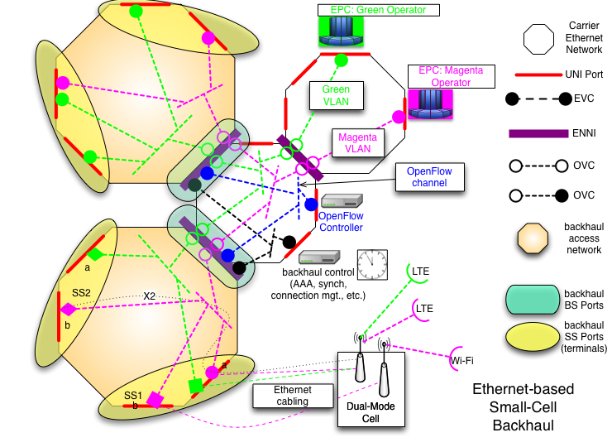

Slide 7
Use Case #6: Media-Independent Handover [802.21]
wireless end devices require mobility support from the network
Specific link characteristics vary widely, but requirements for mobility support are quite general:
  Identity verification
  Transfer of mobility context
  Link re-establishment
  Re-routing
OpenFlow is defined in a media-independent fashion, which should make it quite suitable as a south-bound interface for 802.21 Point of Service (PoS) issuing commands to a Point of Attachment (PoA)
MIH PoS is a natural point for an SDN controller to reside

Slide 8
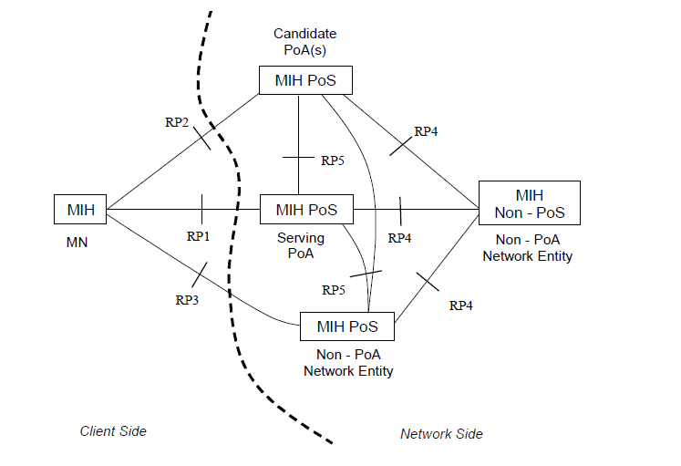
MIH reference diagram

Slide 9
MIH service model
MICS: media independent command service
  Handover commit, get candidate target networks, …
MIIS: media independent information service
  Target PoS address(es), network neighborhood, …
MIES: media independent event service
  Events that could trigger a handover (bandwidth deterioration, …)

Slide 10
Use Case 15: Sharing access and backhaul network resources [OmniRAN]
Sharing access and backhaul network resources
abstracting multiple heterogeneous access networks into a single access model
need to define open interfaces to manage and configure heterogeneous access networks
OmniRAN provides a generic model of an access network based on multiple IEEE 802 technologies
Proposal:
  OpenFlow protocol extensions for controlling and configuring IEEE 802 nodes - ONF responsibility
  ‘OmniRAN’ Network Reference Model (e.g. listing the control functions and interfaces required for controlling the access networks), APIs and features for the individual IEEE 802 technologies - IEEE 802 responsibility

Slide 11
SDN-based OmniRAN Architecture

