Slide 1
  Overview of Transport Network Architecture
[IEEE 802.16 Mentor Presentation Template (Rev. 0)]
Document Number:
IEEE 802.16-13-0142-00-000r
Date Submitted:
  2013-07-15
Source:
  Nader Zein Voice: +44 7720415848
  NEC E-mail: nader.zein@emea.nec.com
Re:
  For P802.16r Project, IEEE 802.16 Session #86
Base Contribution:
  16-13-0073-01-000r-ieee-802-16r-architecture-and-requirements-for-small-cell-backhaul
Purpose:
  To give guidance on typical transport network architecture to aid with the development for the above base contribution
Notice:
  This document does not represent the agreed views of the IEEE 802.16 Working Group or any of its subgroups. It represents only the views of the participants listed in the “Source(s)” field above. It is offered as a basis for discussion. It is not binding on the contributor(s), who reserve(s) the right to add, amend or withdraw material contained herein.
Copyright Policy:
  The contributor is familiar with the IEEE-SA Copyright Policy <http://standards.ieee.org/IPR/copyrightpolicy.html>.
Patent Policy:
  The contributor is familiar with the IEEE-SA Patent Policy and Procedures:
      <http://standards.ieee.org/guides/bylaws/sect6-7.html#6> and <http://standards.ieee.org/guides/opman/sect6.html#6.3>.
  Further information is located at <http://standards.ieee.org/board/pat/pat-material.html> and <http://standards.ieee.org/board/pat >.

Slide 2
Introduction
This contribution presents typical basic transport architecture as defined by the NGMN Alliance white paper [1].
Main purpose is to aid with the definitions of terminology and target requirements for small-cells backhaul, noting that white paper does not cover the more advanced features of IMT-Advanced such as Carrier aggregation, CoMP, high order MIMO etc.
This contribution only cover higher level description of network architecture, and link topologies without touching on the capacity or QoS requriments. These could be covered by another contributions.

Slide 3
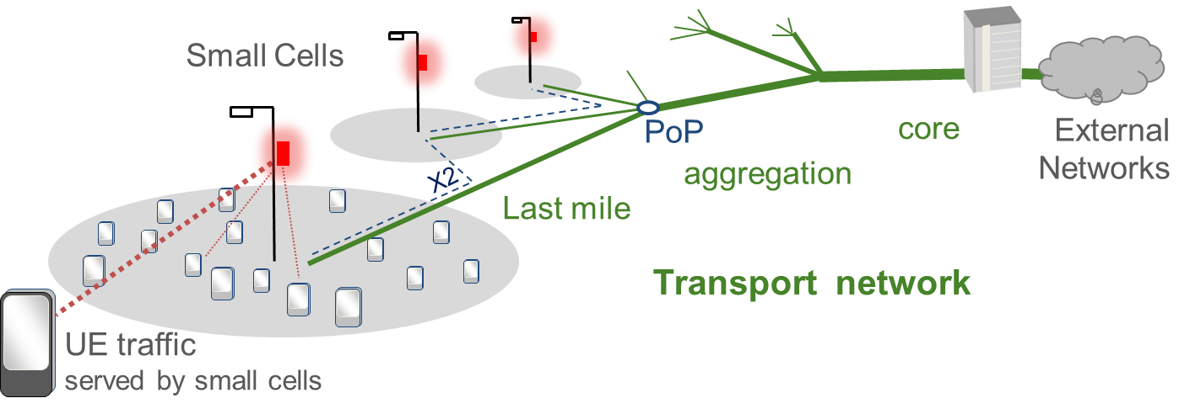
Overview of Backhaul Architecture
The purpose of the transport links shown in green in the figure above is to provide connectivity between the small cells and the core network nodes with desired QoS level.

Slide 4
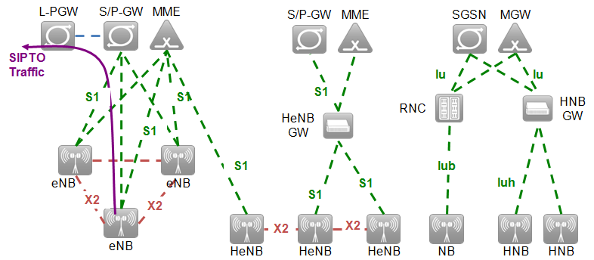
    Small Cell Network Architectures
3GPP LTE and UMTS Release 10 Architecture

Slide 5
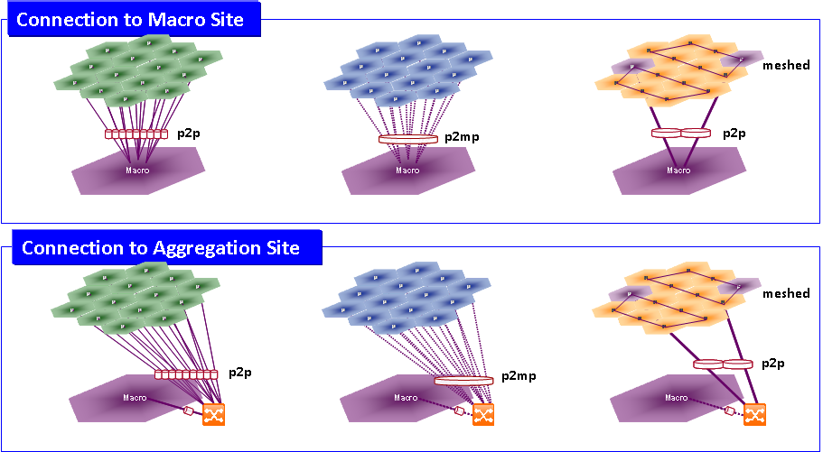
    Backhaul linkTopologies

Slide 6
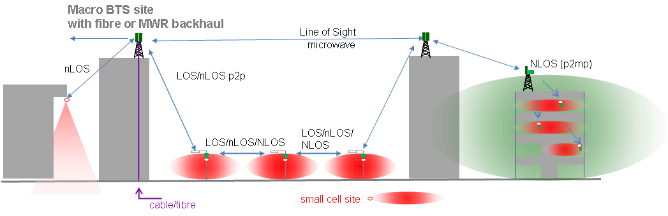
    Wireless topologies

Slide 7
References
Small Cell Backhaul Requirements, A White Paper by the NGMN Alliance, 4th June 2012.

