Slide 1
  Scope and topics for Heterogeneous Networking in IEEE802
[IEEE 802.16 Mentor Presentation Template (Rev. 0)]
Document Number:
  16-12-0662-00-Shet
  Date Submitted:
  2012-05-09
Source:
  Max Riegel Voice: +49 173 293 8240
  Nokia Siemens Networks E-mail: maximilian.riegel@nsn.com
Re:
  Call for contributions for IEEE802.16 HET SG for session #83
Base Contribution:
  n/a
Purpose:
  Discussion of scope and potential topics for heterogeneous networking in IEEE802
Notice:
  This document does not represent the agreed views of the IEEE 802.16 Working Group or any of its subgroups. It represents only the views of the participants listed in the “Source(s)” field above. It is offered as a basis for discussion. It is not binding on the contributor(s), who reserve(s) the right to add, amend or withdraw material contained herein.
Copyright Policy:
  The contributor is familiar with the IEEE-SA Copyright Policy <http://standards.ieee.org/IPR/copyrightpolicy.html>.
Patent Policy:
  The contributor is familiar with the IEEE-SA Patent Policy and Procedures:
      <http://standards.ieee.org/guides/bylaws/sect6-7.html#6> and <http://standards.ieee.org/guides/opman/sect6.html#6.3>.
  Further information is located at <http://standards.ieee.org/board/pat/pat-material.html> and <http://standards.ieee.org/board/pat >.

Slide 2
Scope and potential topics for heterogeneous networking in IEEE802
2012-11-10
Max Riegel
NSN

Slide 3
ToC
Rationale for OmniRAN
  OmniRAN for Communication Networks
    Legacy Communication Networks
      Single interface, single operator, single network
    What’s new?
      Multiple interfaces, multiple service providers, multiple networks
  OmniRAN for New Deployments
      M2M, e.g. SmartGrid, Car, HomeAutomation, …
Scope of OmniRAN
  Generic Access Network Model for IEEE802
  Interface functions
  Relation to other activities in the industry

Slide 4
OmniRAN
OmniRAN defines generic network side interfaces for access networks based on IEEE802 technologies
What does OmniRAN stand for?
  Open mobile network interface for omni-Range Area Networks
It addresses all IEEE802 access technologies including IEEE802.3!

Slide 5
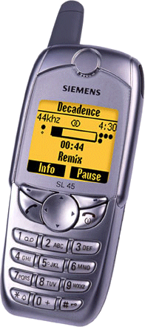
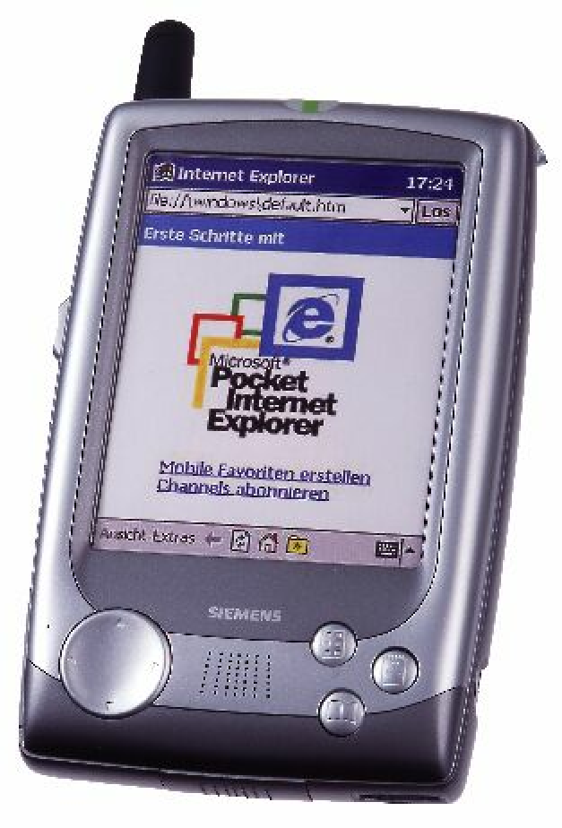
Legacy Communication Networking
Close relationship between user terminal, access network and service provider
  Single interface in terminal
  Single access network topology
  Single operator
    single entity (operator, IT department) controls complete service chain
Internet
Control
Access

Slide 6
What’s new?
… that requires OmniRAN
User-Terminals have to cope with
  multiple network interfaces
    e.g. Cellular, IEEE802.3, IEEE802.11, IEEE802.15
  multiple access network topologies
    e.g. IEEE802.11 in residential, corporate and public
  multiple network subscriptions
    e.g. multiple subscriptions for same interface

Slide 7
OmniRAN for New Deployments
In the past only:
  Communication networks for exchanging information between humans
Nowadays in addition:
  Communication networks between everything
    e.g. SmartGrid, HomeAutomation, Car
  IEEE802 technologies entering the industrial area, e.g. factory automation, in-car communication

Slide 8
Challenges of New Communication Networks Deployments
All new deployments are facing the same issue like traditional communication networks
  e.g. security, provisioning
OmniRAN provides the base networking technologies for all IEEE802 access technologies for new deployments
  instead each application is developing its own network architecture and specifications

Slide 9
Scope of OmniRAN
Network detection and selection
  Finding the most appropriate network when multiple networks are available
Setting up the access link
  Scope of individual IEEE802.xx specifications
Authentication
  Framework, based on IEEE802.1X
Setting up the e2e communication link
  Authorization, Service management
Management of user data connection
  mobility support to maintain connectivity
Usage and inventory reporting
  accounting

Slide 10
Additional OmniRAN functions for consideration
Initialization and maintenance of subscriptions
  Adding new users to a network
  Maintaining subscriptions
    e.g. renewal, change, termination
Initialization and maintenance of terminals
  Adding new communication end-points to a network
  Provisioning of configuration data and policies
  Update of policies

Slide 11
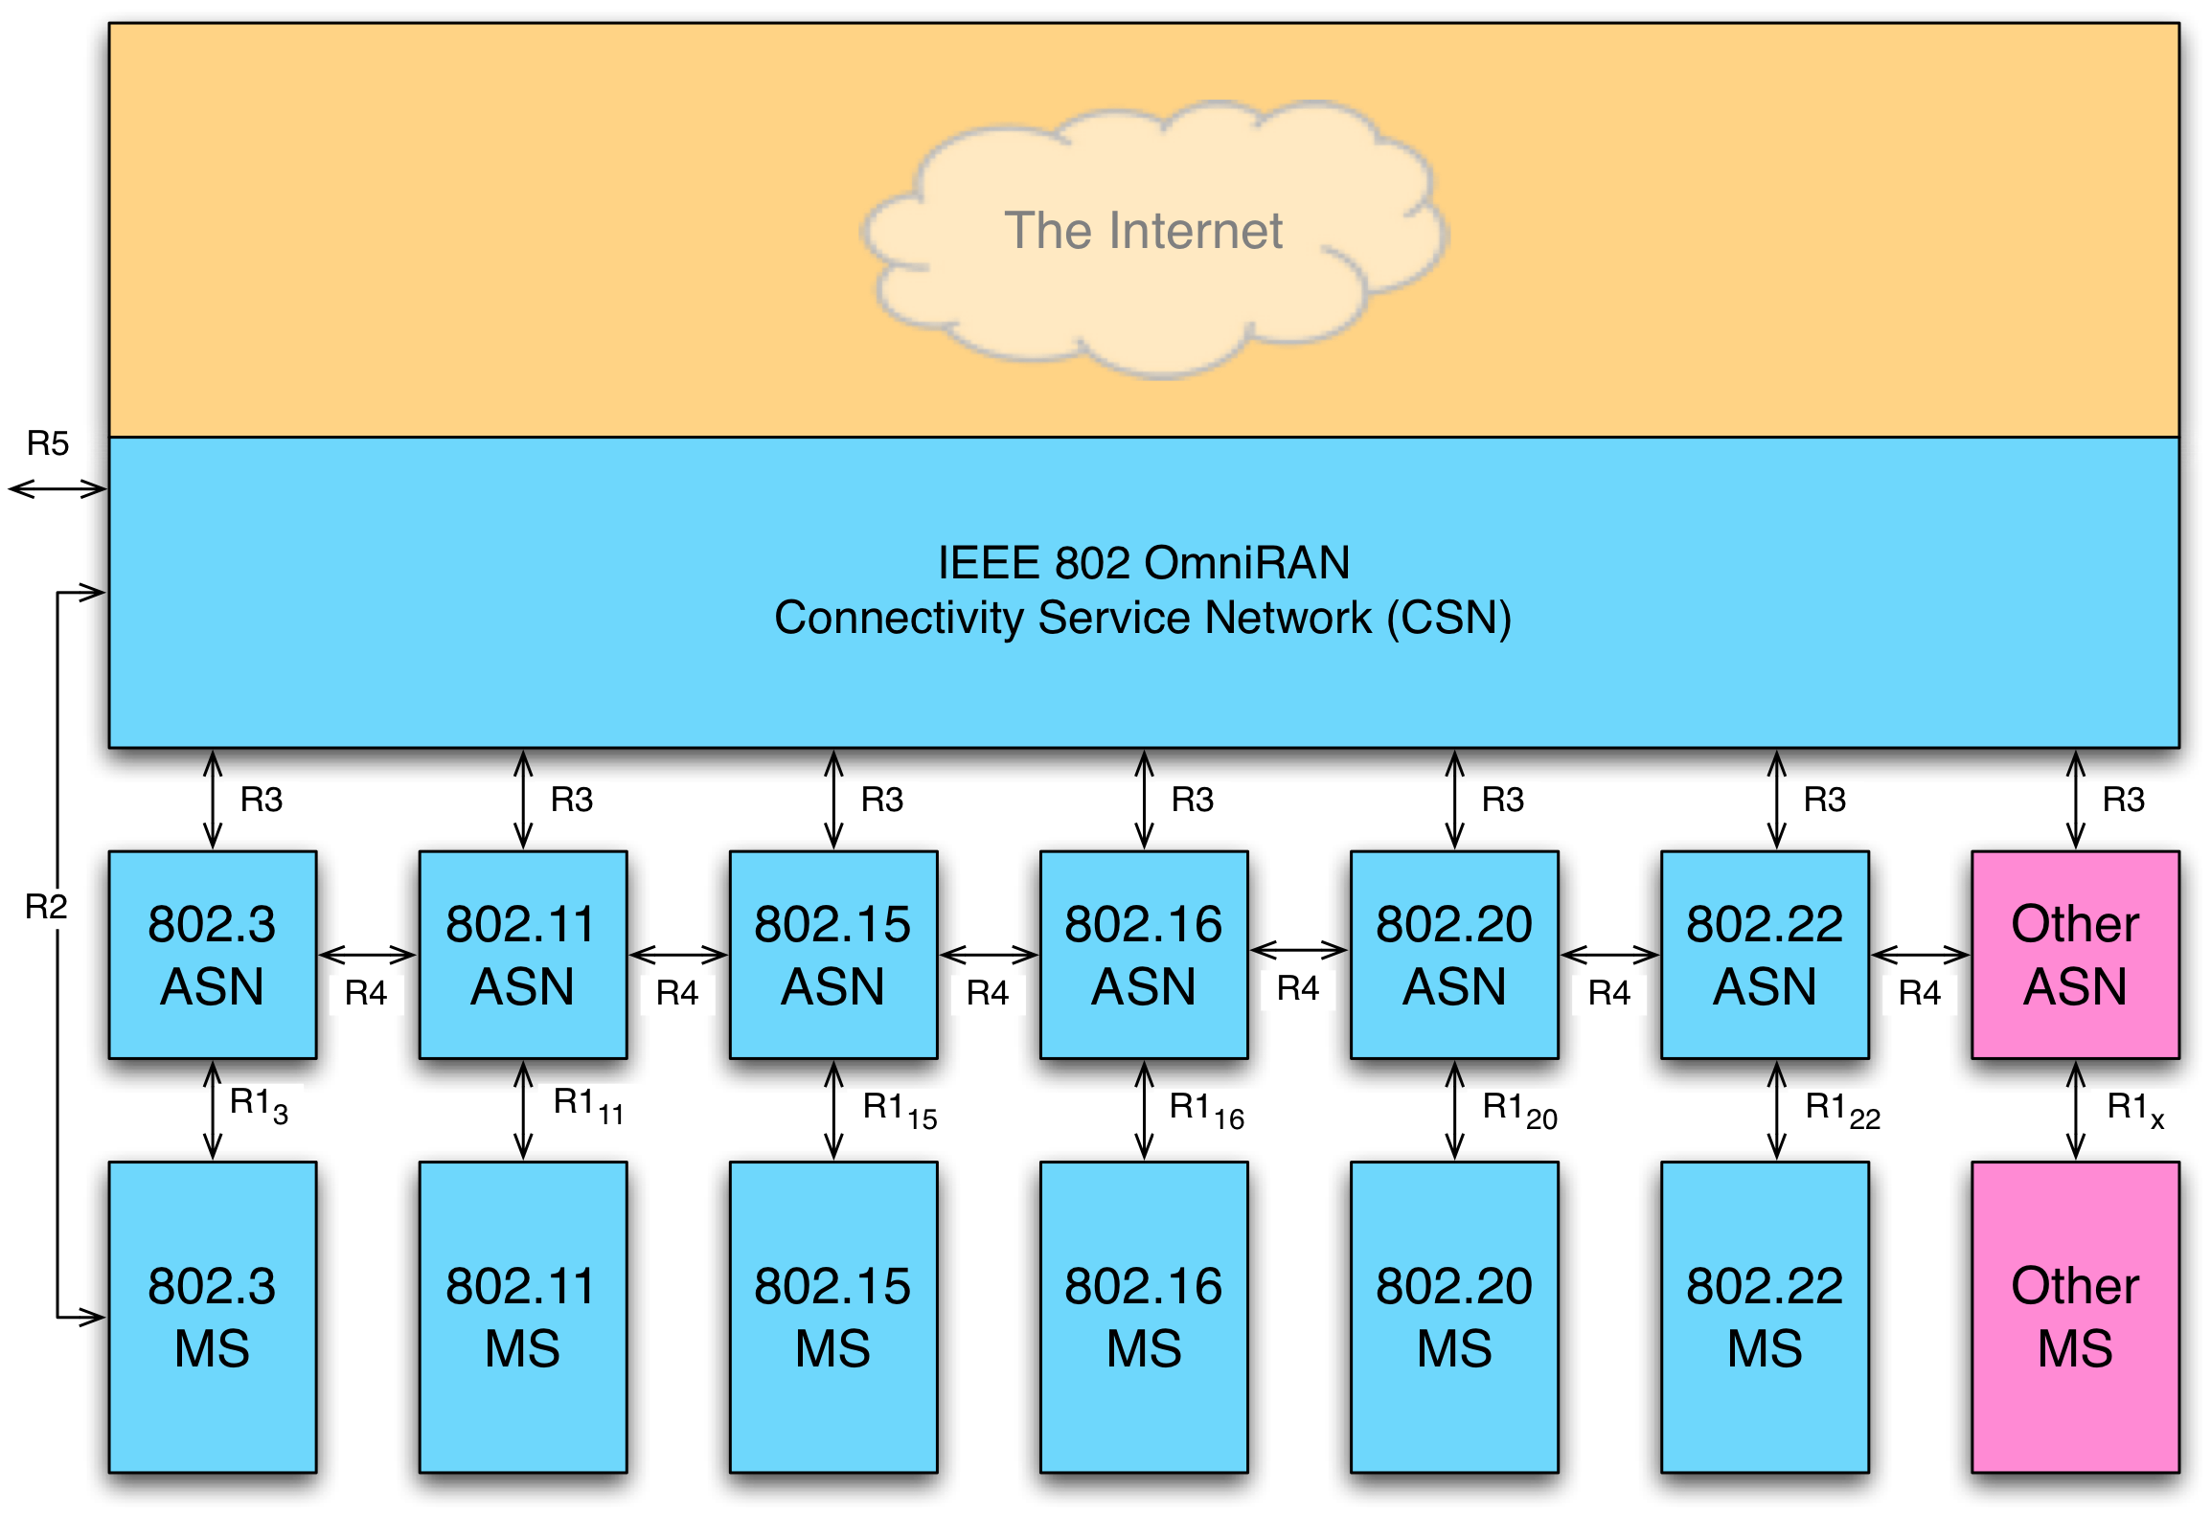
OmniRAN Architecture Overview

Slide 12
OmniRAN Interfaces
R1: Access link, technology specific
R2: User & terminal authentication, subscription & terminal initialization and maintenance
R3: Authorization, Service management, user data connection, accounting
R4: Inter-access network coordination and cooperation, fast inter-technology handover
R5: Inter-operator roaming control interface

Slide 13
Relation to other standardization activities
There are plenty of related standardization activities in the industry
  WFA Hotspot 2.0
    solving the networking issues for IEEE802.11
  WiMAX Forum
    Mobile WiMAX Network specifications
  3GPP
    Interworking with non-3GPP technologies
  IEEE1905.1
    Specification for home networks
  SmartGrid and M2M
    many activities somehow touching the topic
  …
    there may be even many more related activites

Slide 14
How to proceed?
There are benefits to work on heterogeneous networking in IEEE802.
Further analysis necessary to define the missing pieces to enable broader ecosystem for IEEE802 networks.
Discussions for PAR and 5C needs involvement across all IEEE P802 WGs
Proposal to establish ECSG on OmniRAN

