Slide 1
  Extremely Dense Access Networks as OmniRAN Use Case
Document Number:
  IEEE 802.16-12-0661-00-Shet
Date Submitted:
  2012-11-10
Source:
  Claudio Cicconetti
  Telecommunications & Smart Systems Business Units R&D Manager
  INTECS SpA
  Project manager FP7 CROWD
Re:
Use Case for OmniRAN scope definition
Base Contribution:
  None.
Purpose:
  Description of possible OMNIRAN Features for extremely dense heterogeneous scenarios
Notice:
  This document does not represent the agreed views of the IEEE 802.16 Working Group or any of its subgroups. It represents only the views of the participants listed in the “Source(s)” field above. It is offered as a basis for discussion. It is not binding on the contributor(s), who reserve(s) the right to add, amend or withdraw material contained herein.
Copyright Policy:
The contributor is familiar with the IEEE-SA Copyright Policy <http://standards.ieee.org/IPR/copyrightpolicy.html>
Patent Policy:
  The contributor is familiar with the IEEE-SA Patent Policy and Procedures:
      <http://standards.ieee.org/guides/bylaws/sect6-7.html#6> and <http://standards.ieee.org/guides/opman/sect6.html#6.3>.
  Further information is located at <http://standards.ieee.org/board/pat/pat-material.html> and <http://standards.ieee.org/board/pat >.

Slide 2
Extremely dense access networks as OMNIRAN use case: the FP7 CROWD project
Session #82, San Antonio, TX
November 2012

Slide 3
Motivation
Number of wireless users increasing rapidly
  Load doubles every year
Dramatic capacity improvements are only possible through re-use
To meet high demands, wireless networks of the future will be very dense

Slide 4
Motivation
History has shown that “single size fits all” is not applicable to wireless networks
Fast evolution of technology
  Investments protected through incremental deployments
Wireless networks of the future will be very heterogeneous

Slide 5
Motivation
History (Cooper’s law) show us that the vast majority of capacity increase comes from reducing the cell size
Future RAN characteristics: Reduced cell size + heterogeneous technologies
  With current technologies this means a mixture of IEEE and 3GPP access technologies
  We also need a suitable network to join it→OMNIRAN

Slide 6
OMNIRAN Features for extremely dense heterogeneous scenarios
The features we envision for the OMNIRAN network:
  Heterogeneous technology reconfiguration
  Common interface enabling inter-technology cooperation
  Architectural enablers for optimized mobility
  Usage of OMNIRAN as enabler for heterogeneous backahuling
  Fill the GAP between 3GPP and IEEE technology

Slide 7
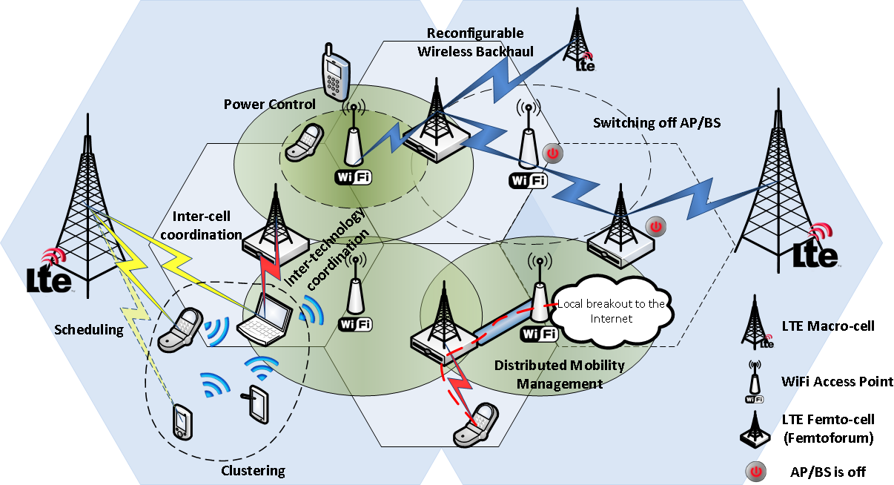
Vision

Slide 8
Project objective
To devise novel mechanisms at layer 2 or above for:
network density-aware MAC operation,
energy-efficient operation,
connectivity management with heterogeneous networks,
dynamic backhaul optimisation,
in order to
support energy- and resource-efficient wireless dense networks with very high-capacity.

Slide 9







Relevance to OmniRAN
CROWD is an ideal use case for OmniRAN
  CROWD expected to build on results from IEEE 802 (.11, .21) and IETF (DMM, MIF, NETEXT)
The vision has solid support
  The CROWD vision is endorsed by top stakeholders while the execution is financially supported by the European Commission

Slide 10

Facts
Title: Connectivity management for enerRgy Optimised Wireless Dense networks (CROWD)
Start: 1/1/13
End: 30/6/15 (duration 30 months)
Total cost: 4,460 k€
Total effort: 443 PM

