Slide 1
Broadband Internet Performance: A View from the Gateway
Document Number:
IEEE 802.16-12-0373-01-Smet”, per <http://ieee802.org/16/submit.html>
Date Submitted:
2012-05-16
Source:
Nick Feamster
Georgia Institute of Technology E-mail: feamster - gatech . edu
Re:
Solicitation of input contributions by IEEE 802.16’s Metrology Study Group <http://ieee802.org/16/sg/met> for IEEE 802.16’s Session #79 of 14-17 May 2012
Base Contribution:
[none]
Purpose:
Consideration during discussions of Study Group activity and plans.
Notice:
This document does not represent the agreed views of the IEEE 802.16 Working Group or any of its subgroups. It represents only the views of the participants listed in the “Source(s)” field above. It is offered as a basis for discussion. It is not binding on the contributor(s), who reserve(s) the right to add, amend or withdraw material contained herein.
Copyright Policy:
The contributor is familiar with the IEEE-SA Copyright Policy <http://standards.ieee.org/IPR/copyrightpolicy.html>.
Patent Policy:
The contributor is familiar with the IEEE-SA Patent Policy and Procedures:
<http://standards.ieee.org/guides/bylaws/sect6-7.html#6> and <http://standards.ieee.org/guides/opman/sect6.html#6.3>.
Further information is located at <http://standards.ieee.org/board/pat/pat-material.html> and <http://standards.ieee.org/board/pat >.

Slide 2
Broadband Internet Performance: A View from the Gateway
Srikanth Sundaresan, Walter de Donato, Stephen Woodrow, Nick Feamster, Renata Teixeira, Sam Crawford, Antonio Pescapè
http://projectbismark.net

Slide 3
Key Research Challenge: Home Network Management
Monitoring
Continuous measurements of ISP performance (“Am I getting what I’m paying for?”)
Monitoring traffic use inside the home (“Who’s hogging the bandwidth?”)
Security (“Are devices in the home compromised?”)
Control
Traffic prioritization (e.g., ensure file sharing does not clobber critical traffic)
Parental controls
Most important issue: Current infrastructures make management too complex.
Notes:
----- Meeting Notes (8/12/11 11:52) -----
managed home area network service/business.
helping users set up their own home network inside their home.
almost everyone for whom they've installed service has had to upgrade their router
lots of proactive maintenance on a home visit
all the way to the host (spyware protection). should they? they are in discussions as to how far they should go into the home.
blacklisting/automated prevention running on the router itself. real-time blacklisting. epb currently uses websense cloud-based service.
IPv6 to the home may happen soon. company will move over in the first of the year (corporate). routers on the GPON network being upgraded to support IPv6
Security: seeing where connections are coming in from
from a customer perception perspective, how do you subtly make sure the customer knows that the problem is internal so that they don't blame the ISP
smart grid: what is going on in the house? service lines in the fuse box uses power line carrier. current transformers on lines expose different patterns of usage and alert the customer before they get a giant bill. not yet looking at individual devices.
how much effort is a customer willing to put in to monitor the usage? heavy hitters use most of the electricity. trends: tail on small device consumption is long and getting longer. the heavy hitters have made efforts to become more energy efficient. encouraging time-shifting of activities through time-of-use rates... but not everyone will want to go there. intiial things: water heater (switch to cycle during peak times; run hotter than normal during off-peak, etc.), A/C, dryer, refrigerator. *controlled cycling*: a control to every one of these things + management + priorities to ensure that no more than two of these were on at a time.
peak time is around 5-6p (everyting is on, from home to work... AC is all on, etc.)
people don't think about electricity usage. how do we do certain things behind the scenes without compromising their experiences. use X-10 or Zigbee or Z-Wave technology to control home appliances
EPB: customers pay different rates when they go over 1Gbps.
----- Meeting Notes (8/12/11 12:22) -----
the minute you start layering in rate structures, people will be forced to have better monitoring, QoS tools, functions, etc.
EPB service tiers: 30, 50, 100, 1G
idea: show off what you have to the consumers (EPB is proud of their service)
what types of applications for the home area network?
- need to decide where services stop. once that decision is made, the applications will become a little more clear
- convergence of consumer electronics devices --> device management in the home
- diagnostics/troubleshooting (where is the problem? internal vs. ISP). cloud-based management. visibility into the home.
- performance monitoring
- security

Slide 4
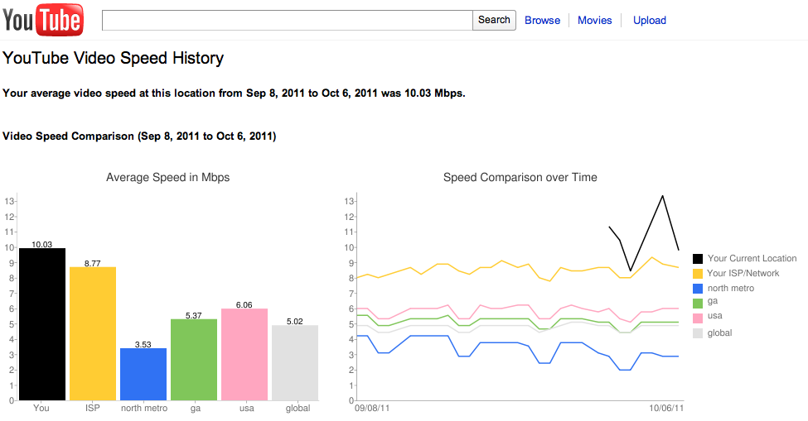
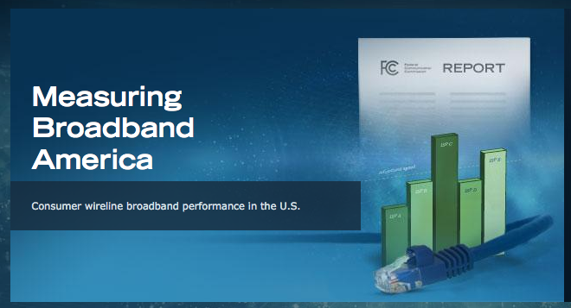
Example: What Performance Do Home Users See?
Access ISPs
What performance are customers seeing?
Can they gain better visibility into downtimes?
Can visibility into problems help reduce service calls?
Content Providers
How do content routing or traffic engineering decisions affect end user performance
Also, consumers and regulators
Notes:
Don’t know how broadband networks perform; even notion of performance not well understood;

Slide 5
Most Current Approaches: Not Accurate or Continuous
Home Network: AT&T DSL
6 Mbps Down, 512 Kbps Up
Last Mile
ISP Network
speedtest.net: 4.4 Mbps, 140 Kbps
Netalyzr: 4.8 Mbps, 430 Kbps
End host measurements are not continuous, and affected by confounding factors
Notes:
Many challenges in getting accurate, representative measurements from end-hosts

Slide 6
Measurements from the Home Router: Continuous, Direct
Home Network: AT&T DSL
6 Mbps Down, 512 Kbps Up
Last Mile
ISP Network
speedtest.net: 4.4 Mbps, 140 Kbps
Netalyzr: 4.8 Mbps, 430 Kbps
Home Router: 5.6 Mbps, 460 Kbps
Enables periodic measurements, and can account for confounding factors
Notes:
Single bullet, practice timing

Slide 7
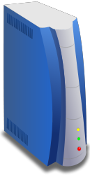
The BISmark Platform
Last Mile
Internet
BISmark Gateway
Nearby Server
OpenWrt firmware with custom measurement suite
Periodic active measurements of access link, home network
Metrics: Throughput, latency, jitter
Current hardware: Netgear 3700v2 router
Planned support for other hardware platforms

Slide 8
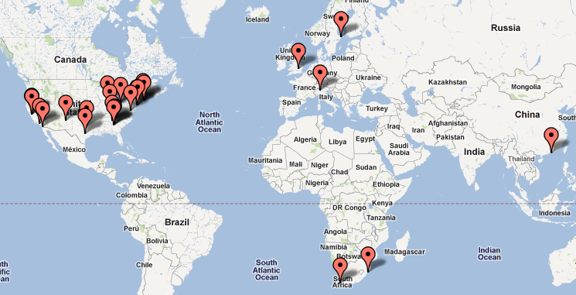
BISmark: An SDN Application Platform for Home Networks
http://projectbismark.net
Current: Active performance measurement & monitoring, home network management
Planned: Generic always-on application platform for high-speed home networks (“GENI at home”)
Opportunities: Performance monitoring/evaluation platform for applications, application development platform (low barrier to entry)
70+ nodes deployed in homes
30+ locations in 10+ countries
Pilot deployment planned in EPB (Chattanooga). Ongoing discussions with Case Connection (Cleveland/Case Western)

Slide 9
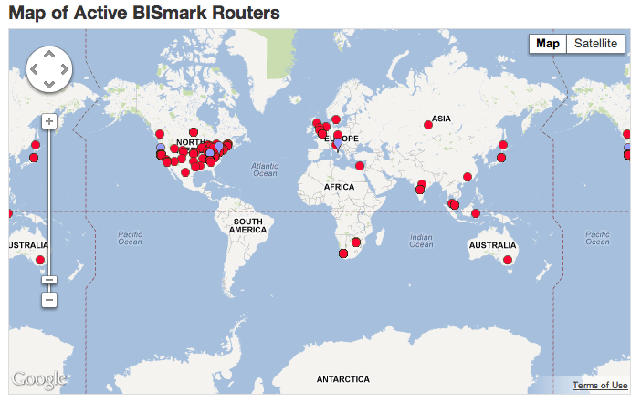
State of BISmark Deployment
Support for TP-Link 1043 and Atom forthcoming
About 70 nodes around the world
Ongoing deployments in Europe and Asia

Slide 10
BISmark’s Measurements
Throughput: iperf, netperf, curl, shaperprobe
Latency: ping, fping, httping
Other: traceroute, tcptraceroute, paris-traceroute, nslookup, D-ITG
The parameters of each of these tests can be configured at the management server

Slide 11
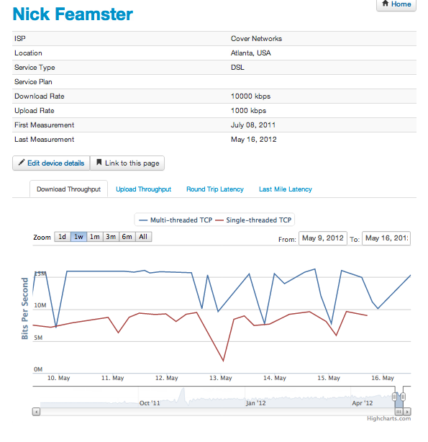
Network Dashboard
Display’s user’s performance: upload and download throughput, latency, last-mile latency
View (and compare) data over time

Slide 12
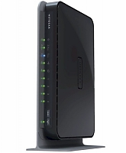
BISmark: Hardware and Software
Firmware
OpenWrt, with luci web interface
IPv6-capable
Netgear 3800 router
Atheros chipset
MIPS processor, 16 MB flash, 64 MB RAM
Gigabit ethernet
2.4 GHz and 5 GHz radio
Notes:
Have slide before this that highlights all results

Slide 13
Customizable Measurements
Routers periodically download scripts from a central management server
Periodic updates over SSL
Each router could, in theory, run custom tests

Slide 14
Management and Measurement
Central control server at Georgia Tech
Listens for periodic heartbeats from routers
Pushes configuration updates, on-demand test scripts
Receives measurement data
Stores in postgres database for network dashboard
Measurement servers
In Georgia Tech, University of Napoli, University of Cape Town
Measurement Lab servers to be commissioned soon

Slide 15
Results: Overview
Throughput measurement technique depends on usage scenario
Traffic shaping is highly variable across users
Access link characteristics affect performance
Modem buffers induce high latency
Impact on Web performance
Notes:
Have slide before this that highlights all results

Slide 16
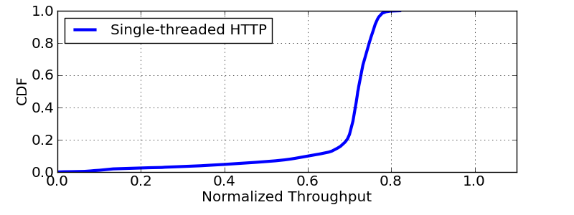
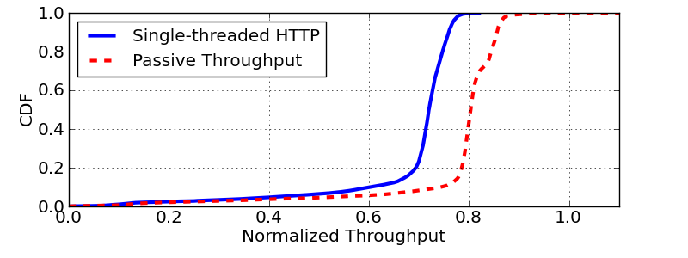
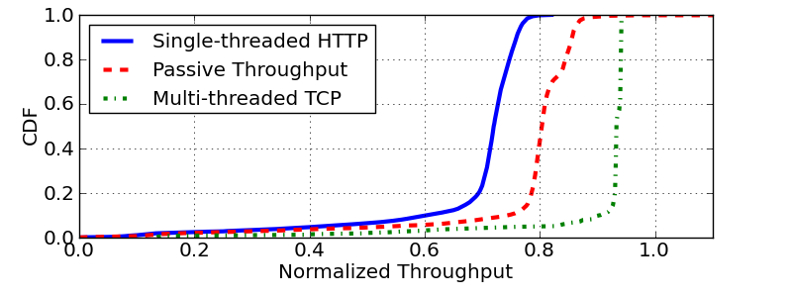
Interpreting Throughput Results
Different techniques measure different aspects of throughput
Notes:
Change color of multi-threaded, talk about the expriment first, axes, then single threaded, then results

Slide 17
Traffic Shaping: PowerBoost
Cable companies advertise “PowerBoost”
Short bursts of high bandwidth
Non-existent in DSL
Notes:
Look at comcast rfc (in paper). Think about title

Slide 18
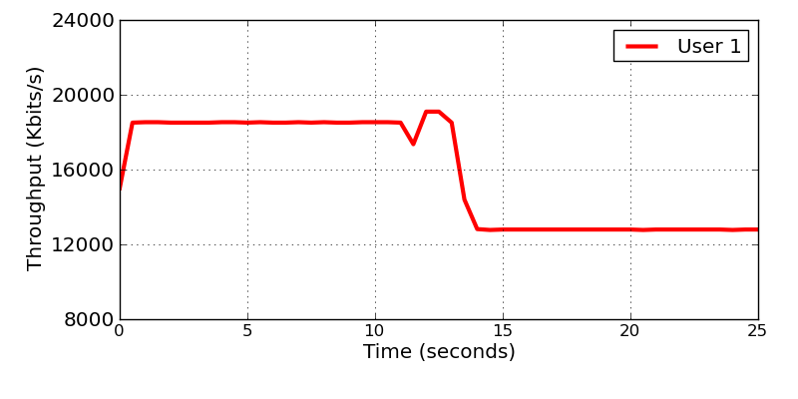
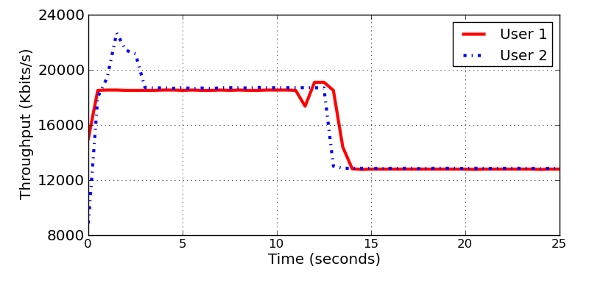
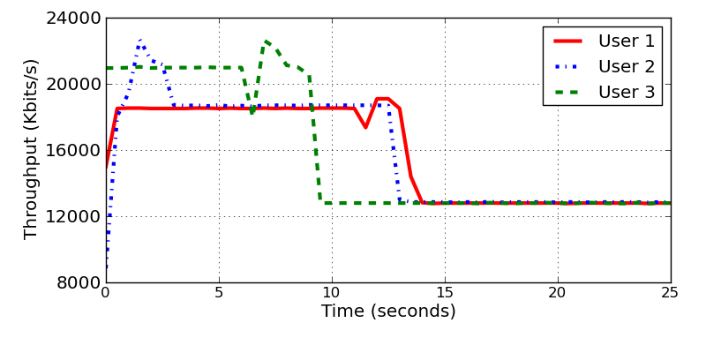
Case Study: Traffic Shaping
Short-term throughput significantly different from sustainable throughput
Notes:
Talk about token buckets after first user, don’t have to talk about numbrs for others, just explain they’re different

Slide 19
Latency Measurements
Parameter | What it captures
End-to-end | Latency to nearby server
Last-mile | Latency to edge of ISP network
Under Load | Buffer delays due to cross traffic
Notes:
Schematic

Slide 20
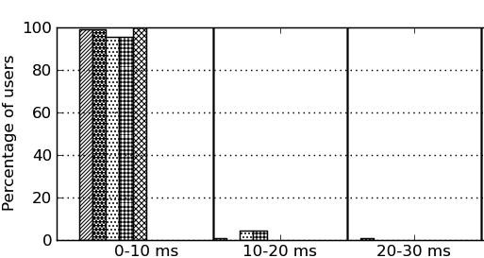
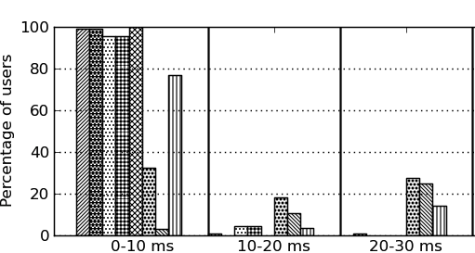
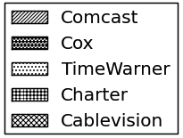
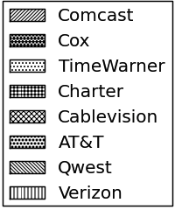
Case Study: Last-mile Latency
Cable ISPs
DSL ISPs
DSL last-mile latencies can be high
Notes:
Single bullet , have patterns for cab;le/dsl

Slide 21
DSL Interleaving Affects Latency
Fastpath vs. Interleaved last-mile data path
9
8
7
6
5
4
3
2
1
Fastpath sends data in order, can recover from single losses
Fastpath is susceptible to bursty loss
9
6
3
8
5
2
7
4
1
Extra Delay
Interleaving sends data out-of-order, can recover from bursty loss
Notes:
Messages, codeword, chunks
Remove reassembly animation, show extra delay

Slide 22
Example: Latency-Throughput Tradeoff
Both users have same service plan
User 2: high latency, low loss
2.5
Throughput (Mbits/s)
Interleaving decreases loss, increases latency, improves throughput
User 1: low latency, high loss
2.2
10
30
Latency (ms)
Interleaving creates a trade-off between latency and throughput

Slide 23
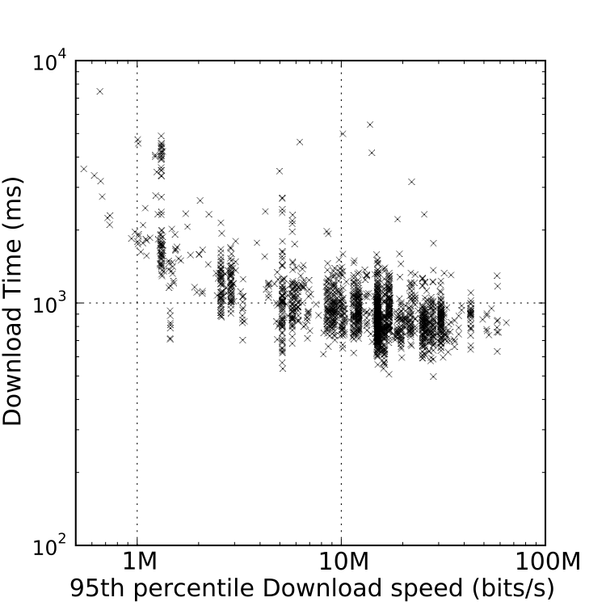
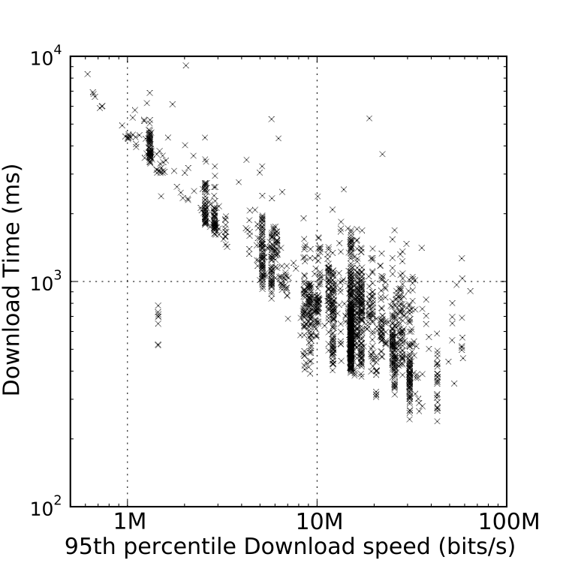
Effect on Web Performance
Users don’t always get benefit of high-end service plans

Slide 24
Bottlenecks on Performance
Web objects are small
TCP slow start significantly degrades performance
Latencies can be high
TCP scales even slower
Server side inefficiencies
Nearly 1 second to set up TCP transfer (ebay)!
No support for persistent connections (CNN)

Slide 25
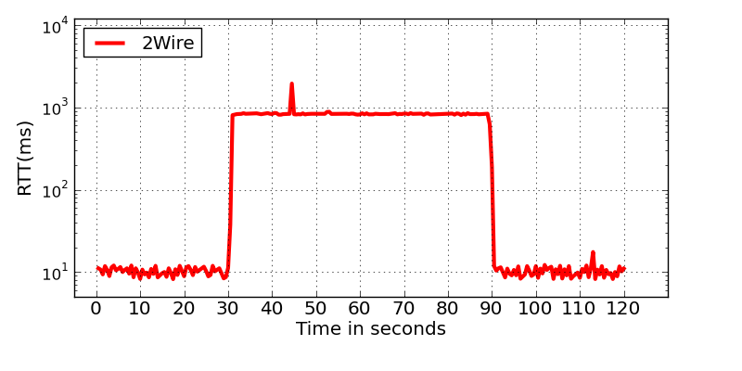
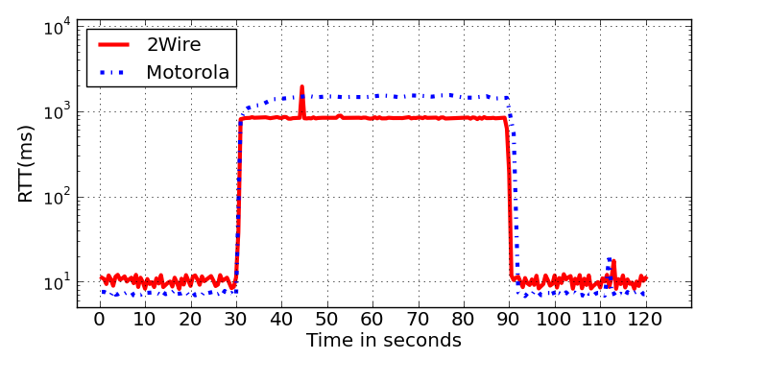
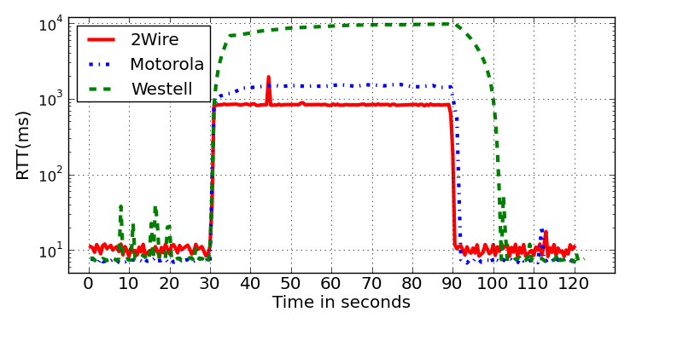
Case Study: Modem Buffers
10 seconds!
Modem buffers can introduce significant latency
Notes:
Performance degradataion can happen even at router; people tend to blame isps
Also talk about how easy it is to see this effect, someone uploading stuff in the home netwrk

Slide 26
Ongoing Work: Research
A view from the edge for transit and access ISPs
Effect of peering on performance
IPv6 performance
Effect of CDN location, traffic engineering on application performance
Want to help? Need server deployments!
Understand home networks better
Effect of wireless
When is the problem not the ISP’s fault?

Slide 27
Ongoing Work: Logistics
IPv6 connectivity and measurements
Moving measurements (and data) to Measurement Lab
Automating registration process
Streamlining firmware upgrades

Slide 28
Another Application: Usage Control
Network management in homes is challenging
One aspect of management: usage control
Usage cap management
Parental control
Bandwidth management
Idea: Outsource network management/control
Home router runs OpenFlow switch
Usage reported to off-site controller
Controller adjust behavior of traffic flows

Slide 29
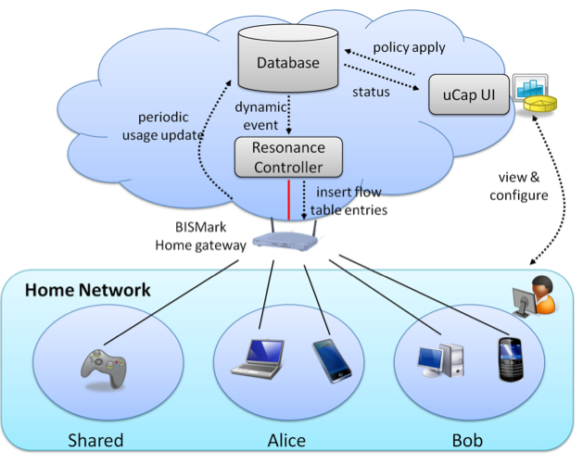
Usage Cap Management in Homes: Design and Implementation
User monitors behavior and sets policies with UI
Resonance controller (OpenFlow) manages policies and router behavior

Slide 30
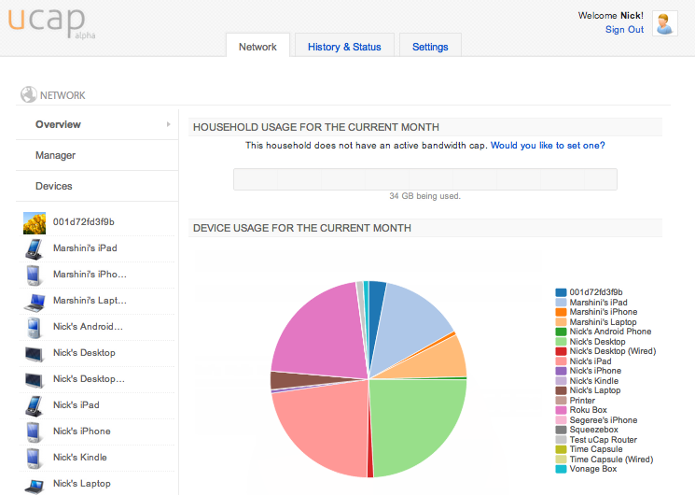
uCap: Network Usage Control and Prioritization

Slide 31
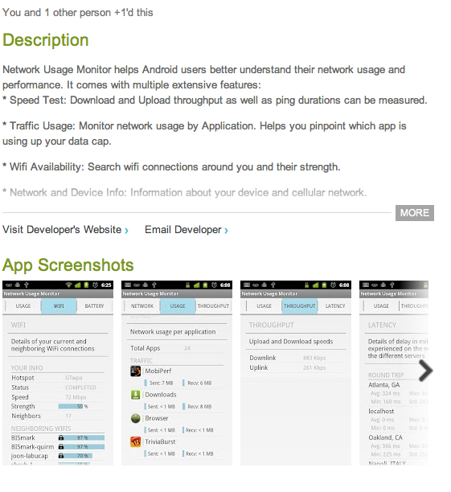
Ongoing Work: Mobile Measurements
BISmark measurements and Network Dashboard interface for Android platform: http://goo.gl/VHuh4

Slide 32
Get Involved!
Host BISmark routers
Get a high-end router for free!
Host measurement servers
Geographic diversity is important for reliable measurements
Contribute measurement tests
Open-source, capability to run on-demand scripts
All code is currently available at http://github.com/bismark-devel

Slide 33
http://projectbismark.net
http://projectbismark.github.com/
bismark-core@projectbismark.net

