Slide 1
  WiMAX Networking Paradigms – Base for heterogeneous networking in IEEE802?
[IEEE 802.16 Mentor Presentation Template (Rev. 0)]
Document Number:
  IEEE802.16-12-0355-00-Shet
Date Submitted:
  2012-05-09
Source:
  Max Riegel Voice: +49 173 293 8240
  Nokia Siemens Networks E-mail: maximilian.riegel@nsn.com
Re:
  Call for contributions for IEEE802.16 HET SG for session #79
Base Contribution:
  n/a
Purpose:
  Introduction of WiMAX networking paradigms to provide information for evaluating applicability to heterogeneous networking in IEEE802
Notice:
  This document does not represent the agreed views of the IEEE 802.16 Working Group or any of its subgroups. It represents only the views of the participants listed in the “Source(s)” field above. It is offered as a basis for discussion. It is not binding on the contributor(s), who reserve(s) the right to add, amend or withdraw material contained herein.
Copyright Policy:
  The contributor is familiar with the IEEE-SA Copyright Policy <http://standards.ieee.org/IPR/copyrightpolicy.html>.
Patent Policy:
  The contributor is familiar with the IEEE-SA Patent Policy and Procedures:
      <http://standards.ieee.org/guides/bylaws/sect6-7.html#6> and <http://standards.ieee.org/guides/opman/sect6.html#6.3>.
  Further information is located at <http://standards.ieee.org/board/pat/pat-material.html> and <http://standards.ieee.org/board/pat >.

Slide 2
WiMAX Networking Paradigms
Base for heterogeneous networking in IEEE802?
2012-05-09
Max Riegel
NSN

Slide 3
ToC
Where is the value in the networks
Mobile Network Architectures
WiMAX Network Reference Model
  Building blocks
  Reference points
  Data path
Control plane functions
Interworking with 3GPP
Mobile WiMAX Specification Framework
Leveraging WiMAX Network Specifications

Slide 4
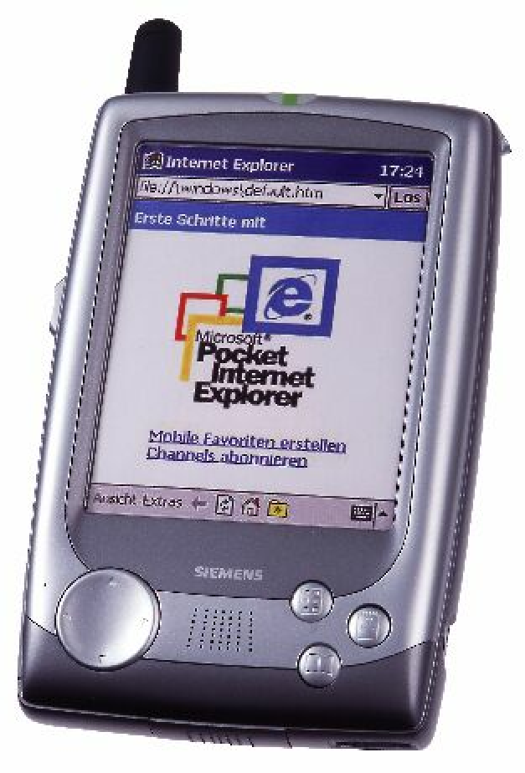
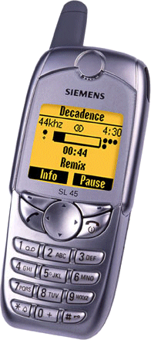
The Mobile Network Operator Value Chain
Services
Commercial operations tend to focus onto increasing their profits
Increasing the customer base is one dimension of increasing profits, introduction of new services is the other dimension.
The profits acchievable by new services depend on the relation between customer value (price) and the cost for realizing the service
Management will allways focus on high value while keeping the expenses for the realization small
  Best example: SMS
The radio access network is adding most to the cost, hardly anything to the profits.
  Bandwidth is considered as a scarce resource
  Results in traffic growth of ~7%/year
⬅ Profit Center
Control
⬅ Profit Enabler
Radio Access
⬅ Cost Center
Tight coupling (and subsidizing) of terminals is key to profits
Subscriber

Slide 5

The Broadband Operator Value Pattern
ASP
ASP
ASP
ASP
The Internet introduced a major change in the value creation of network operators by allowing everybody to provide services to end costomers.
Application service provision, connectivity service provision and access service provision have become independent businesses in competitive markets.
This led to the pervasive proliferation of services over broadband pipes.
There is a new kind of mobile service provider coming up, with services tied to the device
(iOS & Android environment)
Profit Center
Internet
ISP
ISP
ISP
Profit Center
Radio Access
Radio Access
Profit Center
Traffic growth: ~70%/y
Terminal is open and belongs to the customer
(no subsidizing)
Subscriber
Subscriber
Subscriber

Slide 6
Mobile Network Architectures
Legacy Architecture
Mobile WiMAX Network Architecture
MNO ‘A’
MNO ‘B’
ASP
Services
Services
Internet
Core
Core
CSN
CSN
CSN
NSP
R5
RAN
RAN
R3
NAP
ASN
ASN
R2
R4
R1
Subscriber
Subscriber
Subscriber
Subscriber
Subscriber

Slide 7
Entities of the WiMAX Network Reference Model
CSN: Connectivity Serving Network
Logical representation of the functions of a NSP, e.g.
  Connectivity to the Internet, ASPs
  Authentication, authorization and accounting
  IP address management
  Mobility and roaming between ASNs
  Policy & QoS management based on a SLA
ASN: Access Serving Network
Logical representation of the functions of a NAP, e.g.
  802.16 interface w/ network entry and handover
  Radio Resource Management & Admission ctrl.
  L2 Session/mobility management
  QoS and Policy Enforcement
  Mobile Access Gateway (MAG)
  Forwarding to selected CSN

Slide 8
Mobile WiMAX Network Reference Model
R2
MS
R1
BS
ASN
CSN
R6
ASN GW
CSN
R8
R3
R5
BS
R6
R4
Another ASN
ASP Network
OR Internet
ASP Network
OR Internet
Mobile WiMAX Network Reference Point
Control and Data Path Control only
MS: Mobile subscriber station
ASN: Access Serving Network
CSN: Connectivity Serving Network

Slide 9
WiMAX Reference Points
MS
ASN
CSN
R6
R1
RRM-C
RRM-S
R3
Pg/SM
Pg/SM
Pag. & Loc
Pag. & Loc
Config
Authorization
Authorization
PKM
PKM
Authentication
Authentication
QoS
QoS
QoS Ctrl
QoS Ctrl
HO
HO
Mob Mgmt
Mob Mgmt
DataPath
DataPath
DataPath
Encaps
Encaps
NRM Reference Points represent a bundle of protocols between peer entities
  Similar to a real IP network interface
The implementation of a particular protocols over a reference point is optional
  If a particular protocol is present, it must conform to the WiMAX specification

Slide 10
WiMAX Networking Considerations
Interoperability enforced via reference points without dictating how vendors implement edges of reference points
Introduces the notion of functional entities – which can be combined or decomposed by vendor and/or operator
No single physical ASN or CSN topology is mandated – allowing room for vendor / operator differentiation
  Standardized decomposition of ASN into BS and ASN-GW
  CSN is fully kept opaque; no aim for standardized implementations
Mobility is mainly achieved by ASN anchored MM (R6, R4)
  R3 mobility (MIP) is used for path optimization, network sharing and wide-area nomadicity, but not for seamless handover.
AAA and Roaming is based on IETF EAP supporting any kind of ‘credentials’ (Password, Certificate, SIM & U-SIM)

Slide 11
Anchoring of the Customer/Terminal in the CSN
R1
ASN
R6
ASN
GW
R3
CSN
R5
CSN
MS
BS
Internet
IP
IP
IP
IP
CS
CS
GRE
Tunnel
GRE
XXX
Tunnel
XXX
LNK
LNK
MAC
MAC
IP
IP
IP
IP
PHY
802.16
PHY
LNK
LNK
LNK
LNK
All user traffic is tunneled between MS and CSN
  The 802.16 Convergence Sublayer (CS) provides tunneling over the air.
  GRE tunneling is applied in the ASN when R6 is exposed
  Either MIP tunneling or other generic tunnels in the case of Simple IP networks are used on R3

Slide 12
Main Control Plane Functions
Network entry discovery and selection
  MS scans and detects available WiMAX access; NAP selection
Authentication, Authorization and Accounting (AAA)
  Network access authentication and authorization based on the home CSN‘s subscriber profile; accounting procedures
Network entry and exit
  Procedures for establishing initial connectivity with a WiMAX network and leaving the network gracefully.
IP addressing
  Assignment of IP address to MS via DHCP, MIP/AAA or stateless autoconfiguration for IPv6.
Security
  Distribution of keying material within the ASN and CSN; reference point protection; control of air interface security

Slide 13
Control Plane Functions (2)
QoS and Service Flow Management
  Creation, modification and deletion of service flows; installation of static QoS profiles in the ASN
ASN anchored mobility management
  Handover support of the radio link between base stations within the same ASN or between ASNs
CSN anchored mobility management
  Mobility management based on Proxy Mobile IP between ASNs where the mobility anchor is in the CSN
Radio Resource Management
  Support function within the ASN to increase deployment efficiency of available radio resources
Paging and Idle Mode support
  Control procedures in the network to support the 802.16 functions for paging, location update and entering/exiting idle mode.

Slide 14
Heterogeneous Networking with 3GPP
HSS
SWx
S6a
PCRF
Gxc
Gx
Rx
SGi
Ope
rator's IP
Serving
PDN
Services
3GPP
Gateway
Gateway
(e.g. IMS, PSS
Access
S5
etc.)
S2b
S6b
Gxb
SWm
S2a
ePDG
3GPP AAA
SWn
Server
HPLMN
Non
-
3GPP
Gxa
Networks
Trusted
SWu
Untrusted
Non
-
3GPP IP
Non
-
3GPP IP
Access
Access
SWa
STa
e.g. WiMAX access network
UE
3GPP standardized the EPC architecture with access to the 3GPP LTE core network through other than 3GPP radio technologies, e.g.:
  WiMAX
  Cdma (mobile cellular networks following the 3GPP2 specifications)
  WiFi

Slide 15
WiMAX Interworking with 3GPP EPC
Wi-Fi is currently following a similar approach (SaMOG)
While well suited for 3GPP operators, others may prefer other kind of solutions for heterogeneous networking.

Slide 16
Mobile WiMAX Specification Framework
Application
Clients
Application
Server
IMS
IP Connectivity
R2
R5
BS
ASN-GW
AAA
AAA
Rating
Rating
Radio I/F
Radio I/F
DHCP
Clearing
X5
Clearing
DHCP
AAA
IEEE802.16
MAC
PHY
R1
IEEE802.16
MAC
PHY
R6
R3
X6
AAA
Financial
Settlement
Financial
Settlement
HA
HA
MGW
Rating
SS/MS
ASN
CSN
WRX
CSN
WiMAX provides ‘generic’ network specifications for:
  User Network Interface
    Authentication, IP-Configuration, Provisioning
  Network Network Interface
    Network sharing, Roaming

Slide 17
Leveraging WiMAX Specifications for heterogeneous networking in IEEE802
While somewhat specific to IEEE802.16, WiMAX network specifications can be leveraged to define generic network interfaces across all IEEE802 technologies
  User authentication and device provisioning
  QoS and policy control
  Network sharing and Roaming
  (Mobility, when needed!)

