Slide 1
CR 1783 Challenges in Using Single NPCA Minimum Duration Threshold
Date: 2024-05-xx
Authors:
Name | Affiliations | Address | Phone | Email
Shravan Kumar Kalyankar | Huawei |  |  | kalyankar.shravan.kumar@huawei.com
Huang Lei
Rojan Chitrakar
Yunbo Li

Slide 2
NPCA Min. Duration Threshold
Proposes a mechanism to resolve CID 1783.
CID | Clause | Comment
1783 | 37.10 | The NPCA Minimum Duration Threshold should be long enough to complete at least one frame exchange in the NPCA P-channel, otherwise it's waste of power to do the switch.

Slide 3
D0.2: NPCA Minimum Duration Threshold
D0.2 (P66L25): The NPCA Minimum Duration Threshold field indicates the minimum duration of inter-BSS activity (inter-BSS PPDU or inter-BSS TXOP) that is required to have been indicated on the primary channel of the BSS as a necessary condition to permit an NPCA STA to switch to the NPCA primary channel to perform NPCA operation. The encoding and the maximum value of this field are TBD.

Slide 4
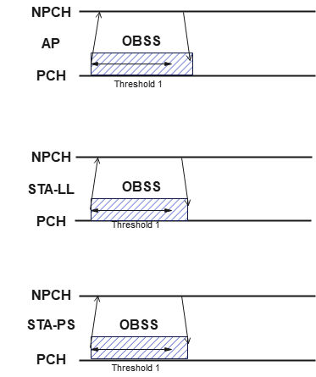
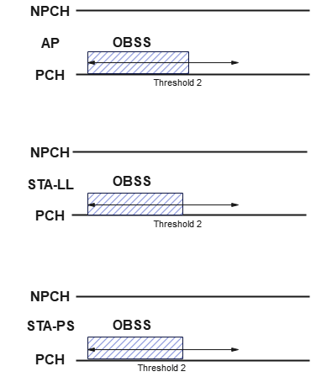
Challenges in Using a Single NPCA Minimum Duration Threshold
Using a shorter NPCA Minimum duration threshold (threshold duration equal to single frame exchange) will be ineffective when the OBSS duration is short leading to power wastage for the STAs which fail to access the NPCA primary channel.
Multiple STAs contend to access the NPCA primary channel, even when the NPCA duration is sufficient for a single frame exchange.
The single threshold approach is ineffective especially when the STAs have power constraints or STAs want power saving.
Using a longer NPCA Minimum duration threshold will limit the main motivation of NPCA mechanism.
Using longer threshold would reduce the probability of benefiting from NPCA mechanism especially when the STAs have LL requirement.
The single threshold approach is ineffective especially when the STAs have different requirements.
Fig. 1. Using a short threshold value.
Fig. 2. Using a long threshold value.
Single threshold (NPCA Min. Duration Threshold) is hard to balance different requirements of the STAs.

Slide 5
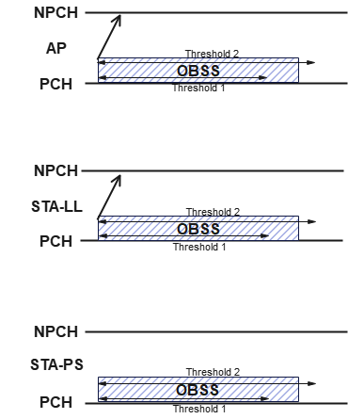
Two NPCA Minimum Duration Threshold’s
AP shall indicate two different NPCA Min. Duration Threshold’s,
NPCA Min. Duration Threshold1 for latency sensitive STA’s,
NPCA Min Duration Threshold2 for other STA’s.
Where, $NPCA Min. Duration Threshold1 < NPCA Min. Duration Threshold2$.
The STAs with Power Saving (PS) requirement or any other STAs can skip switching to NPCA primary channel when the detected OBSS duration is shorter than Threshold2.
However, the latency sensitive STAs can switch to NPCA primary channel when the detected OBSS duration is greater than Threshold1.
The two NPCA Minimum Duration thresholds can be transmitted to STAs via a beacon using NPCA element.
Fig. 3. Using two thresholds.

Slide 6
Two NPCA Minimum Duration Threshold’s
B0
B7
B8
Bx
Bx+1
Bx+6
Bx+7
Bx+12
Bx+13
Bx+18
NPCA Primary Channel | NPCA Minimum Duration Threshold1 | NPCA Minimum Duration Threshold2 | NPCA Switching Delay | NPCA Switch Back Delay
8
TBD
TBD
6
6
Figure 9-aa3 – NPCA Operation Information field format.
Two NPCA Minimum Duration Thresholds are indicated. The NPCA Minimum Duration Threshold1 field indicates the minimum duration of inter-BSS activity (inter-BSS PPDU or inter-BSS TXOP) that is required to have been indicated on the primary channel of the BSS as a necessary condition to permit an NPCA STA with latency sensitive traffic to switch to the NPCA primary channel to perform NPCA operation. The NPCA Minimum Duration Threshold2 field indicates the minimum duration of inter-BSS activity (inter-BSS PPDU or inter-BSS TXOP) that is required to have been indicated on the primary channel of the BSS as a necessary condition to permit the other NPCA STAs to switch to the NPCA primary channel to perform NPCA operation. The encoding and the maximum value of these fields are TBD.

Slide 7
Two NPCA Minimum Duration Threshold’s
TGbn editor: Modify the sub-clause as following:
1)
b. If the STA has latency sensitive traffic, the TXOP duration, determined from the Duration field of the received frame(s), is greater than the value indicated in the most recently received or transmitted NPCA Minimum Duration Threshold1 field corresponding to its BSS
i) Whether the RXVECTOR parameter TXOP_DURATION of the received PPDU(s)
are considered for this comparison is TBD
c. If the STA has doesn’t have the latency sensitive traffic, the TXOP duration, determined from the Duration field of the received frame(s), is greater than the value indicated in the most recently received or transmitted NPCA Minimum Duration Threshold2 field corresponding to its BSS
i) Whether the RXVECTOR parameter TXOP_DURATION of the received PPDU(s)
are considered for this comparison is TBD
2)
b. If the STA has latency sensitive traffic, the TXOP duration, determined from the Duration field of the received frame(s), is greater than the value indicated in the most recently received or transmitted NPCA Minimum Duration Threshold1 field corresponding to its BSS
i). Whether the RXVECTOR parameter TXOP_DURATION of the received PPDU(s) are considered for this comparison is TBD.
c. If the STA doesn’t have latency sensitive traffic, the TXOP duration, determined from the Duration field of the received frame(s), is greater than the value indicated in the most recently received or transmitted NPCA Minimum Duration Threshold2 field corresponding to its BSS.
i). Whether the RXVECTOR parameter TXOP_DURATION of the received PPDU(s) are considered for this comparison is TBD.

Slide 8
Summary
In this contribution, we explored potential of using two NPCA Minimum Duration Thresholds instead of a single threshold.

Slide 9
References
IEEE P802.11bn™/D0.2, March 2025.
11-25/0537r2, “cc50-cid-1783-discussion-on-npca-minimum-duration-threshold”.

Slide 10
Straw Poll 1
Do you support that two NPCA Minimum Duration Thresholds are indicated?
Y/N/A

Slide 11
Straw Poll 2
Do you support that the Low Latency required STAs are prioritized over Power Saving STAs during a short duration OBSS?
Y/N/A

Slide 12
Straw Poll 3
Do you support resolution to the CID 1783 and incorporate the proposed text changes into the latest TGbn draft ?
Y/N/A

