Slide 1
CID 368: Guard Interval for DRU
Date: 4/2/2025
Authors:

Slide 2
Introduction
CID 368 comments on the lack of GI=1.6 usec for DRU
This submission provides additional background and motivation for the requested change

Slide 3
Background
Distributed RU (DRU) is only defined with 4xLTF and GI=3.2 usec
Regular RUs support 1xLTF, 2xLTF, 4xLTF and GI=0.8, 1.6 and 3.2 usec
4xLTF is needed because interpolation is not straightforward for distributed tone sets
However, there is no reason DRUs could not support GI values other than 3.2 usec
Only supporting GI=3.2 usec results in a loss of 10% relative to support of GI=1.6 usec
See [1] for earlier proposal

Slide 4
DRU gains
The possible power gain of using DRU is closely tied to the number of users in the (UL) OFDMA transmission
Specifically:

Slide 5
Importance of the Two-user case
OFDMA can only work in situations where STAs have simultaneous traffic
The larger an OFDMA group, the harder it is to find STAs with simultaneous traffic
Moreover, combining STAs at different distances from the AP will degrade the performance of the closer STAs (see e.g. [2])
UL Target Receive Power constraints
Ideally, selected STAs should be at a similar distance from the AP
It is much more likely to find a 2-STA group that meets the necessary conditions
For the reasons above, the two-user case is an important use case for UL OFDMA

Slide 6
Impact of GI values in two-user case
How does the absence of GI=1.6usec affect the performance of DRU in the two-user case relative to RRU?
Compare:
Performance of RRU with GI=1.6 usec
Performance of DRU (2.62 dB gain over RRU) with GI=3.2 usec
Performance of DRU (2.62 dB gain over RRU) with GI=1.6 usec
Note: Currently not supported in 802.11bn

Slide 7
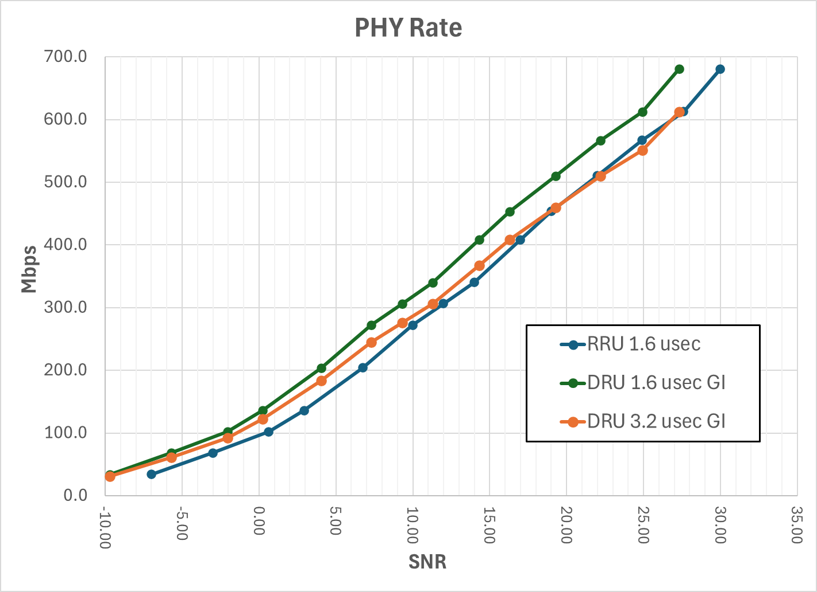
RvR In AWGN
Performance clearly impacted by absence of GI=3.2 usec
A 2.62 dB gain can be seen for DRU that support 1.6 usec GI
DRU with 3.2 usec GI can perform worse than RRU for mid/high MCS

Slide 8
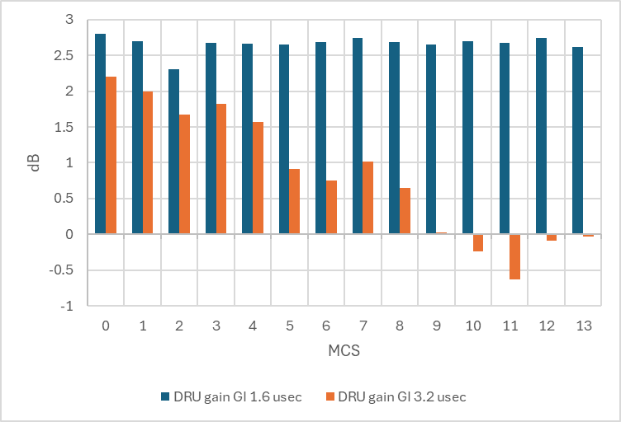
SNR gain as function of MCS
Gains calculated relative to RRU with 1.6 usec GI
Expected gain of 2.62 dB quickly disappears
Performance of DRU can be worse than RRU for higher MCS

Slide 9
Conclusion
Not providing support for 1.6 usec GI in DRUs can significantly degrade the performance of DRU in the two-user case
We propose to add GI=1.6 usec as a possible option for DRU to mitigate the losses

Slide 10
References
[1] 802.11-25/1480, UHR-LTF for DRU
[2] 802.11-24/1778, Distributed RU Distortion, Beamforming, Power Control

