Slide 1
Transmit Constellation Error Definition for UHR TB PPDU using RRU
Date: 2025-05-08
Authors:

Slide 2
Introduction
802.11bn defined four new MCS values to improve the RvR.
[1] proposed the transmit constellation error requirement for the new MCSs in the UHR MU PPDU transmission.
In this contribution, we propose the following:
transmit constellation error requirements of UHR TB PPDU transmission using RRU for New MCSs
unused tone error definition and requirements of UHR TB PPDU transmission using RRU

Slide 3
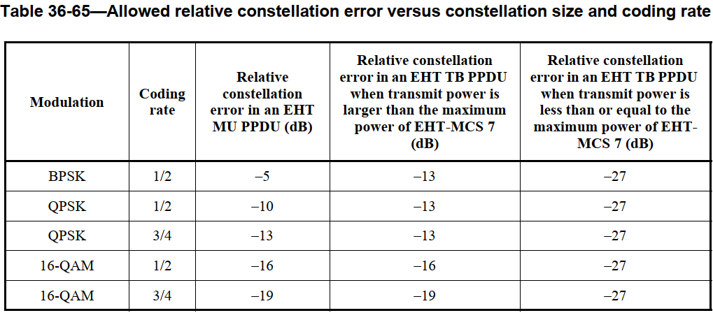
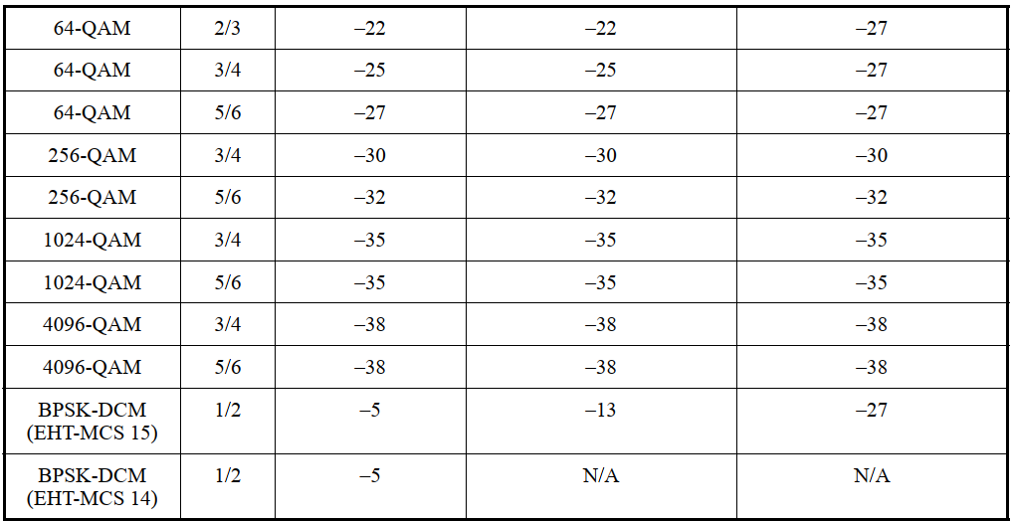
Transmit Constellation Error Definition
Transmit Constellation Error is defined in 802.11be in “Table 36-65—Allowed relative constellation error versus constellation size and coding rate”.
Tighter constellation error requirement is defined to limit cross-RU and cross-user interference, thus
When transmit power is larger than the maximum power of MCS7, transmit constellation error requirement for MCS2 (-13dB) needs to be supported.
When transmit power is less than or equal to the maximum power of MCS7, transmit constellation error requirement for MCS7 (-27dB) needs to be supported.

Slide 4
Transmit Constellation Error for UHR TB PPDU using RRU
The transmit constellation error for MCS0-15 should follow the same definition as in EHT.
For the new MCSs, we propose the values as shown in red below.
MCS | Transmit Constellation Error in an UHR MU PPDU (dB) | Relative constellation error in an UHR TB PPDU using RRU when transmit power is larger than the maximum power of UHR-MCS 7 (dB) | Relative constellation error in an UHR TB PPDU using RRU when transmit power is less than or equal to the maximum power of UHR-MCS 7 (dB)
QPSK 2/3 | -12* | -13 | -27
16QAM 2/3 | -18* | -18 | -27
16QAM 5/6 | -20* | -20 | -27
256QAM 2/3 | -29* | -29 | -29
* proposed in [1] for UHR MU PPDU

Slide 5
Table of Transmit Constellation Error Definition
MCS | Transmit Constellation Error in an UHR MU (dB) | Relative constellation error in an UHR TB PPDU using RRU when transmit power is larger than the maximum power of UHR-MCS 7 (dB) | Relative constellation error in an UHR TB PPDU using RRU when transmit power is less than or equal to the maximum power of UHR-MCS 7 (dB)
BPSK 1/2 | -5 | -13 | -27
QPSK 1/2 | -10 | -13 | -27
QPSK 2/3 | -12 | -13 | -27
QPSK 3/4 | -13 | -13 | -27
16QAM 1/2 | -16 | -16 | -27
16QAM 2/3 | -18 | -18 | -27
16QAM 3/4 | -19 | -19 | -27
16QAM 5/6 | -20 | -20 | -27
64QAM 2/3 | -22 | -22 | -27
64QAM 3/4 | -25 | -25 | -27
64QAM 5/6 | -27 | -27 | -27
256QAM 2/3 | -29 | -29 | -29
256QAM 3/4 | -30 | -30 | -30
256QAM 5/6 | -32 | -32 | -32
1024QAM 3/4 | -35 | -35 | -35
1024QAM 5/6 | -35 | -35 | -35
4096QAM 3/4 | -38 | -38 | -38
4096QAM 5/6 | -38 | -38 | -38

Slide 6
Unused Tone Error Requirement for RRU
For EHT, the requirement for unused tone error is defined as follows:
$$UnusedToneError\left(i_{RU26, start}+m\right)≤\left\{\begin{matrix}\begin{matrix}max\left(ε−2, −38dB\right), \\ max\left(ε−12, −38dB\right),\end{matrix} & \begin{matrix}if −r≤m≤−1 \\ if −2r≤m≤−r−1\end{matrix} \\ \begin{matrix}max\left(ε−22, −38dB\right), \\ −38dB,\end{matrix} & \begin{matrix}if −3r≤m≤−2r−1 \\ otherwise\end{matrix}\end{matrix}\right.$$
$$UnusedToneError\left(i_{RU26, end}+m\right)≤\left\{\begin{matrix}\begin{matrix}max\left(ε−2, −38dB\right), \\ max\left(ε−12, −38dB\right),\end{matrix} & \begin{matrix}if 1≤m≤r \\ if r+1≤m≤2r\end{matrix} \\ \begin{matrix}max\left(ε−22, −38dB\right), \\ −38dB,\end{matrix} & \begin{matrix}if 2r+1≤m≤3r \\ otherwise\end{matrix}\end{matrix}\right.$$
We propose that UHR TB PPDU using RRU adopts the same unused tone error definition and requirement as EHT TB PPDU.
For hybrid RRU/DRU operation, the unused tone error definition is TBD.

Slide 7
Summary
We propose transmit constellation error requirement of UHR TB PPDU using RRU for the new MCSs as follows.
We propose unused tone error definition and requirement of UHR TB PPDU when all users are scheduled with RRU is the same as in EHT TB PPDU.
MCS | Transmit Constellation Error in an UHR MU PPDU (dB) | Relative constellation error in an UHR TB PPDU using RRU when transmit power is larger than the maximum power of UHR-MCS 7 (dB) | Relative constellation error in an UHR TB PPDU using RRU when transmit power is less than or equal to the maximum power of UHR-MCS 7 (dB)
QPSK 2/3 | -12* | -13 | -27
16QAM 2/3 | -18* | -18 | -27
16QAM 5/6 | -20* | -20 | -27
256QAM 2/3 | -29* | -29 | -29

Slide 8
Straw Poll #1
Do you agree to add the following to 11bn SFD?
The definition for the transmit constellation error in an UHR TB PPDU using RRU:
Transmit Constellation Error requirement of UHR TB PPDU using RRU for MCS0-15 follows the same definition as in EHT.
Transmit Constellation Error requirement for TB PPDU using RRU for the new MCSs (QPSK 2/3, 16QAM 2/3, 16QAM 5/6 and 256QAM 2/3) is:
MCS | Relative constellation error in an UHR TB PPDU using RRU when transmit power is larger than the maximum power of UHR-MCS 7 (dB) | Relative constellation error in an UHR TB PPDU using RRU when transmit power is less than or equal to the maximum power of UHR-MCS 7 (dB)
QPSK 2/3 | -13 | -27
16QAM 2/3 | -18 | -27
16QAM 5/6 | -20 | -27
256QAM 2/3 | -29 | -29

Slide 9
Straw Poll #2
Do you agree to add the following to 11bn SFD?
The unused tone EVM definition and requirement of UHR TB PPDU when all users are scheduled with RRU is the same as in EHT TB PPDU.

Slide 10
Reference
[1] 11-25/354r0 Transmit Constellation Error for Additional MCSs, Genadiy Tsodik, et. al (Huawei).

