Slide 1
Link Adaptation with Interference Mitigation
Date: 2025-05-09
Authors:

Slide 2
Introduction
Interference Mitigation (IM) is a PHY feature introduced in UHR [1]
Motivation: random, unexpected interference is one of the main reasons for the limited reliability in WLAN [4]
  By using additional pilots in the data portion of the PPDU, the interference within the PPDU may be mitigated

Slide 3
Approved Motions
Motion #35, [2]
  Define a mode with additional pilots, located within the data portion of the PPDU, which are used for interference estimation & mitigation
    Note: zero-energy pilots alternative to be considered as well
Motion #245, [3]
  The Interference Mitigation feature is only defined with LDPC
Motion #246, [3]
  For each bandwidth, there is a fixed number of IM pilots (value TBD)
Motion #247, [3]
  Within any transmission that uses IM pilots, they are used in every data OFDM symbol and in the same corresponding subcarriers positions, for a given BW

Slide 4

Recap: Interference Mitigation Pilots [4]
Transmitting known pilots in the data portion of a PPDU will allow a (multi-antenna) receiver to track and mitigate potential interfering signals
The receiver will apply an interference mitigation (receive beamforming) scheme
  E.g., Minimum Variance Distortionless Response (MVDR)
Advantages:
  Can handle interference of any bandwidth
Disadvantages:
  Need ‘extra’ Rx antennas (beyond N_SS)
  to cancel the interference
Using IM as additional dimension in trial-and-error based link adaptation has been discussed in [4] (see appendix for details)
Interference Mitigation Pilot
Data

Slide 5
Transmission with IM Pilots
Using IM pilots may help in successful transmission in presence of interference
  May enable using same/higher MCS in presence of interference
AP
(Transmitter)
PPDU
ACK not received
AP
(Transmitter)
PPDU
ACK received by AP due to IM pilots
STA
(Receiver)
STA
(Receiver)
Interference
Interference
ACK
IM Pilots: OFF
IM Pilots: ON

Slide 6
Problem
Once IM pilots are enabled, the AP receives ACK in presence and absence of interference
  Keeps using IM pilots indefinitely
If interference is short-lived, IM pilots are not needed for subsequent PPDU transmissions
  Using IM pilots takes up ~10% of data subcarriers
Using IM pilots without interference leads to drop in throughput
IM Pilots used in absence of interference
AP
(Transmitter)
PPDU 1
PPDU 2
STA
(Receiver)
Interference
ACK
ACK
IM Pilots: ON
IM Pilots: ON

Slide 7
Proposed Solution 1
The STA (receiver) detects presence/absence of interference using IM pilots
If IM pilots are being used and interference is absent, STA may indicate to the AP to switch off IM pilots
  STA may also indicate whether interference is present/absent
AP
(Transmitter)
PPDU 1
PPDU 2
UHR Link
Adaptation frame
Disable IM Pilots
STA
(Receiver)
ACK
ULA
ACK
IM Pilots: ON
IM Pilots: OFF

Slide 8
Proposed Solution 2
The STA (receiver) measures the interference using IM pilots and indicates interference level to the AP
AP/STAs may determine parameters based on the interference information
AP
(Transmitter)
PPDU 1
PPDU 2
Indicate interference level
STA
(Receiver)
ACK
ULA
ACK
IM Pilots: ON
IM Pilots: Decision based on ULA

Slide 9
Conclusion
Once IM pilots are enabled, the AP may keep using them indefinitely, leading to inefficiency in transmission, especially in absence of interference.
We propose to include interference mitigation (using IM pilots) in UHR link adaptation.

Slide 10
References
[1] 11-24/2008r2, “PDT-PHY-Interference-Mitigation”
[2] 11-24/0171r26, “tgbn-motions-list-part-1”
[3] 11-25/0014r16, “tgbn-motions-list-part-2”
[4] 11-24/1264r0, “Supporting Rx Interference Mitigation in TGbn”
[5] 11-17/0328r6, “Link Adaptation Feedback for Combating Interferences”

Slide 11
Straw Poll 1
Do you agree to add in the 11bn specification:
11bn defines a mechanism for UHR link adaptation considering interference mitigation.
Details of the mechanism are TBD.
Y
N
A

Slide 12
Straw Poll 2
Do you agree to add in the 11bn specification:
UHR STA enabling the interference mitigation can transmit UHR link adaptation (ULA) control subfield including the information of interference mitigation.
Details are TBD (e.g., whether interference is present/absent or interference level changes).
Y
N
A

Slide 13
Appendix

Slide 14
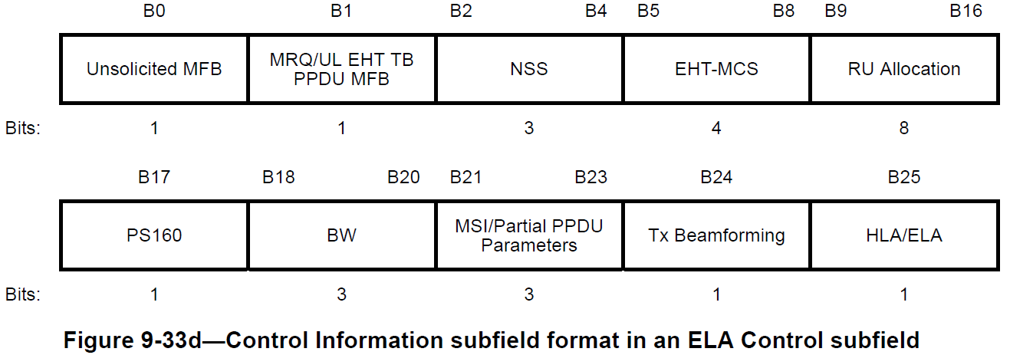
ELA Control Subfield

Slide 15
LA Perspective: IM enabled/disabled selection [4]
How is the selection between IM enabled and IM disabled carried out?
Adaptive approach:
  Treat this selection as another dimension in the link adaptation TX parameters’ search space for goodput maximization along with: MCS, Nss, CP length, etc.
    Combine IM selection with the ACK guided trial-and-error based search. Example concepts:
      During IM disabled: Probe a higher MCS along with IM enabled.
      During IM enabled: Probe current MCS along with IM disabled.
    For trigger based uplink: The receiving AP can apply on-going and link independent monitoring of interference that can further serve the IM selection decision.
  This approach ensures IM pilots are invested
  only when they lead to higher goodput
Fixed approach:
  If link reliability is more important than utilizing maximum throughput, IM enabled can be applied as a fixed configuration.

Slide 16
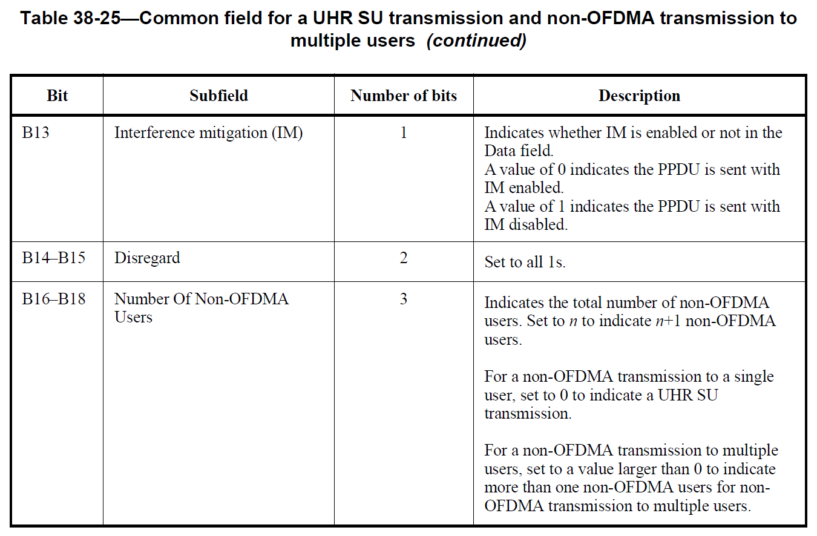
IM in UHR-SIG

